Slide 1
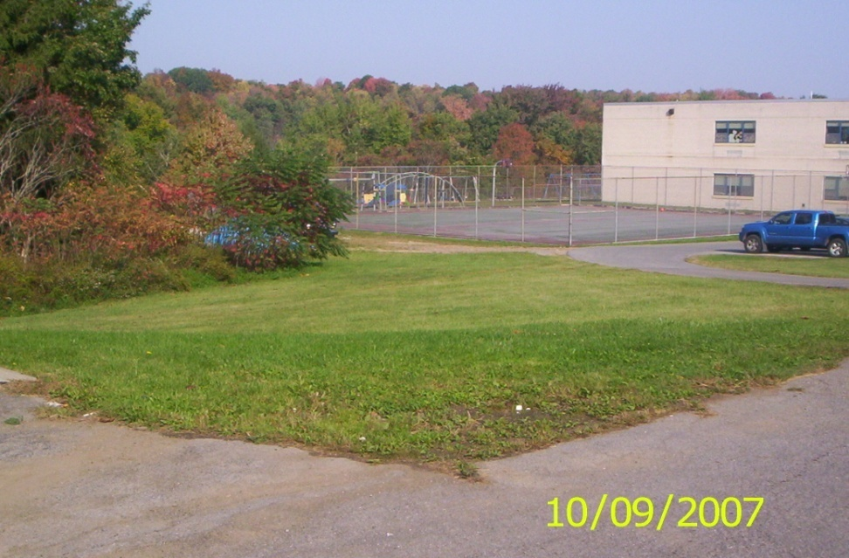
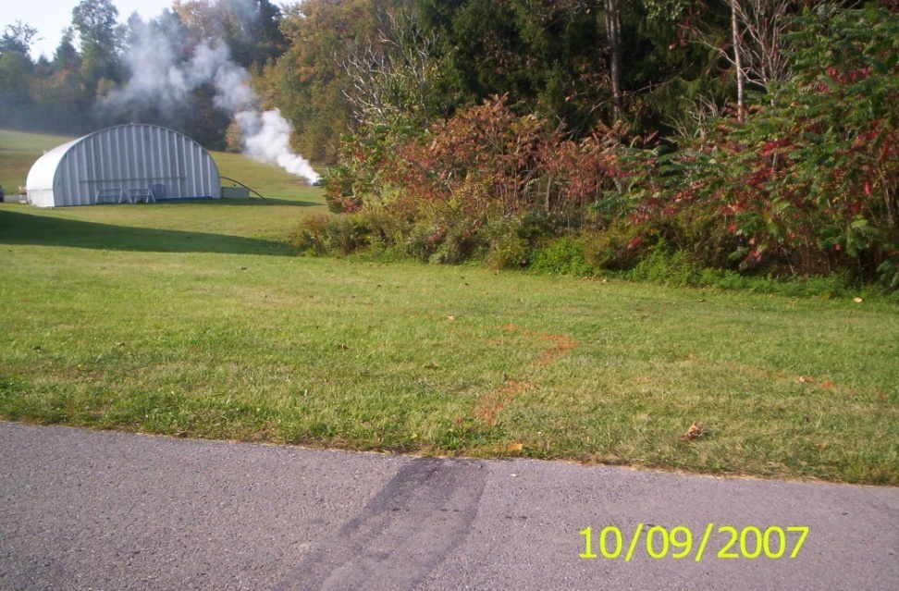
Highmark Healthy High 5
Outdoor Fitness Course
The following pictures are the areas where the stations will be located.

Slide 2
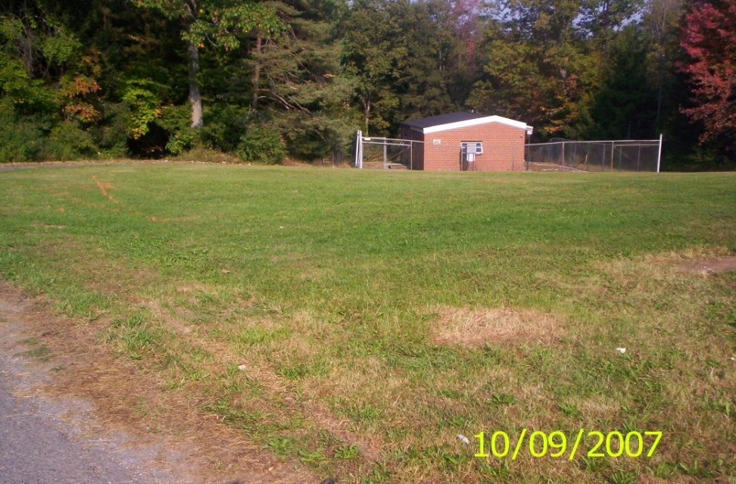
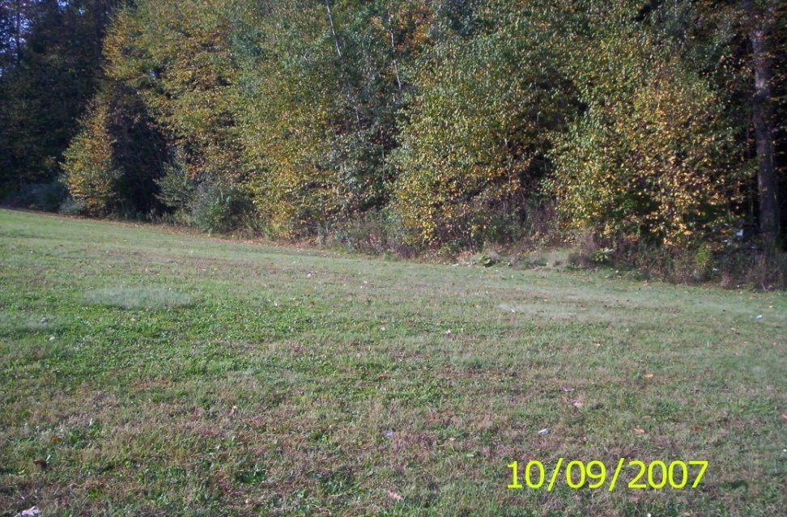
Highmark Healthy High 5
Outdoor Fitness Course

Slide 3
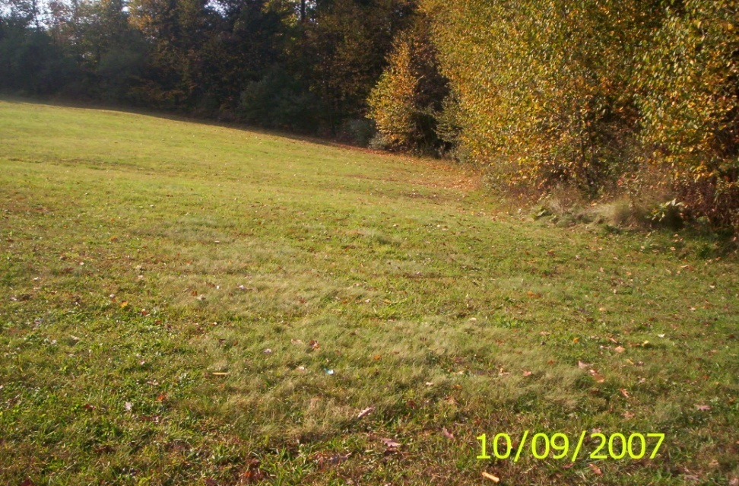
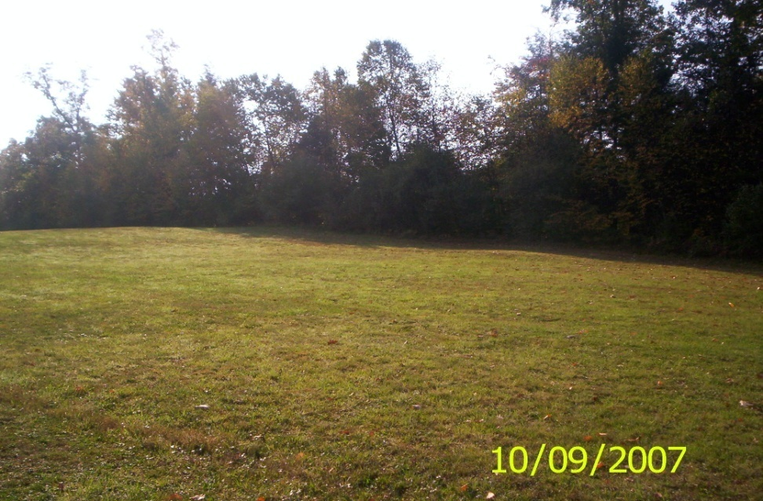
Highmark Healthy High 5
Outdoor Fitness Course

Slide 4
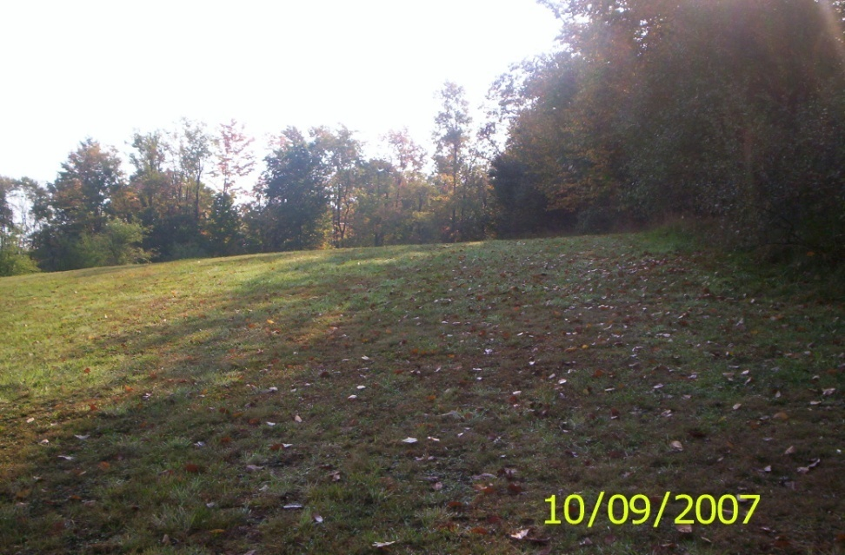
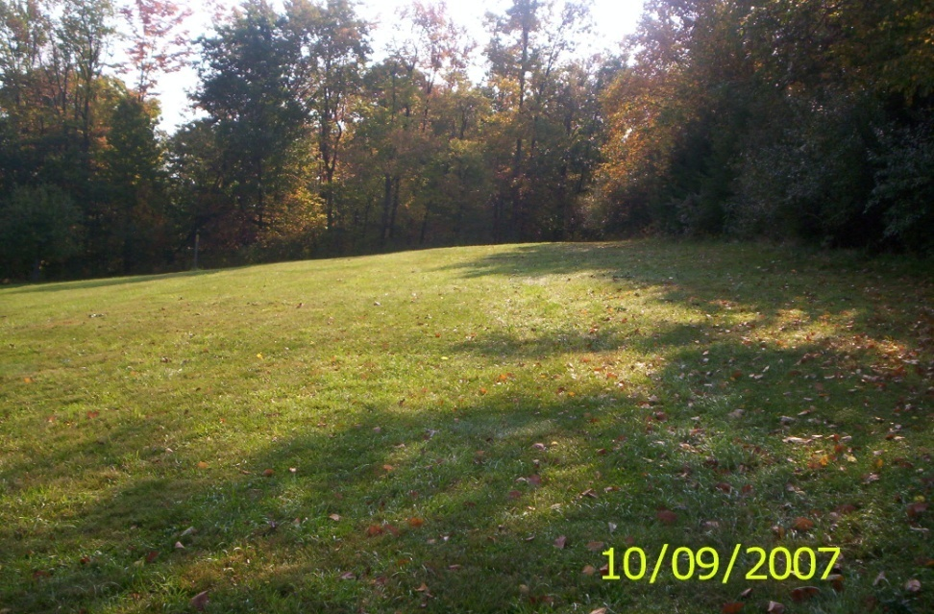
Highmark Healthy High 5
Outdoor Fitness Course

Slide 5
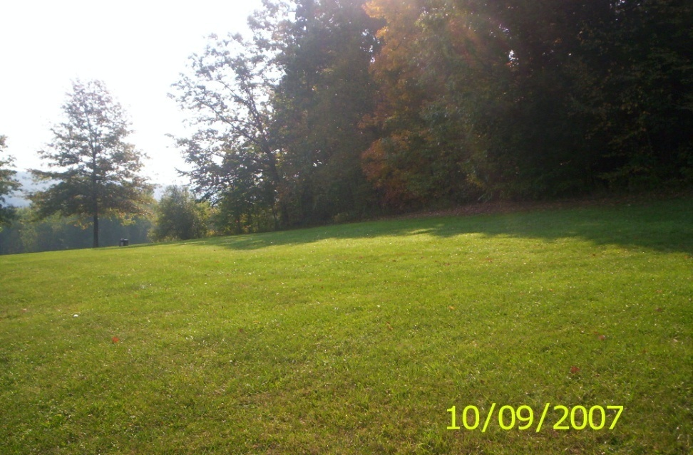
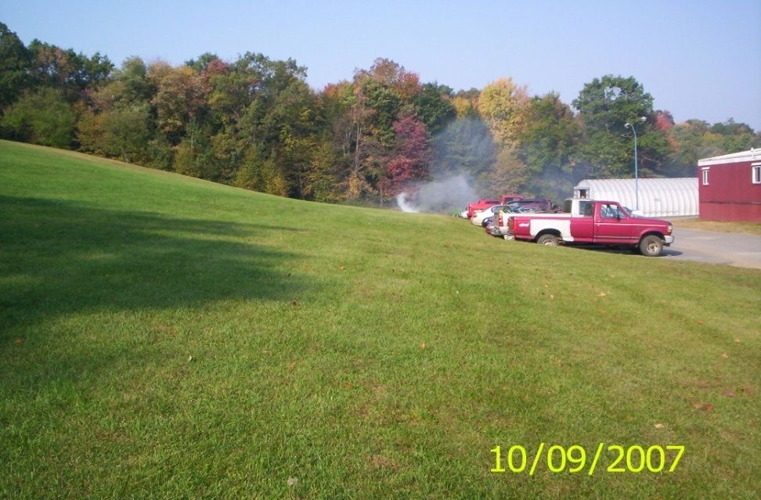
Highmark Healthy High 5
Outdoor Fitness Course

Slide 6
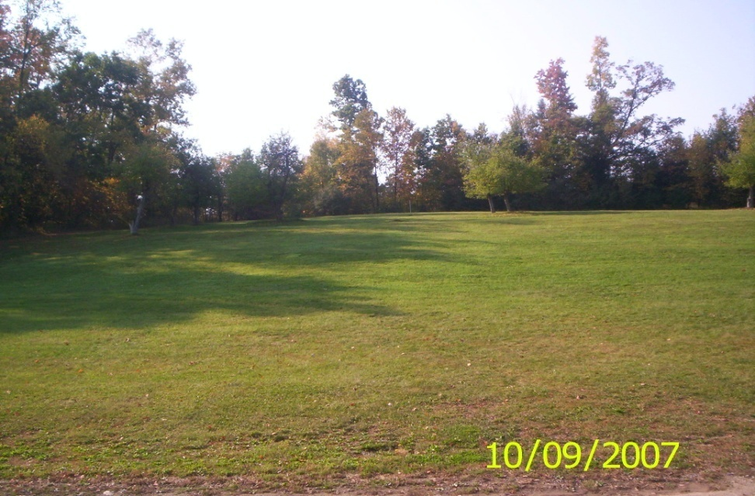
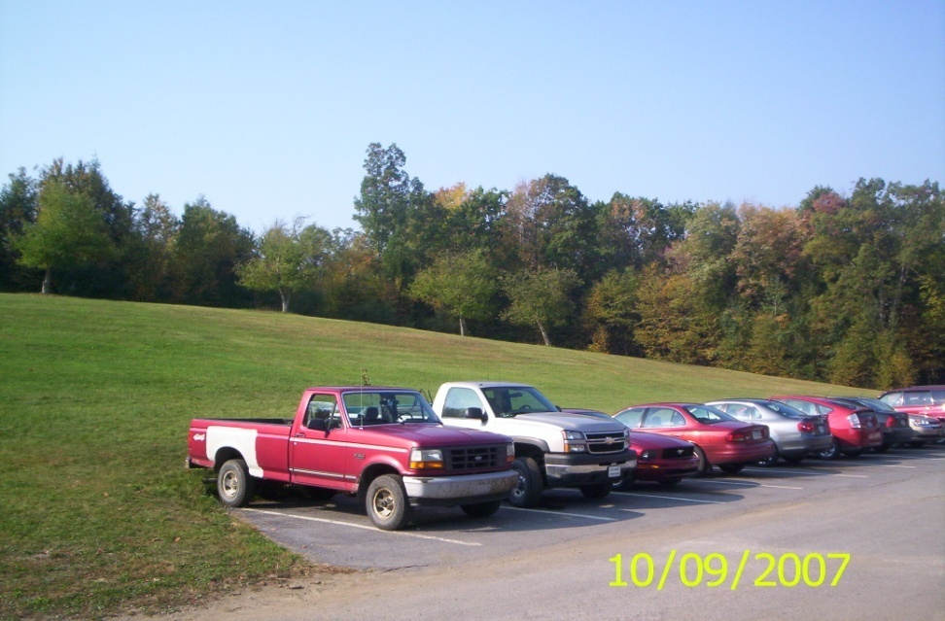
Highmark Healthy High 5
Outdoor Fitness Course

