Slide 1
PEP Grant Summary
John Kutz
Amy Snyder
Blair Packer

Slide 2
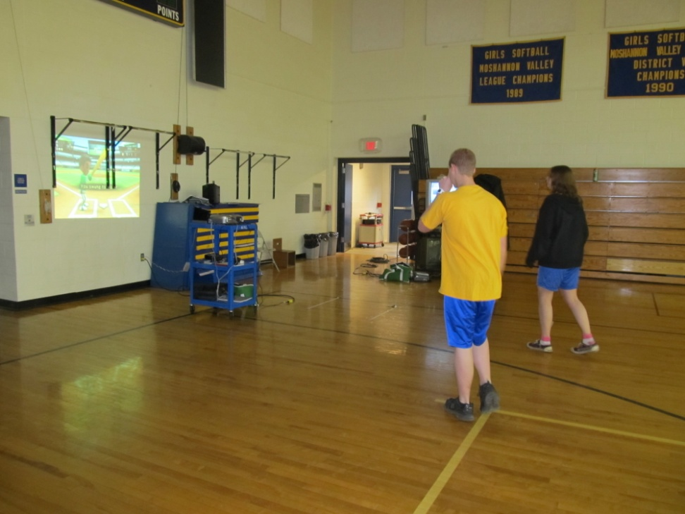
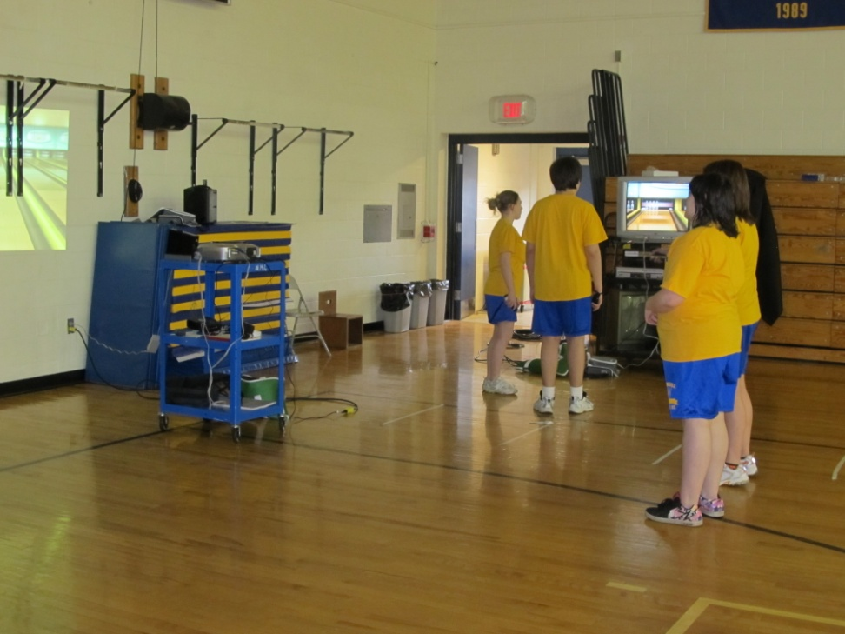
Wii Game Systems

Slide 3
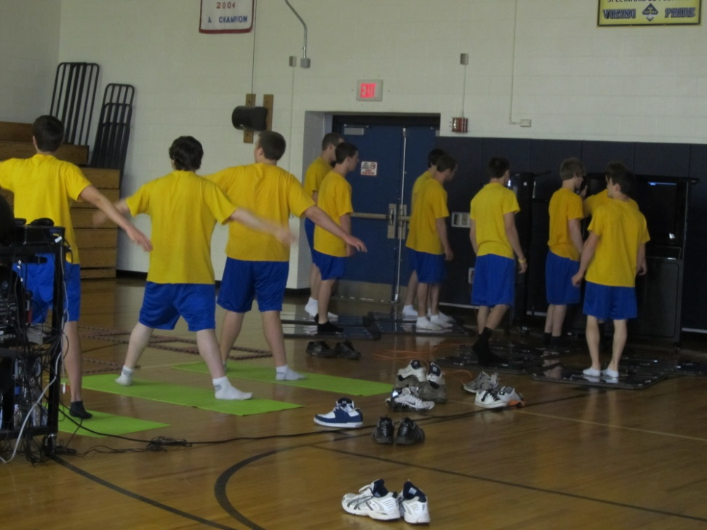
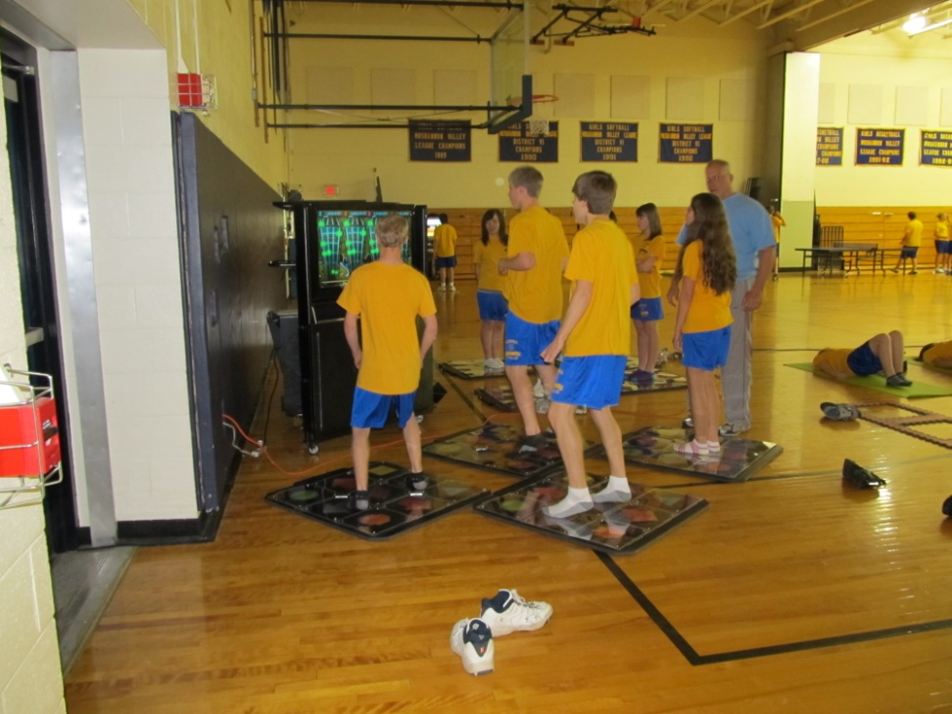
Blu Fit Dance System

Slide 4
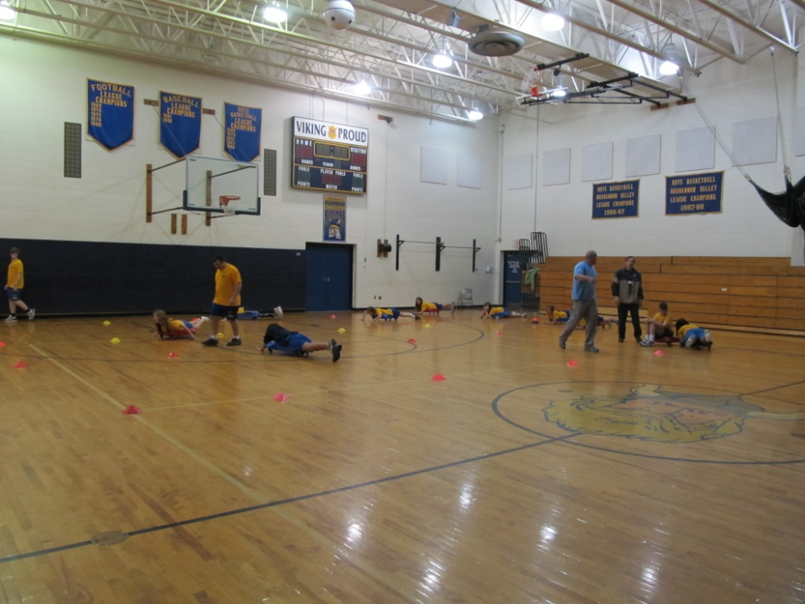
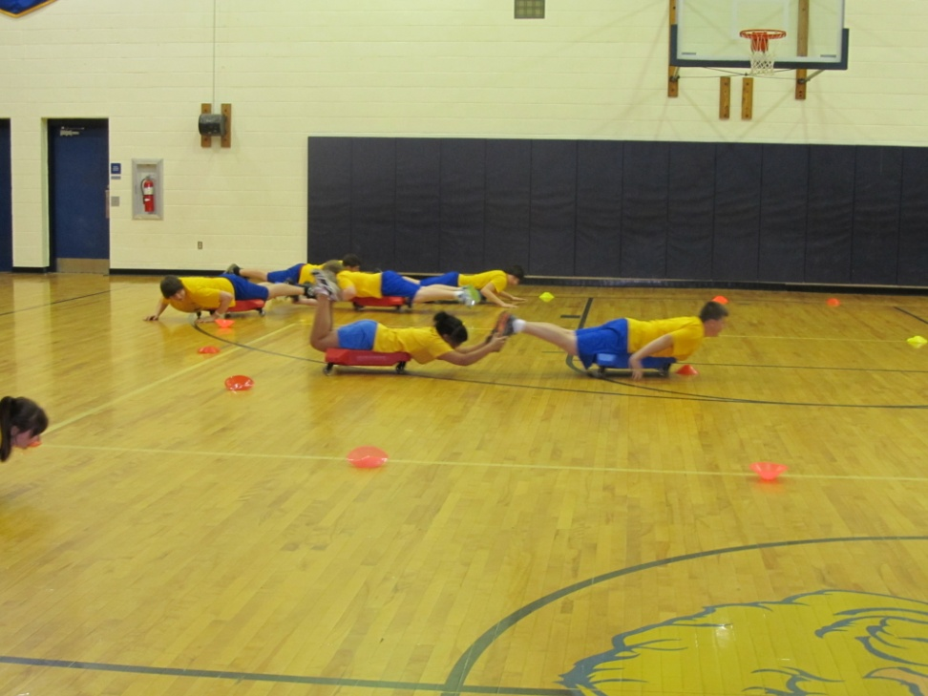
SHARBADE

Slide 5
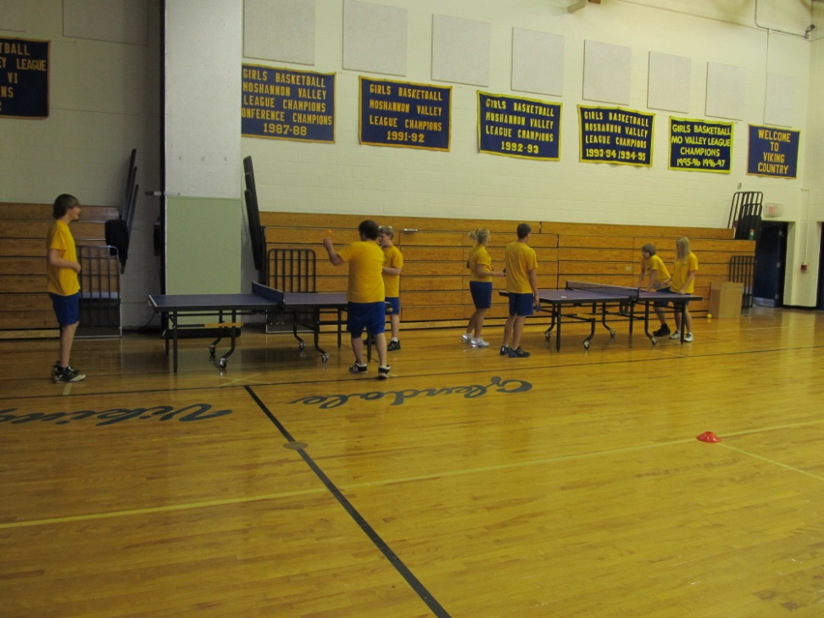
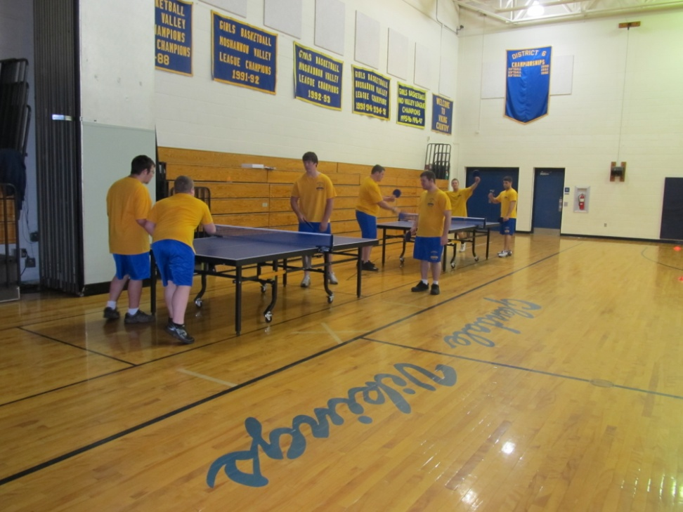
Robo Pong
-new ping pong tables, paddles and balls.

Slide 6
HOPSports
Interactive Youth Training System
The HOPSports mission is to improve the activity, health and vitality of America's youth by implementing physical activities with a unique and effective system to encourage movement, educate youth on energy and nutrition and deliver important societal messages in a cost-effective, entertaining, and youth-oriented format!

Slide 7
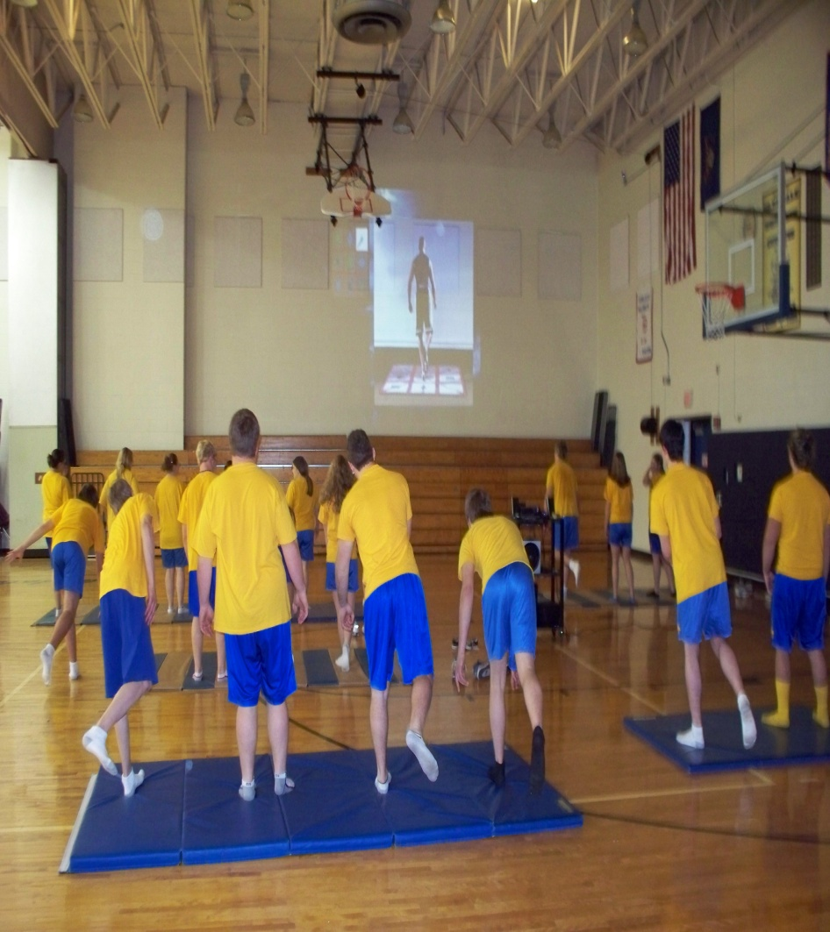
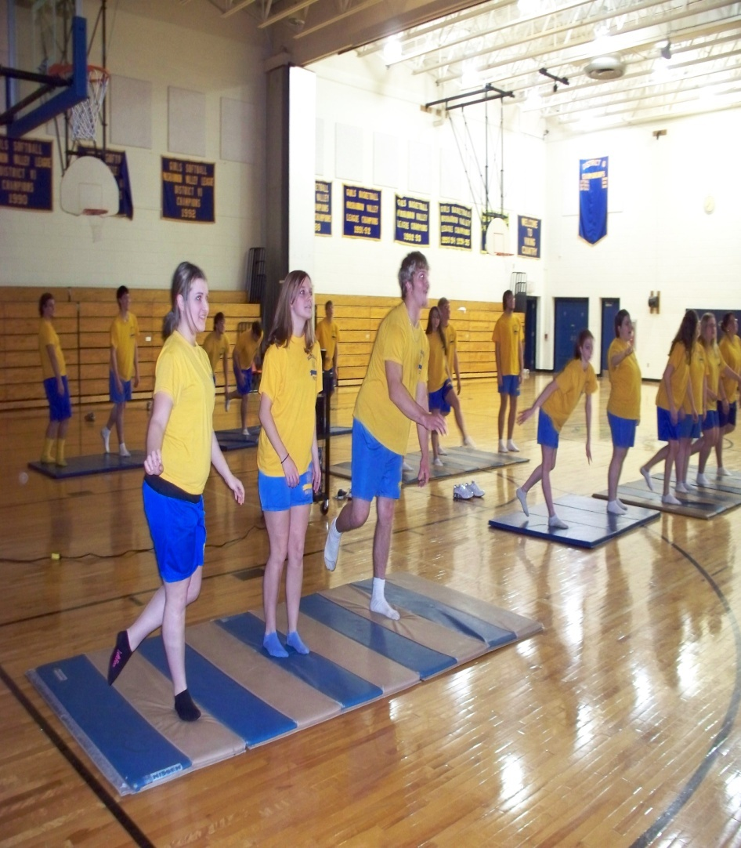
Working on our balance.

Slide 8
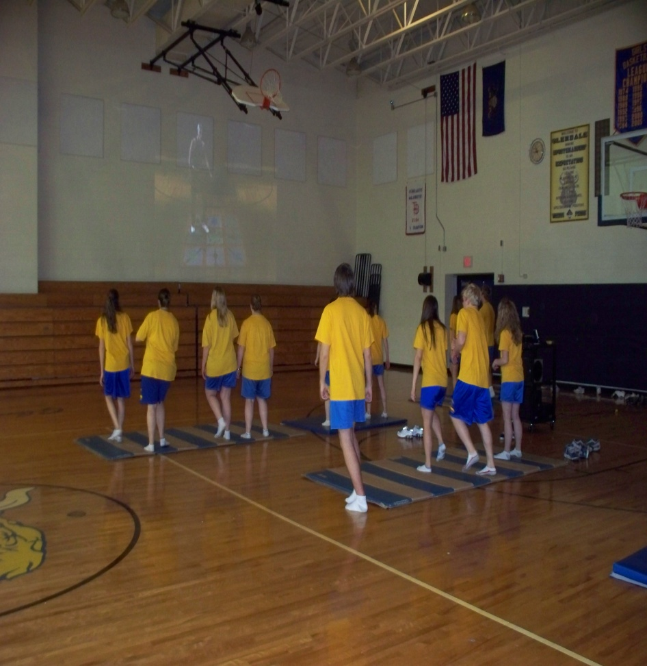
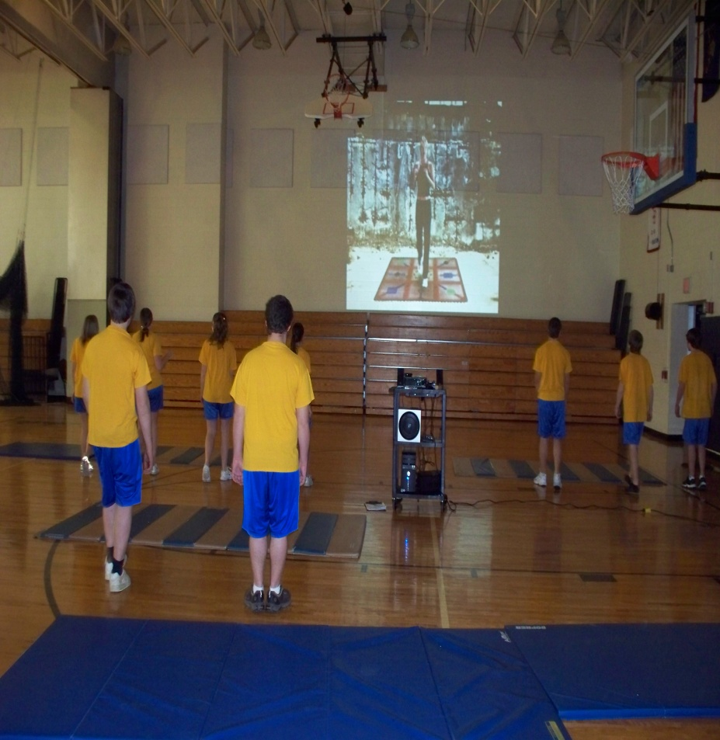
How about some Kickboxing to get your heart rate up?

Slide 9
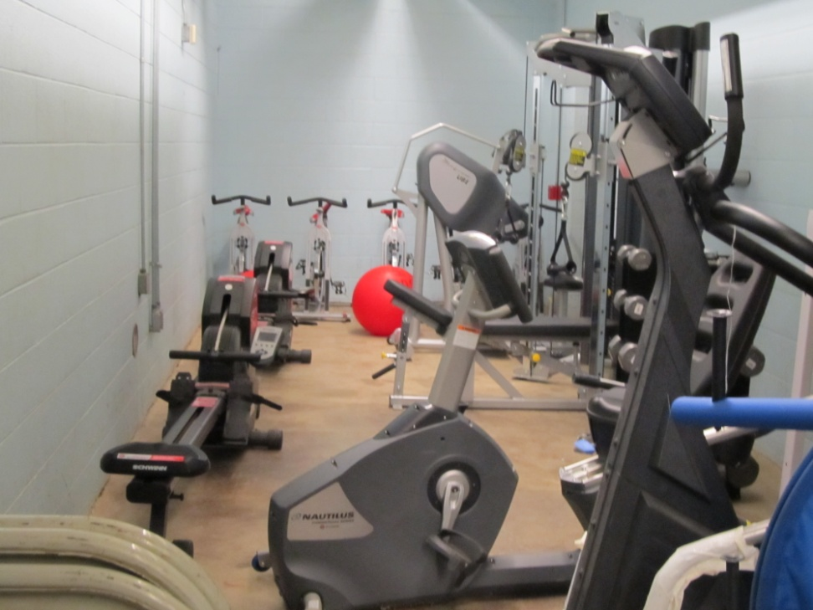
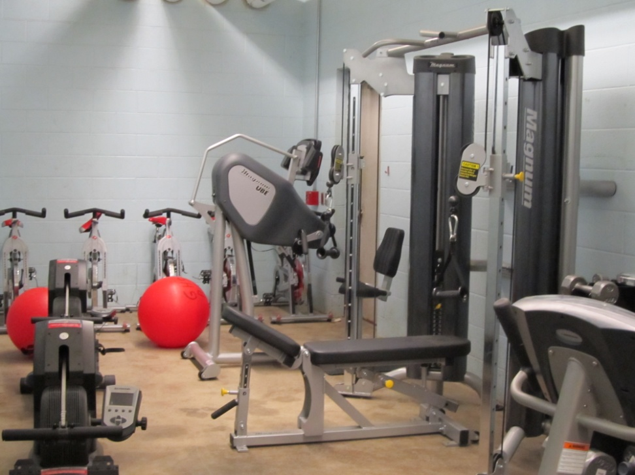
Modified Physical Education Room

