Slide 1
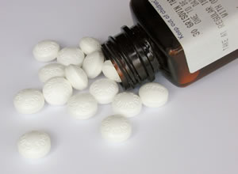
Medicine Safety

Slide 2
Medicine Safety
All medicine must meet standards set by FDA.
Food and Drug Administration (FDA) -
Administration established by federal government that tests & approves drugs to minimize risk to American public.

Slide 3
FDA Regulations
1. FDA requires manufacturer to supply information about medicine.
Chemical composition
Directions for use
Illness/Symptoms it helps
Possible side effects
2. Medicines go through step-by-step process (6-10 years).
3. Safety & effectiveness tested on groups of healthy & ill patients.
Herbal & Dietary supplements are not regulated the same way.

Slide 4
Releasing Drugs to the Public
The FDA determines how medicines are released to the public.
Prescription Medicines –
Medicines that cannot be used safely without the written approval of a licensed physician.
Over-the-Counter Medicines (OTC) –
Medicines you can buy without a doctor’s prescription.
Prescription & OTC can still be harmful if not used as directed.

Slide 5
What is Medicine Misuse?
Medicine Misuse -
Using a medicine in a way other than the one intended.
Examples:
Taking too much or too little of a medicine
Taking someone else’s medicine
Giving your prescription medicine to someone else
Discontinuing use of medicine without informing doctor
Taking a medicine for longer period than prescribed
Mixing Medicines

Slide 6
What is medicine abuse?
Medicine abuse –
Intentionally taking medication for nonmedical reasons.

Slide 7
Which OTC Medicine is Best?
Consider the following when choosing an OTC:
Decide what kind of OTC will work for you.
what are your signs & symptoms
2. Decide whether you want generic or brand- name medicine.
3. Read the label
Ingredients – active & inactive ingredients listed
Uses – explains what signs & symptoms product relieves
Warnings – informs about dangerous interactions
Directions – indicates dosage & frequency of dosage

Slide 8
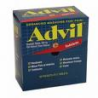
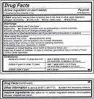

Slide 9
OTC Medicines Label Reading 101 page 532

Slide 10
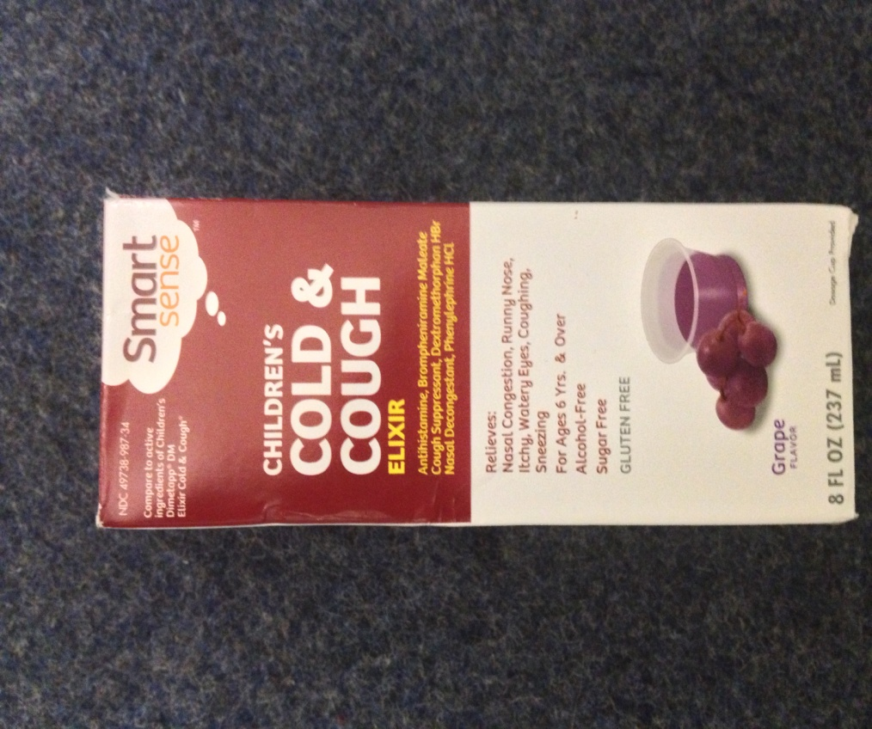
What are some side effects?
drowsiness
excitability in children
nervous, dizzy or sleeplessness
What is the lot number?
1FK0631
Is this a generic or
name brand product?
Generic

Slide 11
What are the uses?
Temporary relief of:
headache
sinus congestion &
pressure
nasal congestion
minor aches and pains
Ask a doctor before use if you
have…
liver disease heart disease
thyroid disease diabetes
prostate disease high b/p

Slide 12
Are there any situations where this medicine should not be consumed?
children under 12
What is the storage temperature?
68-77 degrees
Can a mother who is breast feeding use this medicine?
possibly, must contact a health care provider first

Slide 13
What are the uses for this product?
relieves minor irritation, pain, sore throat & sore mouth
When should you contact a Doctor?
symptoms do not improve in 7 days
irritation, pain or redness persists or worsens
swelling, rash, or fever develops

Slide 14
What are the special instructions for women who are in the last 3 months of their pregnancy?
Do not use, because…
When should you talk to a doctor about use?
if the stomach bleeding warning applies to you
history of stomach problems, heartburn
have high b/p, heart disease, liver cirrhosis or kidney disease
you are taking a diuretic
you have asthma

Slide 15
For what age group is this product intended?
children aged 2-11
What is this medicine used for?
reduces fever
relieves minor aches & pains due to:
the common cold
flu
headache
sore throat
toothache

Slide 16
What is the OTC medicine used to treat?
temporarily relieves
cough due to minor throat & bronchial tube irritation
the impulse to cough to help you get to sleep
What is the lot #?
53690
What is the expiration date?
01/2013

Slide 17
Who should talk to a doctor before using this medicine?
under a doctor’s care for any serious condition
taking any other drug
Who should NOT use this medicine?
if you have ever had an allergic reaction to any other pain reliever/fever reducer
right before or after heart surgery

Slide 18
What are some side effects?
excitability, especially in children
drowsiness
What symptoms does this product relieve?
aches, fever, sore throat
sneezing, runny nose
cough
Is this a generic or name brand product?
name brand

Slide 19
When should you contact a Doctor?
heart disease
thyroid disease
diabetes
high B/P
persistent cough
What is the lot #?
WO00579051
When does this medicine expire?
07/2014

Slide 20
Ask a doctor before use if you have…
liver disease
emphysema, chronic bronchitis
glaucoma
enlarged prostate
cough w/too much phlegm
Are there any situations where this medicine should not be taken?
children under 4 yrs.

Slide 21
Is this a generic or name brand medicine?
generic
What is the storage temperature?
59-77 degrees
Ask a doctor before use if you have…
heart disease
thryoid disease
high B/P
diabetes
enlarged prostate

Slide 22
Conclusion
The FDA has been established to protect the American public.
Misusing medicines can be extremely dangerous.
Reading medicine labels is very important to eliminate dangerous effects.

Slide 23
Medicine Use, Misuse, or Abuse?
John has a headache, he goes to the medicine cabinet and reads the medicine label and takes the recommended dosage.
Medicine Use

Slide 24
Medicine Use, Misuse, or Abuse?
Beth is at school and is feeling sick to her stomach. Beth tells her friend who gives her 2 tablets from her purse. Beth’s friend says, “Take these, my doctor said they work wonders for a stomach ache.” Beth takes the tablets.
Medicine Misuse

Slide 25
Medicine Use, Misuse or Abuse
Jason is at a party on Friday night when his friend Sarah passes him a bowl with a lot of different sized and colored pills. She tells him to just take one and pass it.
Medicine Abuse

Slide 26
Medicine Use, Misuse, or Abuse?
4. Adam feels as if a cold is coming on. On his way to school, he stops at the store and buys cough syrup. Adam doesn’t have a spoon so he takes a sip of the cough syrup to get through the day.
Medicine Misuse

Slide 27
Medicine Use, Misuse, or Abuse?
5. Lisa just ate a big bean burrito. She feels like she has heartburn. Lisa goes to the school nurse who gives her a cup with 2 tablespoons of “the pink stuff”.
Medicine Use

Slide 28
Medicine Use, Misuse, or Abuse?
6. Jade has strep throat. Her doctor prescribed an antibiotic to her. Jade thinks to herself, “If I take twice the dosage maybe my sickness will go away twice as fast”. Jade then takes the medicine.
Medicine Misuse

Slide 29
Medicine Use, Misuse, or Abuse?
7. Tim has a skin infection on his arm. His doctor prescribes an antibiotic to him. After 3 days of taking the medicine there is no sign of the skin infection. Tim stops taking the medicine and saves the rest of the bottle in case another skin infection occurs.
Medicine Misuse

Slide 30
Medicine Use, Misuse, or Abuse?
8. Mark was just cut from the basketball team. He feels like his life is out of control. He goes to the medicine cabinet where he knows there is some old medicine his father used for pain after his knee surgery.
Medicine Abuse

Slide 31
Medicine Use, Misuse, or Abuse?
9. Jessica sprained her ankle. Her doctor prescribes ibuprofen to her to take away the pain. After taking the medicine, Jessica breaks out in hives all over her body. Jessica stops taking the medicine and calls her doctor.
Medicine Use

Slide 32
Medicine Use, Misuse, or Abuse?
10. Joe is the star linemen for the football team. Joe takes medication for his diabetes. Joe’s girlfriend Kelly is a cheerleader and also takes medication for diabetes. One day Kelly forgets to take her medication. Joe says, “I have the same medication.” Kelly then takes the medication.
Misuse

