Slide 1
Chapter 4
The Tissue Level of Organization

Slide 2
INTRODUCTION
A tissue is a group of similar cells that usually have a similar embryological origin and are specialized for a particular function.
The nature of the extracellular material that surrounds the connections between the cells that compose the tissue influence the structure and properties of a specific tissue.
The science that deals with the study of tissues is called histology
Pathologists, physicians who specialize in laboratory studies of cells and tissues, aid other physicians in making diagnoses; they also perform autopsies.

Slide 3
TYPES OF TISSUES AND THEIR ORIGINS
Four principal types based on function and structure
Epithelial tissue
  covers body surfaces, lines hollow organs, body cavities, and ducts; and forms glands.
Connective tissue
  protects and supports the body and its organs, binds organs together, stores energy reserves as fat, and provides immunity.
Muscle tissue
  is responsible for movement and generation of force.
Nervous tissue
  initiates and transmits action potentials (nerve impulses) that help coordinate body activities.

Slide 4
Origin of Tissues
Primary germ layers within the embryo
  endoderm
  mesoderm
  Ectoderm
Tissue derivations
  epithelium from all 3 germ layers
  connective tissue & muscle from mesoderm
  nerve tissue from ectoderm

Slide 5
DEVELOPMENT
Normally, most cells within a tissue remain in place, anchored to
  other cells
  basement membranes
  connective tissues
Exceptions include phagocytes and embryonic cells involved in differentiation and growth.

Slide 6
Biopsy
In a biopsy, samples of living tissue is removed for microscopic examination , is a chief responsibility of a pathologist.
Removal of living tissue for microscopic examination
  surgery
  needle biopsy
Useful for diagnosis, especially cancer
Tissue preserved, sectioned and stained before microscopic viewing

Slide 7
CELL JUNCTIONS
Cell junctions are points of contact between adjacent plasma membranes.
Depending on their structure, cell junctions may serve one of three functions.
  Some cell junctions form fluid-tight seals between cells.
  Other cell junctions anchor cells together or to extracellular material.
  Still others act as channels, which allow ions and molecules to pass from cell to cell within a tissue.

Slide 8
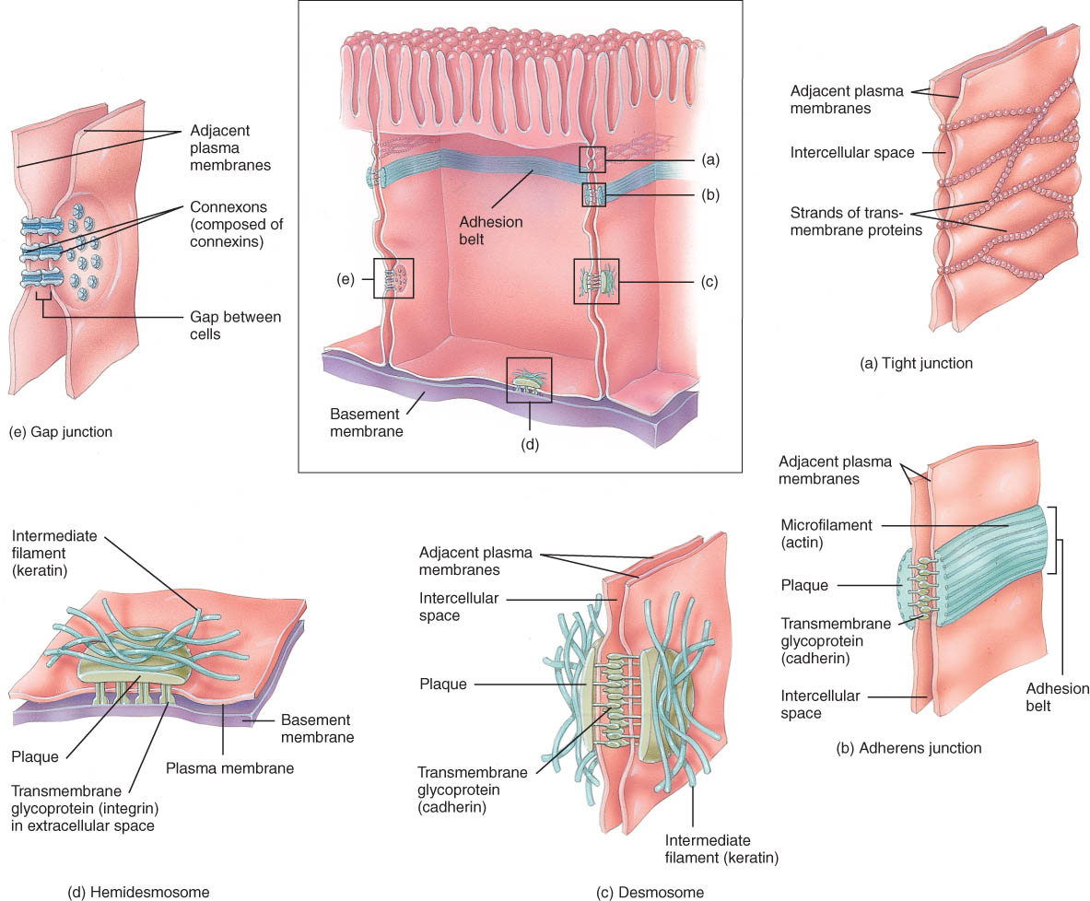
CELL JUNCTIONS
The five most important kinds of cell junctions are tight junctions, adherens junctions, desmosomes, hemidesmosomes, and gap junctions

Slide 9
Cell Junctions
Tight junctions
Adherens junctions
Gap junctions
Desmosomes
Hemidesmosomes

Slide 10
Tight Junctions
Watertight seal between cells
Plasma membranes fused with a strip of proteins
They are formed by weblike strands of transmembrane proteins that hold adjacent membranes together.
They are common between cells that line GI and bladder.

Slide 11
Adherens Junctions
Holds epithelial cells together
Structural components
  plaque = dense layer of proteins inside the cell membrane
  microfilaments extend into cytoplasm
  integral membrane proteins connect to membrane of other cell called cadherins

Slide 12
Desmosomes
Composed of plague
Resists cellular separation and cell disruption
Similar structure to adherens junction except intracellular intermediate filaments cross cytoplasm of cell and link the cytoskeletons of cells together.
Common in the cells of the epidermis and between cardiac muscle fibers in the heart.

Slide 13
Hemidesmosomes
Half a desmosome
Connect cells to extracellular material such as the basement membrane

Slide 14
Gap Junctions
Tiny space between plasma membranes of 2 cells
Crossed by protein channels called connexons forming fluid filled tunnels
Allows cells ion a tissue to rapidly communicate through connexons, transmembrane protein channels that connect cells together
Muscle and nerve impulses spread from cell to cell
  heart and smooth muscle of gut

Slide 15
EPITHELIAL TISSUES

Slide 16
Epithelial Tissue -- General Features
Are arranged in sheets, either in single or multiple layers
Consists mostly of closely packed cells with little extracellular material
Many cell junctions often provide secure attachment.
Has an apicial surface (upper or free surface) and a basal surface attached to a basement membrane
Adhere firmly to nearby connective tissue via a thin extracellular layer, the basement membrane
Is avascular (without blood vessels), nutrients and waste must move by diffusion
Good nerve supply
Rapid cell division (high mitotic rate)

Slide 17
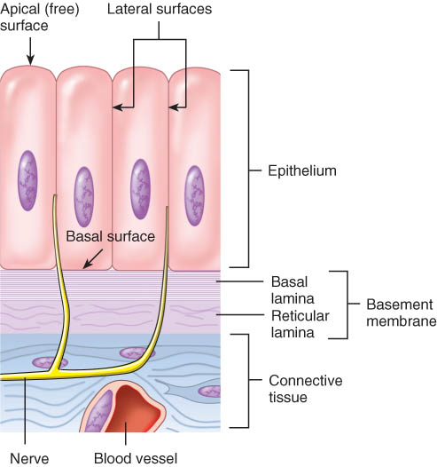
Basement Membrane
Basal lamina
  from epithelial cells
  collagen fibers
Reticular lamina
  secreted by connective tissue cells
  reticular fibers
Functions:
  guide for cell migration during development
  may become thickened due to increased collagen and laminin production
Example: In diabetes mellitus, the basement membrane of small blood vessels, especially those in the retina and kidney, thickens.

Slide 18
Epithelial Tissue Functions
Functions
  protection
  filtration
  lubrication
  secretion
  digestion
  absorption
  transportation
  excretion
  sensory reception
  reproduction.

Slide 19
Types of Epithelium
Covering and lining epithelium
  epidermis of skin
  lining of blood vessels and ducts
  lining respiratory, reproductive, urinary & GI tract
Glandular epithelium
  secreting portion of glands
  thyroid, adrenal, and sweat glands

Slide 20
Classification of Epithelium
Classified by arrangement of cells into layers
  simple = one cell layer thick
  stratified = two or more cell layers thick
  pseudostratified = one layer that appears as several
    nuclei are located at multiple levels so it looks multilayered
Classified by shape of surface cells
  squamous =flat
  cuboidal = cube-shaped
  columnar = tall column
  transitional = shape varies with tissue stretching

Slide 21
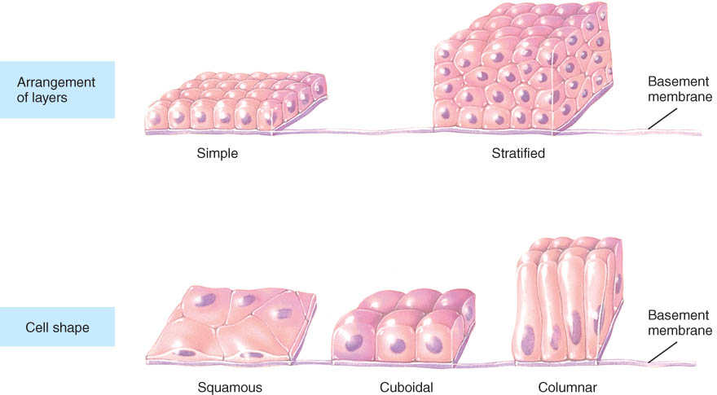
Epithelium

Slide 22
Epithelial Tissue
Covering and lining epithelia may be classified as a combination of arrangement of layers and shapes of cells. The name of the specific type of stratified epithelium depends on the shape of the surface cells.

Slide 23
Simple Epithelium
Simple squamous epithelium consists of a single layer of flat, scale-like cells
  adapted for diffusion and filtration and is found in lungs and kidneys
  It is not found in parts of the body that are subject to little wear and tear.
  Endothelium lines the heart and blood vessels.
  Mesothelium lines the thoracic and abdominopelvic cavities and covers the organs within them.
Simple cuboidal epithelium consists of a simple layer of cube-shaped cells
  adapted for secretion and absorption.

Slide 24
Simple Epithelium
Simple columnar epithelium consists of a single layer of rectangular cells and can exist in two forms
  Nonciliated simple columnar epithelium contains microvilli
    increase surface are and the rate of absorption
    goblet cells secrete mucus
  Ciliated simple columnar epithelium contains cells with hair-like processes called cilia
    provides motility and helps to move fluids or particles along a surface

Slide 25
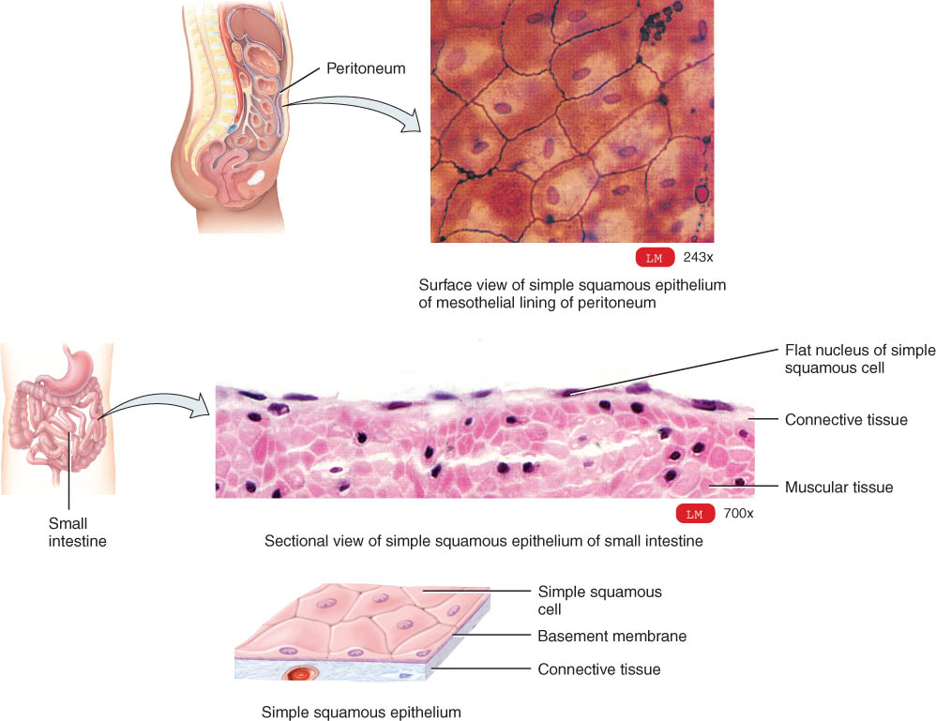
Simple Squamous Epithelium
Single layer of flat cells
  very thin --- controls diffusion, osmosis and filtration
    blood vessel lining (endothelium) and lining of body cavities (mesothelium)
  nuclei are centrally located
  Cells are in direct contact with each other.

Slide 26
Examples of Simple Squamous
Surface view of lining of peritoneal cavity
Section of intestinal showing serosa

Slide 27
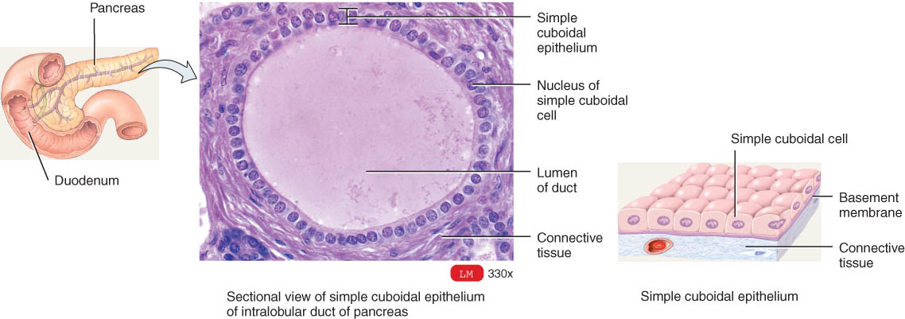
Simple Cuboidal Epithelium
Single layer of cube-shaped cells viewed from the side
  nuclei are round and centrally located
  lines tubes of kidney
  adapted for absorption or secretion

Slide 28
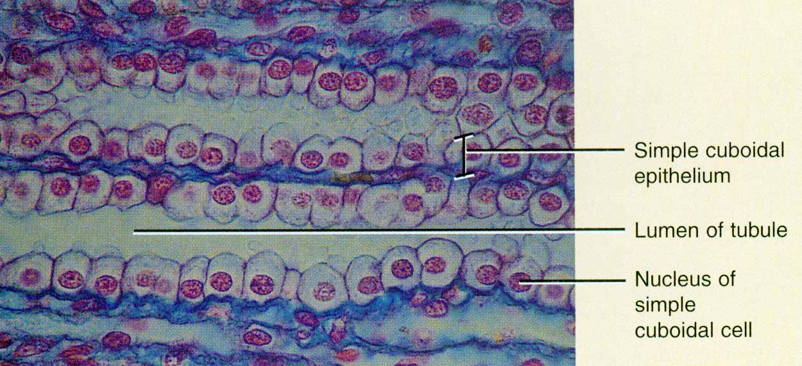
Example of Simple Cuboidal
X-Sectional view of kidney tubules

Slide 29
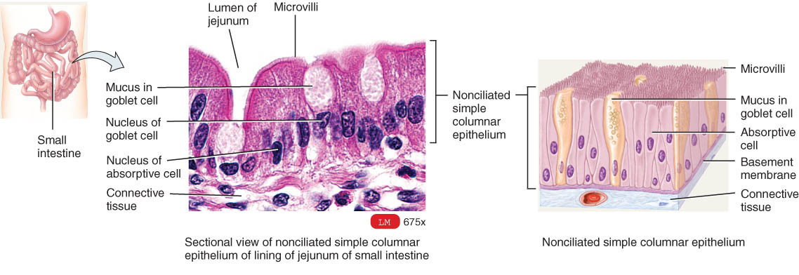
Nonciliated Simple Columnar
Single layer rectangular cells
Unicellular glands (goblet cells) secrete mucus
  lubricate GI, respiratory, reproductive and urinary systems
Microvilli (non-motile, fingerlike membrane projections)
  adapted for absorption in GI tract (stomach to rectum)

Slide 30
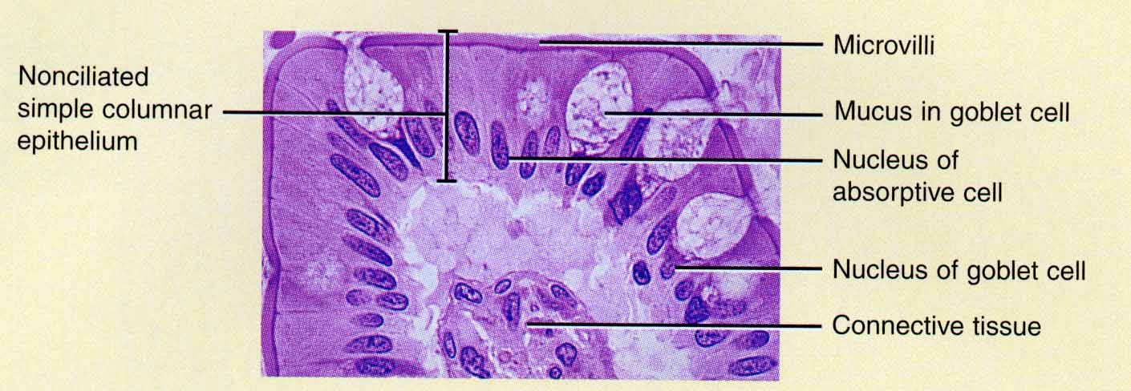
Ex. Nonciliated Simple Columnar
Section from small intestine

Slide 31
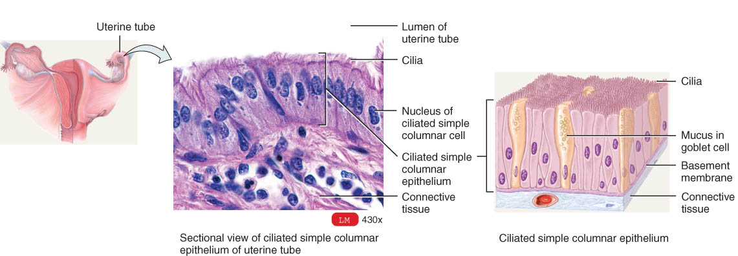
Ciliated Simple Columnar Epithelium
Single layer rectangular cells with cilia
Unicellular glands (goblet cells) secrete mucus
Cilia (motile membrane extensions) move mucous
  found in respiratory system and in uterine tubes

Slide 32
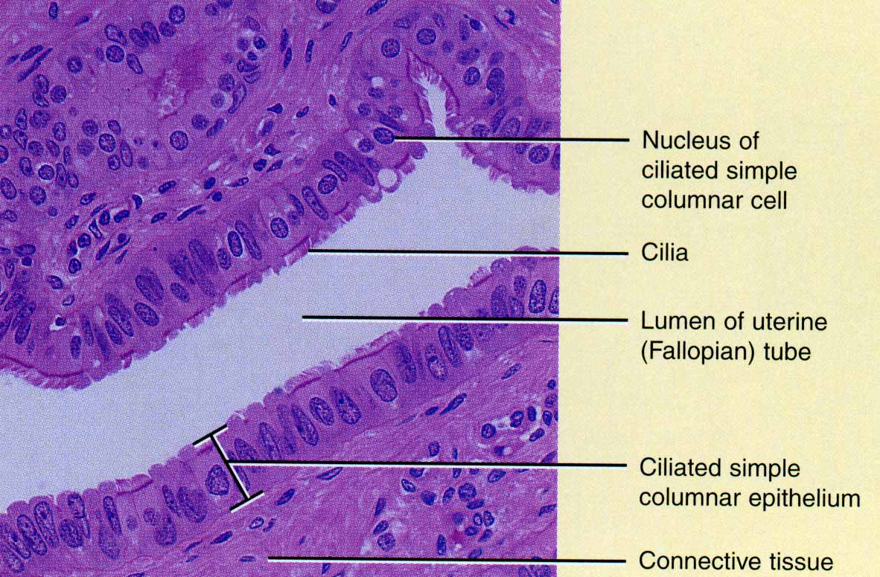
Ex. Ciliated Simple Columnar
Section of uterine tube

Slide 33
Pseudostratified Epithelium
Pseudostratified epithelium appears to have several layers because the nuclei are at various levels.
All cells are attached to the basement membrane but some do not reach the apical surface.
In pseudostratified ciliated columnar epithelium, the cells that reach the surface either secrete mucus (goblet cells) or bear cilia that sweep away mucus and trapped foreign particles.
Pseudostratified nonciliated columnar epithelium contains no cilia or goblet cells.

Slide 34
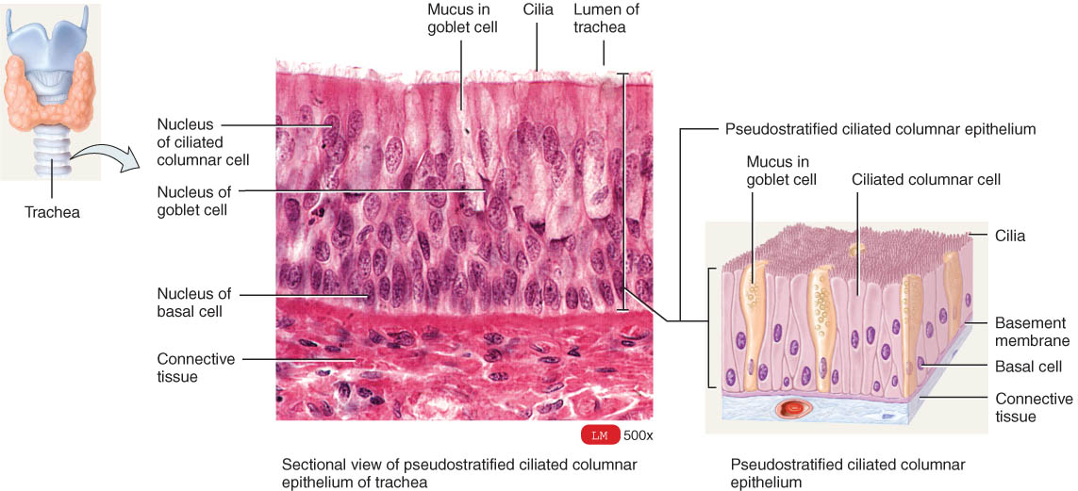
Pseudostratified Ciliated Columnar Epithelium
Single cell layer of cells of variable height
  Nuclei are located at varying depths (appear layered.)
  Found in respiratory system, male urethra & epididymis

Slide 35
Stratified Epithelium
Epithelia have at least two layers of cells.
  more durable and protective
  name depends on the shape of the surface (apical) cells
Stratified squamous epithelium consists of several layers of
  top layer of cells is flat and deeper layers of cells vary in shape fromcuboidal to columnar.
  basal cells replicate by mitosis and ultimately work their way to the surface.
Keratinized stratified squamous epithelium
  a tough layer of keratin (a protein resistant to friction and repels bacteria) is deposited in the surface cells.
Nonkeratinized epithelium remains moist.

Slide 36
Papanicolaou Smear (Pap smear)
Collect sloughed off cells of uterus and vaginal walls
Might indicate cancer or precancerous cells
Recommended annually for women over 18 or if sexually active

Slide 37
Stratified Epithelium
Stratified cuboidal epithelium
  rare tissue consisting of two or more layers of cube-shaped cells whose function is mainly protective.
Stratified columnar epithelium consists of layers of cells
  top layer is columnar
  somewhat rare and functions in protection and secretion
Transitional epithelium consists of several layers of variable shape.
  capable of stretching / permits distention of an organ
  lines the urinary bladder
  lines portions of the ureters and the urethra.

Slide 38
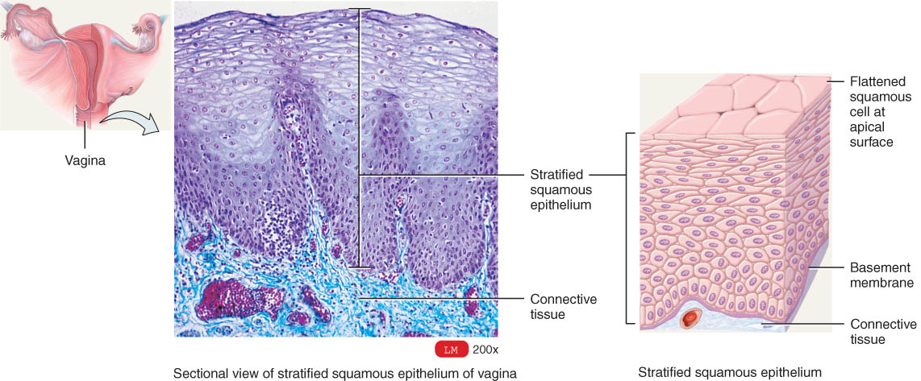
Stratified Squamous Epithelium
Several cell layers thick
  flat surface cells
  Keratinized = surface cells dead and filled with keratin
    skin (epidermis)
  Nonkeratinized = no keratin in moist living cells at surface
    mouth, vagina

Slide 39
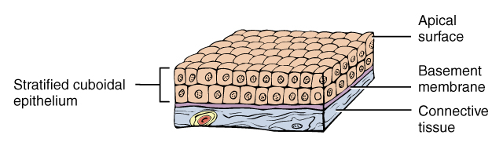
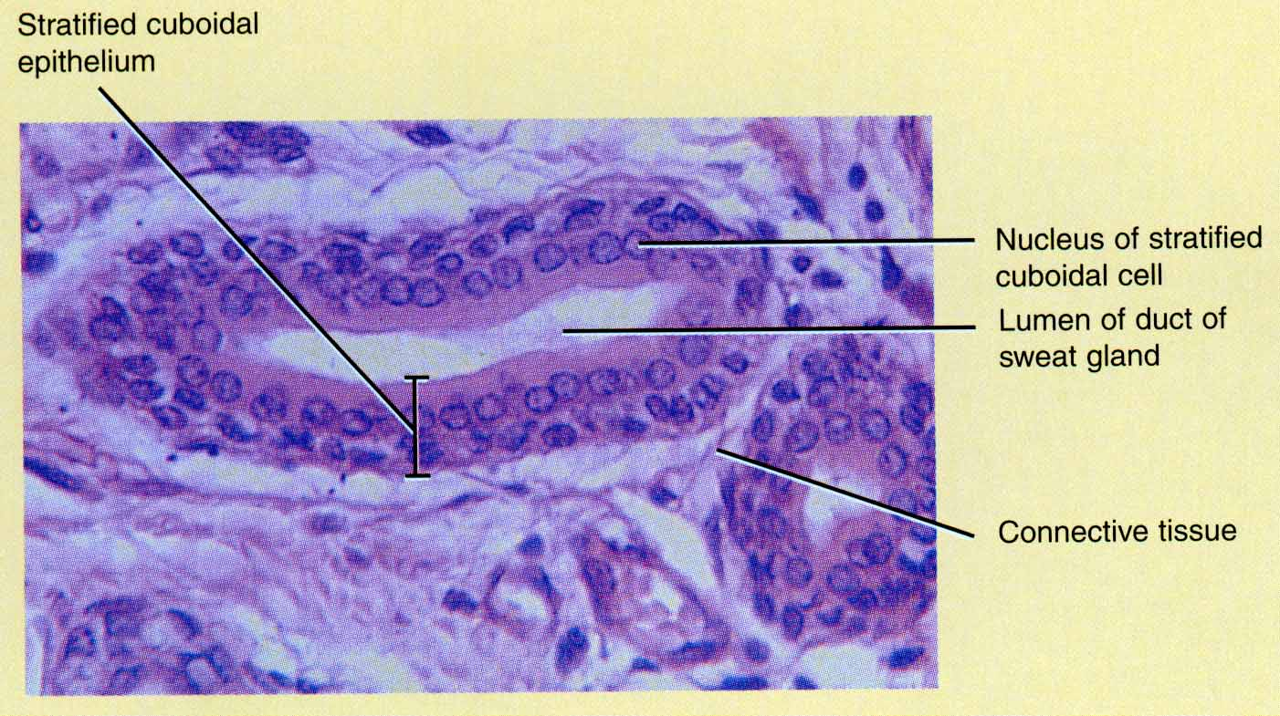
Stratified Cuboidal Epithelium
Multilayered
Surface cells cuboidal
  rare
  sweat gland ducts
  male urethra

Slide 40
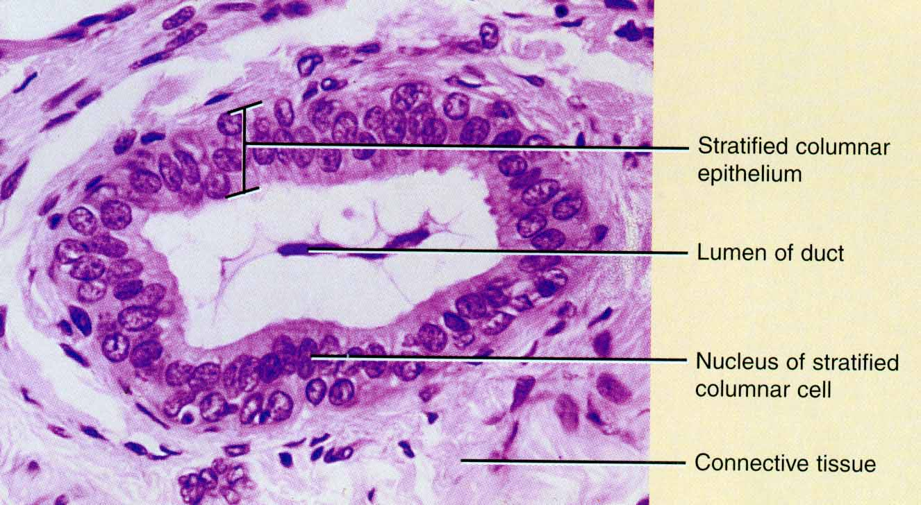
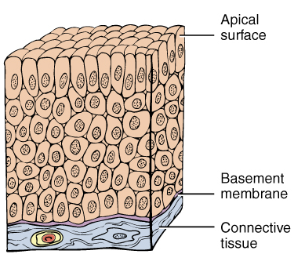
Stratified Columnar Epithelium
Multilayered
  columnar surface cells
  rare
  very large ducts
  part of male urethra

Slide 41
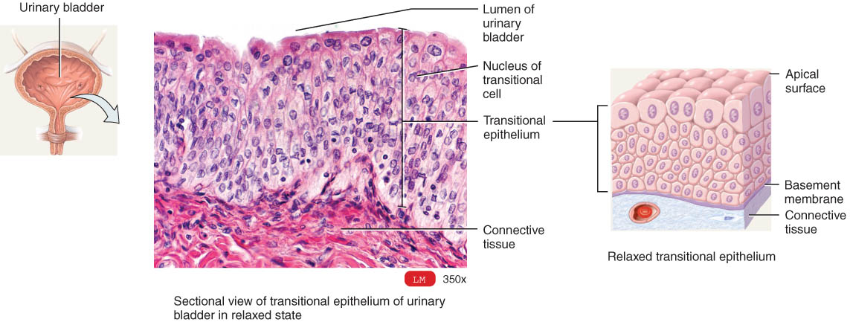
Transitional Epithelium
Multilayered
  surface cells varying in shape
    round to flat (if stretched)
  lines hollow organs that expand from within (urinary bladder)

Slide 42
Glandular Epithelium
gland:
  a single cell or a mass of epithelial cells adapted for secretion
  derived from epithelial cells that sank below the surface during development
Endocrine glands are ductless and their products enter the extracellular fluid and diffuse into the blood.
Exocrine glands (sweat, oil, and digestive glands) secrete their products into ducts that empty at the surface of covering and lining epithelium or directly onto a free surface.

Slide 43
Glandular Epithelium
Exocrine glands
  cells that secrete---sweat, ear wax, saliva, digestive enzymes onto free surface of epithelial layer
  connected to the surface by tubes (ducts)
  unicellular glands or multicellular glands
Endocrine glands
  secrete hormones into the bloodstream
  hormones help maintain homeostasis

Slide 44
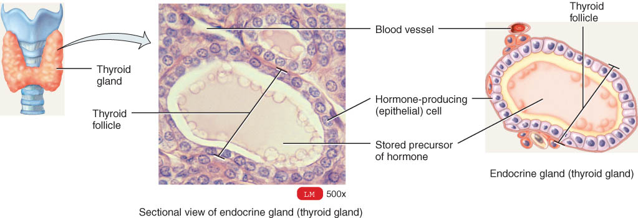
Simple Cuboidal Epithelium

Slide 45
Structural Classification of Exocrine Glands
Unicellular (single-celled) glands
  goblet cells
Multicellular glands are composed of cells that form a distinctive microscopic structure or macroscopic organ, such as sweat, oil, and salivary glands.
  branched (compound) or unbranched (simple)
  tubular or acinar (flask-like) shape
  Combining the shapes of the secretory portion with the degree of branching of the duct gives the structural classification for multicellular glands.

Slide 46
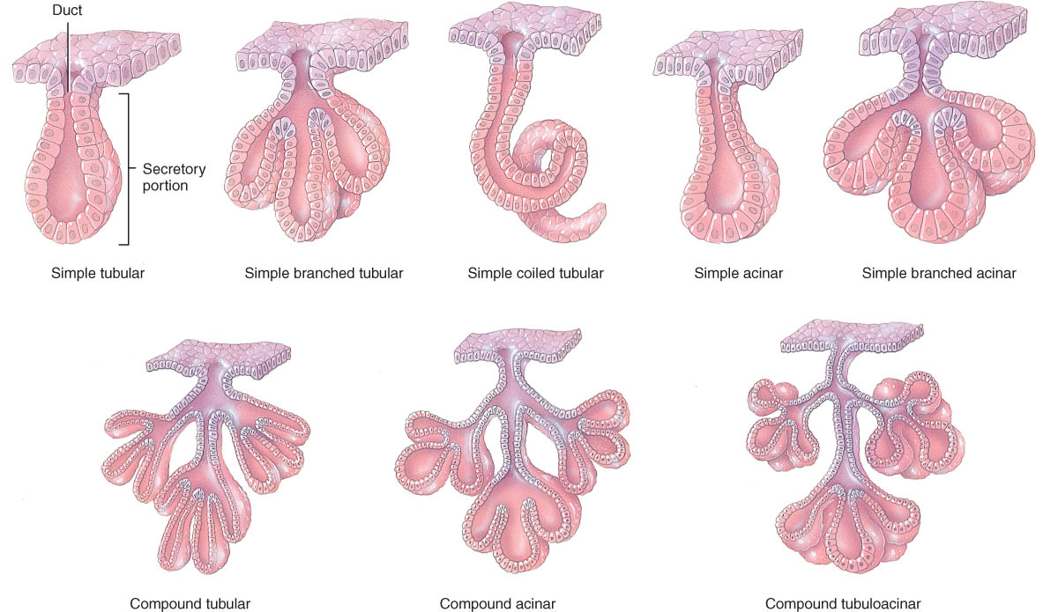
Examples of Simple Glands
Unbranched ducts = simple glands
Duct areas are blue

Slide 47
Examples of Compound Glands
Which is acinar? Which is tubular?

Slide 48
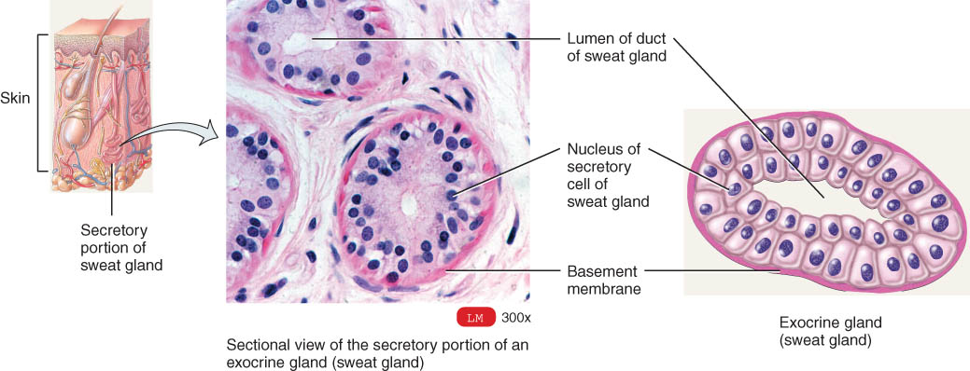
Duct of Multicellular Glands
Sweat gland duct
Stratified cuboidal epithelium

Slide 49
Exocrine Glands – Functional Classification
Functional classification exocrine glands is based on whether a secretion is a product of a cell or consists of entire or partial glandular cells themselves.
Merocrine glands
  form the secretory products and discharge it by exocytosis.
Apocrine glands
  accumulate secretary products at the apical surface of the secreting cell; that portion then pinches off from the rest of the cell to form the secretion with the remaining part of the cell repairing itself and repeating the process.
Holocrine glands
  accumulate the secretory product in the cytosol
  cell dies it and its products are discharged as the glandular secretion with the discharged cell being replaced by a new one.

Slide 50
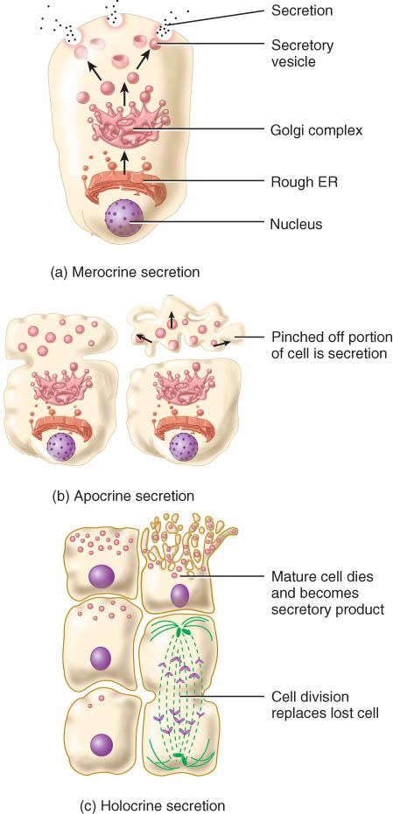
Methods of Glandular Secretion
Merocrine -- most glands
  saliva, digestive enzymes & watery (sudoriferous) sweat
Apocrine
  smelly sweat
Holocrine -- oil gland
  cells die & rupture to release products

Slide 51
CONNECTIVE TISSUE
Is the abundant and widely distributed in the body
derived from mesoderm

Slide 52
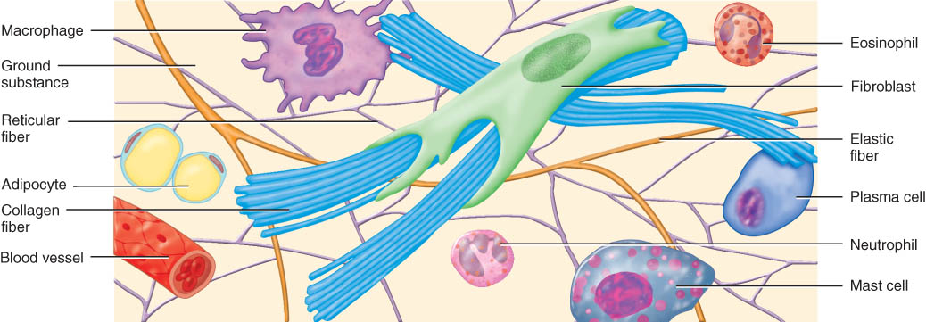
Connective Tissues
Connective tissue consists of 2 basic elements: cells and extracellular matrix.
Matrix (fibers & ground substance) is secreted by cells
Consistency may be fluid, semi-fluid, gelatinous, fibrous, or calcified, is usually secreted by the connective tissue cells and adjacent cells and determines tissue’s qualities.
Does not occur on free surfaces
Highly vascular, except in cartilage & tendons
Except for cartilage, connective tissue has a nerve supply

Slide 53
Connective Tissue Cells
derived from mesenchyme
  Immature cells have names that end in -blast( e.g., fibroblast, chondroblast)
  Mature cells have names that end in -cyte (e.g., osteocyte
  Most mature cells have a reduced capacity for cell division and matrix formation and are mostly involved in maintaining the matrix.

Slide 54
Connective Tissue Cells
  Fibroblasts (which secrete fibers and matrix)
  Adipocytes (or fat cells, which store energy in the form of fat)
  White blood cells (or leukocytes)
    Macrophages develop from monocytes
      engulf bacteria & debris by phagocytosis
    Plasma cells develop from B lymphocytes
      produce antibodies that fight against foreign substances
    Mast cells produce histamine that dilate small BV

Slide 55
Extracellular Matrix: Ground Substance
Ground Substance
The ground substance and fibers, deposited in the space inbetween the cells, comprise the matrix of connective tissue.
  glycosamino glycans (GAG’s) are hyaluronic acid, chondroitin sulfate, dermatan sulfate, and keratan sulfate
  The function of the ground substance is that it supports, binds and provides a medium for the exchange of materials between the blood cells, and is active in influencing cell functions.
Chondroitin sulfate and glucosamine are used as nutritional supplements to maintain joint cartilage. It is not known why the supplements benefit some individuals and not others.

Slide 56
Extracellular Matrix: Fibers
Fibers in the matrix provide strength and support for tissues.
Collagen fibers
  composed of the protein collagen
  tough and resistant to stretching
  allow some flexibility in tissue
  Found in bone, cartilage, tendons, and ligaments.

Slide 57
Elastic fibers
  composed of the protein elastin surrounded by the glycoprotein fibrillin
  provide strength and stretching capacity
  Found in skin, blood vessels, and lungs.
Reticular fibers
  composed of collagen and glycoprotein
  support in the walls of blood vessels, in spleen, in lymph nodes
  supporting network around fat cells, nerve fibers, and skeletal and smooth muscle fibers

Slide 58
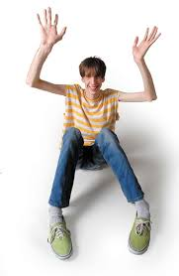
Clinical Application: Marfan Syndrome
Inherited disorder of fibrillin gene
Results in abnormal development of elastic fibers
  Tendency to be tall with very long legs, arms, fingers and toes
  Life-threatening weakening of aorta may lead to rupture

Slide 59
If a ligament is stretched beyond normal capacity it results in a sprain (a stretched or torn ligament).
Because they are avascular, ligaments heal slowly.

Slide 60
Embryonic Connective Tissue
Connective tissue that is present primarily in the embryo or fetus is called embryonic connective tissue.
Mesenchyme, found almost exclusively in the embryo, is the tissue form from which all other connective tissue eventually arises.
Mucous connective tissue (Wharton’s jelly) is found in the umbilical cord of the fetus.

Slide 61
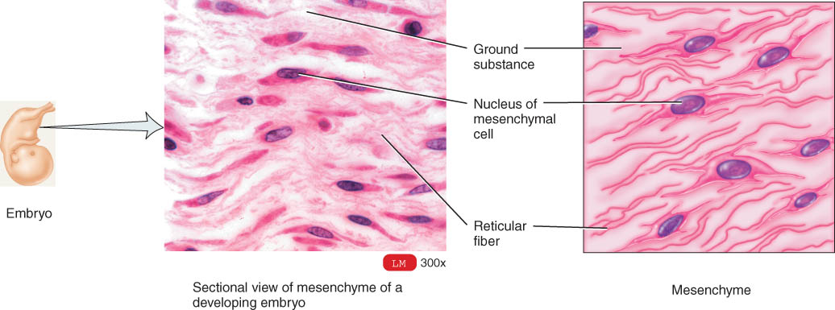
Embryonic Connective Tissue:
Mesenchyme
Irregularly shaped cells
semifluid ground substance with reticular fibers

Slide 62
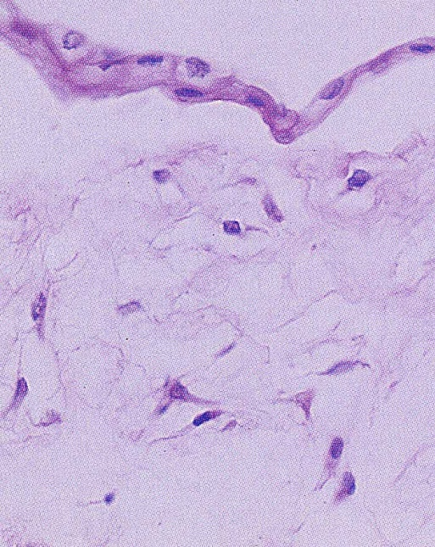
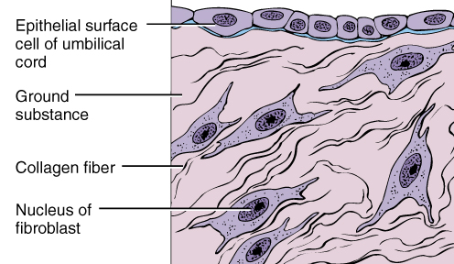
Embryonic Connective Tissue:
Mucous Connective Tissue
Star-shaped cells in jelly-like ground substance
Found only in umbilical cord

Slide 63
Types of Mature Connective Tissue
connective tissue proper
  loose connective tissue
    consists of all three types of fibers, several types of cells, and a semi-fluid ground substance
  dense connective tissue
Cartilage
  Hyaline, elastic, reticular
bone tissue
  compact and trabecular
Blood and Lymph
Subtypes include loose connective tissue, dense connective tissue, cartilage, bone, and blood.

Slide 64
Loose Connective Tissues
Loose connective tissue consists of all three types of fibers, several types of cells, and a semifluid ground substance
Sub-types of loose connective tissue
  areolar connective tissue
  adipose tissue
  reticular tissue

Slide 65
Areolar Connective Tissue
Prime example of loose connective tissue
Cell types = fibroblasts, plasma cells, macrophages, mast cells and a few white blood cells
Has different kinds of cells and all 3 types of fibers present
Gelatinous ground substance
It is found in the subcutaneous layer of the integument

Slide 66
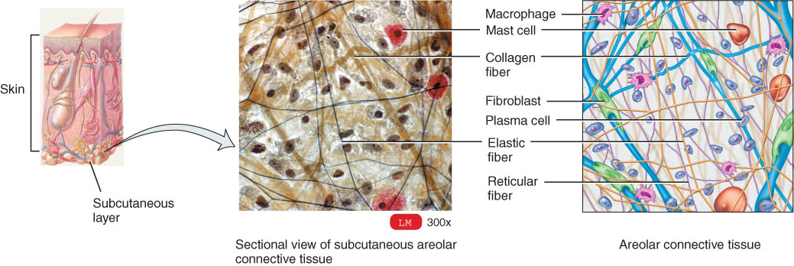
Areolar Connective Tissue
Black = elastic fibers,
Tan/Pink = collagen fibers
Nuclei are mostly fibroblasts

Slide 67
Adipose
Adipose tissue consists of adipocytes which are specialized for storage of triglycerides.
  found wherever areolar connective tissue is located.
  reduces heat loss through the skin, serves as an energy reserve, supports, protects, and generates considerable heat to help maintain proper body temperature in newborns (brown fat).
Liposuction involves sucking out small amounts of adipose tissue.

Slide 68
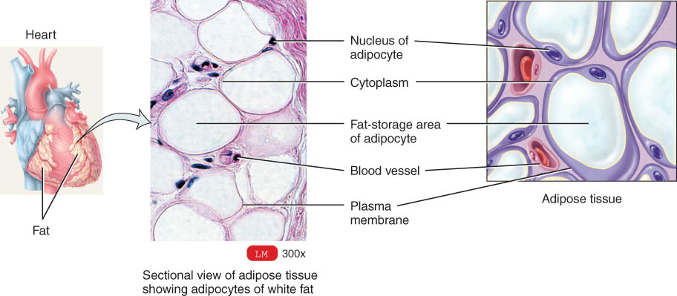
Adipose Tissue
Peripheral nuclei due to large fat storage droplet
Deeper layer of skin, organ padding, yellow marrow
Brown fat (found in infants) has more blood vessels and mitochondria and is responsible for heat generation

Slide 69
Reticular Connective Tissue
Reticular connective tissue consists of fine interlacing reticular fibers and reticular cells.
  forms the stroma of certain organs.
  helps to bind together the cells of smooth muscle.

Slide 70
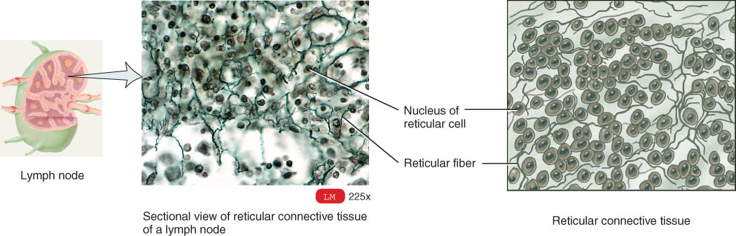
Reticular Connective Tissue
Network of fibers & cells that produce framework of organ
Holds organ together (liver, spleen, lymph nodes, bone marrow)

Slide 71
Dense Connective Tissue
Dense connective tissue contains more numerous, thicker, and dense fibers but considerably fewer cells than loose connective tissue.
Types of dense connective tissue
  dense regular connective tissue
  dense irregular connective tissue
  elastic connective tissue

Slide 72
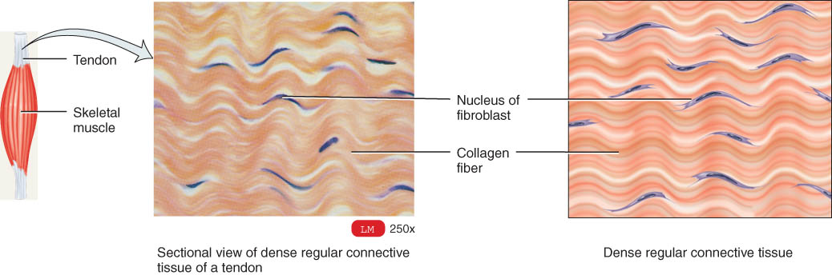
Dense Regular Connective Tissue
Collagen fibers in parallel bundles with fibroblasts between bundles of collagen fibers
White, tough and pliable when unstained (forms tendons)
Also known as white fibrous connective tissue

Slide 73
Dense irregular connective tissue
Dense irregular connective tissue contains collagen fibers that are irregularly arranged and is found in parts of the body where tensions are exerted in various directions.
  occurs in sheets, such as the dermis of the skin.
  found in heart valves, the perichondrium, the tissue surrounding cartilage, and the periosteum.

Slide 74
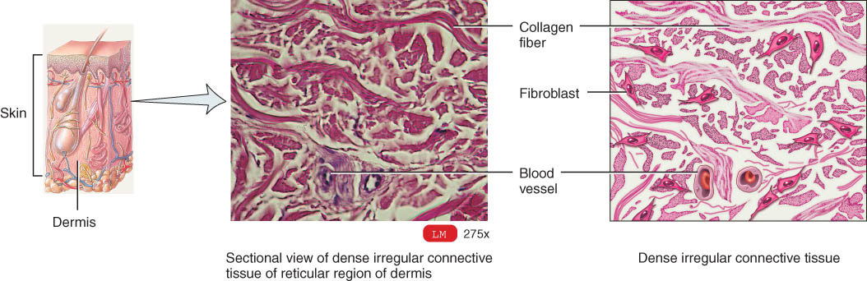
Dense Irregular Connective Tissue
Collagen fibers are irregularly arranged (interwoven)
Tissue can resist tension from any direction
Very tough tissue -- white of eyeball, dermis of skin

Slide 75
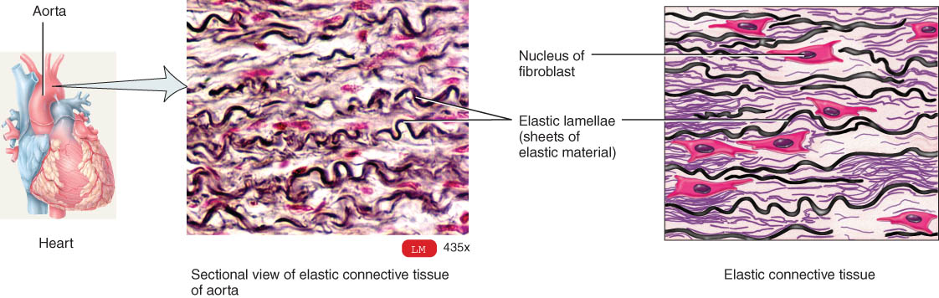
Elastic Connective Tissue
Branching elastic fibers and fibroblasts
It is quite strong and can recoil back to its original shape after being stretched.
Found in lung tissue, vocal cords, elastic arteries, ligament between vertebrae

Slide 76
Cartilage
Cartilage consists of a dense network of collagen fibers and elastic fibers embedded in chondroitin sulfate.
  strength is due to its collagen fibers and its resilience is due to the chondroitin sulfate
  Chondrocytes occur with spaces called lacunae in the matrix.
It is surrounded by a dense irregular connective tissue membrane called the perichondrium.
Unlike other connective tissues, cartilage has no blood vessels or nerves (except in the perichondrium).

Slide 77
Cartilage
3 major types of cartilage
  hyaline cartilage
  fibrocartilage
  elastic cartilage

Slide 78
Three types of cartilage.
Hyaline cartilage
  most abundant, but weakest
  has fine collagen fibers embedded in a gel-type matrix
  affords flexibility and support and at joints, reduces friction and absorbs shock
Fibrocartilage
  contains bundles of collagen fibers in its matrix
  lacks perichondrium
  Combining strength and rigidity, it is the strongest of the three types of cartilage
Elastic cartilage
  contains a threadlike network of elastic fibers
  perichondrium is present
  provides strength and elasticity maintains the shape of certain organs

Slide 79
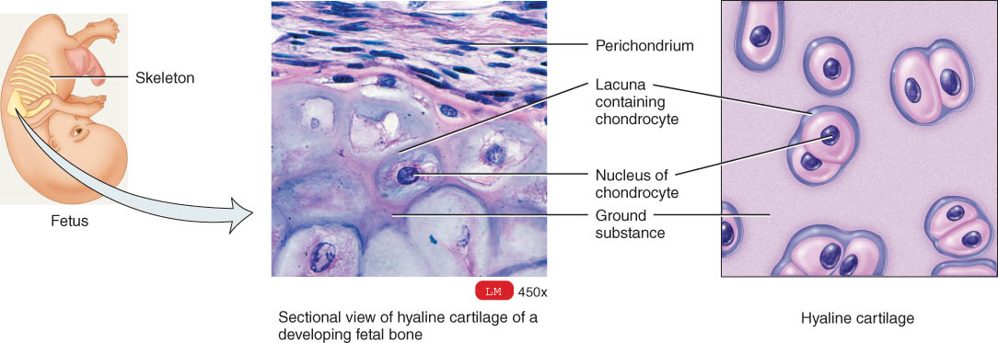
Hyaline Cartilage
Bluish-shiny white rubbery substance
Chondrocytes sit in spaces called lacunae
No blood vessels or nerves so repair is very slow
Reduces friction at joints as articular cartilage

Slide 80
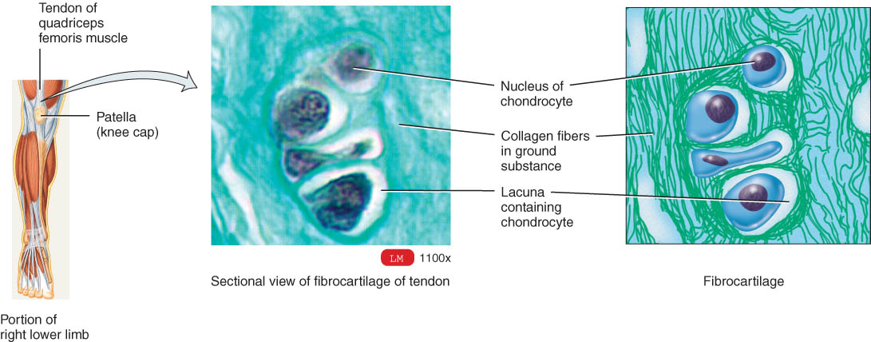
Fibrocartilage
Many more collagen fibers causes rigidity & stiffness
Strongest type of cartilage (intervertebral discs)

Slide 81
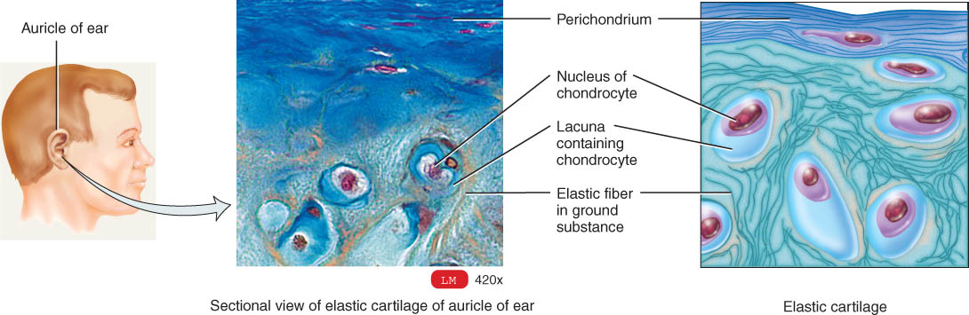
Elastic Cartilage
Elastic fibers help maintain shape after deformations
Ear, nose, vocal cartilages

Slide 82
Growth & Repair of Cartilage
The growth of cartilage is accomplished by interstitial growth (expansion from within) and appositional growth (from the outside).
Grows and repairs slowly because it is avascular
Interstitial growth
  chondrocytes divide and form new matrix
  occurs in childhood and adolescence
Appositional growth
  chondroblasts secrete matrix onto surface
  produces increase in width

Slide 83
Bone (Osseous) Tissue
Protects, provides for movement, stores minerals, site of blood cell formation
Bone (osseous tissue) consists of a matrix containing mineral salts and collagenous fibers and cells called osteocytes.
Classified as
  Spongy bone
    sponge-like with spaces and trabeculae
    trabeculae = struts of bone surrounded by red bone marrow
    no osteons (cellular organization)
  Compact bone
    solid, dense bone
    basic unit of structure is osteon (haversian system)

Slide 84
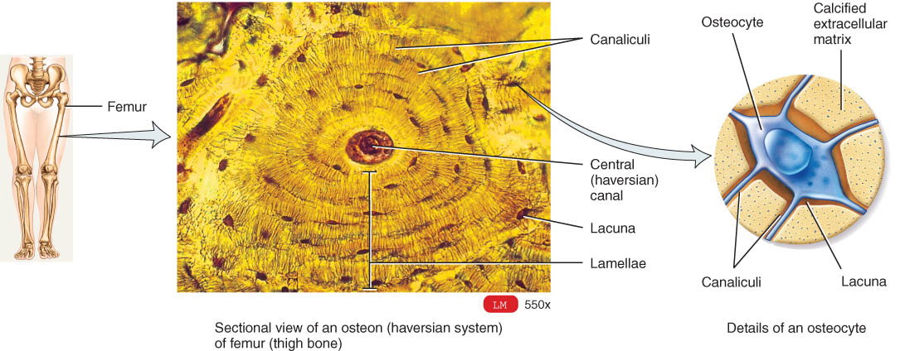
Compact Bone: Osteon (Haversion System)
lamellae (rings) of mineralized matrix
  calcium & phosphate---give bone its hardness and collegen fibers that give bone its strength.
  interwoven collagen fibers provide strength
Lacunae are small spaces between lamellae that contain mature bone cells called osteocytes.
Canaliculi are minute canals containing processes of osteocytes that provide routes for nutrient and waste transport.
A central (Haversian) canal contains blood vessels and nerves.

Slide 85
Bone
Bone supports, protects, helps provide movement, stores minerals, and houses blood-forming tissue.

Slide 86
Liquid connective tissue
Blood
  Blood (vascular tissue) consists of a liquid matrix called plasma and formed elements
Lymph is interstitial fluid flowing in lymph vessels.
  Contains less protein than plasma
  Move cells and substances (eg., lipids) from one part of the body to another

Slide 87
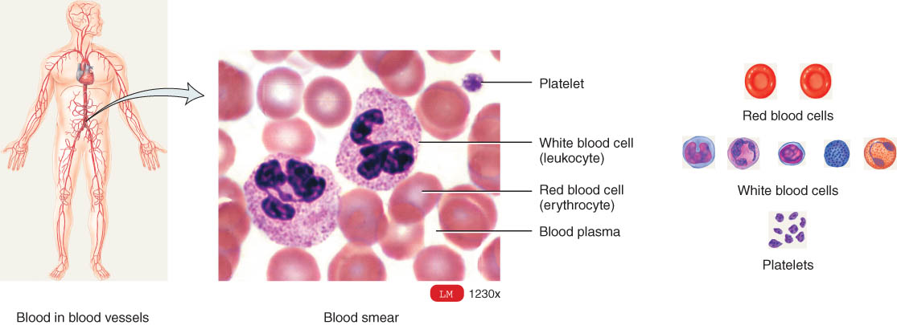
Blood
Connective tissue with a liquid matrix (the plasma)
Cell types include red blood cells (erythrocytes), white blood cells (leukocytes) and cell fragments called platelets
  clotting, immune functions, transport of O2 and CO2

Slide 88
Tissue Engineering
Has allowed scientists new tissues grown in the laboratory (skin & cartilage) for replacement of damaged tissues.
Research in progress
  insulin-producing cells (pancreas)
  dopamine-producing cells (brain)
  bone, tendon, heart valves, intestines & bone marrow

Slide 89
MEMBRANES
Membranes are flat sheets of pliable tissue that cover or line a part of the body.
Epithelial membranes consist of an epithelial layer and an underlying connective tissue layer (lamina propria)
  include mucous membranes, serous membranes, and the cutaneous membrane or skin.
Synovial membranes line joints and contain only connective tissue.

Slide 90
Mucous Membranes
Mucous membranes (mucosae) line cavities that open to the exterior.
  such as mouth, stomach, vagina, urethra, etc
Epithelial layer of a mucus membrane is an important aspect of the body’s defense mechanisms, acting as a barrier to microbes and a trapping surface for particles.
The connective tissue layer of a mucous membrane is called the lamina propria.
Tight junctions between cells prevent simple diffusion of most substances.
Mucous is secreted from underlying glands to keep surface moist

Slide 91
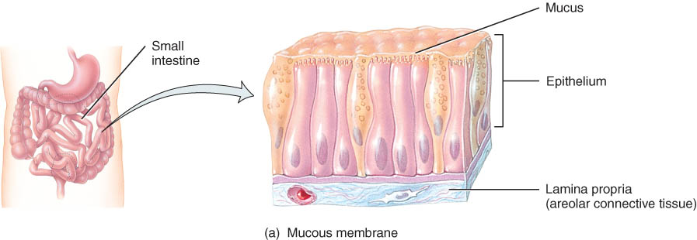
Mucous Membranes

Slide 92
Serous Membranes
Simple squamous cells overlying loose CT layer
  consist of parietal and visceral layers
Squamous cells secrete slippery fluid
Lines a body cavity that does not open to the outside such as chest or abdominal cavity
Examples:
  pleura, peritoneum and pericardium
    membrane on walls of cavity = parietal layer
    membrane over organs in cavity = visceral layer
    The epithelial layer secretes a lubricating serous fluid that reduces friction between organs and the walls of the cavities in which they are located.
Serous membranes may become inflamed with the buildup of serous fluid resulting in pleurisy, peritonitis, or pericarditis.

Slide 93
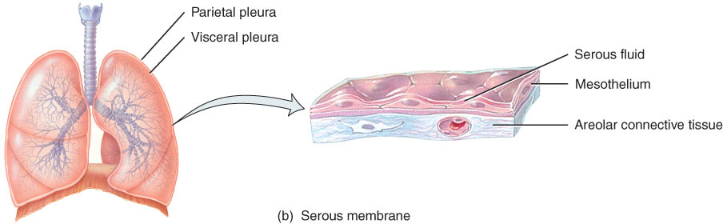
Serous Membranes

Slide 94
Cutaneous Membranes
Cutaneous membranes cover body surfaces and consist of epidermis and dermis

Slide 95
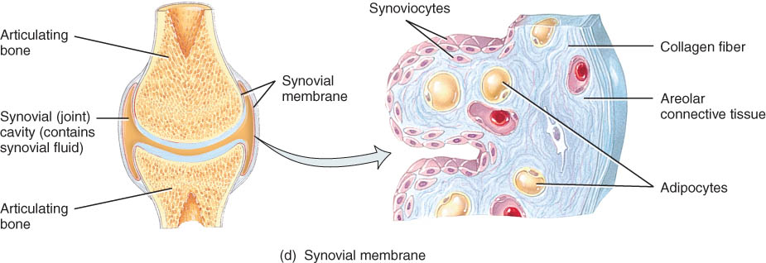
Synovial Membranes
Line joint cavities of all freely movable joints
Line bursae, and tendon sheaths
No epithelial cells---just special cells that secrete a lubricating synovial fluid.

Slide 96
MUSCLE TISSUE
consists of fibers (cells) that are modified for contraction (provide motion, maintenance of posture, and heat.)
three types.
  Skeletal muscle tissue is attached to bones, is striated, and is voluntary.
  Cardiac muscle tissue forms most of the heart wall, is striated, and is usually involuntary.
  Smooth (visceral) muscle tissue is found in the walls of hollow internal structures (blood vessels and viscera), is nonstriated, and is usually involuntary. It provides motion - constriction of blood vessels and airways, propulsion of foods through the gastrointestinal tract, and contraction of the urinary bladder and gallbadder).

Slide 97
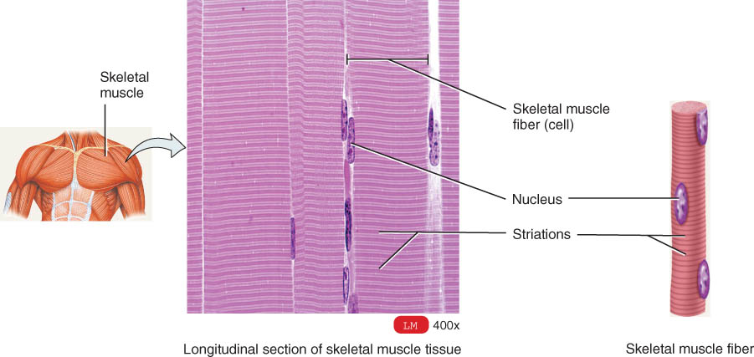
Skeletal Muscle
Cells are long cylinders with many peripheral nuclei
Visible light and dark banding (looks striated)
Voluntary (conscious control)

Slide 98
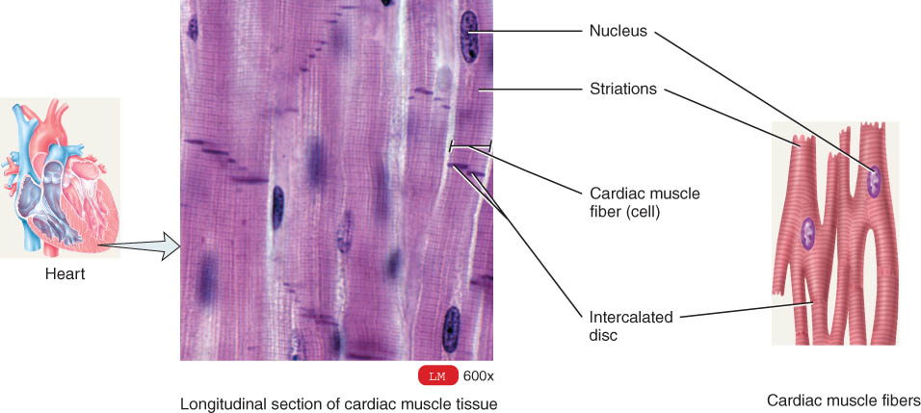
Cardiac Muscle
Cells are branched cylinders with one central nuclei
Involuntary and striated
Attached to and communicate with each other by intercalated discs and desmosomes

Slide 99
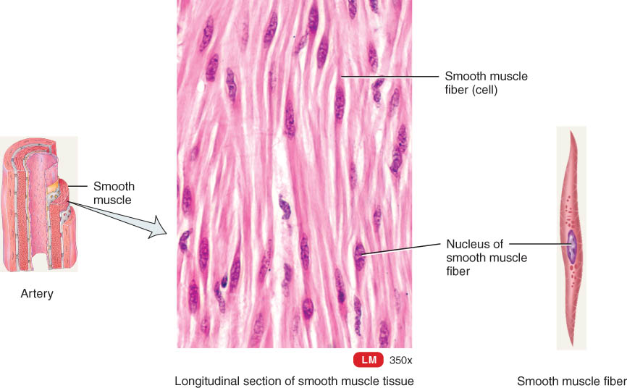
Smooth Muscle
Spindle shaped cells with a single central nuclei
Walls of hollow organs (blood vessels, GI tract, bladder)
Involuntary and nonstriated

Slide 100
NERVOUS TISSUE
The nervous system is composed of only two principal kinds of cells:
  neurons (nerve cells)
  neuroglia (protective and supporting cells).
Most neurons consist of a cell body and two types of processes called dendrites and axons.
Neurons are sensitive to stimuli, convert stimuli into nerve impulses, and conduct nerve impulses to other neurons, muscle fibers, or glands.
Neuroglia protect and support neurons and are often the sites of tumors of the nervous system.

Slide 101
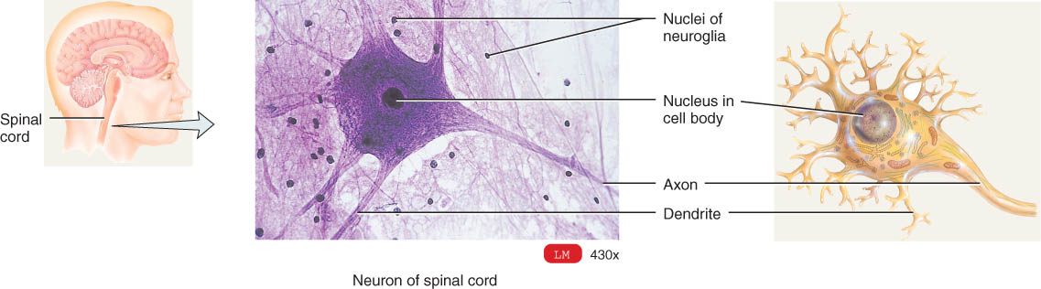
Nerve Tissue
Cell types -- nerve cells and neuroglial (supporting) cells
Nerve cell structure
  nucleus & long cell processes conduct nerve signals
    dendrite(s) --- signal travels toward the cell body
    axon ---- signal travels away from cell body

Slide 102
EXCITABLE CELLS
Neurons and muscle fibers are excitable cells
  they show electrical excitability (action potentials).

Slide 103
TISSUE REPAIR: RESTORE HOMEOSTASIS
Tissue repair is the process that replaces worn out, damaged, or dead cells.
Each of the four classes of tissues has a different capacity to replenish its parenchymal cells.
  Epithelial cells are replaced by the division of stem cells or by division of undifferentiated cells.
  Some connective tissues such as bone has a continuous capacity for renewal whereas cartilage replenishes cells less readily.
  Muscle cells have a poor capacity for renewal.
  Nervous tissue has the poorest capacity for renewal

Slide 104
Tissue Repair: Restoring Homeostasis
Worn-out, damaged tissue must be replaced
Fibrosis is the process of scar formation.
  If the injury is extensive granulation tissue (actively growing connective tissue) is formed.
Adhesions, which sometimes result from scar tissue formation, cause abnormal joining of adjacent tissues, particularly in the abdomen and sites of previous surgery. These can cause problems such as intestinal obstruction.

Slide 105
Conditions Affecting Tissue Repair
Nutrition is important to tissue repair
  adequate protein for structural components
  vitamin C for production of collagen and new blood vessels
Proper blood circulation is essential in tissue repair
  delivers O2 & nutrients & removes fluids & bacteria
With aging
  collagen fibers change in quality
  elastin fibers fragment and abnormally bond to calcium
  cell division and protein synthesis are slowed

Slide 106
Aging
The tissues of young people repair reaidly and efficiently; the process slows down with aging.
The younger body is generally in a better nutritional state, its tissues have a better blood supply, and its cells have a faster metabolic rate.

Slide 107
DISORDERS: HOMEOSTATIC IMBALANCES
Disorders of epithelial tissues are mainly specific to individual organs, such as skin cancer which involves the epidermis or peptic ulcer disease which involves the epithelial lining of the stomach or small intestine.
The most prevalent disorders of connective tissue are autoimmune disorders which are diseases in which antibodies produced by the immune system fail to distinguish what is foreign from what is self and attacks the body’s own tissues.

Slide 108
Sjogren’s Syndrome
Autoimmune disorder inflammation and destruction of exocrine glands
Dryness of mouth and eyes
20 % of older adults show some signs

Slide 109
Systemic Lupus Erythematosus (SLE)
Autoimmune disorder -- causes unknown
Chronic inflammation of connective tissue
Nonwhite women during childbearing years
Females 9:1 (1 in 2000 individuals)
Painful joints, ulcers, loss of hair, fever
Life-threatening if inflammation occurs in major organs --- liver, kidney, heart, brain, etc.

Slide 110
end

