Slide 1
Chapter 7
The Skeletal System: The Axial Skeleton
Lecture Outline

Slide 2
INTRODUCTION
Familiarity with the names, shapes, and positions of individual bones helps to locate other organs and to understand how muscles produce different movements due to attachment on individual bones and the use of leverage with joints.
The bones, muscles, and joints together form the musculoskeletal system.

Slide 3
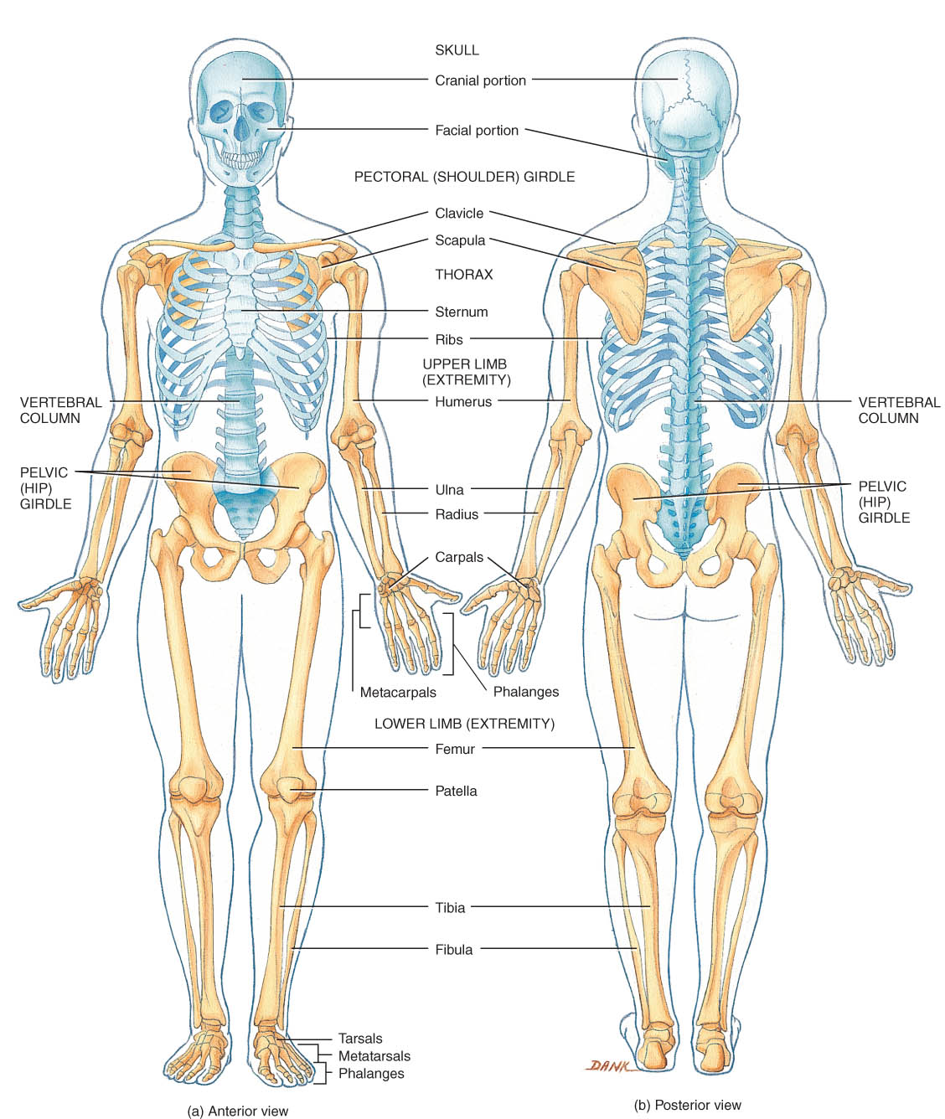
Chapter 7 The Skeletal System:The Axial Skeleton
Axial Skeleton
80 bones
lie along longitudinal axis
skull, hyoid, vertebrae, ribs, sternum, ear ossicles
Appendicular Skeleton
126 bones
upper & lower limbs and pelvic & pectoral girdles

Slide 4
DIVISIONS OF THE SKELETAL SYSTEM
The axial skeleton consists of bones arranged along the longitudinal axis of the body. The parts of the axial skeleton, composed of 80 bones, are the skull, hyoid bone, vertebral column, sternum, and ribs (Figure 7.1).
The appendicular skeleton comprises one of the two major divisions of the skeletal system.It consists of 126 bones in the upper and lower extremities (limbs or appendages) and the pectoral (shoulder) and pelvic (hip) girdles, which attach them to the rest of the skeleton.

Slide 5
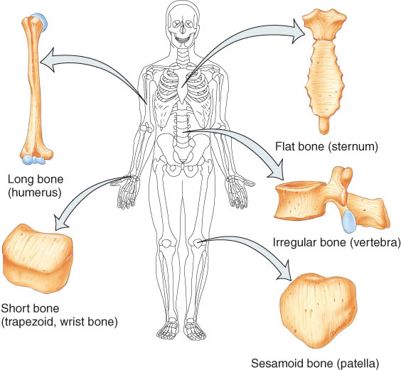
Types of Bones
5 basic types of bones:
long = compact
short = spongy except surface
flat = plates of compact enclosing spongy
irregular = variable
sesamoid = develop in tendons or ligaments (patella)
Sutural bones = in joint between skull bones

Slide 6
BONE SURFACE MARKINGS
There are two major types of surface markings.
Depressions and openings participate in joints or allow the passage of soft tissue.
Processes are projections or outgrowths that either help form joints or serve as attachment points for connective tissue.
Table 7.2 describe the various surface markings along with examples of each.

Slide 7
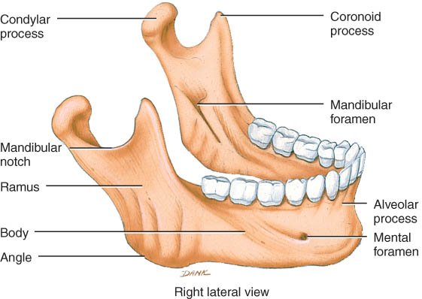
Bone Surface Markings from Table 7.2
Foramen = opening
Fossa = shallow depression
Sulcus = groove
Meatus = tubelike passageway or canal
Condyle = large, round protuberance
Facet = smooth flat articular surface
Trochanter = very large projection
Tuberosity = large, rounded, roughened projection
Learning the terms found in this Table will simplify your study of the skeleton.

Slide 8
SKULL
The skull, composed of 22 bones, consists of the cranial bones (cranium) and the facial bones (face) (Figures. 7.3 through 7.8).
General Features
The skull forms the large cranial cavity and smaller cavities, including the nasal cavity and orbits (eye sockets).
Certain skull bones contain mucous membrane lined cavities called paranasal sinuses.
The only moveable bone of the skull, other than the ear ossicles within the temporal bones, is the mandible.
Immovable joints called sutures hold the skull bones together.

Slide 9
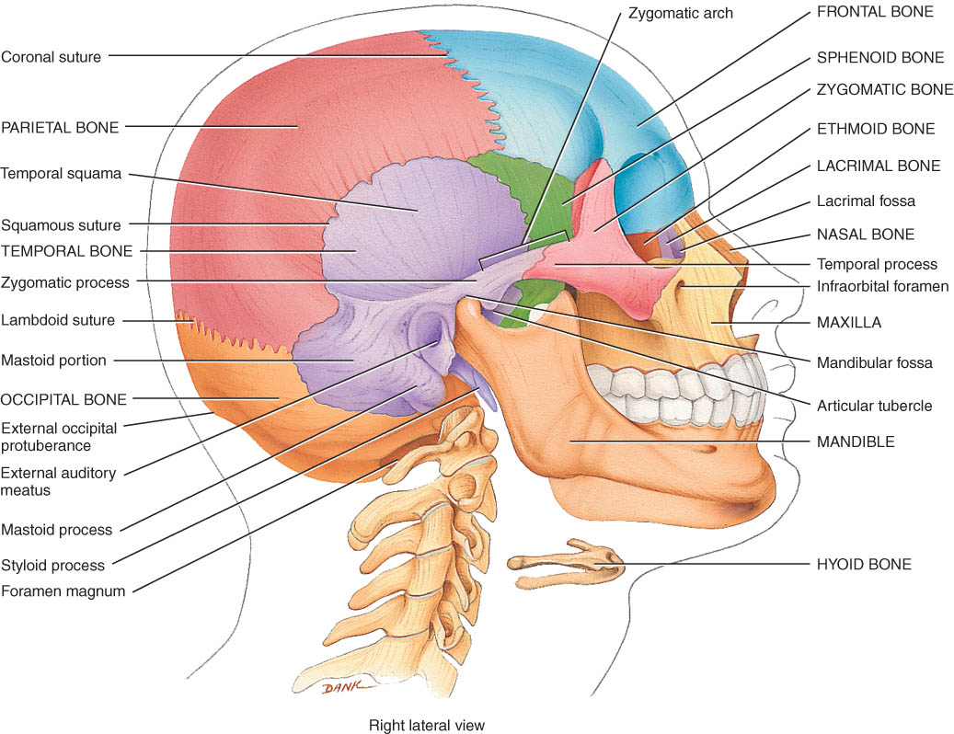
The Skull
8 Cranial bones
protect brain & house ear ossicles
muscle attachment for jaw, neck & facial muscles
14 Facial bones
protect delicate sense organs -- smell, taste, vision
support entrances to digestive and respiratory systems

Slide 10
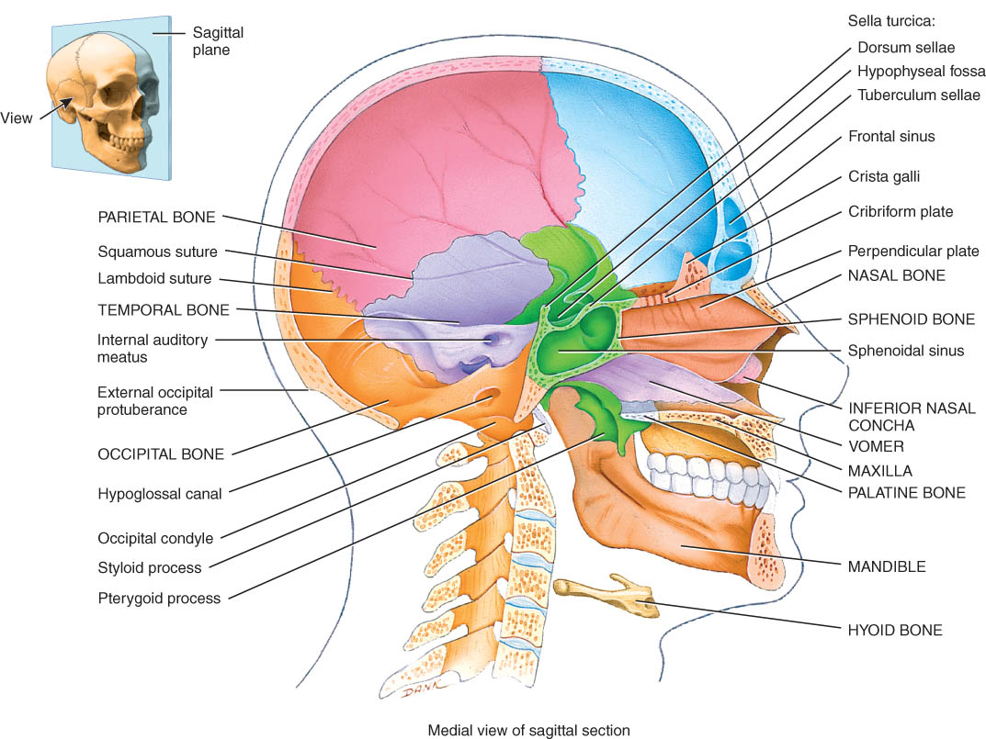
The 8 Cranial Bones
Frontal
Parietal (2)
Temporal (2)
Occipital
Sphenoid
Ethmoid

Slide 11
Frontal Bone
Forehead, roof of orbits, & anterior cranial floor
Frontal suture gone by age 6 (metopic suture)
Supraorbital margin and frontal sinus
A “black eye” results from accumulation of fluid and blood in the upper eyelid following a blow to the relatively sharp supraorbital margin (brow line).

Slide 12
cranial bone functions
They protect the brain.
Their inner surfaces attach to membranes that stabilize the positions of the brain, blood vessels, and nerves.
The outer surfaces of cranial bones provide large areas of attachment for muscles that move the various parts of the head.
Facial bones form the framework of the face and protect and provide support for the nerves and blood vessels in that area.
Cranial and facial bones together protect and support the special sense organs.

Slide 13
Parietal & Temporal Bones
Parietal
sides & roof of cranial cavity
Temporal
temporal squama
zygomatic process forms part of arch
external auditory meatus
mastoid process
styloid process
stylomastoid foramen(VII)
mandibular fossa (TMJ)
petrous portion (VIII)

Slide 14
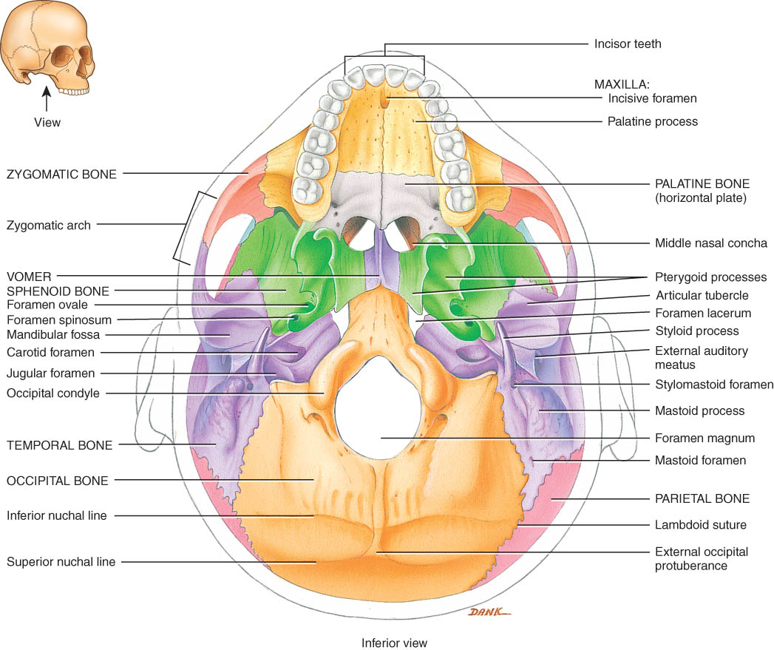
Temporal and Occipital bones
Temporal
carotid foramen (carotid artery)
jugular foramen (jugular vein)
Occipital
foramen magnum
occipital condyles
external occipital protuberance attachment for ligamentum nuchae
superior & inferior nuchal lines

Slide 15
Sphenoid bone
Base of skull
Pterygoid processes are attachment sites for jaw muscles

Slide 16
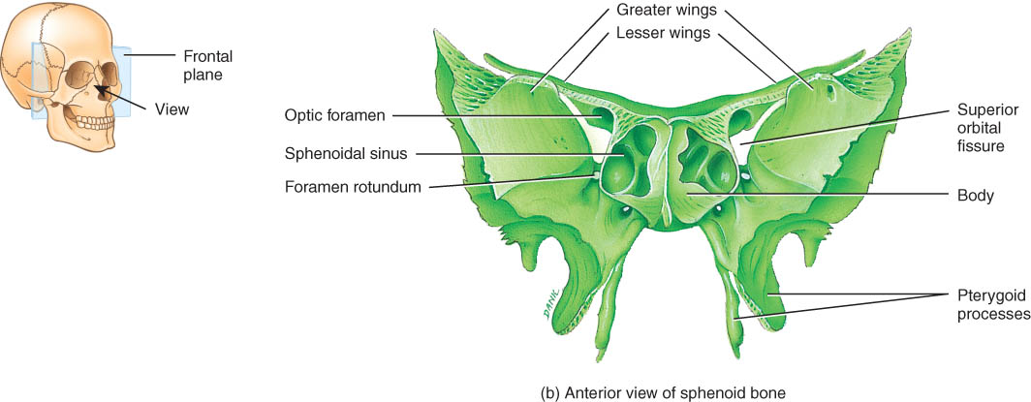
Sphenoid in Anterior View
Body is a cubelike portion holding sphenoid sinuses
Greater and lesser wings
Pterygoid processes

Slide 17
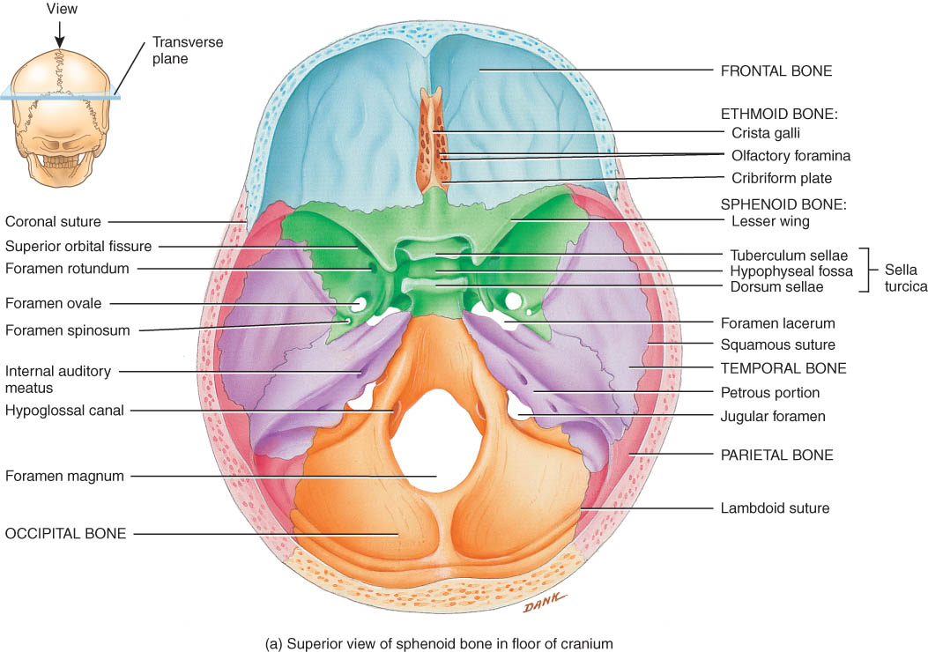
Sphenoid from Superior View
Lesser wing & greater wing
Sella turcica holds pituitary gland
Optic foramen

Slide 18
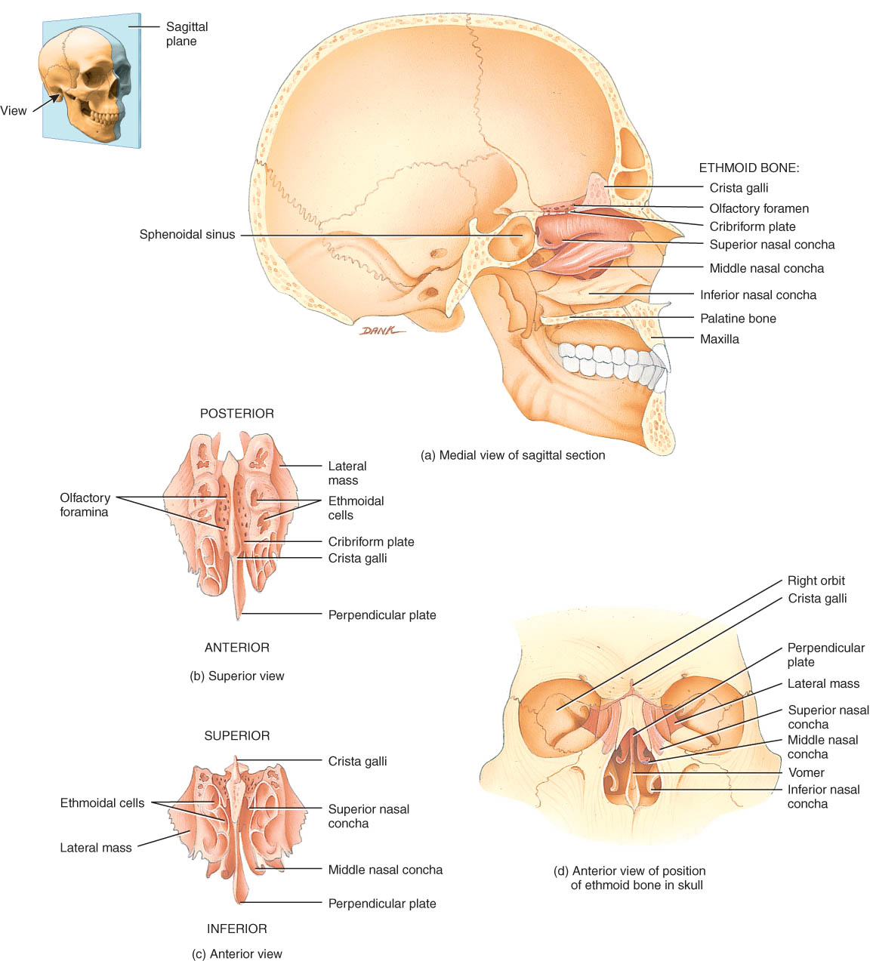
Ethmoid Bone
The ethmoid bone forms part of the anterior portion of the cranial floor, the medial wall of the orbits, the superior portion of the nasal septum, and most of the superior side walls of the nasal cavity. It is a major superior supporting structure of the nasal cavity (Figures 7.11, 7.13).
Crista galli attaches to the membranes that cover the brain

Slide 19
Ethmoid bone
Lateral masses contain ethmoid sinuses
Perpendicular plate is upper part of nasal septum
Superior & middle nasal concha or turbinates
filters & warms air

Slide 20
14 Facial Bones
Nasal (2) Maxillae (2) Zygomatic (2)
Mandible (1) Lacrimal (2) Palatine (2)
Inferior nasal conchae (2) Vomer (1)

Slide 21
Maxillary bones
Floor of orbit, floor of nasal cavity or hard palate
Maxillary sinus
Alveolar processes hold upper teeth
Cleft palate is lack of union of maxillary bones

Slide 22
Zygomatic Bones
Cheekbones
Lateral wall of orbit along with sphenoid
Part of zygomatic arch along with part of temporal

Slide 23
Lacrimal and Inferior Nasal Conchae
Lacrimal bones
part of medial wall of orbit
lacrimal fossa houses lacrimal sac
Inferior nasal concha or turbinate (not part of ethmoid)
Inferior Nasal Conchae

Slide 24
Mandible
Body, angle & rami
Condylar & coronoid processes
Alveolar processes for lower teeth
Mandibular & mental foramen

Slide 25
TMJ
The mandible articulates with the temporal bone to form the temporomandibular joint (Figure 7.4).
Temporomandibular joint (TMJ) syndrome is dysfunction to varying degrees of the temporomandibular joint. Causes appear to be numerous and the treatment is similarly variable.

Slide 26
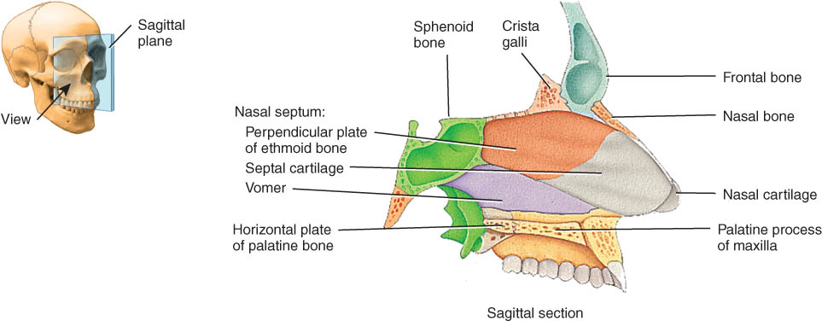
Palatine & Vomer
Palatine
L-shaped : one end is back part of hard palate, other end is part of orbit (see previous picture)
Vomer
posterior part of nasal septum

Slide 27
Nasal Septum
The nasal septum is a vertical partition that divides the nasal cavity into right and left sides (Figure 7.11).
A deviated nasal septum is a lateral deflection of the septum from the midline, usually resulting from improper fusion of septal bones and cartilage.

Slide 28
Nasal Septum
Divides nasal cavity into left and right sides
Formed by vomer, perpendicular plate of ethmoid and septal cartilage
Deviated septum does not line in the midline
developmental abnormality or trauma

Slide 29
The orbits (eye sockets)
The orbits contain the eyeballs and associated structures and are formed by seven bones of the skull (Figure 7.12).
Five important foramina are associated with each orbit

Slide 30
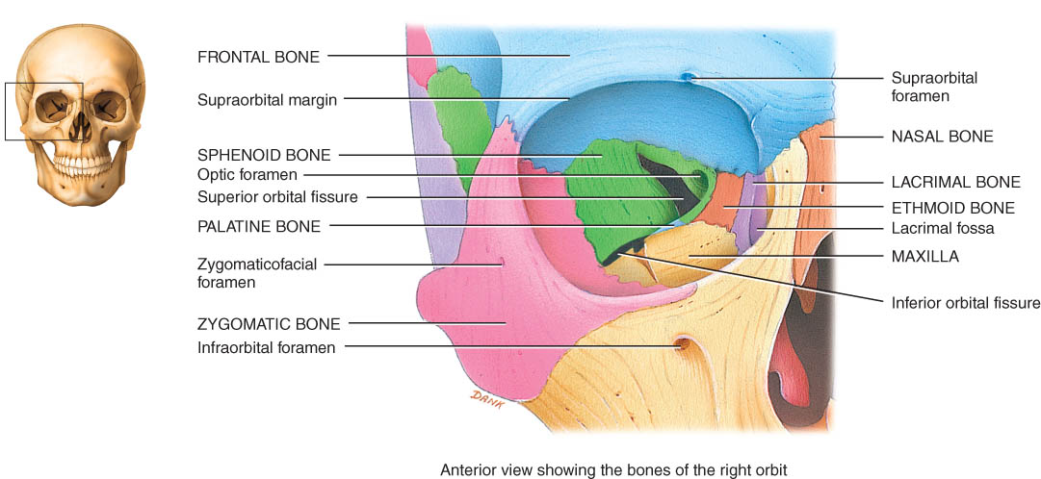
Bones of the Orbit
Roof is frontal and sphenoid
Lateral wall is zygomatic and sphenoid
Floor is maxilla, zygomatic and sphenoid
Medial wall is maxilla, lacrimal, ethmoid and sphenoid
Orbital fissures and optic foramen

Slide 31
Foramina of the Skull
Table 7.4 describes major openings of skull
In which bone would you find the following and what is their function?
foramen magnum
optic foramen
mandibular foramen
carotid canal
stylomastoid foramen

Slide 32
Unique Features of the Skull

Slide 33
Sutures
Sutures are immovable joints found only between skull bones and hold skull bones together.
Sutures include the coronal, sagittal, lamboidal,and squamous sutures, among others (Figures 7.4, 7.6).

Slide 34
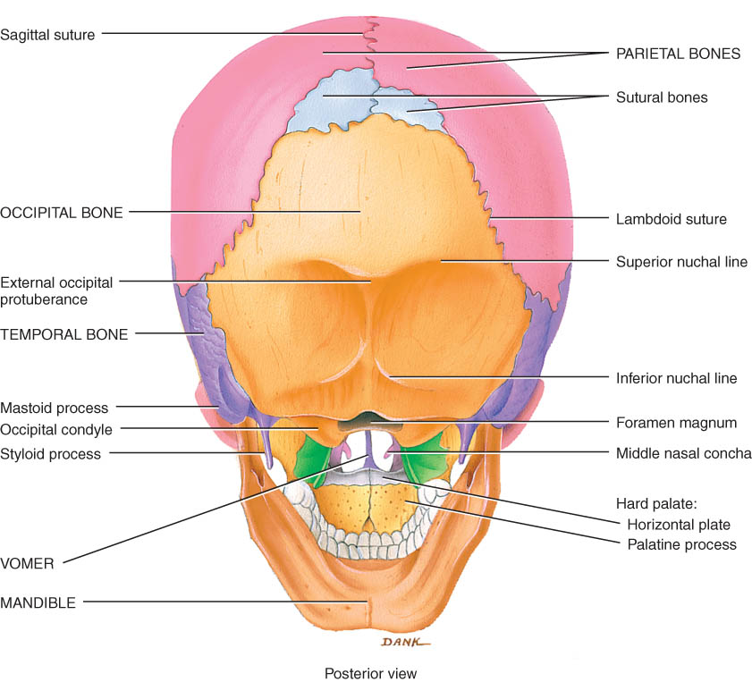
Sutures
Lamboid suture unites parietal and occipital
Sagittal suture unites 2 parietal bones

Slide 35
Sutures
Coronal suture unites frontal and both parietal bones
Squamous suture unites parietal and temporal bones

Slide 36
Paranasal Sinuses
Paranasal sinuses are cavities in bones of the skull that communicate with the nasal cavity.
They are lined by mucous membranes and also serve to lighten the skull and serve as resonating chambers for speech.
Cranial bones containing the sinuses are the frontal, sphenoid, ethmoid, and maxillae.
Sinusitis occurs when membranes of the paranasal sinuses become inflamed due to infection or allergy.

Slide 37
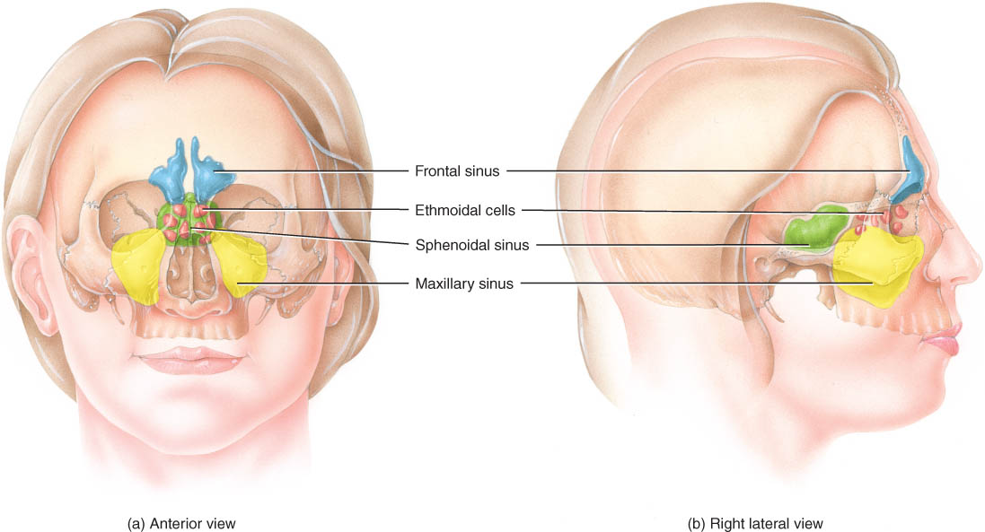
Paranasal Sinuses
Paired cavities in ethmoid, sphenoid, frontal and maxillary
Lined with mucous membranes and open into nasal cavity
Resonating chambers for voice, lighten the skull
Sinusitis is inflammation of the membrane (allergy)

Slide 38
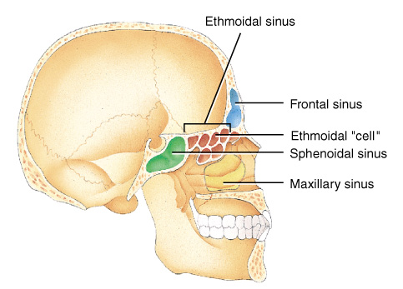
Paranasal Sinuses
Paired cavities in ethmoid, sphenoid, frontal and maxillary
Lined with mucous membranes and open into nasal cavity
Resonating chambers for voice, lighten the skull
Sinusitis is inflammation of the membrane (allergy)

Slide 39
Fontanels
Fontanels are dense connective tissue membrane-filled spaces between the cranial bones of fetuses and infants. They remain unossified at birth but close early in a child’s life (Figure 7.14).
The major fontanels are the anterior, posterior, anterolaterals, and posterolaterals .
Fontanels have two major functions.
They enable the fetal skull to modify its size and shape as it passes through the birth canal.
They permit rapid growth of the brain during infancy.

Slide 40
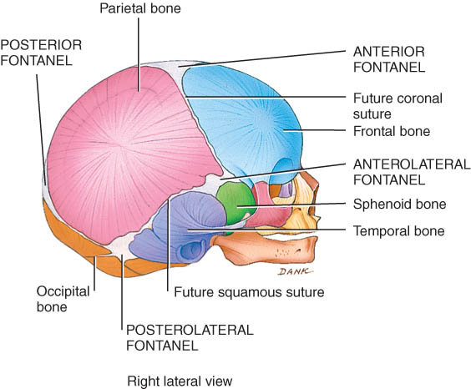
Fontanels of the Skull at Birth.
Dense connective tissue membrane-filled spaces (soft spots)
Unossified at birth but close early in a child's life.

Slide 41
HYOID BONE
The hyoid bone is a unique component of the axial skeleton because it does not articulate with any other bones.
The hyoid bone consists of a horizontal body and paired projections, the lesser and greater horns. (Figure 7.15)

Slide 42
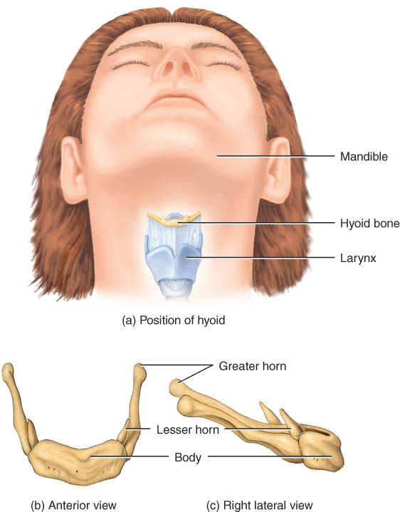
Hyoid Bone
U-shaped single bone
Articulates with no other bone of the body
Suspended by ligament and muscle from skull
Supports the tongue & provides attachment for tongue, neck and pharyngeal muscles

Slide 43
VERTEBRAL COLUMN
The vertebral column, along with the sternum and ribs, makes up the trunk of the skeleton.
The 26 bones of the vertebral column are arranged into five regions: cervical, thoracic, lumbar, sacral, and coccygeal (Figure 7.16a).

Slide 44
Vertebral Column
Backbone or spine built of 26 vertebrae
Five vertebral regions
cervical vertebrae (7) in the neck
thoracic vertebrae ( 12 ) in the thorax
lumbar vertebrae ( 5 ) in the low back region
sacrum (5, fused)
coccyx (4, fused)

Slide 45
Intervertebral Discs
Between adjacent vertebrae absorbs vertical shock
Permit various movements of the vertebral column
Fibrocartilagenous ring with a pulpy center

Slide 46
Normal Curves of the Vertebral Column
The four normal vertebral curves are the cervical and lumbar (anteriorly convex curves) and thoracic and sacral (anteriorly concave curves) (Figure 7.16b).
Between adjacent vertebrae, from the first cervical (atlas) to the sacrum, are intervertebral discs that form strong joints, permit various movements of the vertebral column, and absorb vertical shock (Figure 7.16d).
In the fetus, there is only a single anteriorly concave curve (Figure 7.16c).
The cervical curve develops as the child begins to hold his head erect.
The lumbar curve develops as the child begins to walk.
All curves are fully developed by age 10.

Slide 47
Normal Curves of the Vertebral Column
Primary curves
thoracic and sacral are formed during fetal development
Secondary curves
cervical if formed when infant raises head at 4 months
lumbar forms when infant sits up & begins to walk at 1 year

Slide 48
Vertebrae
Parts of a typical vertebra include a body, a vertebral arch, and several processes (Figure 7.17).

Slide 49
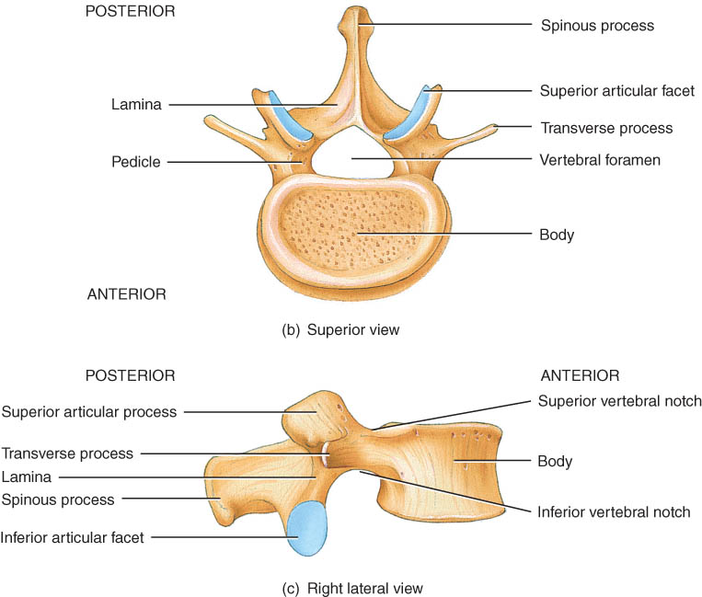
Typical Vertebrae
Body
weight bearing
Vertebral arch
pedicles
laminae
Vertebral foramen
Seven processes
2 transverse
1 spinous
4 articular
Vertebral notches

Slide 50
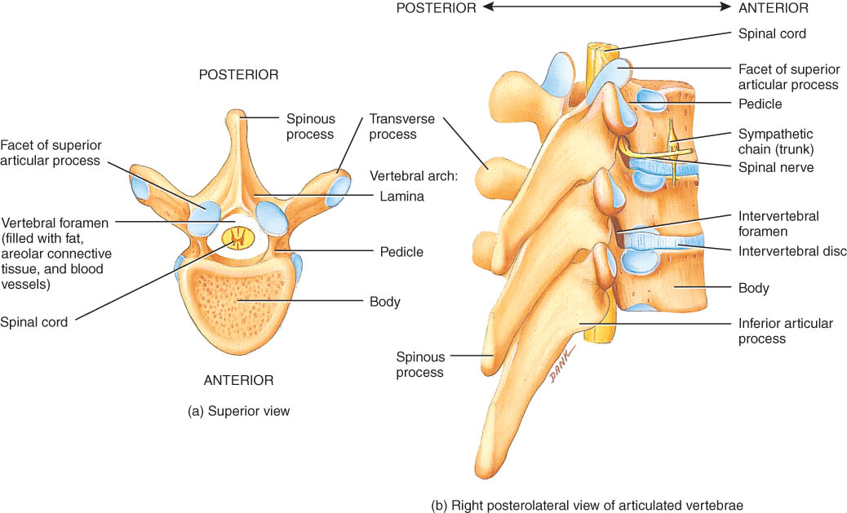
Intervertebral Foramen & Spinal Canal
Spinal canal is all vertebral foramen together
Intervertebral foramen are 2 vertebral notches together

Slide 51
Regions of the Vertebral Column

Slide 52
Cervical Region
There are 7 cervical vertebrae (Figure 7.18a).
The first cervical vertebra is the atlas and supports the skull (Figure 7.18a, b).
The second cervical vertebra is the axis, which permits side-to-side rotation of the head (Figure 7.18a, c).
The third to sixth correspond to the structural patterns of the typical cervical vertebrae (Figure 7.18d).
The seventh called the vertebra prominens is somewhat different (Figure 7.18)

Slide 53
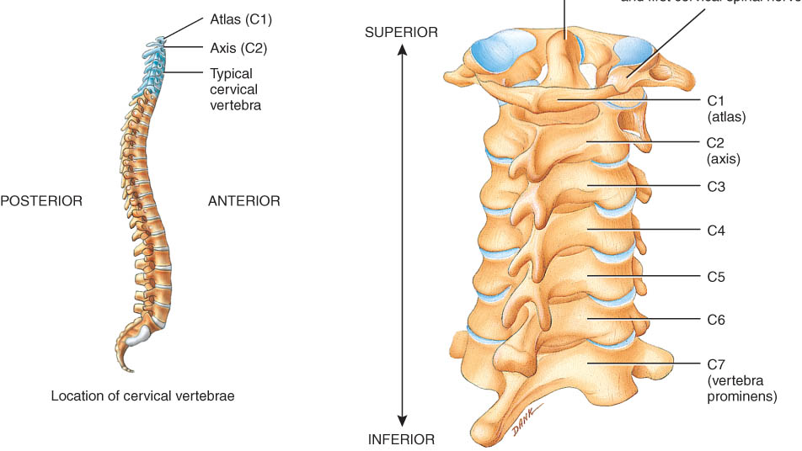
Typical Cervical Vertebrae (C3-C7)
Smaller bodies but larger spinal canal
Transverse processes
shorter, with transverse foramen for vertebral artery
Spinous processes of C2 to C6 often bifid
1st and 2nd cervical vertebrae are unique - atlas & axis

Slide 54
Atlas & Axis (C1-C2)
Atlas -- ring of bone, superior facets for occipital condyles
nodding movement at atlanto-occipital joint signifies “yes”
Axis -- dens or odontoid process is body of atlas
pivotal movement at atlanto-axial joint signifies “no”

Slide 55
Thoracic Region
There are 12 thoracic vertebrae (Figure 7.19).
These vertebrae articulate with the ribs.

Slide 56
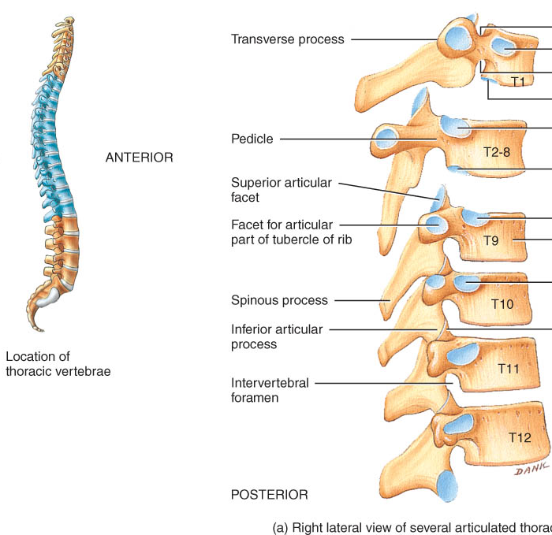
Thoracic Vertebrae (T1-T12)
Larger and stronger bodies
Longer transverse & spinous processes
Facets or demifacets on body for head of rib
Facets on transverse processes (T1-T10) for tubercle of rib

Slide 57
Lumbar Region
There are 5 lumbar vertebrae (Figure 7.20).
They are the largest and strongest vertebrae in the column.
Table 7.4 summarizes the major structural differences among the cervical, thoracic, and lumbar vertebrae.

Slide 58
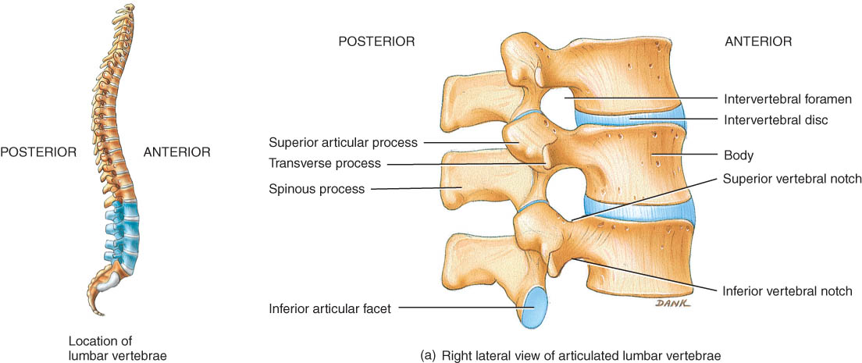
Lumbar Vertebrae
Strongest & largest
Short thick spinous & transverse processes
back musculature

Slide 59
Sacrum
The sacrum is formed by the union of 5 sacral vertebrae (Figure 7.21a) and serves as a strong foundation for the pelvic girdle.
Table 8.1 shows the differences between the male and female sacrum.

Slide 60
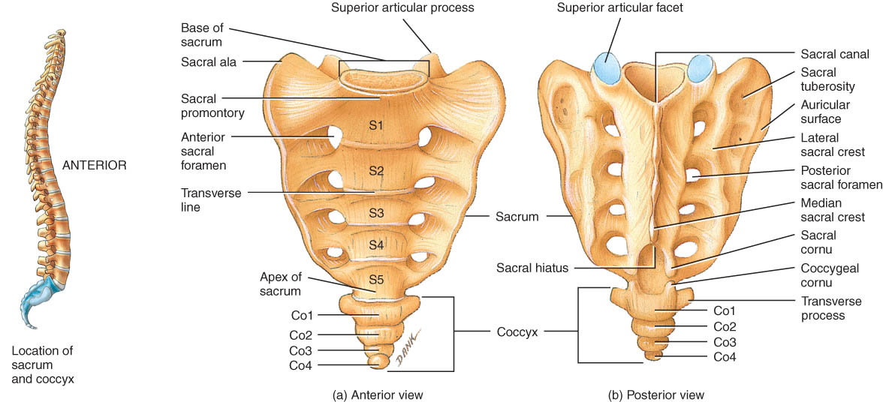
Sacrum
Union of 5 vertebrae (S1 - S5) by age 30
median sacral crest was spinous processes
sacral ala is fused transverse processes
Sacral canal ends at sacral hiatus
Auricular surface & sacral tuberosity of SI joint

Slide 61
Coccyx
The coccyx is formed by the fusion of 4 coccygeal vertebrae (Figure 7.21).
Caudal anesthesia (epidural block), frequently used during labor (in childbirth), causes numbness in the regions innervated by the sacral and coccygeal nerves (approximately from the waist to the knees).

Slide 62
Coccyx
Union of 4 vertebrae (Co1 - Co4) by age 30
Caudal or epidural anesthesia during delivery
into sacral hiatus anesthetize sacral & coccygeal nerves
sacral and coccygeal cornu are important landmarks

Slide 63
THORAX
The term thorax refers to the entire chest.
The skeletal part of the thorax (a bony cage) consists of the sternum, costal cartilages, ribs, and the bodies of the thoracic vertebrae (Figure 7.22).
The thoracic cage encloses and protects the organs in the thoracic and superior abdominal cavities. It also provides support for the bones of the shoulder girdle and upper limbs.

Slide 64
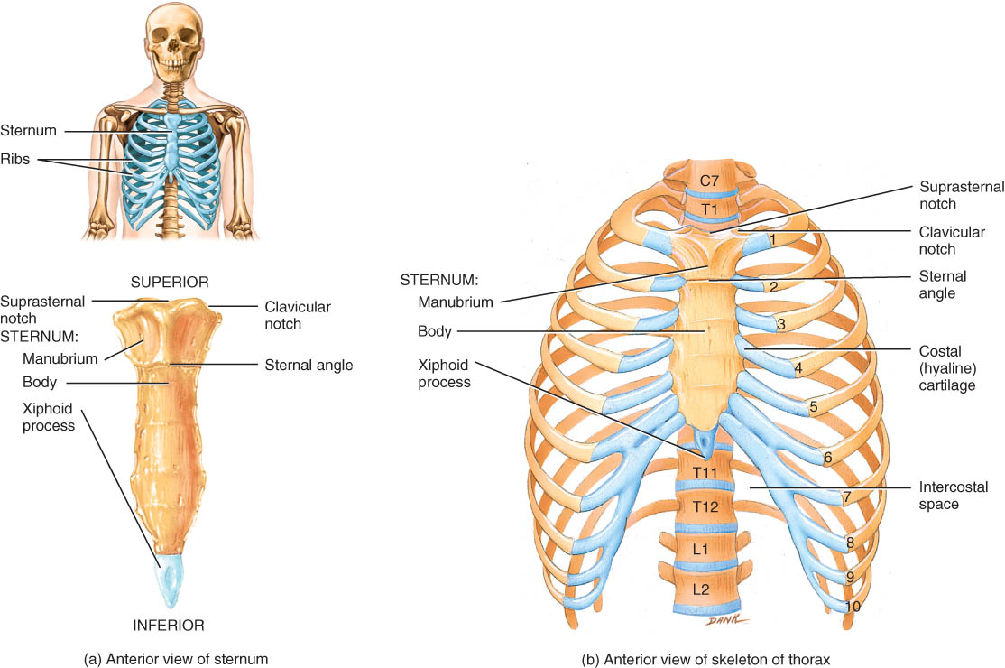
Thorax

Slide 65
Thorax
Bony cage flattened from front to back
Sternum (breastbone)
Ribs
1-7 are true ribs (vertebrosternal)
8-12 are false ribs (vertebrochondral)
11-12 are floating
Costal cartilages
Bodies of the thoracic vertebrae.

Slide 66
Sternum
The sternum is located on the anterior midline of the thoracic wall.
It consists of three parts: manubrium, body, and xiphoid process (Figure 7.22).

Slide 67
Sternum
Manubrium
1st & 2nd ribs
clavicular notch
Body
costal cartilages of 2-10 ribs
Xiphoid
ossifies by 40
CPR position
abdominal mm.
Sternal puncture
biopsy

Slide 68
Ribs
The 12 pairs of ribs give structural support to the sides of the thoracic cavity (Figure 7.22b).
The first 7 pairs of ribs are called true ribs; the remaining five pairs, false ribs (with the last two false ribs called floating ribs).
Figure 7.23a shows the parts of a typical rib.
Rib fractures are the most common types of chest injuries.

Slide 69
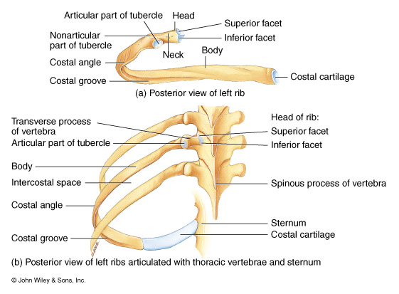
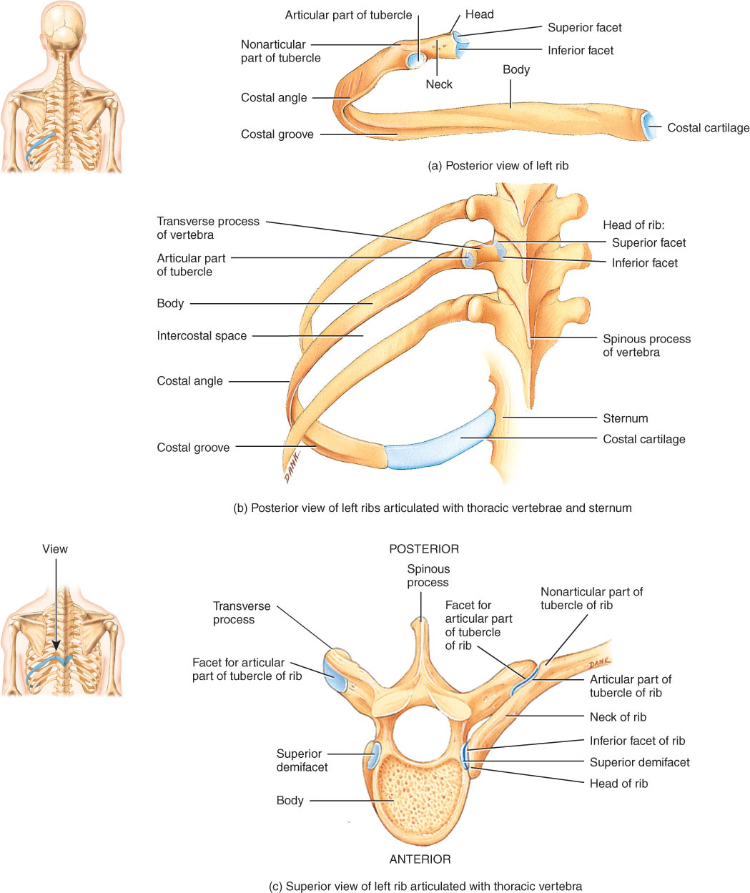
Ribs
Increase in length from ribs 1-7, thereafter decreasing
Head and tubercle articulate with facets
Body with costal groove containing nerve & blood vessels
Intercostal spaces contain intercostal muscles

Slide 70
Rib Articulation
Tubercle articulates with transverse process
Head articulates with vertebral bodies

Slide 71
DISORDERS: HOMEOSTATIC IMBALANCES
Protrusion of the nucleus pulposus into an adjacent vertebral body is called a herniated (slipped) disc (Figure 7.24). This movement exerts pressure on spinal nerves, causing considerable pain.

Slide 72
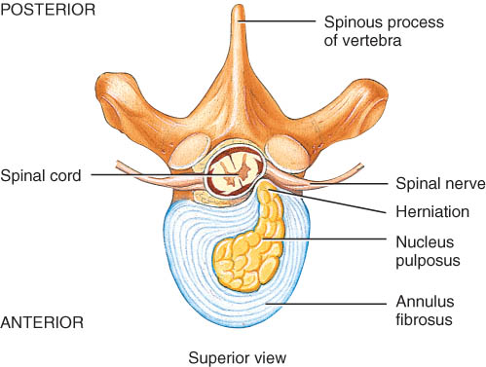
Herniated (Slipped) Disc
Protrusion of the nucleus pulposus
Most commonly in lumbar region
Pressure on spinal nerves causes pain
Surgical removal of disc after laminectomy

Slide 73
DISORDERS: HOMEOSTATIC IMBALANCES
Abnormal curvatures of the vertebral column include scoliosis, an lateral bending of the vertebral column; kyphosis, an exaggerated curve of the thoracic curve; and lordosis, an exaggeration of the lumbar curve (Figure 7.25 a-c).
Spina bifida is a congenital defect caused by failure of the vertebral laminae to unite at the midline. This may involve only one or several vertebrae; nervous tissue may or may not protrude through the skin (Figure 7.26).

Slide 74
Clinical Problems
Abnornal curves of the spine.
scoliosis (lateral bending of the column)
kyphosis (exaggerated thoracic curve)
lordosis (exaggerated lumbar curve)
Spina bifida is a congenital defect
failure of the vertebral laminae to unite
nervous tissue is unprotected
paralysis

Slide 75
end

