Slide 1
Chapter 8
The Skeletal System: Appendicular Skeleton
Lecture Outline

Slide 2
INTRODUCTION
The appendicular skeleton includes the bones of the upper and lower extremities and the shoulder and hip girdles.
The appendicular skeleton functions primarily to facilitate movement.

Slide 3
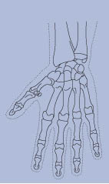
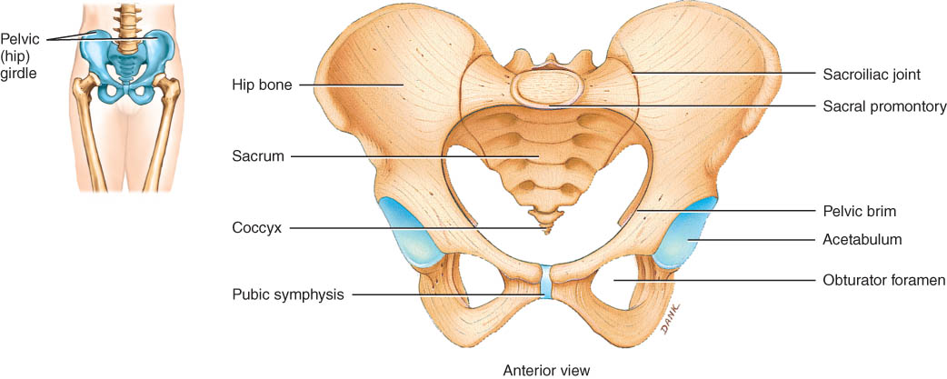
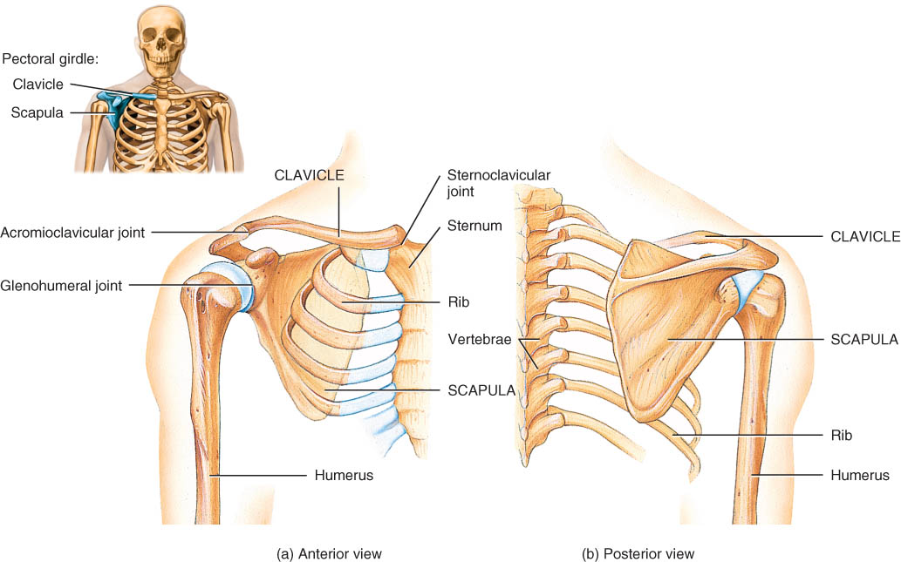
Chapter 8 The Skeletal System: Appendicular Skeleton
Pectoral girdle
Pelvic girdle
Upper limbs
Lower limbs

Slide 4
Pectoral (Shoulder) Girdle
The pectoral or shoulder girdle attaches the bones of the upper limbs to the axial skeleton (Figure 8.1).
Consists of scapula and clavicle
Clavicle articulates with sternum (sternoclavicular joint)
Clavicle articulates with scapula (acromioclavicular joint)
Scapula held in place by muscle only
Upper limb attached to pectoral girdle at shoulder (glenohumeral joint)

Slide 5
Clavicle
The clavicle or collar bone lies horizontally in the superior and anterior part of thorax superior to the first rib and articulates with the sternum and the clavicle (Figure 8.2).
The clavicle, one of the most frequently broken bones in the body, transmits mechanical force from the upper limb to the trunk.

Slide 6
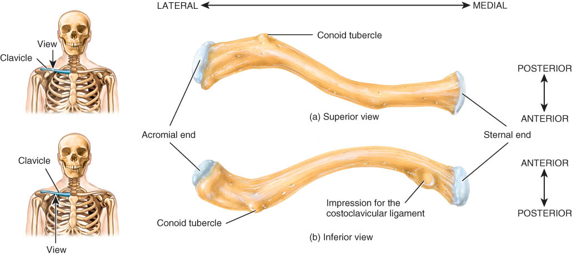
Clavicle (collarbone)
S-shaped bone with two curves
medial curve convex anteriorly/lateral one concave anteriorly
Extends from sternum to scapula above 1st rib
Fracture site is junction of curves
Ligaments attached to clavicle stabilize its position.

Slide 7
Scapula
The scapula or shoulder blade articulates with the clavicle and the humerus (Figure 8.3).
The scapulae articulate with other bones anteriorly, but are held in place posteriorly only by complex shoulder and back musculature.

Slide 8
Anterior Surface of Scapula
Subscapular fossa filled with muscle
Coracoid process for muscle attachment

Slide 9
Posterior Surface of Scapula
Triangular flat bone found in upper back region
Scapular spine ends as acromion process
a sharp ridge widening to a flat process
Glenoid cavity forms shoulder joint with head of humerus
Supraspinous & infraspinous fossa for muscular attachments

Slide 10
UPPER LIMB (EXTREMITY)
Each upper limb consists of 30 bones including the humerus, ulna, radius, carpals, metacarpals, and phalanges (Figure 8.4).

Slide 11
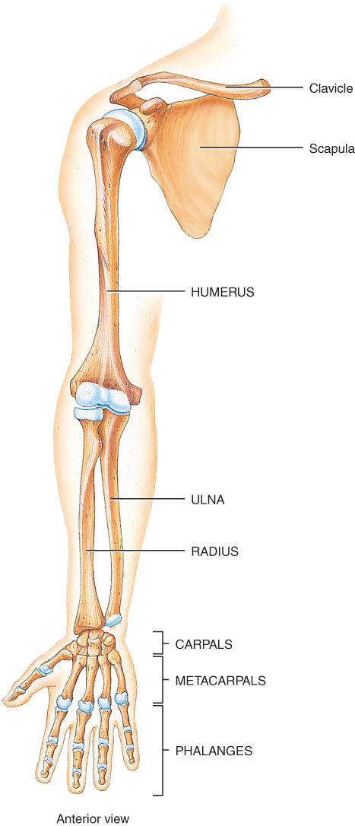
Upper Extremity
Each upper limb = 30 bones
humerus within the arm
ulna & radius within the forearm
carpal bones within the wrist
metacarpal bones within the palm
phalanges in the fingers
Joints
shoulder (glenohumeral), elbow, wrist, metacarpophalangeal, interphalangeal

Slide 12
Humerus
The humerus is the longest and largest bone of the upper limb (Figure 8.5).
It articulates proximally with the scapula and distally at the elbow with both the radius and ulna.

Slide 13
Humerus --- Proximal End
Part of shoulder joint
Head & anatomical neck
Greater & lesser tubercles for muscle attachments
Intertubercular
sulcus or bicipital
groove
Surgical neck is
fracture site
Deltoid tuberosity
Shaft

Slide 14
Humerus --- Distal End anterior and posterior
Forms elbow joint with
ulna and radius
Capitulum
articulates with head of radius
Trochlea
articulation with ulna
Olecranon fossa
posterior depression for olecranon process of ulna
Medial & lateral epicondyles
attachment of forearm muscles

Slide 15
Ulna and Radius
The ulna is located on the medial aspect of the forearm (Figure 8.6).
The radius is located on the lateral aspect (thumb side) of the forearm (Figure 8.6)
The radius and ulna articulate with the humerus at the elbow joint (Figure 8.7a), with each other (Figure 8.7b, c), and with three carpal bones. (Figure 8.8)

Slide 16
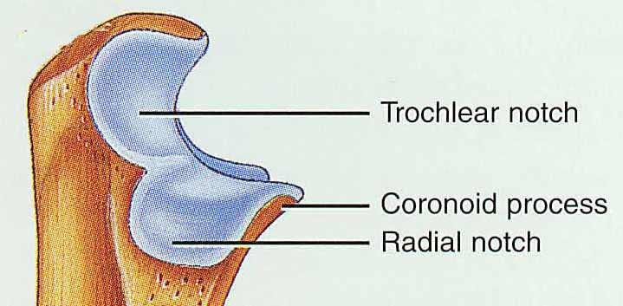
Ulna & Radius --- Proximal End
Ulna (on little finger side)
trochlear notch articulates with humerus & radial notch with radius
olecranon process forms point of elbow
Radius (on thumb side)
head articulates with capitulum of humerus & radial notch of ulna
tuberosity for muscle attachment

Slide 17
Ulna & Radius --- Proximal End
Ulna (on little finger side)
trochlear notch articulates with humerus & radial notch with radius
olecranon process forms point of elbow
Radius (on thumb side)
head articulates with capitulum of humerus & radial notch of ulna
tuberosity for muscle attachment

Slide 18
Elbow Joint
Articulation of humerus with ulna and radius
Ulna articulates with trochlea of humerus
Radius articulates with capitulum of humerus
Interosseous membrane between ulna & radius provides site for muscle attachment

Slide 19
Ulna and Radius - Distal End
Ulna --styloid process
head separated from wrist joint by fibrocartilage disc
Radius
forms wrist joint with scaphoid, lunate & triquetrum
forms distal radioulnar joint with head of ulna

Slide 20
Carpals, Metacarpal, and Phalanges
The eight carpal bones, bound together by ligaments, comprise the wrist (Figure. 8.8).
Five metacarpal bones are contained in the palm of each hand (Figure 8.8).
Each hand contains 14 phalanges, three in each finger and two in each thumb (Figure 8.8).

Slide 21
8 Carpal Bones (wrist)
Proximal row - lat to med
scaphoid - boat shaped
lunate - moon shaped
triquetrum - 3 corners
pisiform - pea shaped
Distal row - lateral to medial
trapezium - four sided
trapezoid - four sided
capitate - large head
hamate - hooked process
Carpal tunnel--tunnel of bone & flexor retinaculum

Slide 22
Metacarpals and Phalanges
Metacarpals
5 total----#1 proximal to thumb
base, shaft, head
knuckles (metacarpophalangeal joints)
Phalanges
14 total: each is called phalanx
proximal, middle, distal on each finger, except thumb
base, shaft, head

Slide 23
Hand

Slide 24
PELVIC (HIP) GIRDLE
The pelvic (hip) girdle consists of two hipbones (coxal bones) and provides a strong and stable support for the lower extremities, on which the weight of the body is carried (Figure 8.9).
Each hipbone (coxal bone) is composed of three separate bones at birth: the ilium, pubis, and ischium.
These bones eventually fuse at a depression called the acetabulum, which forms the socket for the hip joint (Figure 8.10a).

Slide 25
Pelvic Girdle and Hip Bones
Pelvic girdle = two hipbones united at pubic symphysis
articulate posteriorly with sacrum at sacroiliac joints
Each hip bone = ilium, pubis, and ischium
fuse after birth at acetabulum
Bony pelvis = 2 hip bones, sacrum and coccyx

Slide 26
The Ilium
The larger of the three components of the hip bone and articulates (fuses) with the ischium and pubis (Figure 8.10b,c).
Bone marrow aspiration or bone marrow biopsy are frequently performed on the iliac crest in adults.
The ischium is the inferior, posterior portion of the hip bone (Figure 8.10b,c).
The pubis is the anterior and inferior part of the hip bone (Figure 8.10b,c).

Slide 27
Ilium
Iliac crest and iliac spines for muscle attachment
Iliac fossa for muscle attachment
Gluteal lines indicating muscle attachment
Sacroiliac joint at auricular surface & iliac tuberosity
Greater sciatic notch for sciatic nerve

Slide 28
Ischium and Pubis
Ischium
ischial spine & tuberosity
lesser sciatic notch
ramus
Pubis
body
superior & inferior ramus
pubic symphysis is pad of fibrocartilage between 2 pubic bones

Slide 29
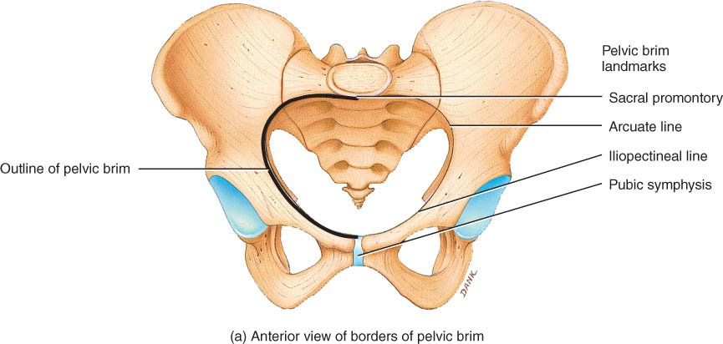
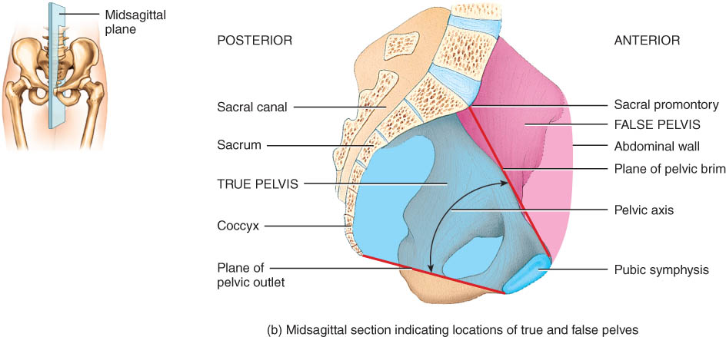
Pelvis
Pelvis = sacrum, coccyx & 2 hip bones
Pelvic brim
sacral promontory to symphysis pubis
separates false from true pelvis
false pelvis holds only abdominal organs
Inlet & outlet
Pelvic axis = path of babies head

Slide 30
True and False Pelves
Together with the sacrum and coccyx, the two hipbones (coxal bones) form the pelvis.
The greater (false) and lesser (true) pelvis are anatomical subdivisions of this basin-like structure (Figure 8.11a).
Pelvimetry, the measurement of the size of the inlet and the outlet of the birth canal, is important during pregnancy

Slide 31
Female and Male Skeletons
Male skeleton
larger and heavier
larger articular surfaces
larger muscle attachments
Female pelvis
wider & shallower
larger pelvic inlet & outlet
more space in true pelvis
pubic arch >90 degrees

Slide 32
COMPARISON OF FEMALE AND MALE PELVES
Male bones are generally larger and heavier than those of the female; the male’s joint surfaces also tend to be larger.
Muscle attachment points are more well-defined in the bones of a male than of a female due to the larger size of the muscles in males.
A number of anatomical differences exist between the pelvic girdles of females and those of males, primarily related to the need for a larger pelvic outlet in females to facilitate childbirth (Table 8.1).

Slide 33
Female Male

Slide 34
COMPARISON OF PECTORAL AND PELVIC GIRDLES
The pectoral girdle does not directly articulate with the vertebral column; the pelvic girdle does.
The pectoral girdle sockets are shallow and maximize movement; those of the pelvic girdle are deeper and allow less movement.
The structure of the pectoral girdle offers more movement than strength; the pelvic girdle, more strength than movement.

Slide 35
LOWER LIMB (EXTREMITY)
Each lower extremity is composed of 30 bones, including the femur, tibia, fibula, tarsals, metatarsals, and phalanges (Figure 8.12).

Slide 36
Lower Extremity
Each lower limb = 30 bones
femur and patella within the thigh
tibia & fibula within the leg
tarsal bones in the foot
metatarsals within the forefoot
phalanges in the toes
Joints
hip, knee, ankle
proximal & distal tibiofibular
metatarsophalangeal

Slide 37
Femur
The femur or thighbone is the largest, heaviest, and strongest bone of the body (Figure 8.13a, b).
It articulates with the hip bone and the tibia.
head articulates with acetabulum (attached by ligament of head of femur)
medial & lateral condyles articulate with tibia
neck is common fracture site
greater & lesser trochanters, linea aspera, & gluteal tuberosity-- muscle attachments
patellar surface is visible anteriorly between condyles

Slide 38
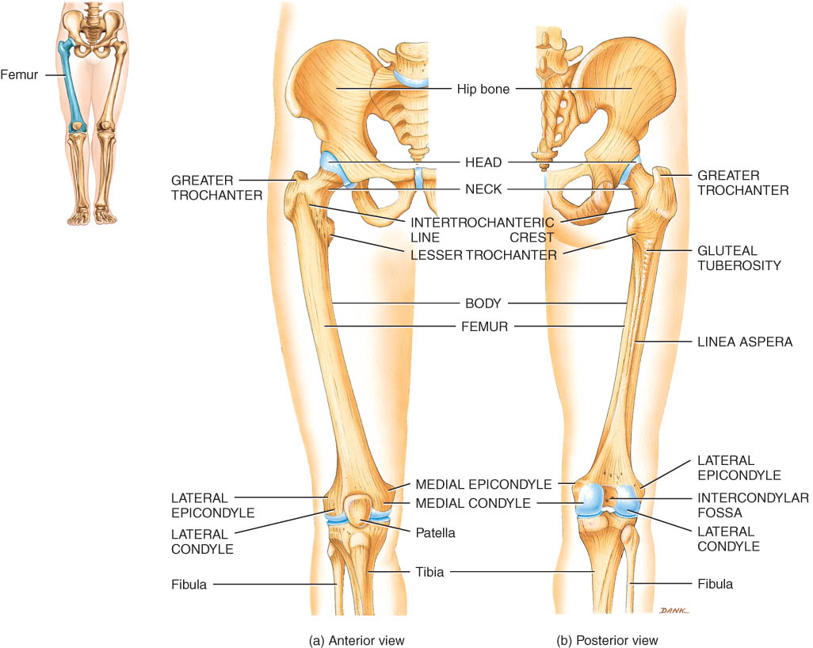
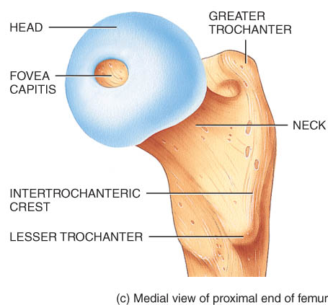
Femur

Slide 39
Patella
The patella or kneecap is a sesamoid bone located anterior to the knee joint (Figure 8.14).
It functions to increase the leverage of the tendon of the quadriceps femoris muscle, to maintain the position of the tendon when the knee is bent, and to protect the knee joint.
Patellofemoral stress syndrome is a common knee problem in runners.

Slide 40
Patella
triangular sesamoid bone
increases leverage of quadriceps femoris tendon

Slide 41
Tibia and Fibula
The tibia or shinbone is the larger, medial, weight-bearing bone of the leg (Figure 8.15).
The fibula is parallel and lateral to the tibia (Figure 8.15).

Slide 42
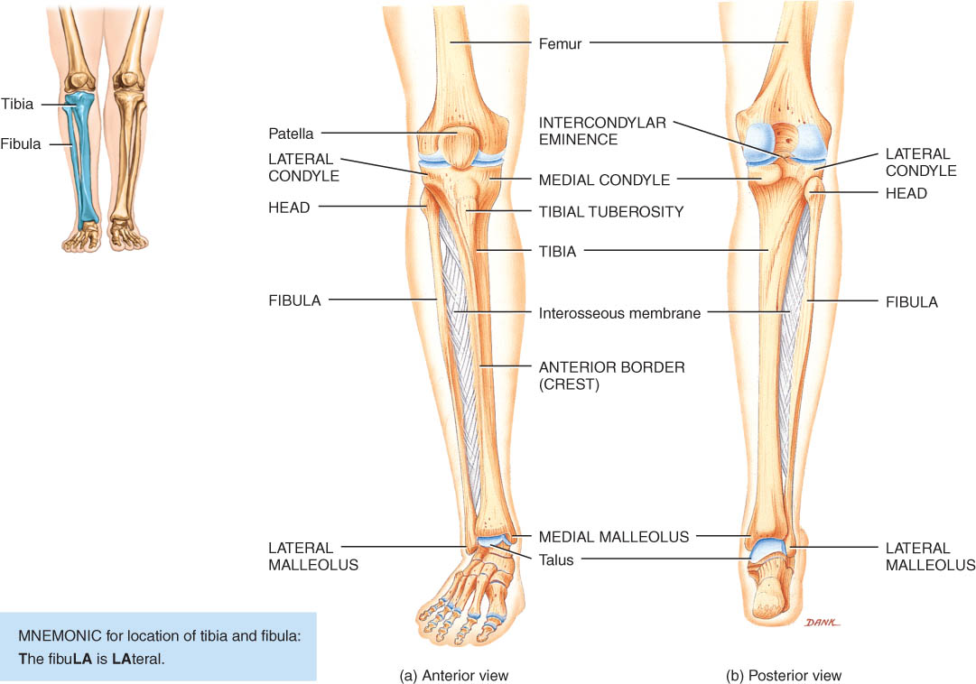
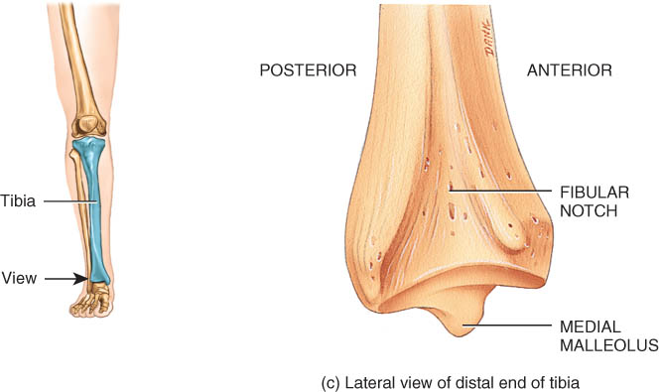
Tibia and Fibula
Tibia
medial & larger bone of leg
weight-bearing bone
lateral & medial condyles
tibial tuberosity for patellar lig.
proximal tibiofibular joint
medial malleolus at ankle

Slide 43
Tibia and Fibula
Fibula
not part of knee joint
muscle attachment only
lateral malleolus at ankle
lateral view of tibia

Slide 44
Tarsals, Metatarsals, and Phalanges
Seven tarsal bones constitute the ankle and share the weight associated with walking (Figure 8.16).
Five metatarsal bones are contained in the foot (Figure 8.16).
Fractures of the metatarsals are common among dancers, especially ballet dancers.
The arrangement of phalanges in the toes is the same as that described for the fingers and thumb above - fourteen bones in each foot (Figure 8.16).

Slide 45
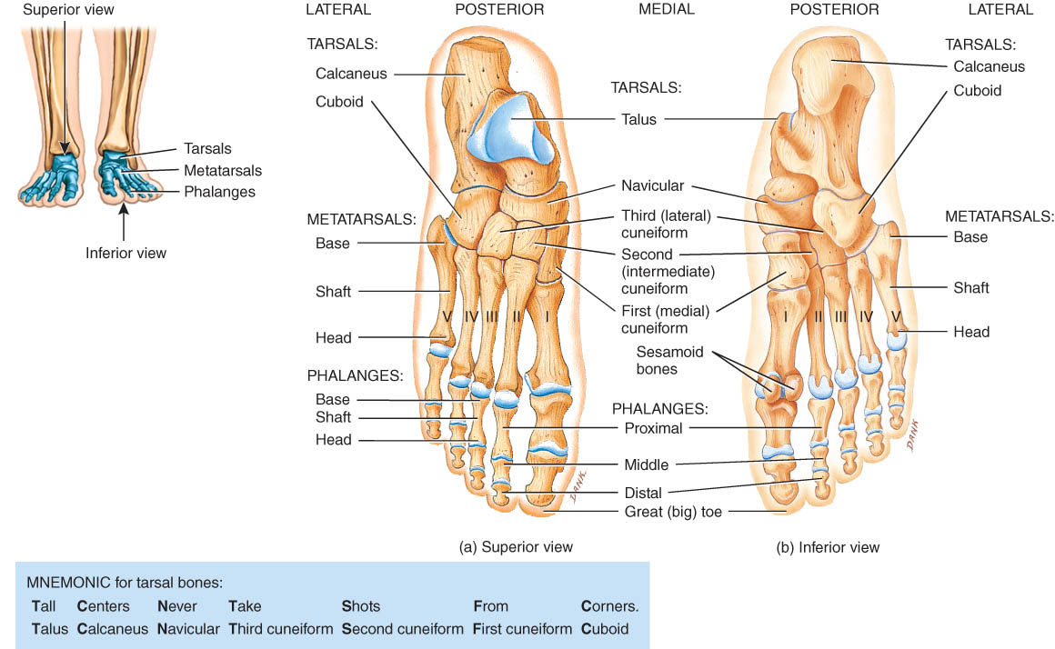
Tarsus
Proximal region of foot (contains 7 tarsal bones)
Talus = ankle bone (articulates with tibia & fibula)
Calcaneus - heel bone
Cuboid, navicular & 3 cuneiforms

Slide 46
Metatarsus and Phalanges
Metatarsus
midregion of the foot
5 metatarsals (1 is most medial)
each with base, shaft and head
Phalanges
distal portion of the foot
similar in number and arrangement to the hand
big toe is hallux

Slide 47
Arches of the Foot
The bones of the foot are arranged in two non-rigid arches that enable the foot to support the weight of the body; provide an ideal distribution of body weight over the hard and soft tissues, and provide leverage while walking (Figure 8.17).
Flatfoot, clawfoot, and clubfoot are caused by decline, elevation, or rotation of the medial longitudinal arches.

Slide 48
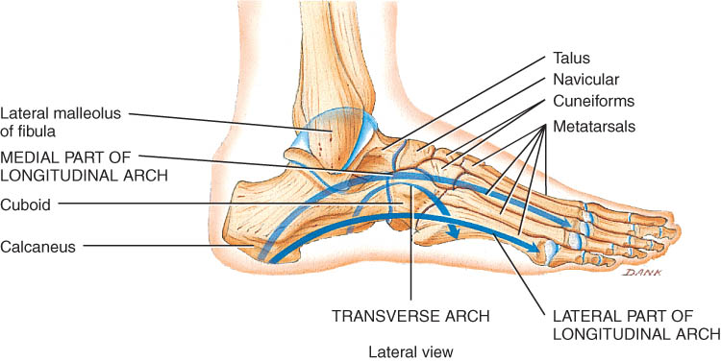
Arches of the Foot
Function
distribute body weight over foot
yield & spring back when weight is lifted
Longitudinal arches along each side of foot
Transverse arch across midfoot region
navicular, cuneiforms & bases of metatarsals

Slide 49
Clinical Problems
Flatfoot
weakened ligaments allow bones of medial arch to drop
Clawfoot
medial arch is too elevated
Hip fracture
1/2 million/year in US
osteoporosis
arthroplasty

Slide 50
DEVELOPMENTAL ANATOMY OF THE SKELETAL SYSTEM
Bone forms from mesoderm by intramembranous or endochondrial ossification. (Figure 6.6)
The skull begins development during the fourth week after fertilization (Figure 8.18a)
Vertebrae are derived from portions of cube-shaped masses of mesoderm called somites (Figure 10.10)
Around the fifth week of embryonic life, extremities develop from limb buds, which consist of mesoderm and ectoderm (Figure8.18b).
By the sixth week, a constriction around the middle portion of the limb buds produces hand plates and foot plates, which will become hands and feet. (Figure8.18c)
By the seventh week, the arm, forearm and hand are evident in the upper limb bud and the thigh, leg, and foot appear in the lower limb bud. (Figure8.18d)
By the eighth week the limb buds have developed into limbs. (Figure8.18e)

Slide 51
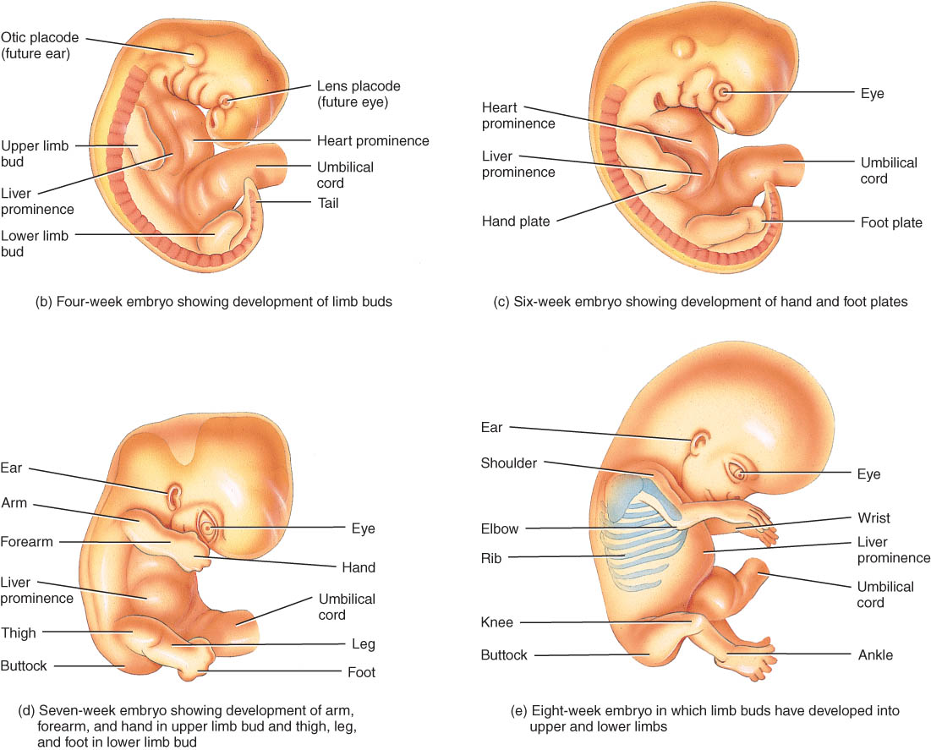

Slide 52
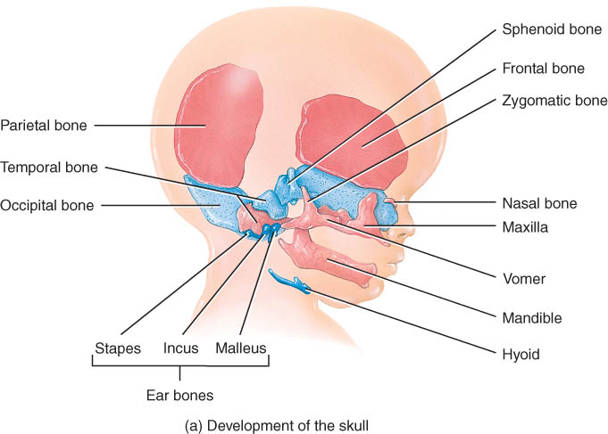

Slide 53
end

