Slide 1
Chapter 9
Joints

Slide 2
INTRODUCTION
A joint (articulation or arthrosis) is a point of contact between two or more bones, between cartilage and bones, or between teeth and bones.
The scientific study of joints is called arthrology.

Slide 3
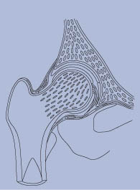
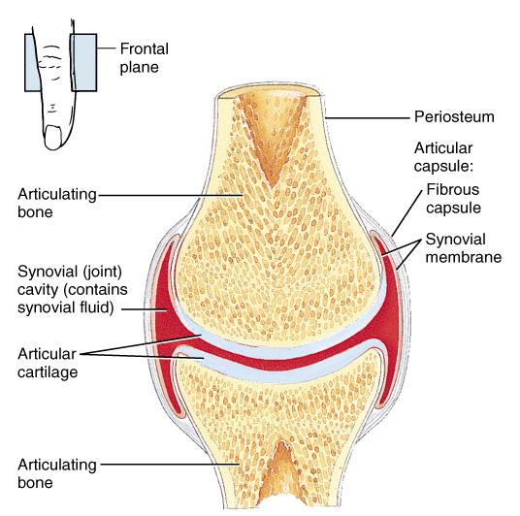
Chapter 9 Joints
Joints hold bones together but permit movement
Point of contact
between 2 bones
between cartilage and bone
between teeth and bones
Arthrology = study of joints
Kinesiology = study of motion

Slide 4
Classification of Joints
Structural classification is based on the presence or absence of a synovial (joint) cavity and type of connecting tissue. Structurally, joints are classified as
fibrous, cartilaginous, or synovial.
Functional classification based on the degree of movement:
immovable = synarthrosis
slightly movable = amphiarthrosis
freely movable = diarthrosis

Slide 5
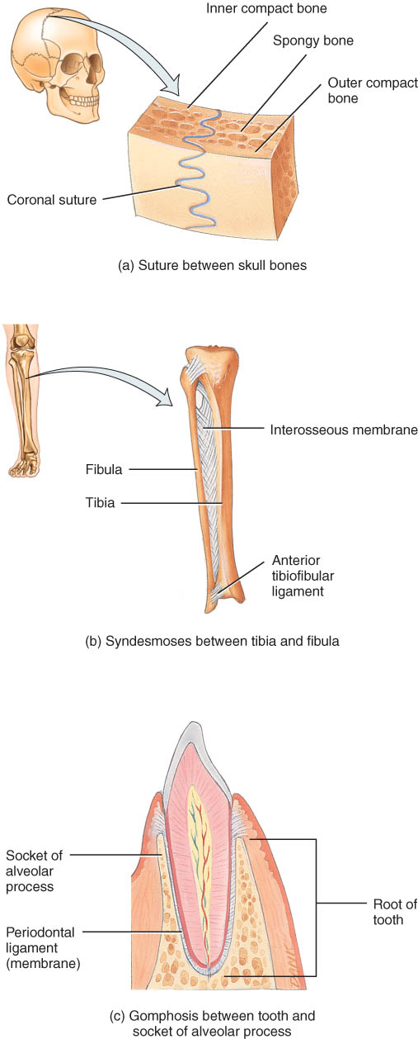
Fibrous Joints
Lack a synovial cavity
Bones held closely together by fibrous connective tissue
Permit little or no movement (synarthroses or amphiarthroses)
3 structural types
sutures
syndesmoses
gomphoses

Slide 6
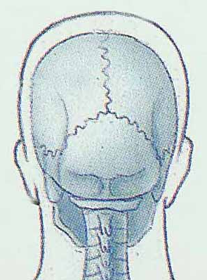
Sutures
A suture is a fibrous joint composed of a thin layer of dense fibrous connective tissue that unites skull bones.
Immovable (synarthrosis)
If fuse completely in adults is synostosis
Example – frontal suture between left and right ides sides of the frontal bone

Slide 7
Syndesmosis
Fibrous joint in which there is more fibrous connective tissue than in a suture
bones united by ligament
Slightly movable (amphiarthrosis)

Slide 8
Gomphosis
Ligament holds cone-shaped peg in bony socket
Immovable (amphiarthrosis)
Example – root of a tooth in its socket

Slide 9
Cartilaginous Joints
Lacks a synovial cavity
Allows little or no movement
Bones tightly connected by fibrocartilage or hyaline cartilage
2 types
synchondroses
symphyses

Slide 10
Synchondrosis
Connecting material is hyaline cartilage
Immovable (synarthrosis)
Epiphyseal plate or joints between ribs and sternum

Slide 11
Symphysis
Connecting material is a disc of fibrocartilage
Slightly movable (amphiarthroses)
Intervertebral discs and pubic symphysis

Slide 12
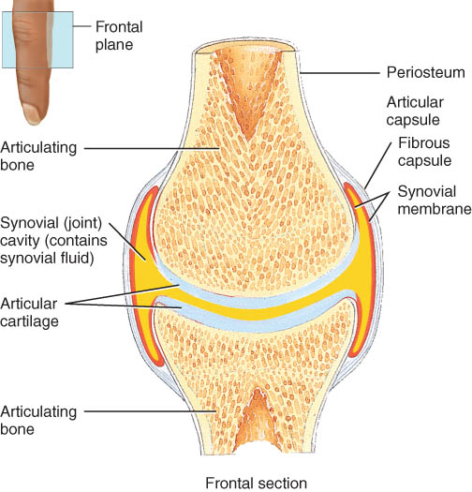
Synovial Joints
Synovial cavity separates articulating bones
Freely moveable (diarthrotic)
Articular cartilage
Covers bones at synovial joints
reduces friction
absorbs shock
Articular capsule
surrounds joint
thickenings in fibrous capsule called ligaments
Synovial membrane
inner lining of capsule

Slide 13
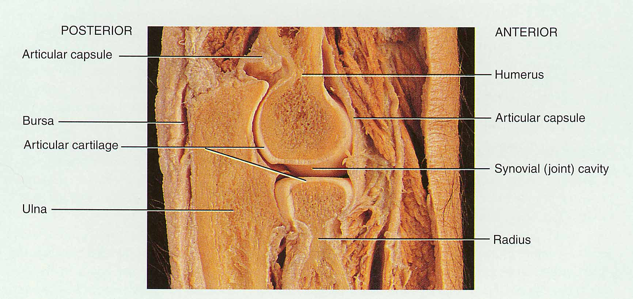
Example of Synovial Joint
Joint space is synovial joint cavity
Articular cartilage covering ends of bones
Articular capsule

Slide 14
Techniques for cartilage replacement
In cartilage transplantation chondrocytes are removed from the patient, grown in culture, and then placed in the damaged joint.
Eroded cartilage may be replaced with synthetic materials
Researchers are also examining the use of stem cells to replace cartilage.

Slide 15
Articular Capsule
The articular capsule surrounds a diarthrosis, encloses the synovial cavity, and unites the articulating bones.
The articular capsule is composed of two layers - the outer fibrous capsule (which may contain ligaments) and the inner synovial membrane (which secretes a lubricating and joint-nourishing synovial fluid).
The flexibility of the fibrous capsule permits considerable movement at a joint, whereas its great tensile strength helps prevent bones from dislocating.
Other capsule features include ligaments and articular fat pads

Slide 16
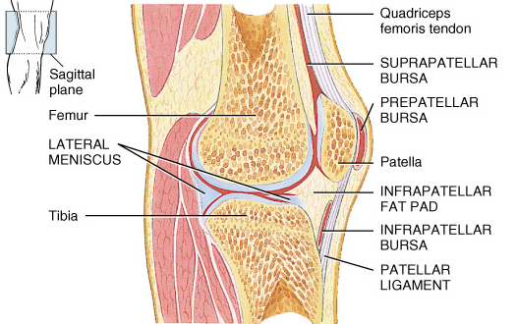
Special Features
Synovial Membrane
secretes synovial fluid which lubricates
and reduces friction in the joint and supplies nutrients to and removes metabolic wastes from the joint
- When there is a buildup of this fluid, the fluid may be aspirated and medications may be injected into the cavity.
Accessory ligaments
Hold bone to bone
Articular discs or menisci
Modify the shape of the joint surfaces of the articulating bones, help maintain the stability of the joint, and direct the flow of synovial fluid to the areas of greatest friction.
Torn cartilage is damage to the articular dics that lie between the ends of some bones & is usually fixed by arthroscopy

Slide 17
Nerve and Blood Supply
Nerves to joints are the same as those that supply the skeletal muscles that move the joint.
Joint capsule and ligaments contain pain fibers and sensory receptors
Blood supply to the structures of a joint are branches from nearby structures
Numerous arteries and veins supply the joints and surrounding structures except the articular cartilage which is supplied from the synovial fluid

Slide 18
Sprain versus Strain
Sprain
Is the forcible twisting of joint that stretches or tears ligaments but no dislocation of the bones
may damage nearby blood vessels, muscles or tendons
swelling & hemorrhage from blood vessels
ankle if frequently sprained
Strain
generally less serious injury
overstretched or partially torn muscle

Slide 19
Bursae and Tendon Sheaths
Bursae
Are synovial fluid filled saclaike structures that cushion the movement of one body part over another.
Tendon sheaths
tubelike bursae that wrap around tendons where there is considerble friction such as the shoulder joint
Bursitis
chronic inflammation of a bursa

Slide 20
TYPES OF MOVEMENT AT SYNOVIAL JOINTS

Slide 21
Gliding Movements
Gliding movements occur when relatively flat bone surfaces move back and forth and from side to side with respect to one another.
In gliding joints there is no significant alteration of the angle between the bones.
Gliding movements occur at plantar joints.

Slide 22
Angular Movements
In angular movements there is an increase or a decrease in the angle between articulating bones. Three principle types are flexion, extension, and hyperextension.
Flexion results in a decrease in the angle between articulating bones.
Lateral flexion involves the movement of the trunk sideways to the right or left at the waist. The movement occurs in the frontal plane and involves the intervertebral joints.
Extension results in an increase in the angle between articulating bones.
Hyperextension is a continuation of extension beyond the anatomical position and is usually prevented by the arrangement of ligaments and the anatomical alignment of bones.

Slide 23
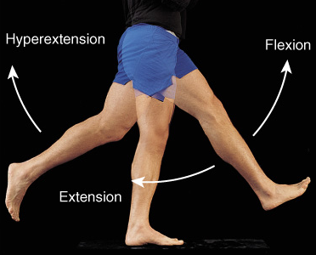
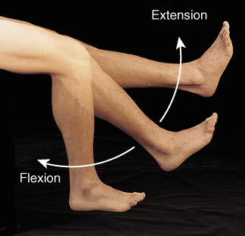
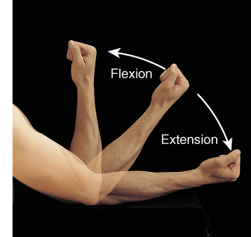
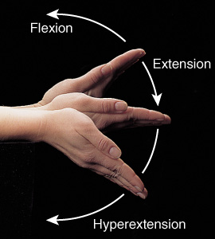
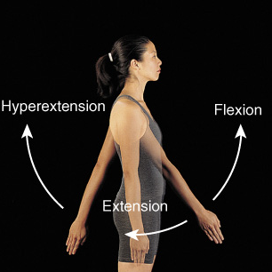
Flexion, Extension & Hyperextension

Slide 24
Abduction, Adduction, and Circumduction
Abduction refers to the movement of a bone away from the midline.
Adduction refers to the movement of a bone toward the midline.
Circumduction refers to movement of the distal end of a part of the body in a circle.
Circumduction occurs as a result of a continuous sequence of flexion, abduction, extension, and adduction.
Condyloid, saddle, and ball-and-socket joints allow circumduction.

Slide 25
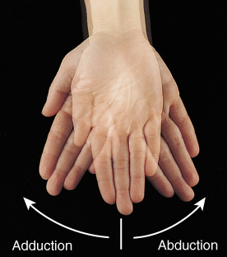
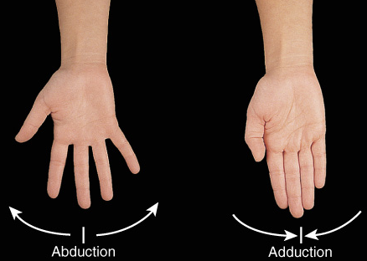
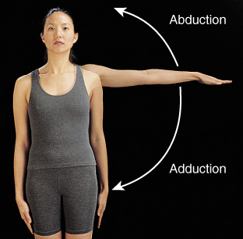
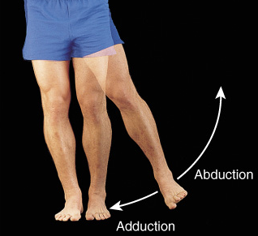
Abduction and Adduction
Condyloid joints
Ball and Socket joints

Slide 26
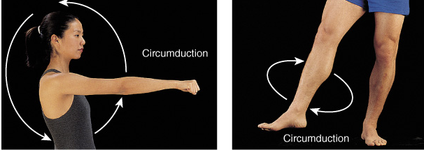
Circumduction
Movement of a distal end of a body part in a circle
Combination of flexion, extension, adduction and abduction
Occurs at ball and socket, saddle and condyloid joints

Slide 27
In rotation, a bone revolves around its own longitudinal axis.
Pivot and ball-and-socket joints permit rotation.
If the anterior surface of a bone of the limb is turned toward the midline, medial rotation occurs. If the anterior surface of a bone of the limb is turned away from the midline, lateral rotation occurs.

Slide 28
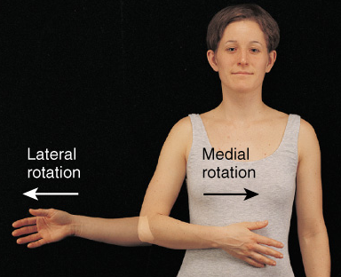
Rotation
Bone revolves around its own longitudinal axis
medial rotation is turning of anterior surface in towards the midline
lateral rotation is turning of anterior surface away from the midline
At ball & socket and pivot type joints

Slide 29
Special Movements
Elevation is an upward movement of a part of the body.
Depression is a downward movement of a part of the body.
Protraction is a movement of a part of the body anteriorly in the transverse plane.
Retraction is a movement of a protracted part back to the anatomical position.

Slide 30
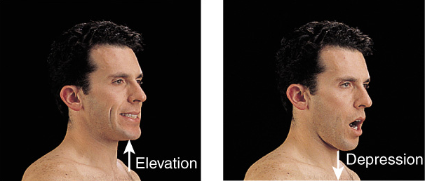
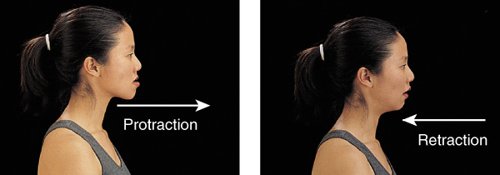
Special Movements of Mandible
Elevation = upward
Depression = downward
Protraction = forward
Retraction = backward

Slide 31
Special Movements
Inversion is movement of the soles medially at the intertarsal joints so that they face away from each other.
Eversion is a movement of the soles laterally at the intertarsal joints so that they face away from each other .
Dorsiflexion refers to bending of the foot at the ankle in the direction of the superior surface.
Plantar flexion involves bending of the foot at the ankle joint in the direction of the plantar surface.

Slide 32
Special Movements
Supination is a movement of the forearm at the proximal and distal radioulnar joints in which the palm is turned anteriorly or superiorly.
Pronation is a movement of the forearm at the proximal and distal radioulnar joints in which the distal end of the radius crosses over the distal end of the ulna and the palm is turned posteriorly or inferiorly.
Opposition is the movement of the thumb at the carpometacarpal joint in which the thumb moves across the palm to touch the tips of the finger on the same hand.
A dislocation or luxation is a displacement of a bone from a joint.

Slide 33
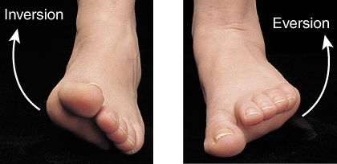
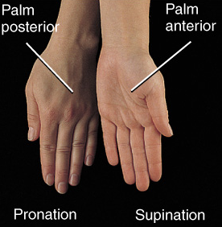
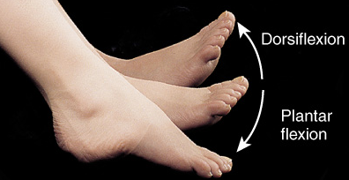
Special Hand & Foot Movements
Inversion
Eversion
Dorsiflexion
Plantarflexion
Pronation
Supination

Slide 34
TYPES OF SYNOVIAL JOINTS
Planar joints permit mainly side-to-side and back-and-forth gliding movements. These joints are nonaxial.

Slide 35
Planar Joint
Bone surfaces are flat or slightly curved
Side to side movement only
Rotation prevented by ligaments
Examples
intercarpal or intertarsal joints
sternoclavicular joint
vertebrocostal joints

Slide 36
TYPES OF SYNOVIAL JOINTS
A hinge joint contains the convex surface of one bone fitting into a concave surface of another bone. Movement is primarily flexion or extension in a single plane.

Slide 37
Hinge Joint
Convex surface of one bones fits into concave surface of 2nd bone
Uniaxial like a door hinge
Examples
Knee, elbow, ankle, interphalangeal joints
Movements produced
flexion = decreasing the joint angle
extension = increasing the angle
hyperextension = opening the joint beyond the anatomical position

Slide 38
TYPES OF SYNOVIAL JOINTS
In a pivot joint, a round or pointed surface of one bone fits into a ring formed by another bone and a ligament. Movement is rotational and monaxial.

Slide 39
Pivot Joint
Rounded surface of bone articulates with ring formed by 2nd bone & ligament
Monoaxial since it allows only rotation around longitudinal axis
Examples
Proximal radioulnar joint
supination
pronation
Atlanto-axial joint
turning head side to side “no”

Slide 40
TYPES OF SYNOVIAL JOINTS
In an condyloid joint, an oval-shaped condyle of one bone fits into an elliptical cavity of another bone. Movements are flexion-extension, abduction-adduction, and circumduction.

Slide 41
Condyloid or Ellipsoidal Joint
Oval-shaped projection fits into oval depression
Biaxial = flex/extend or abduct/adduct is possible
Examples
wrist and metacarpophalangeal joints

Slide 42
TYPES OF SYNOVIAL JOINTS
A saddle joint contains one bone whose articular surface is saddle-shaped and another bone whose articular surface is shaped like a rider sitting in the saddle. Movements are flexion-extension, abduction-adduction, and circumduction.

Slide 43
Saddle Joint
One bone saddled-shaped; other bone fits as a person would sitting in that saddle
Biaxial
Circumduction allows tip of thumb travel in circle
Opposition allows tip of thumb to touch tip of other fingers
Example
trapezium of carpus and metacarpal of the thumb

Slide 44
TYPES OF SYNOVIAL JOINTS
In a ball-and-socket joint, the ball-shaped surface of one bone fits into the cuplike depression of another. Movements are flexion-extension, abduction-adduction, rotation, and circumduction.

Slide 45
Ball and Socket Joint
Ball fitting into a cuplike depression
Multiaxial
flexion/extension
abduction/adduction
rotation
Examples (only two!)
shoulder joint
hip joint

Slide 46
SELECTED JOINTS OF THE BODY

Slide 47
Tempromandibular Joint (TMJ)
The TMJ is a combined hinge and planar joint formed by the condylar process of the mandible, the mandibular fossa, and the articular tubercle of the temporal bone.
Movements include opening and closing and protraction and retraction of the jaw.
When dislocation occurs, the mouth remains open.

Slide 48
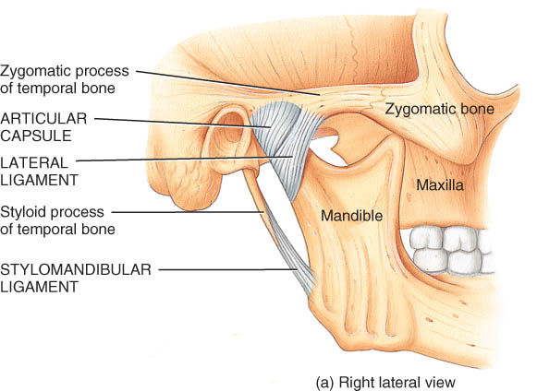
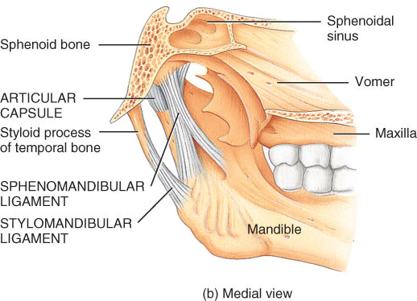
Temporomandibular Joint
Synovial joint
Articular disc
Gliding above disc
Hinge below disc
Movements
depression
elevation
protraction
retraction
lateral
medial

Slide 49
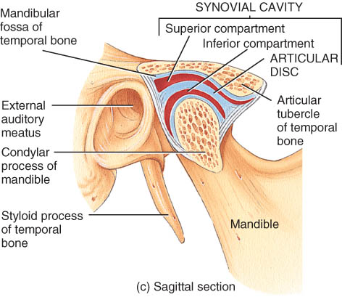
Temporoman-dibular Joint
Synovial joint
Articular disc
Gliding above disc
Hinge below disc
Movements
depression
elevation
protraction
retraction

Slide 50
Shoulder Joint
This is a ball-and-socket joint formed by the head of the humerus and the glenoid cavity of the scapula.
Movements at the joint include flexion, extension, abduction, adduction, medial and lateral rotation, and circumduction of the arm .
This joint shows extreme freedom of movement at the expense of stability.
Rotator cuff injury and dislocation or separated shoulder are common injuries to this joint.

Slide 51
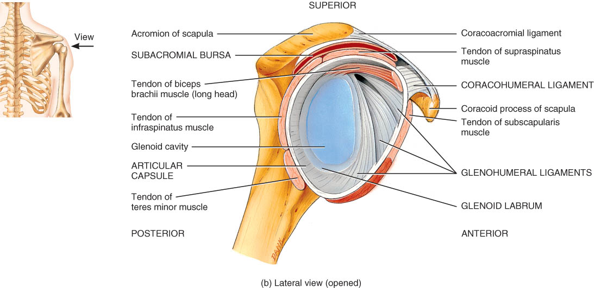
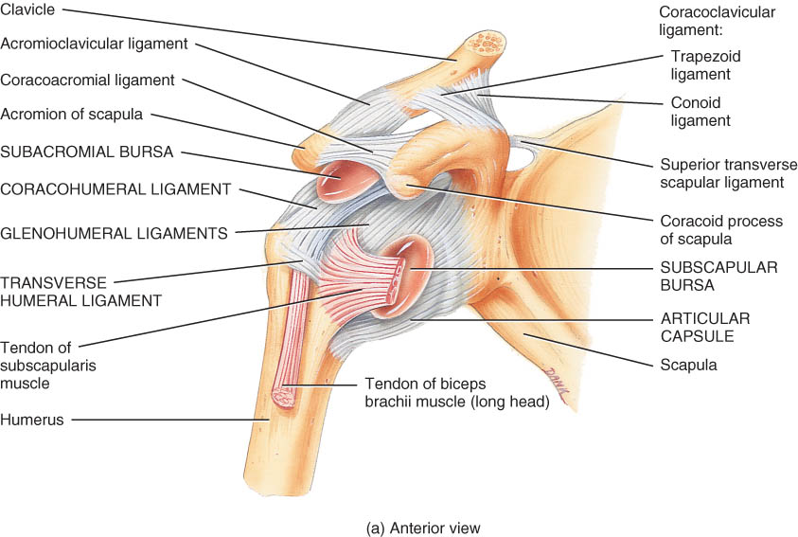
Shoulder Joint
Head of humerus and glenoid cavity of scapula
Ball and socket
All types of movement

Slide 52
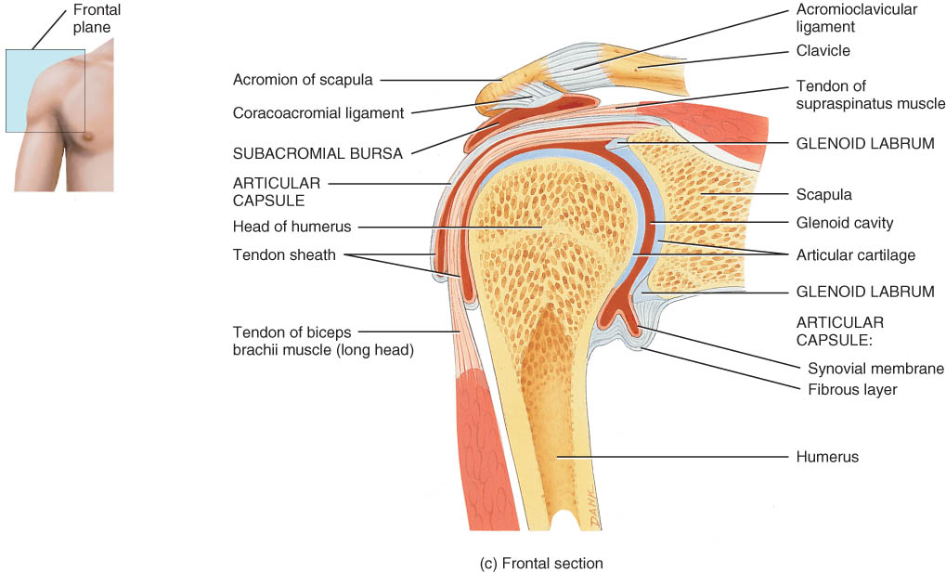
Glenohumeral (Shoulder) Joint
Articular capsule from glenoid cavity to anatomical neck
Glenoid labrum deepens socket
Many nearby bursa (subacromial)

Slide 53
Supporting Structures at Shoulder
Associated ligaments strengthen joint capsule
Transverse humeral ligament holds biceps tendon in place

Slide 54
Rotator Cuff Muscles
Attach humerus to scapula
Encircle the joint supporting the capsule
Hold head of humerus in socket

Slide 55
Elbow Joint
This is a hinge joint formed by the trochlea of the humerus, the trochlear notch of the ulna, and the head of the radius.
Movements at this joint are flexion and extension of the forearm.
Tennis elbow, little elbows, and dislocation of the radial head are common injuries to this joint.

Slide 56
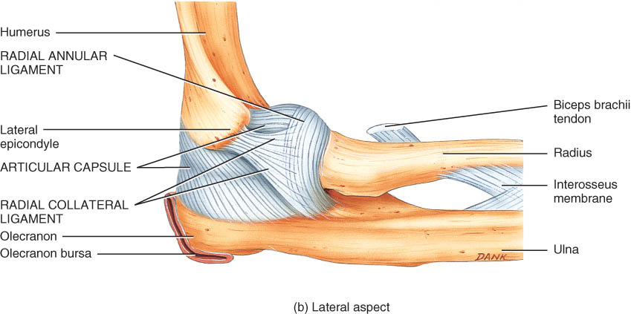
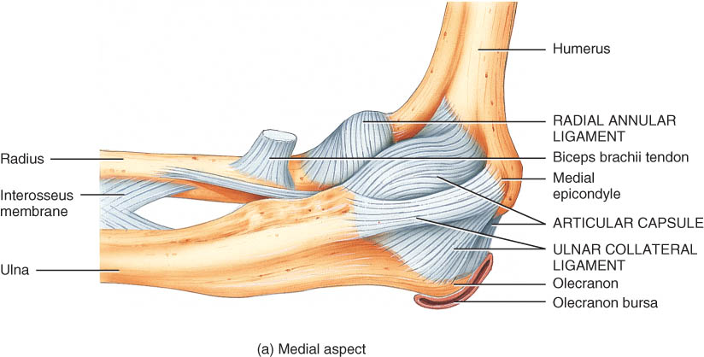
Articular Capsule of the Elbow Joint
lateral aspect
medial aspect
Radial annular ligament hold head of radius in place
Collateral ligaments maintain integrity of joint

Slide 57
Hip Joint
This ball-and-socket joint is formed by the head of the femur and the acetabulum of the hipbone.
Movements at this joint include flexion, extension, abduction, adduction, circumduction, and medial and lateral rotation of the thigh.
This is an extremely stable joint due to the bones making up the joint and the accessory ligaments and muscles.

Slide 58
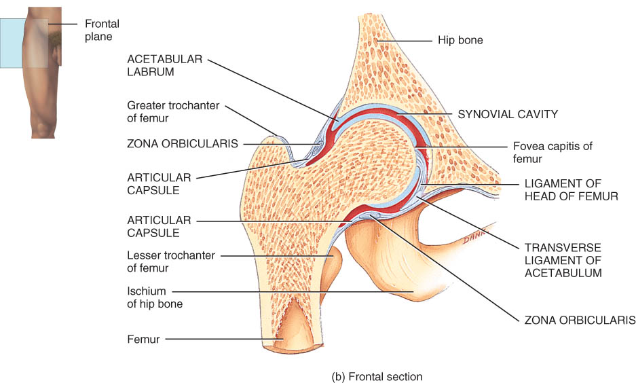
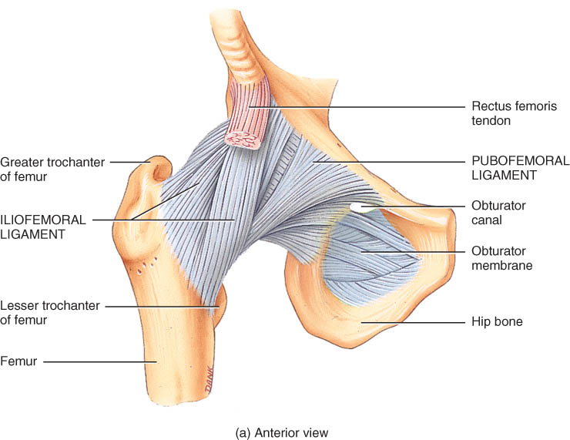
Hip Joint
Head of femur and acetabulum of hip bone
Ball and socket type of joint
All types of movement possible

Slide 59
Hip Joint Structures
Acetabular labrum
Ligament of the head of the femur
Articular capsule

Slide 60
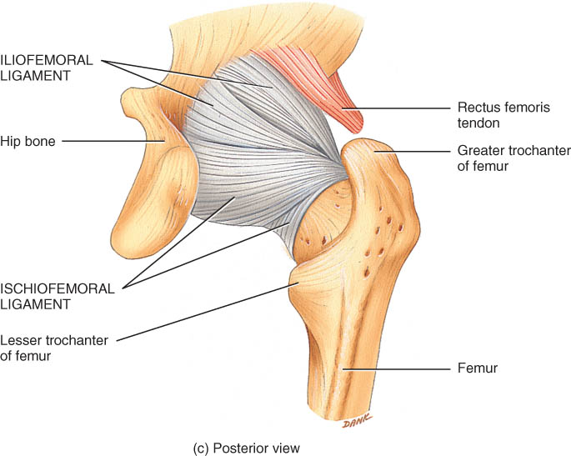
Hip Joint Capsule
Dense, strong capsule reinforced by ligaments
iliofemoral ligament
ischiofemoral ligament
pubofemoral ligament
One of strongest structures in the body

Slide 61
Knee Joints
This is the largest and most complex joint of the body and consists of three joints within a single synovial cavity.
Movements at this joint include flexion, extension, slight medial rotation, and lateral rotation of the leg in a flexed position.
Some common injuries are rupture of the tibial colateral ligament and a dislocation of the knee.

Slide 62
Tibiofemoral Joint
Between femur, tibia and patella
Hinge joint between tibia and femur
Gliding joint between patella and femur
Flexion, extension, and slight rotation of tibia on femur when knee is flexed

Slide 63
Tibiofemoral Joint
Articular capsule
mostly ligs & tendons
Lateral & medial menisci = articular discs
Many bursa
Vulnerable joint
Knee injuries damage ligaments & tendons since bones do not fit together well

Slide 64
External Views of Knee Joint
Patella is part of joint capsule anteriorly
Rest of articular capsule is extracapsular ligaments
Fibular and tibial collateral ligaments

Slide 65
Intracapsular Structures of Knee
Medial meniscus
C-shaped fibrocartilage
Lateral meniscus
nearly circular
Posterior cruciate ligament
Anterior cruciate ligament

Slide 66
FACTORS AFFECTING CONTACT AND RANGE OF MOTION AT SYNOVIAL JOINTS
Structure and shape of the articulating bone
Strength and tautness of the joint ligaments
Arrangement and tension of the muscles
Contact of soft parts
Hormones
Disuse
AGING AND JOINTS
Various aging effects on joints include decreased production of synovial fluid, a thinning of the articular cartilage, and loss of ligament length and flexibility.
The effects of aging on joints are due to genetic factors as well as wear and tear on joints.

Slide 67
Arthroscopy & Arthroplasty
Arthroscopy = examination of joint
instrument size of pencil
remove torn knee cartilages & repair ligaments
small incision only
Arthroplasty = surgical replacement of joints
Most common ones are knee, shoulder, and hip.

Slide 68
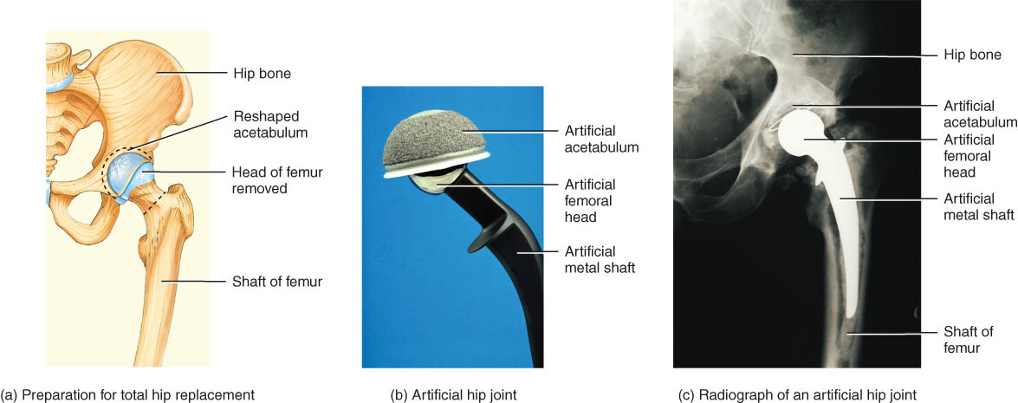
Hip Replacement

Slide 69
DISORDERS: HOMEOSTATIC IMBALANCES: Rheumatism and Arthritis

Slide 70
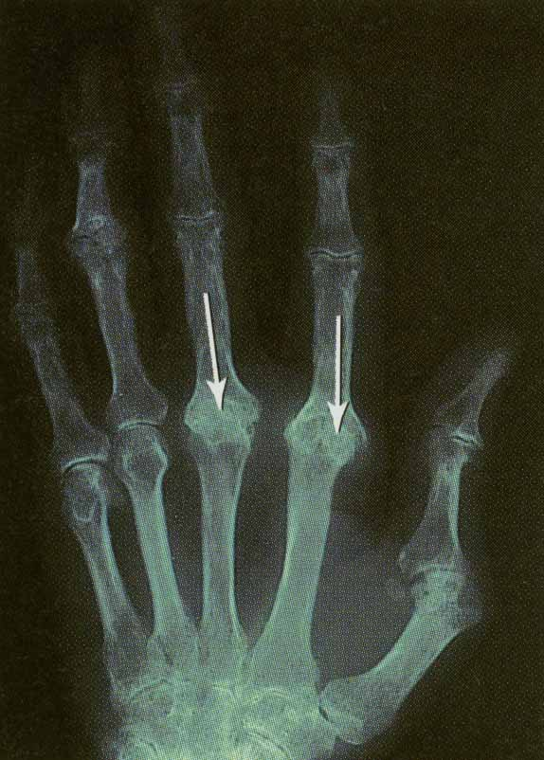
Rheumatoid Arthritis
Refers to bones, tendons, joints, ligaments, or muscles
Form of rheumatism in which the joints become inflamed
Body’s immune system attacks its own cartilage and joint linings resulting in loss of joint
Inflammation, swelling & pain
Final step is fusion of joint

Slide 71
DISORDERS: HOMEOSTATIC IMBALANCES: Rheumatism and Arthritis
Osteoarthritis is a degenerative joint disease commonly known as “wear-and-tear” arthritis. It is characterized by deterioration of articular cartilage and bone spur formation. It is noninflammatory and primarily affects weight-bearing joints.
Gouty arthritis is a condition in which sodium urate crystals are deposited in soft tissues of joints, causing inflammation, swelling, and pain. If not treated, bones at affected joints will eventually fuse, rendering the joints immobile.

Slide 72
DISORDERS: HOMEOSTATIC IMBALANCES:
Lyme disease is a bacterial disease which is transmitted by deer ticks. Symptoms include joint stiffness, fevers, chills, headache, and stiff neck.
Ankylosing spondylitis affects joints between the vertebrae and between the sacrum and hip bone. Its cause is unknown.
Ankle Sprains and Fractures: The ankle is the most frequently injured major joint. Sprains are the most common injury to the ankle.

Slide 73
THE
END!!!

