Slide 1
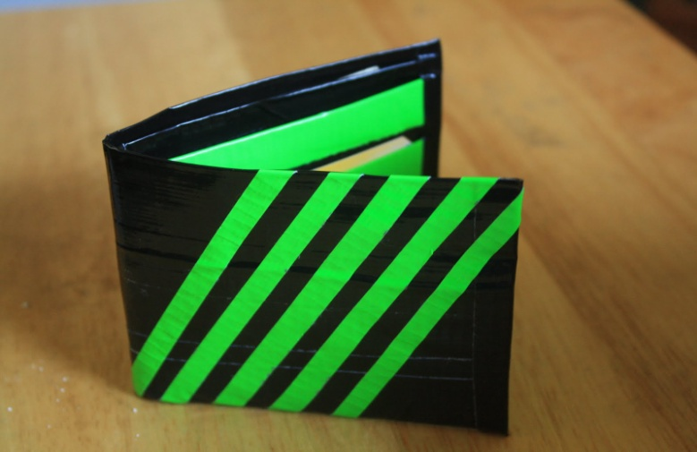
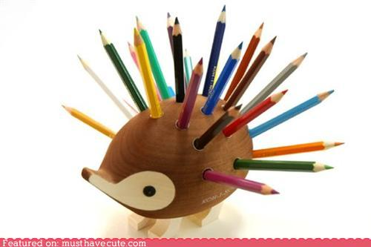
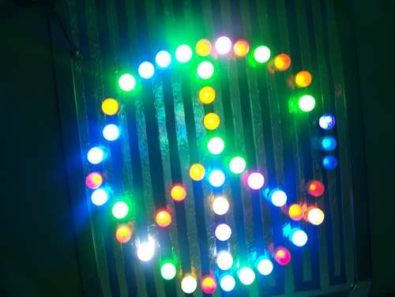
Kylee Fair
Flashlight,Wallet,Pencil Holder HAT

Slide 2
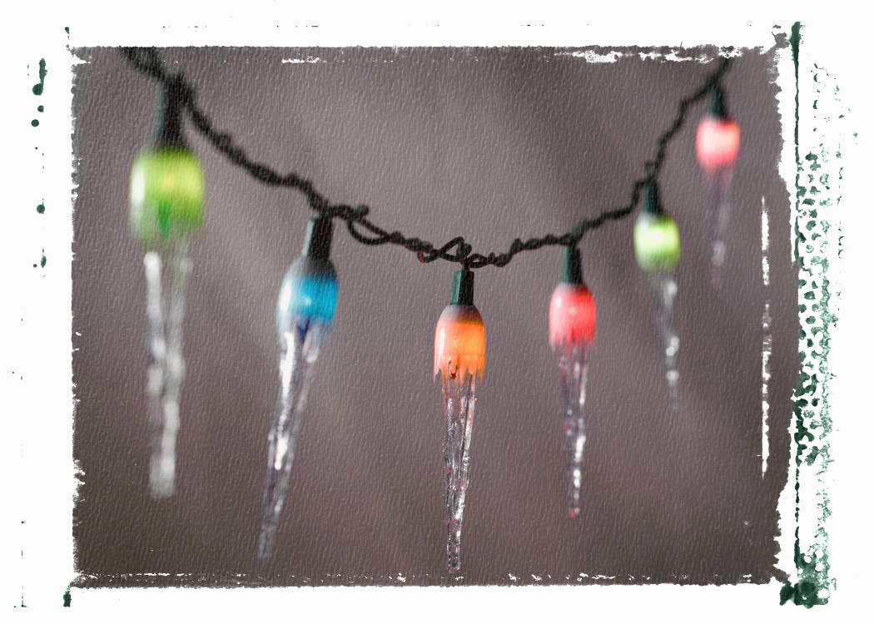
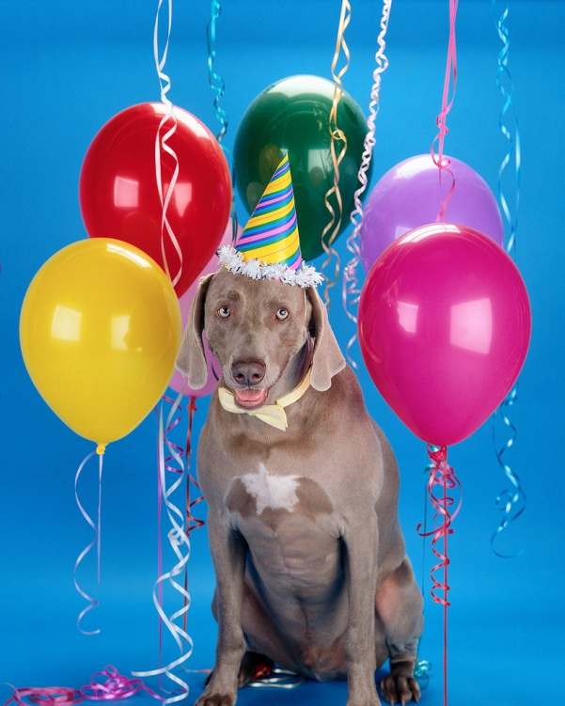
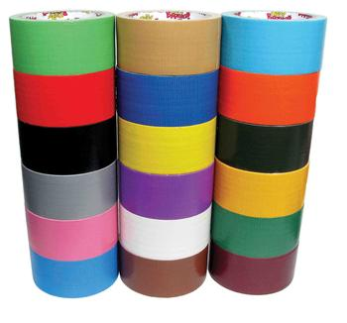
My Logs
December 23-Gatherd materials(Lights,Ducktape,Hat).
December 24-Started making invention

Slide 3
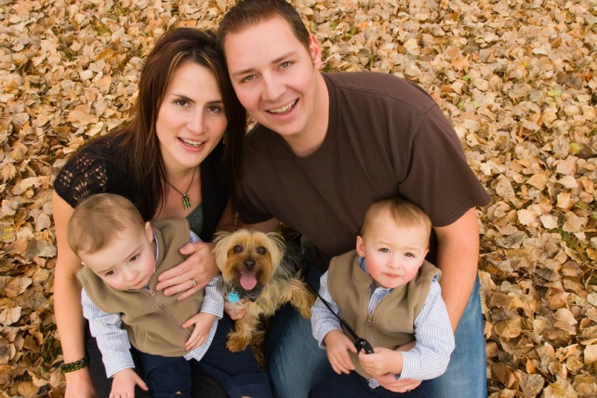
My Research
I looked on the computer to make sure my invention was new.
I also asked my parents and looked in a invention book to make sure my invention was new.

Slide 4
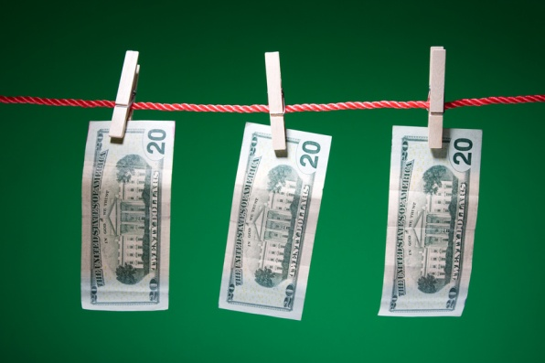
Advantages
My invention will help people so they don’t have to carry a wallet, pencil holder, and a flashlight
My invention wont be expensive and it wont be hard to make

Slide 5
Conclusion
Flashlight,Wallet,Pencil Holder HAT
My favorite thing about my invention is that it saves u time because if u need your wallet your pencil holder and a flashlight u can just put on the hat and u have what u need!!!!
I learned that making a invention takes time its not just something fast that u can make in a hour it takes time.

