Slide 1
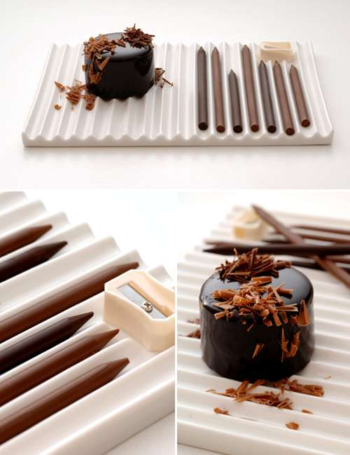
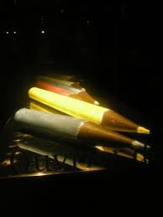
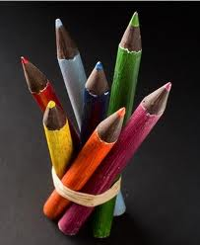
Dylan Tolusciak
Chocolate pencil

Slide 2
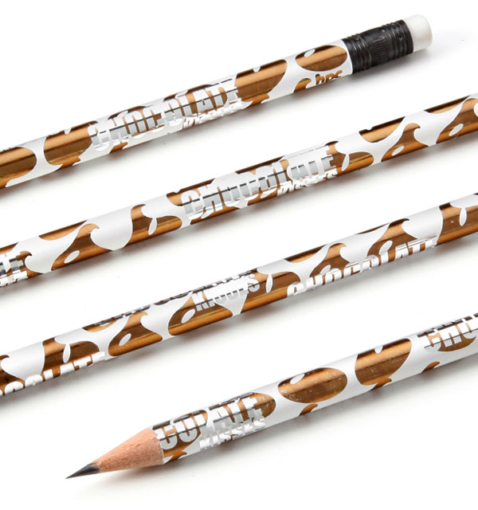
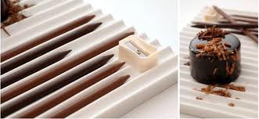
My log
First I will get chocolate.
Then I will melt the chocolate.
Then I will let it dry
Then I will carve it

Slide 3
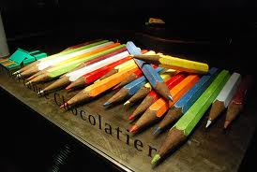
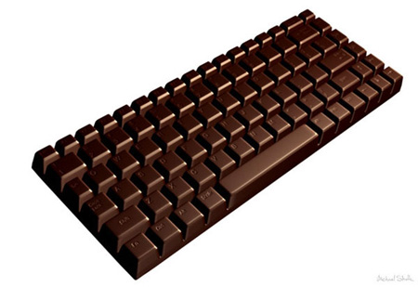
My research
I looked on the computer for chocolate.

Slide 4
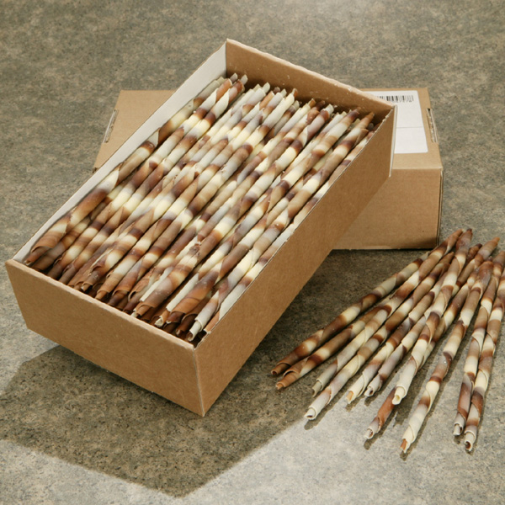
Advantages
My invention will help people when they are hungry.

Slide 5
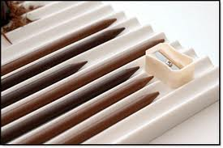
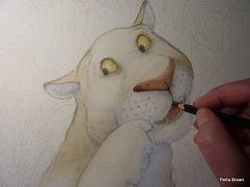
Conclusion
My invention is a chocolate pencil .
It is made out of chocolate.
It is hard to make an invention.

