Slide 1
Chapter 9
Re-expressing the Data:
Get It Straight!

Slide 2
Teaching Tips
As this chapter is mathematically rich, you might be tempted to spend a lot of time here. And indeed, you certainly can explore these concepts deeply for there is a lot to discover. However, this topic is only tested lightly on the AP test and most experienced teachers find that less is more with the number of days they spend on this chapter. The Teacher’s Resource Guide recommends six days.

Slide 3
Straight to the Point
We cannot use a linear model unless the relationship between the two variables is linear. Often re-expression can save the day, straightening bent relationships so that we can fit and use a simple linear model.
Two simple ways to re-express data are with logarithms and reciprocals.
Re-expressions can be seen in everyday life—everybody does it.

Slide 4
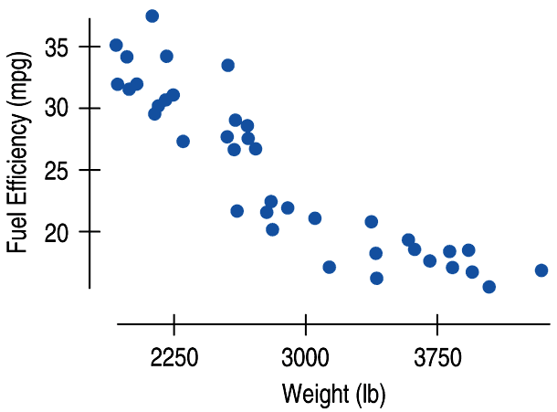
Straight to the Point (cont.)
The relationship between fuel efficiency (in miles per gallon) and weight (in pounds) for late model cars looks fairly linear at first:

Slide 5
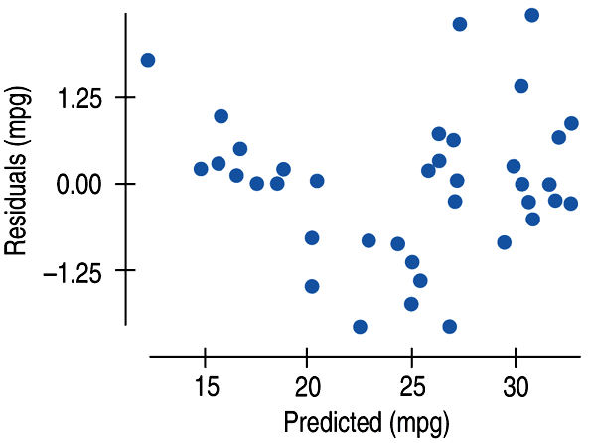
Straight to the Point (cont.)
A look at the residuals plot shows a problem:

Slide 6
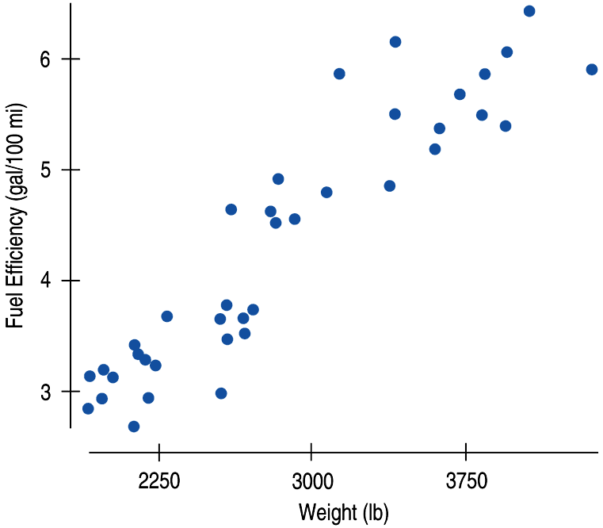
Straight to the Point (cont.)
We can re-express fuel efficiency as gallons per hundred miles (a reciprocal) and eliminate the bend in the original scatterplot:

Slide 7
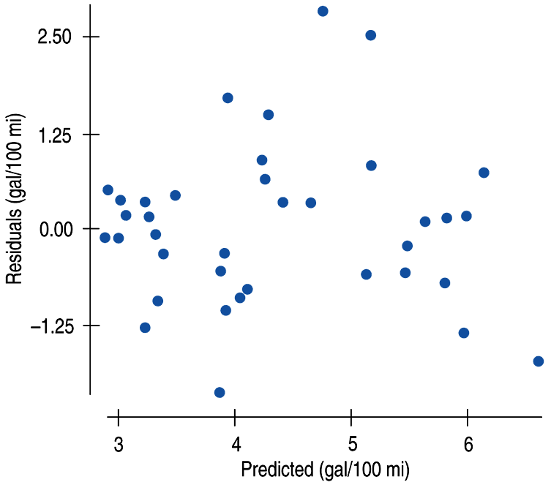
Straight to the Point (cont.)
A look at the residuals plot for the new model seems more reasonable:

Slide 8
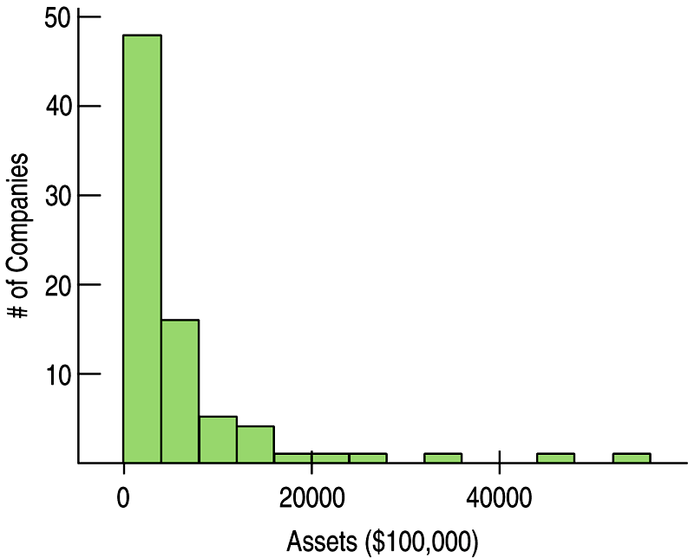
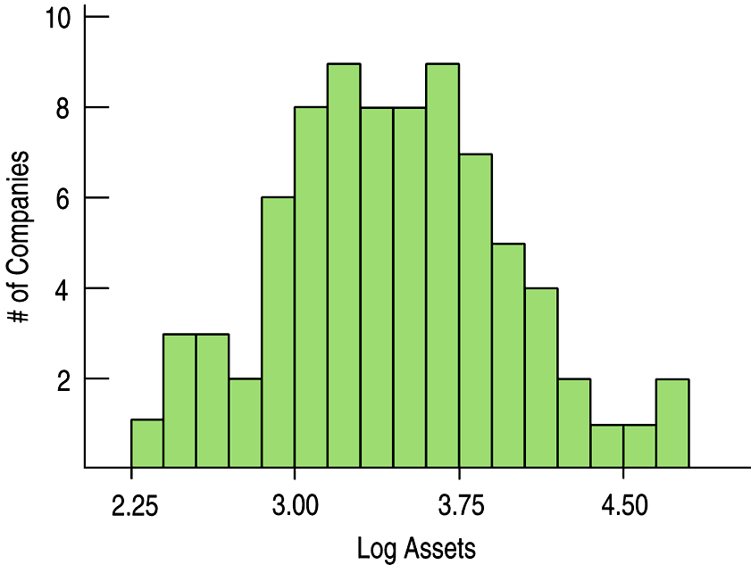
Goals of Re-expression
Goal 1: Make the distribution of a variable (as seen in its histogram, for example) more symmetric.

Slide 9
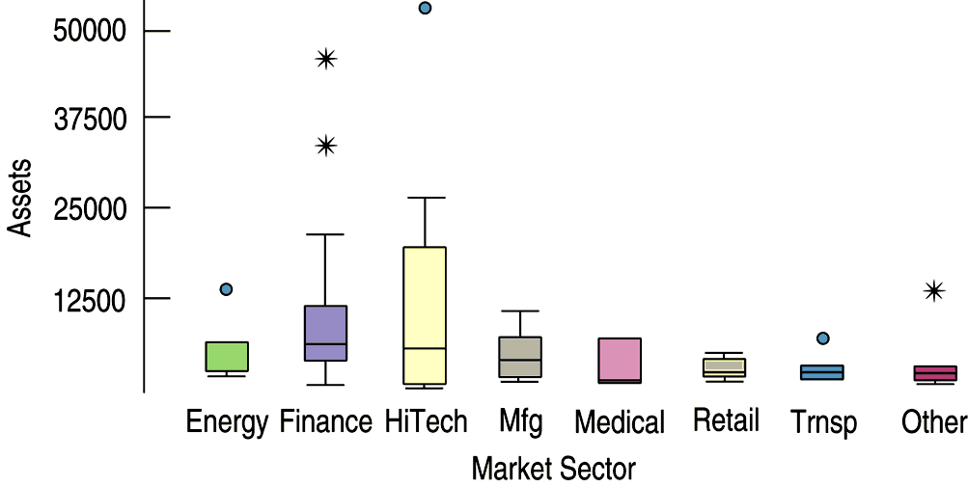
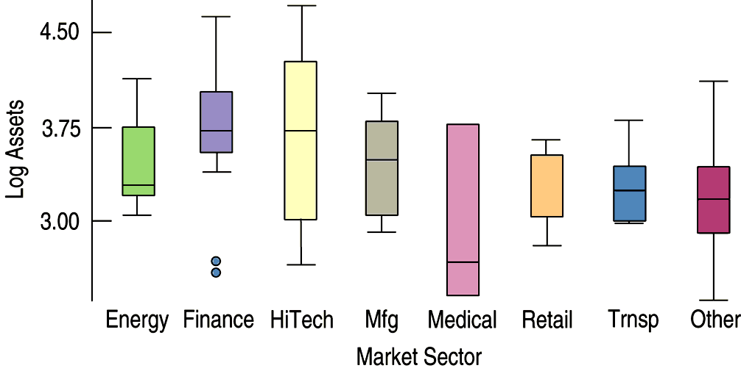
Goals of Re-expression (cont.)
Goal 2: Make the spread of several groups (as seen in side-by-side boxplots) more alike, even if their centers differ.

Slide 10
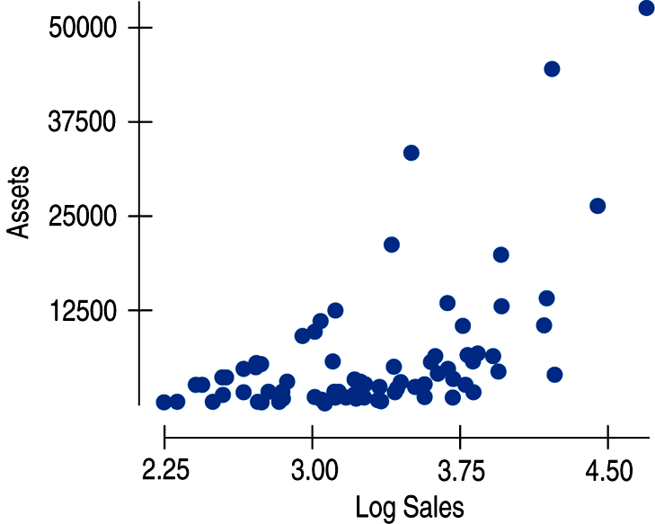
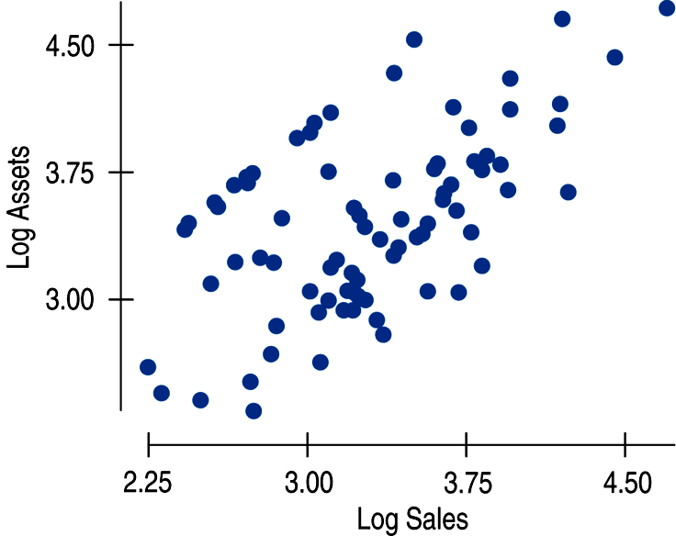
Goals of Re-expression (cont.)
Goal 3: Make the form of a scatterplot more nearly linear.

Slide 11
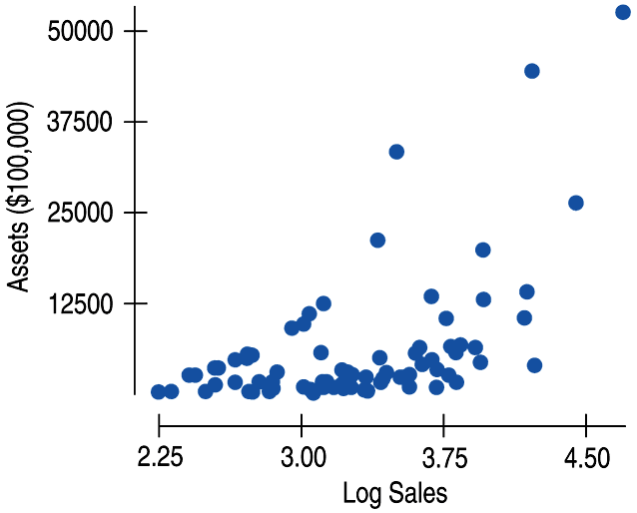
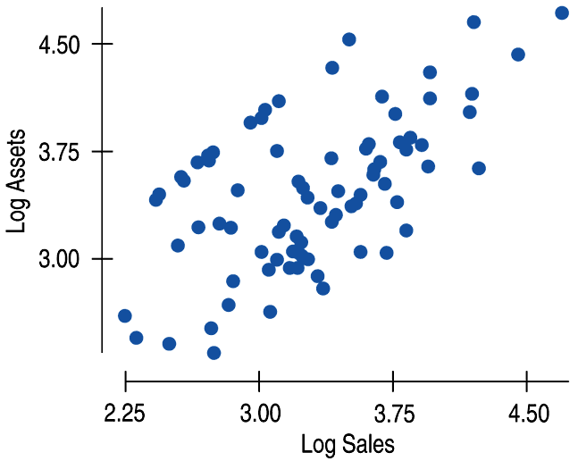
Goals of Re-expression (cont.)
Goal 4: Make the scatter in a scatterplot spread out evenly rather than thickening at one end.
This can be seen in the two scatterplots we just saw with Goal 3:

Slide 12
The Ladder of Powers
There is a family of simple re-expressions that move data toward our goals in a consistent way. This collection of re-expressions is called the Ladder of Powers.
The Ladder of Powers orders the effects that the re-expressions have on data.

Slide 13
The Ladder of Powers
Power
Name
Comment
2
Square of data values
Try with unimodal distributions that are skewed to the left.
1
Raw data
Data with positive and negative values and no bounds are less likely to benefit from re-expression.
½
Square root of data values
Counts often benefit from a square root re-expression.
“0”
We’ll use logarithms here
Measurements that cannot be negative often benefit from a log re-expression.
–1/2
Reciprocal square root
An uncommon re-expression, but sometimes useful.
–1
The reciprocal of the data
Ratios of two quantities (e.g., mph) often benefit from a reciprocal.

Slide 14
Plan B: Attack of the Logarithms
When none of the data values is zero or negative, logarithms can be a helpful ally in the search for a useful model.
Try taking the logs of both the x- and y-variable.
Then re-express the data using some combination of x or log(x) vs. y or log(y).

Slide 15
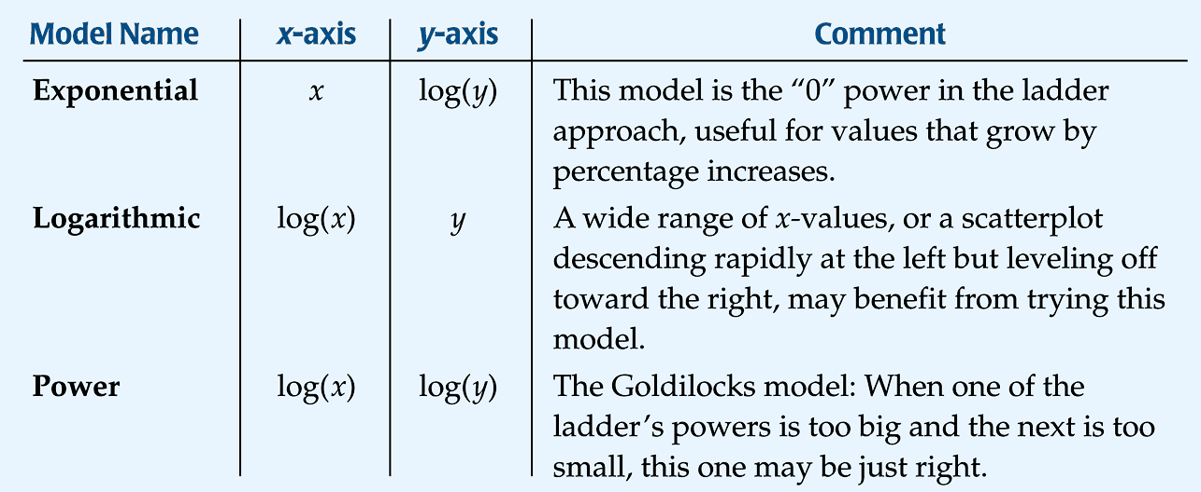
Plan B: Attack of the Logarithms (cont.)

Slide 16
Multiple Benefits
We often choose a re-expression for one reason and then discover that it has helped other aspects of an analysis.
For example, a re-expression that makes a histogram more symmetric might also straighten a scatterplot or stabilize variance.

Slide 17
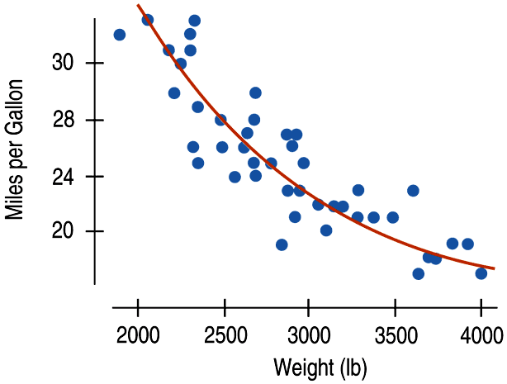
Why Not Just Use a Curve?
If there’s a curve in the scatterplot, why not just fit a curve to the data?

Slide 18
Why Not Just Use a Curve? (cont.)
The mathematics and calculations for “curves of best fit” are considerably more difficult than “lines of best fit.”
Besides, straight lines are easy to understand.
We know how to think about the slope and the y-intercept.

Slide 19
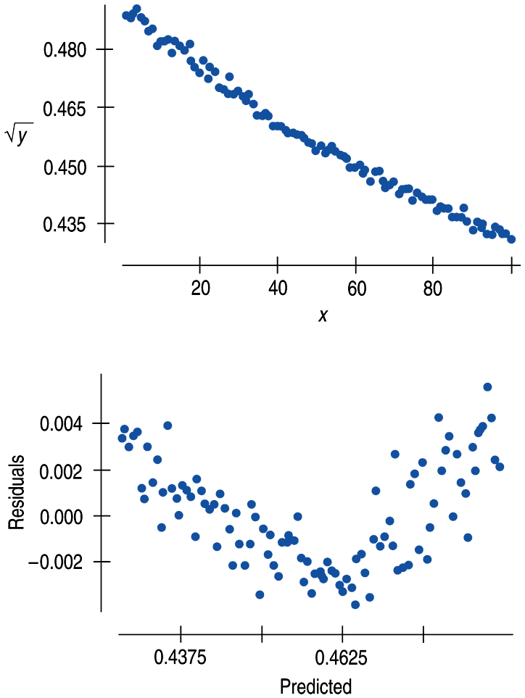
What Can Go Wrong?
Don’t expect your model to be perfect.
Don’t stray too far from the ladder.
Don’t choose a model based on R² alone:

Slide 20
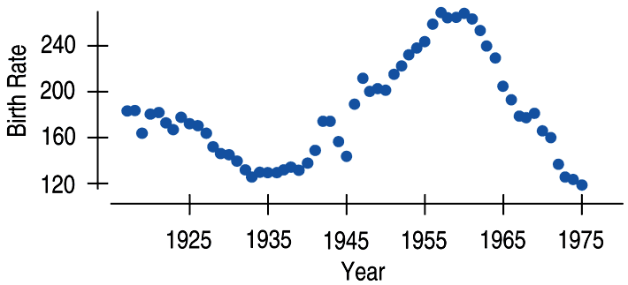
What Can Go Wrong? (cont.)
Beware of multiple modes.
Re-expression cannot pull separate modes together.
Watch out for scatterplots that turn around.
Re-expression can straighten many bent relationships, but not those that go up then down, or down then up.

Slide 21
What Can Go Wrong? (cont.)
Watch out for negative data values.
It’s impossible to re-express negative values by any power that is not a whole number on the Ladder of Powers or to re-express values that are zero for negative powers.
Watch for data far from 1.
Data values that are all very far from 1 may not be much affected by re-expression unless the range is very large. If all the data values are large (e.g., years), consider subtracting a constant to bring them back near 1.

Slide 22
What have we learned?
When the conditions for regression are not met, a simple re-expression of the data may help.
A re-expression may make the:
Distribution of a variable more symmetric.
Spread across different groups more similar.
Form of a scatterplot straighter.
Scatter around the line in a scatterplot more consistent.

Slide 23
What have we learned? (cont.)
Taking logs is often a good, simple starting point.
To search further, the Ladder of Powers or the log-log approach can help us find a good re-expression.
Our models won’t be perfect, but re-expression can lead us to a useful model.

Slide 24
AP Tips
Make sure that you can make accurate predictions using a transformed equation.
Make sure that your descriptions use the transformed variable names, not the original variables, as appropriate.
For example, “89.6% of the variation in log(weight)…”
Don’t get lost in the technology. Most AP problems will ask you evaluate the given output, not ask you to execute long calculator processes.

