Slide 1



The
Comprehensive Literacy Plan
Pennsylvania
Keystones
to
Opportunity
Tom Corbett
Governor
Ron Tomalis
Secretary

Slide 2
Striving Readers Comprehensive Literacy Program (SRCL)
Federal DOE gave grants to states to create or maintain State Literacy Teams
Teams developed statewide comprehensive literacy plans.
Result:
  Pennsylvania Comprehensive Literacy Plan: Keystones to Opportunity (PaCLP)

Slide 3
Statewide Literacy Team
  Actions:
  Reviewed existing PA Literacy Framework (2000)
  Identified gaps and new research
  Built on existing resources – SAS, PA Academic Standards, Common Core Standards, RtII, Resiliency Framework
  Expanded the writing team
  Established a dynamic framework
  Links to resources and best practice

Slide 4
Structure of the PaCLP
Introduction: Vision and Mission
Guiding Principles
  Represent the underlying beliefs and assumptions
Essential Elements
  Provide the building blocks of the plan
Implementing the Plan

Slide 5



Pennsylvania Comprehensive Literacy Plan:
Keystones to Opportunity
Essential Elements
Goals Based on Standards
Disciplinary Literacy
Oral Language
Birth-Grade 12
Vision. All students in Pennsylvania from birth through Grade 12 will become well-educated citizens with a command of literacy that prepares them for the challenges of the 21st century and enables them to achieve their personal and professional goals.
Differentiation of Instruction
Effective Assessment
Partnerships
Mission. The Pennsylvania Comprehensive Literacy Plan (PaCLP) will provide guidance to stakeholders about their roles in developing an integrated, aligned, and comprehensive set of literacy experiences for students.
Engagement and Resiliency
Leadership
Guiding Principles that support the PaCLP
Literacy is the foundation for
all learning
Multiple perspectives: linguistic,
cultural and personal
High expectations for all learners
Evidence-based decision making
21st Century teaching
and learning

Slide 6
Introduction
Overarching Guidance
  Addresses literacy needs of all students (birth-12th grade)
  Emphasizes alignment and transition between grades
  Clarifies and aligns content standards

Slide 7
Vision
All students in Pennsylvania from birth through Grade 12 will become well-educated citizens with a command of literacy that prepares them for the challenges of the 21st century and enables them to achieve their personal and professional goals.

Slide 8
Mission
The Pennsylvania Comprehensive Literacy Plan (PaCLP) will provide guidance to stakeholders about their roles in developing an integrated, aligned, and comprehensive set of literacy experiences for students. The plan includes:
  (1) essential evidence-based notions about the content of literacy (birth-Grade 12) and
  (2) processes by which all stakeholders involved in students’ literacy learning can facilitate that learning in a coherent and consistent manner.

Slide 9
Guiding Principle 1
Literacy is a critical foundation for all learning and serves as a “keystone” for opportunity and success.
  high level learning for all students
  emphasis on meeting the challenges of the 21st century.
  essential at all levels (Birth-Grades 12) and in all disciplines.
  shared responsibility of educators, parents and caretakers, and the broader community.

Slide 10
Guiding Principle 2
Student learning, motivation, and access to educational opportunities are increased when linguistic, cultural, and personal experiences are:
  valued and understood
  represented in the curriculum and classroom practice
  used to help students make connections between what they know and what they are learning.

Slide 11
Guiding Principle 3
There must be high expectations for all learners and a belief that all are capable of gaining literacy skills that enable them to be successful as adults. Instruction
  must address the full range of learners
  be differentiated to meet each child’s needs,
  requires a well-integrated system connecting general, compensatory, gifted, and special education.

Slide 12
Guiding Principle 4
Evidence-based decision-making must be at the heart of all instructional decisions related to literacy development.

Slide 13
Guiding Principle 5
Life long learning of educators is important.
Educators must be…
  prepared to teach effectively in the schools of the 21st century
  provided with continuing professional development support

Slide 14
Six Essential Elements
Each of the essential elements describes content and instructional processes required for comprehensive, aligned literacy program (Birth-grade 12)
Organization of each Essential Element in the document:
  Rationale
  Implications for Practice
  References
  Additional resources (print and non-print)

Slide 15
Essential Element 1
Literacy programs (Birth-grade 12) require a well-articulated, coherent set of goals based on standards. Articulation is needed between all levels, but especially at important transition points.
Emphasizes the relationship among all language arts
Emphasizes importance of using PA Standards for content guidance as well as Common Core State Standards
Highlights the key foci of each of the language arts for Birth- 5; Grades K-5; and Grades 6-12 in chart form

Slide 16
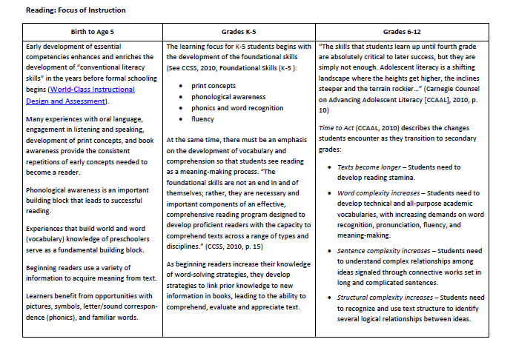


Slide 17
Essential Element 2
Oral language is the foundation for literacy development. Speaking and listening are the tools of communication that become the basis for the written word.
Highlights importance of oral language from Birth-Grade 12
Highlights information about teaching English Language Learners

Slide 18
Essential Element 3
Effective assessment is a key component of quality teaching and learning….Teachers, schools, districts, and the state need the knowledge and understanding of how to use data-driven decision-making to inform instructional practices and improve student learning.
Highlights multiple means of assessment
Describes types of assessments (summative, formative, benchmark, and diagnostic)
Provides resource for creating a school-based assessment and analysis plan (Appendix)

Slide 19
Essential Element 4
Fostering Engagement and Academic Resiliency are keys to developing literate students.
Uses information from SAS (to describe resiliency)
Highlights the importance of school and community libraries for developing motivation to read
Emphasizes the key role of technology in student learning

Slide 20
Essential Element 5
Differentiation of instruction is critical….
It must account for the differences in students’ skills,
interests, cultures, and experiential backgrounds.
Describes dimensions of reading instruction to consider:
    content, instruction, time, grouping, materials, and learning environment.
Highlights Universal Design for Learning (UDL) and its implications for instruction
Describes Response to Instruction and Intervention (RtII)

Slide 21
Essential Element 6
Educators in all of the academic disciplines must incorporate literacy instruction as a means of enhancing students’ ability to learn the content of the discipline.
Describes and provides recommendations for literacy learning in four major academic disciplines: English, Social Studies, Science and Math
Emphasizes importance of disciplinary learning from Birth-Grade 12.
Notes:
(summarizes this information in chart form)

Slide 22
Implementing the Plan (Part IV)
Identifies what PA/PDE has in place and recommendations for improvement
Standards and Goals
Assessments
Partnerships (importance of developing new partnerships and including other stakeholders: community, university, parents, etc.)
Instruction and Intervention
Leadership
Professional Learning

Slide 23
PaCLP
Designed to:
  Provide guidance to stakeholders about their roles in developing an integrated, aligned and comprehensive set of literacy experiences for students (Birth- grade 12).
  Provide specific information about developing, implementing and evaluating an evidence-based school literacy program.
  Be a dynamic, comprehensive and expansive resource
  Be easy to use. Each section contains research findings, instructional implications, and a list of resources, including links to key documents.
  Be used as a basis for professional development.

Slide 24
Contact
Jo Beth McKee
Rosanne Javorsky
Division of Federal Programs
Regional Coordinator
PA Department of Education
jobmckee@pa.gov
717-787-7815
Assistant Executive Director
Teaching and Learning
Allegheny IU3
rosanne.javorsky@aiu3.net
412-394-5792

