Slide 1

Keystones to Opportunity
Pennsylvania’s Vision for Sustainable Growth in Reading Achievement

Slide 2
1
Grant Overview
2
Goals and Strategies
3
Sub-grant Process
4
State Level Activities

Slide 3
Grant Overview
The goal of Striving Readers Comprehensive Literacy (SRCL) is to advance literacy skills – including preliteracy skills, reading and writing – for students from birth through grade 12.
Grants are awarded to State Education Agencies (SEAs) to award sub-grants to local educational agencies (LEAs).
Grants have been awarded to Texas, Pennsylvania, Louisiana, Georgia, Nevada and Montana.

Slide 4
Grant Overview
Pennsylvania applied for $200,000,000 over 5 years.
The year 1 request was $40,000,000 and PA was awarded $38,601,043.
Guidance from USDE – Implement a 5-year project totaling $193,005,215.00.
There is no requirement for matching funds.

Slide 5
Goals and strategies

Slide 6
Goals
Align literacy instruction and state initiatives along the birth to grade 12 continuum at the state level and provide guidance to sub-grantees in aligning local literacy initiatives.
2. Demystify the language and essential elements of effective literacy instruction, and mobilize all stakeholders in support of improved literacy outcomes.

Slide 7
Goals
Provide structures, supports, and tools for school leaders and teachers to use valid and reliable data to guide instructional decision-making in language and literacy.
4. Create 21st Century literacy environments where children can acquire the reading, writing, speaking, listening, and language skills they need to succeed academically.

Slide 8
Goals
Seed innovation by incentivizing and disseminating research-based literacy strategies that result in exceptional reading growth.

Slide 9
Strategies for Aligning Literacy Initiatives
Identifying the SAS Portal as PA’s “Literacy One-Stop”
Positioning PA Intermediate Units as the tactical delivery system
Creating a birth though grade 12 literacy assessment tool
Supporting the successful transition from one part of the literacy continuum to another

Slide 10
Strategies for Demystifying the Language and Elements of Literacy
Creating a glossary of literacy terms
Convening a Guiding Coalition
Launching a statewide media campaign
Providing core training in key areas of literacy

Slide 11
Strategies for Data Driven Decision-making in Literacy
Implementing routine data protocols
Holding annual data retreats
Creating teacher dashboards
Encouraging teacher reflection through core training
Conducting a robust project evaluation

Slide 12
Strategies for Creating 21st Century Learning Environments
Assessing classroom environments
Providing core training in Universal Design for Learning (UDL)
Providing core training in meeting the needs of all learners

Slide 13
Strategies for Seeding Innovation Across the Commonwealth
Rewarding success
Showcasing innovation
Maintaining a laser focus on achieving gains in reading and writing with all age groups

Slide 14
Sub-grant Process

Slide 15
Statutory Requirements
95% of funds must go to local educational agencies (LEAs) via competitive grants!
PDE must ensure that -
(1) 15% of the funds are used to serve children from birth through age 5;
(2) 40% are used to serve students in kindergarten through grade 5;
(3) 20% of funds are used to serve students in middle school;
(4) 20% of funds are used to serve students in high school; and
(5) 5% of funds are used for state leadership.

Slide 16
Guiding Principles for Sub-grant Process
Need plus capacity equals success.
Competition will be rigorous and no LEA is guaranteed funding.
3. Applications must address local need birth through grade 12.

Slide 17
Criteria for Sub-grantee Funding
N+C = Success
High Need
Low Capacity
High Need
High Capacity
Low Need
Low Capacity
Low Need
High Capacity

Slide 18
Definition of Disadvantaged
The term “disadvantaged students” means children and students at risk of educational failure, such as children and students who are living in poverty, who are limited-English-proficient, who are far below grade level or who are not on track to becoming college- or career-ready by graduation.
Who is at risk and how do you know?

Slide 19
Successful Applications
Will be aligned with the PA Comprehensive Literacy Plan;
Will be based on student outcome data;
Will be based on a needs assessment birth through grade 12; and
Will contain a strong evidence base.

Slide 20
Timeline
Pre-application released: December 2011
Letter of Intent to Apply due: December 2011
Pre-application due: January 2012
Invitations for full applications to districts: February 2012
Full applications due: March 2012
Awards for Cohort 1 Announced: March 2012

Slide 21
3-Step Application Review
Level 1 review screens applications based on alignment with the PA Comprehensive Literacy Plan and project needs assessment.
Level 2 review evaluates the strength of the evidence base and the capacity of the applicant to achieve project outcomes.
Level 3 review determines funding based on statutory requirements.

Slide 22
PA Provided Assurance That…
Applications that lack a comprehensive and coherent literacy plan, alignment with state standards, or a strong evidence base will not be funded regardless of the level of need or the available dollars.

Slide 23
State level activities

Slide 24
Intermediate Units Working Together in 3 Regions
Western
Regional
Manager
IU 3
Central
Regional
Manager
IU 13
Eastern
Regional
Manager
IU 20
Intermediate Unit 1
Mt. Oliver IU 2
Allegheny IU 3
Midwestern IU 4
NW Tri-County IU 5
Riverview IU 6
Westmoreland IU 7
Beaver Valley IU 27
ARIN IU 28
Appalachia IU 8
Seneca Highland IU 9
Central IU 10
Tuscarora IU 11
Lincoln IU 12
Lancaster-Leb IU 13
Capital IU 15
C Susquehanna IU 16
Blast IU 17
Schuylkill IU 29
Berks County IU 14
Luzerne IU 18
NE IU 19
Colonial IU 20
Carbon Lehigh IU 21
Bucks County IU 22
Montgomery Cty IU 23
Chester County IU 24
Delaware County 25
Philadelphia IU 26

Slide 25
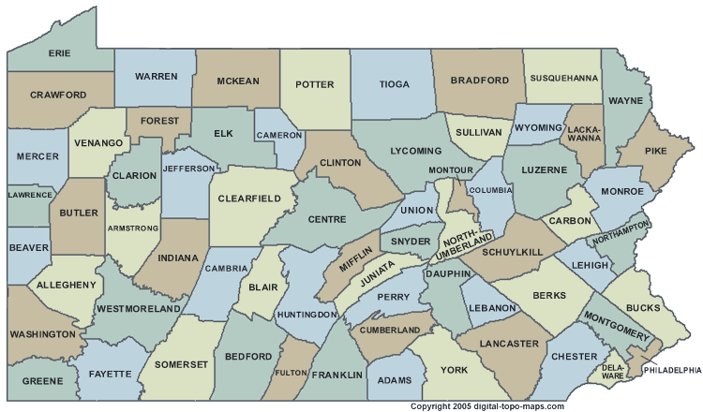
Technical Assistance Leaders Across the State
Regional Coordinators – IU 3, IU 13, IU 20
Content Leads - IU 10, IU 11, IU 12, IU 13, IU 20, IU 21, PaTTAN Harrisburg

Slide 26
Results Matter
The percentage of participating 4-year-old children who achieve significant gains in oral language skills.
2) The percentage of participating 5th grade students who meet or exceed proficiency on State English language arts assessments under section 1111(b)(3) of the ESEA, including those students who demonstrate adequate growth under the State’s Department-approved growth model and are counted as meeting or exceeding proficiency for purposes of accountability determinations.

Slide 27
Results Matter
3) The percentage of participating 8th grade students who meet or exceed proficiency on State English language arts assessments under section 1111(b)(3) of the ESEA, including those students who demonstrate adequate growth under the State’s Department-approved growth model and are counted as meeting or exceeding proficiency for purposes of accountability determinations.
4) The percentage of participating high school students who meet or exceed proficiency on State English language arts assessments under section 1111(b)(3) of the ESEA, including those students who demonstrate adequate growth under the State’s Department-approved growth model and are counted as meeting or exceeding proficiency for purposes of accountability determinations.

Slide 28
Pennsylvania
Keystones to Opportunity
There are no secrets to success. It is the result of preparation, hard work and learning from failure.
Colin Powell

Slide 29
Thank You!

