Slide 1
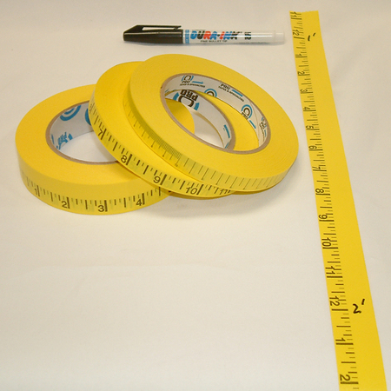
Measurement

Slide 2
The SI system
A description is a spoken or written summary of observations. Ex: The measurements you record are the results of your experiment.
An explanation is an interpretation of observations. As you write your explanation, you make inferences about what just happened and why.
The new system of measurement that was adopted in 1960 and is the internationally accepted system of measurement, is known as the International System of Units (SI).

Slide 3
Si base units
The SI system uses standards of measurement, called base units. (Grams, Meters, Liters)
Other units used in the SI system that are not based units are derived from the base units. (Kilo, Hecto, Deka, Deci, Centi, Milli)
Example, the liter, used to measure volume, was derived from the base unit for liquids.

Slide 4
SI Unit Bases
Quantity Measured | Unit (Symbol)
Length | Meter (m)
Mass | Kilogram (kg)
Time | Second (s)
Electric current | Ampere (A)
Temperature | Kelvin (K)
Substance Amount | Mole (mol)
Light Intensity | Candela (cd)

Slide 5
Si unit prefixes
The SI systems is based on multiples of ten.
Any SI unit can be converted to another by multiplying by a power of 10.
Factors of 10 are represented by prefixes as shown on the next slide.
Ex: The prefix milli means 0.001 or 10^-3. So a millimeter is 0.001 L, or 1/,1000L. Another way to say this is: 1 L is 1,000 times greater than 1mL.

Slide 6
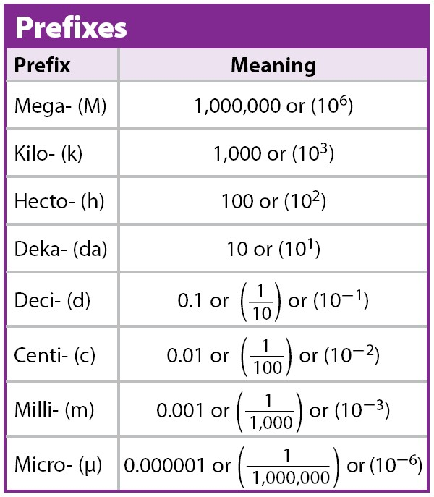
Si unit prefixes cont’d

Slide 7
Side note!!!
When making a measurement you always put a number with a unit.
Ex. 5 kg
The prefix for the unit is always first and the base unit symbol is always second. When there is only one symbol, it is the base unit.

