Slide 1
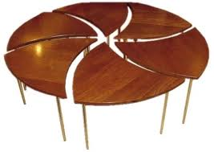
Remote control table
Logan.W.Baur

Slide 2
My log
I went on Google
I wrote how my invention is different
I listed my materials
I drew a picture

Slide 3
Advantages
It can flip the top up to reed a book on it
You can use it while you lay down
You can slide it to different heights

Slide 4
My research
I goggled remote control table
I found a dentist chair
Then I typed automatic table
I found a hospital table

Slide 5
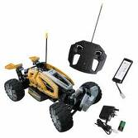
Remote control table
The best part of doing this project was planning it and thinking of how it would help people
I had so much fun doing all this stuff

