Slide 1
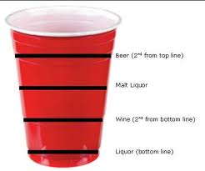
A two sided mug
Presented by Tim Bellin

Slide 2
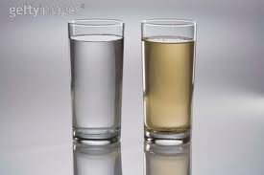
My Log
I went on google and searched for a two sided mug and I found a cup divided in half with two drinks in it.

Slide 3
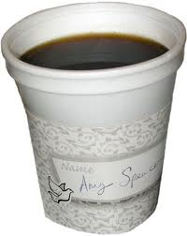
My Research
To improve my mug I will divide it in half so I can put in two drinks

Slide 4
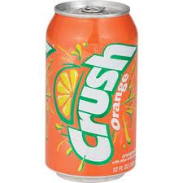
Advantages
The advantages to my mug is when you divide it in half you can have two drinks

Slide 5
Closing page
I wanted to do my mug because if you divide it in half you can have two drinks at a time

