Slide 1
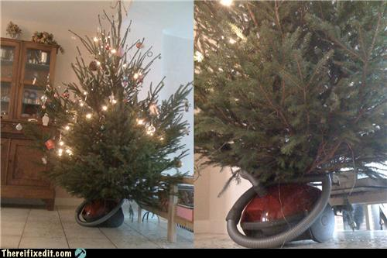
Christmas Tree Sweeper
Made By Camille Caffas

Slide 2
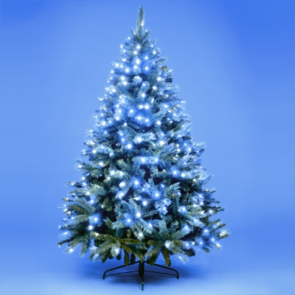
MY LOG
I went on Google and searched for Christmas Tree Sweeper and I had saw that it was already invented. I decided to make it look different and use different materials .

Slide 3
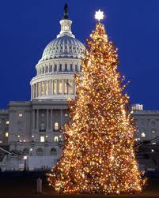
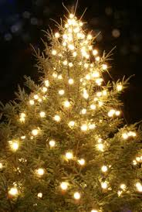
MY RESEARCH
I researched on Google
Then I found some of the materials that were needed they are pipeline or wire, tree and a sweeper.
Next, i drew some blueprints of my invention to see if everything would work
Last, i put it together and had worked out perfectly

Slide 4
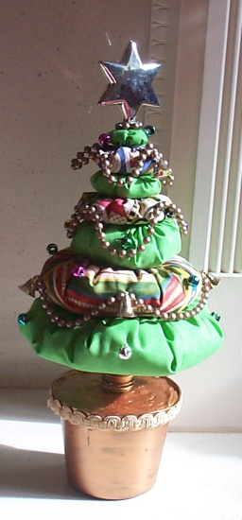
MY ADVANTAGES
I really would like you to buy my product
Because you will not have to do all the work it will do it automatically for you
Also it very decoritve and helpful for friends and family

Slide 5
Closing page
I wanted to make this because
I heard that disabled people cant get around good and bend over and I am preventing that
By inventing and automatic tree sweeper
So they do not have to do as much work

