Slide 1
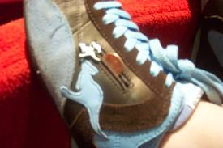
The Shoes with pockets
By: Jaden Domaratz

Slide 2
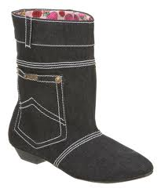
My Log
I thought of an invention to make.
I made a list of materials such as shoes, cloth, and a sewing machine.
I drew how my invention should look.
I thought of how I should make my invention.

Slide 3
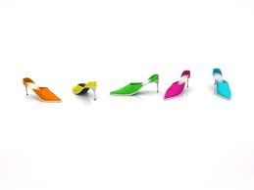
My Research
I went on Google and saw some shoes with pockets on the out side of the shoe so I’m going to put the pockets inside the shoe.

Slide 4
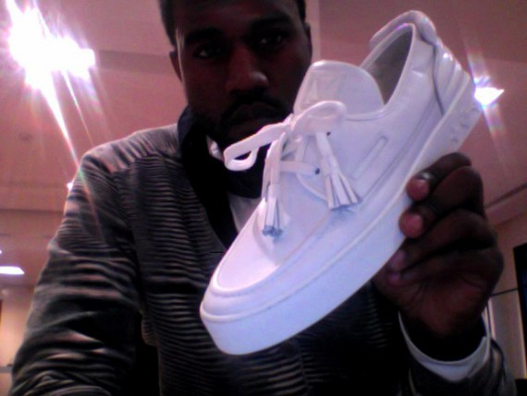
Advantages
You should use my product because if you need a place to store your money The Shoes with pockets is the thing you need.

Slide 5
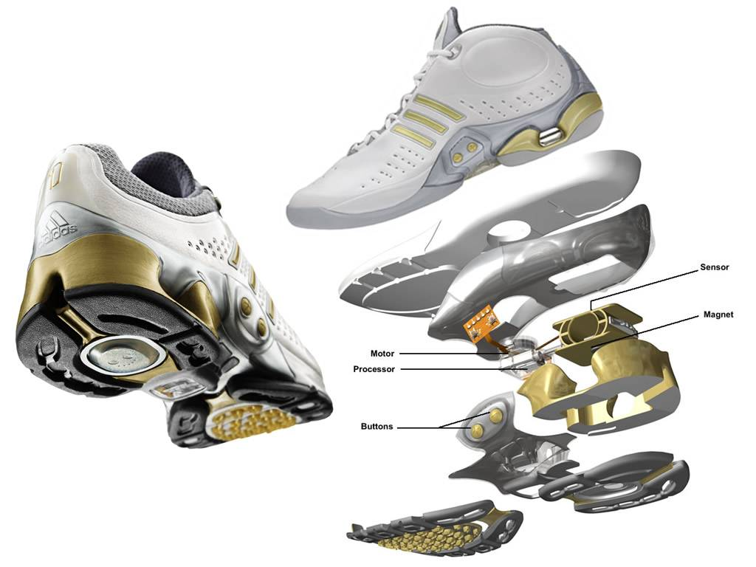
The Shoes with pockets
You need my product. It’s the BEST!!!!!

