Slide 1
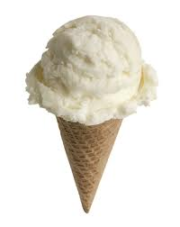
Ice cream money holder
Keidyn Perle

Slide 2
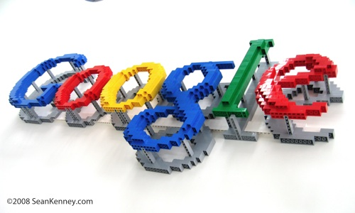
My Logs
In my log I searched on google and I drew pictures of examples. I listed many different ideas. Finally it came to me. An ice cream money holder.

Slide 3
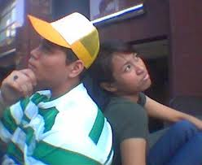
My Research
I searched on Google for ice cream with pockets. I also searched, ice cream with compartments. As a result I found my invention wasn’t made.

Slide 4
Advantages
I believe ice cream shops should buy my product. It’s a creative money holder for them. Most people would put more money in a more creative tip jar.

Slide 5
Ice Cream Money Holder
I hope you will buy my ice cream money holder.

