Slide 1
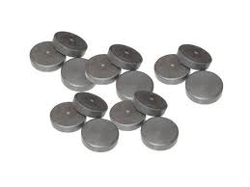
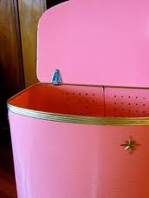
The Magnetic Hamper Written By: Rylie Patterson
Magnet
Magnet
Magnet
Magnet
Materials: Hamper, Strong Magnets

Slide 2
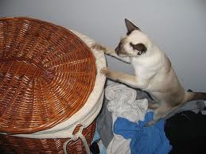
My Log
I Made Up My Idea
I Made Sure My Invention Was Not Invited
I Saw That My Invention Was Not Already Made

Slide 3
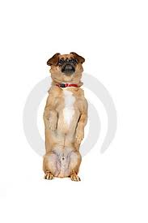
My Research
I Went On Google To See If The Magnetic Hamper Was Invented
I Saw That It Was Not Invented
I Also Looked For Hamper With Magnets
There Was Nothing Invited Like Mine

Slide 4
Advantages
You Should Use My Invention Because It Keeps Your Pets Out Of Your Clothes
Keeping Your Pets Out Of Your Clothes Will Make Your Clothes Last Longer
You Don’t Have To Spend A lot Of Money Because You Can Make It Home Made

Slide 5
Closing Slide
I Found Out That Doing A Invention Is Hard To Do
My Favorite Part Was Doing The Invention
I DON’T Have A Least Favorite Part
If You Learn How To Use My Invention You Would LOVE It
Thank You For Your Time Rylie Patterson

