Slide 1
Automatic Dog Water Bowl
Brayden Zilka

Slide 2
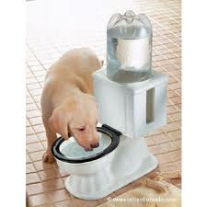
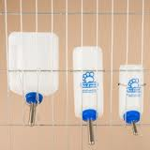
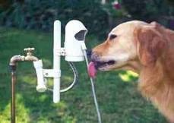
My Log
I searched on Google.
I drew a picture of my invention.
It has a water bowl connected to a hose with a lever connected to the wall.

Slide 3
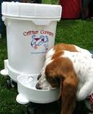
My Research
Today I went on Google and I searched for an automatic dog bowl. I found it was already made, but mine is in a different design. My invention has a water bowl connected to a hose that is connected to the wall. On the hose there will be a lever that will open a valve that releases the water into the bowl.

Slide 4
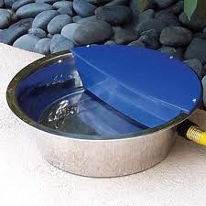
Advantages
You need to use my invention because you won’t have to keep refilling your dog’s water bowl.
Your dog can have fresh water every time it drinks.

Slide 5
The Closing
Thanks for watching! I hope you like using my product as much as I did!

