Slide 1
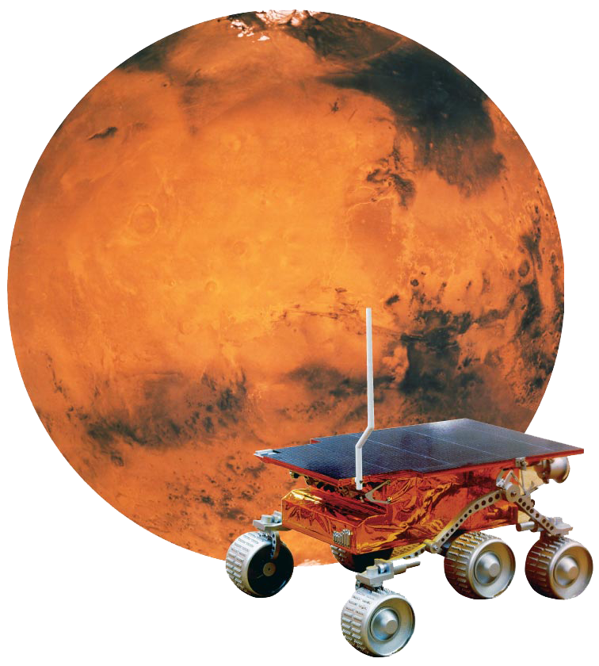
In July 1997, the six-wheeled Sojourner rover became the first robot to explore planet Mars. Sojourner was built to answer questions about the nature of Mars.
Science involves asking questions about nature and then finding ways to answer them.

Slide 2
Science From Curiosity
How does the process of science start and end?

Slide 3
Science From Curiosity
Have you ever checked what was living at the bottom of a pond? Taken off the cover of a baseball to see what was inside? Tried putting more chocolate or less in your milk to find out how much would give the best flavor? These are all examples of curiosity, and curiosity is the basis of science.

Slide 4
Science From Curiosity
Science begins with curiosity and often ends with discovery.

Slide 5
Science From Curiosity
Curiosity provides questions, but scientific results rely on finding answers.
In some experiments, observations are qualitative, or descriptive.
In other experiments, observations are quantitative, or numerical.
Some questions—for example, how the universe began—cannot be answered by direct observations and measurements but only by other kinds of evidence.

Slide 6
Science and Technology
What is the relationship between science and technology?
Science and technology are interdependent. Advances in one lead to advances in the other.

Slide 7
Science and Technology
Science is a system of knowledge and the methods you use to find that knowledge. The goal of science is to expand knowledge.
Technology is the use of knowledge to solve practical problems. The goal of technology is to apply knowledge.

Slide 8
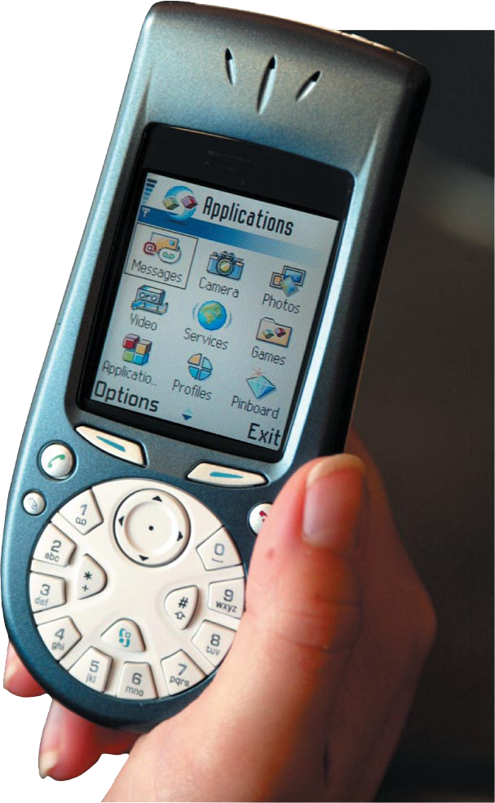
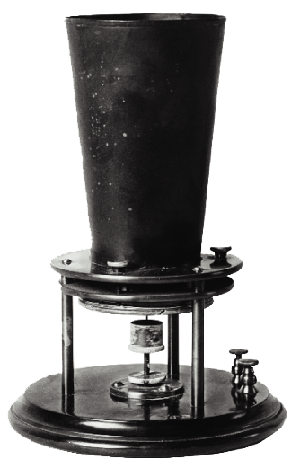
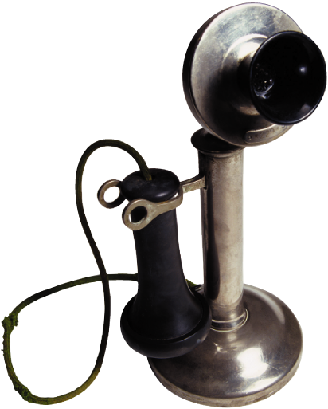
The telephone was invented in 1876. By 1927, it was possible to make a phone call from New York to London. The first mobile telephones, invented during World War II, paved the way for modern cellular phones. At each step, new science was applied to improve the technology of the telephone.

Slide 9
Branches of Science
What are the branches of natural science?

Slide 10
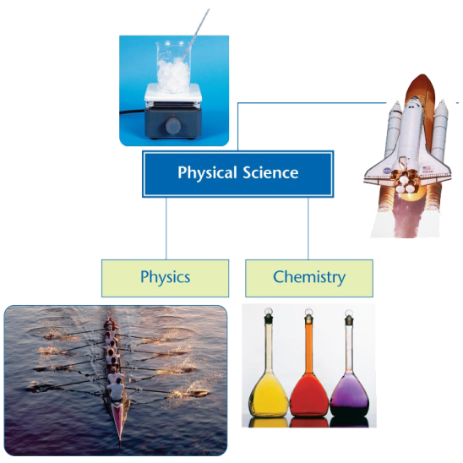
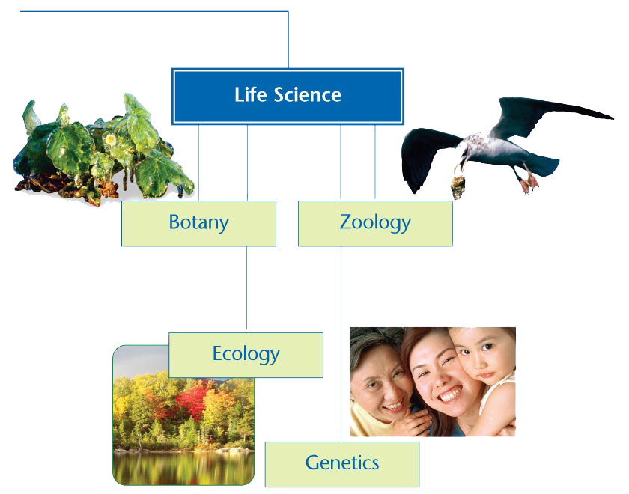
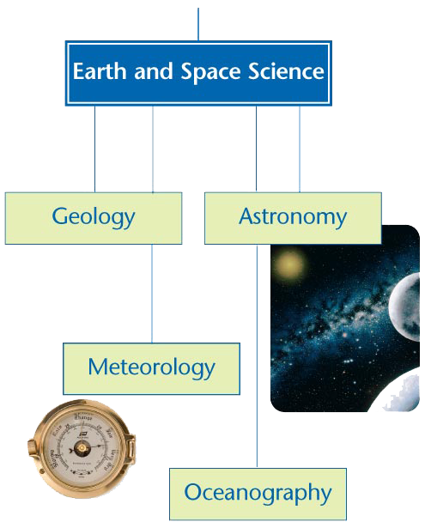
Branches of Science
Natural science is generally divided into three branches: physical science, Earth and space science, and life science.

Slide 11
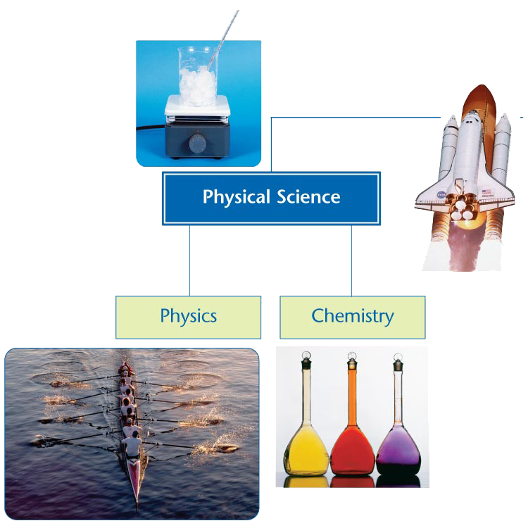

Slide 14
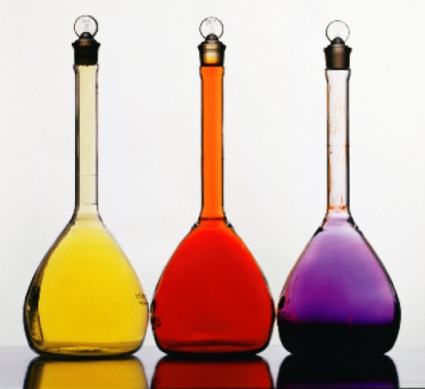
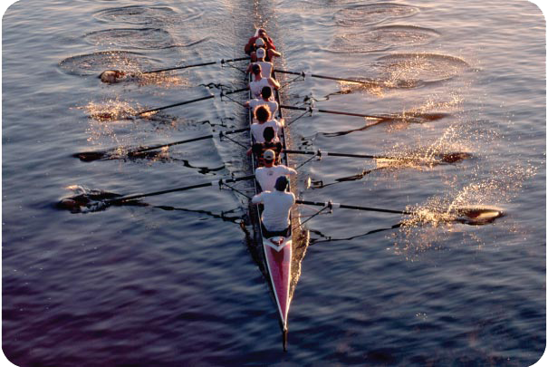
Physical science focuses on nonliving things.
Chemistry is the study of the composition, structure, properties, and reactions of matter.
Physics is the study of matter and energy and the interactions between the two through forces and motion.

Slide 15
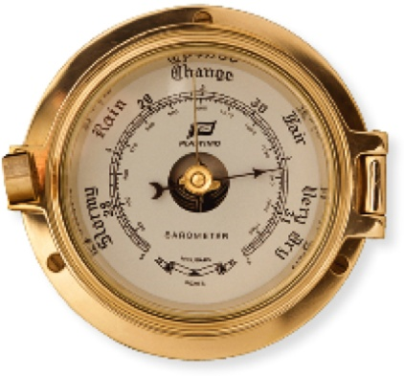
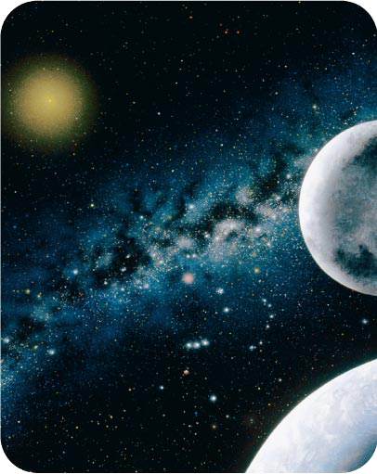
The application of physics and chemistry to the study of Earth is called Earth science.
Geology is the study of the origin, history, structure, and systems of Earth.
Astronomy is the study of the universe beyond Earth.

Slide 16
The study of living things is known as biology, or life science.
Biology includes the physics and chemistry of living things, as well as their origin and behavior.
Biologists study the different ways that organisms grow, survive, and reproduce.

Slide 17
There is overlap between different areas of science.
Much of biology involves changes that are part of chemistry, while much of chemistry is defined by interactions that are part of physics
Biophysics is a growing area of physics that applies physics to biology.

Slide 18
The Big Ideas of Physical Science
Space and Time
The universe is both very old and very big.
Matter and Change
A very small amount of the universe is matter. All matter that you are familiar with is made up of building blocks called atoms.

Slide 19
The Big Ideas of Physical Science
Forces and Motion
Forces cause changes in motion. The laws of physics allow these changes to be calculated exactly.
Energy
Energy exists in many forms. Energy can be transferred from one form or object to another, but it can never be destroyed.

Slide 20
Science and Your Perspective
Science is both a process and a body of knowledge. As more knowledge is added, the models that science uses to describe the universe change.
Be skeptical. Ask questions. Be aware that the scientific facts of today might be changed as knowledge grows. However, believe in the scientific process that has discovered them.

Slide 21
Assessment Questions
An example of technology that is related to the science of physics is
a radio telescope.
the law of conservation of energy.
nuclear fusion in the core of a star.
the speed of light.

Slide 22
Assessment Questions
An example of technology that is related to the science of physics is
a radio telescope.
the law of conservation of energy.
nuclear fusion in the core of a star.
the speed of light.
ANS: A

Slide 23
Assessment Questions
Which of the following would not be included among the main ideas of physical science?
space and time
matter and change
forces, motion, and energy
living systems and organisms

Slide 24
Assessment Questions
Which of the following would not be included among the main ideas of physical science?
space and time
matter and change
forces, motion, and energy
living systems and organisms
ANS: D

Slide 25
Assessment Questions
Natural science is divided into three overlapping branches: physical science, earth and space science, and life science. True False

Slide 26
Assessment Questions
Natural science is divided into three overlapping branches: physical science, earth and space science, and life science. True False
ANS: T

