Slide 1
You are caught in the rain. Should you run or walk? Maybe you should run–less time in the rain means less water falls down on you. Maybe you should walk–moving slower causes you to run into fewer drops. This is a question that you can try to answer with a scientific approach.

Slide 2
Scientific Methods
What is the goal of a scientific method?

Slide 3
Scientific Methods
An organized plan for gathering, organizing, and communicating information is called a scientific method.
You can use a scientific method to search for the answer to a question.
Scientific methods can vary from case to case, depending on the question and how the researcher decides to look for an answer.

Slide 4
Scientific Methods
The goal of any scientific method is to solve a problem or to better understand an observed event.

Slide 5
Scientific Methods
Here is an example of a scientific method. Each step uses specific skills. The order of steps can vary. Sometimes you will use all of the steps and other times only some of them.

Slide 6
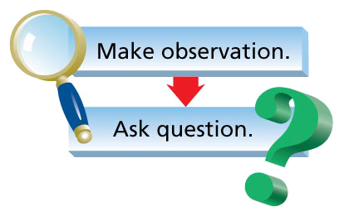
Scientific Methods
Here is an example of a scientific method. Each step uses specific skills. The order of steps can vary. Sometimes you will use all of the steps and other times only some of them.

Slide 7
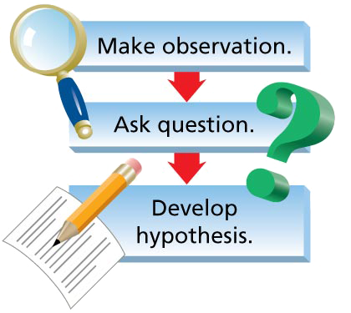
Scientific Methods
Here is an example of a scientific method. Each step uses specific skills. The order of steps can vary. Sometimes you will use all of the steps and other times only some of them.

Slide 8
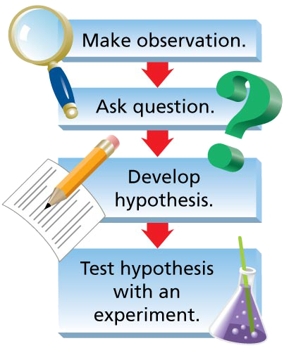
Scientific Methods
Here is an example of a scientific method. Each step uses specific skills. The order of steps can vary. Sometimes you will use all of the steps and other times only some of them.

Slide 9
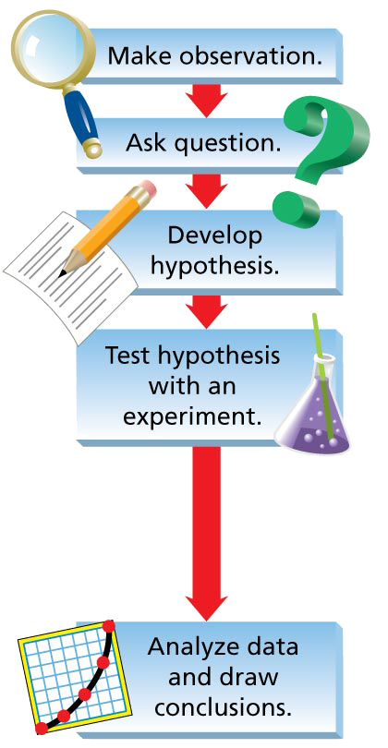
Scientific Methods
Here is an example of a scientific method. Each step uses specific skills. The order of steps can vary. Sometimes you will use all of the steps and other times only some of them.

Slide 10
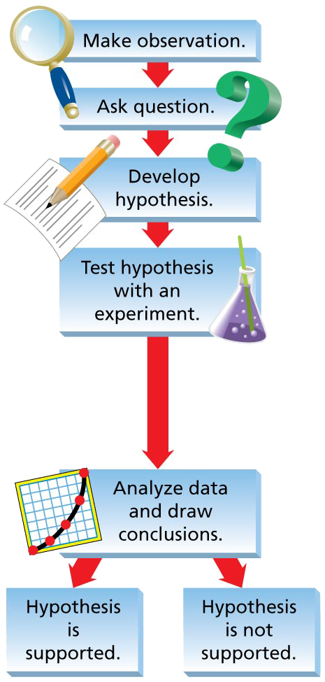
Scientific Methods
Here is an example of a scientific method. Each step uses specific skills. The order of steps can vary. Sometimes you will use all of the steps and other times only some of them.

Slide 11
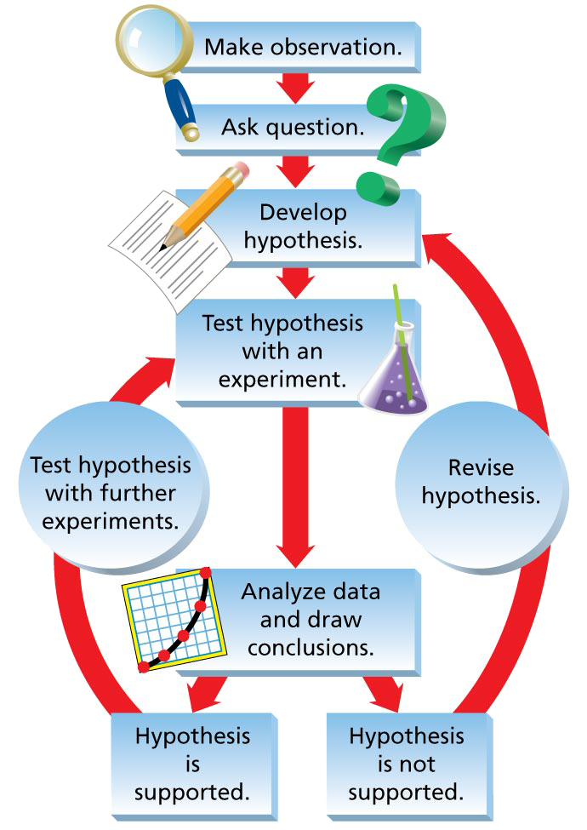
Scientific Methods
Here is an example of a scientific method. Each step uses specific skills. The order of steps can vary. Sometimes you will use all of the steps and other times only some of them.

Slide 12
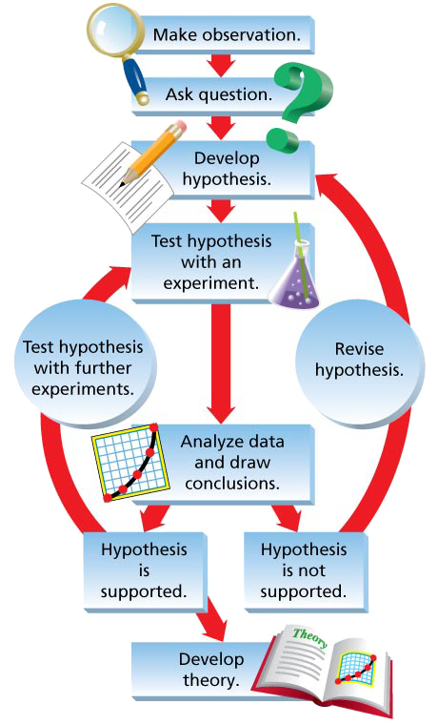
Scientific Methods
Here is an example of a scientific method. Each step uses specific skills. The order of steps can vary. Sometimes you will use all of the steps and other times only some of them.

Slide 13
Scientific Methods
Making Observations
Scientific investigations often begin with observations. An observation is information that you obtain through your senses.
Forming a Hypothesis
A hypothesis is a proposed answer to a question.

Slide 14
Scientific Methods
Testing a Hypothesis
In an experiment, any factor that can change is called a variable.
The manipulated variable causes a change.
The responding variable changes in response to the manipulated variable.
A controlled experiment is an experiment in which only one variable, the manipulated variable, is deliberately changed at a time.

Slide 15
Scientific Methods
Drawing Conclusions
A conclusion describes how facts apply to a hypothesis.
Developing a Theory
A scientific theory is a well-tested explanation for a set of observations or experimental results. Once a hypothesis has been supported in repeated experiments, scientists can begin to develop a theory.

Slide 16
Scientific Methods
Question: How does speed affect how wet you get in the rain?
Hypothesis: The faster your speed, the drier you will stay.
Experiment: Test whether speed affects how wet you get in the rain.

Slide 17
Scientific Methods
In 1997, two meteorologists conducted a controlled experiment to determine if moving faster keeps you drier in the rain.
One scientist walked 100 yards and the other ran the same distance. Variables, such as type of clothes, were controlled.

Slide 18
Scientific Methods
The clothes of the walking scientist accumulated 217 grams of water; the clothes of the running scientist accumulated 130 grams of water.
Draw a Conclusion: The scientists concluded that running in the rain keeps you drier.

Slide 19
Scientific Laws
How does a scientific law differ from a scientific theory?

Slide 20
Scientific Laws
After repeated observations or experiments, scientists may arrive at a scientific law.
A scientific law is a statement that summarizes a pattern found in nature.
For example, Newton’s law of gravity is a scientific law that has been verified over and over. Scientists have yet to agree on a theory that explains how gravity works.

Slide 21
Scientific Laws
A scientific law describes an observed pattern in nature without attempting to explain it. The explanation of such a pattern is provided by a scientific theory.

Slide 22
Scientific Models
Why are scientific models useful?
A model is a representation of an object or event. A street map is a model of a city.
Scientific models make it easier to understand things that might be too difficult to observe directly.

Slide 23
Scientific Models
This computer model represents the interior of an airplane. It helps the engineers visualize the layout of the plane.

Slide 24
Scientific Models
Models help you visualize things that are too small to see, such as atoms, or things that are large, such as the solar system.
An example of a mental, rather than physical, model might be that comets are like giant snowballs, primarily made of ice.
As new data are collected, models can be changed or be replaced by new models.

Slide 25
Working Safely in Science
Safety plays an important role in science. Laboratory work may involve flames or hot plates, electricity, chemicals, hot liquids, sharp instruments, and breakable glassware.
Always follow your teacher’s instructions and the textbook directions exactly.

Slide 26
Assessment Questions
What is a hypothesis?
a statement that summarizes a pattern found in nature
a well-tested explanation for a set of observations or experimental results
an experiment in which only one variable is deliberately changed at a time
a proposed answer to a question

Slide 27
Assessment Questions
What is a hypothesis?
a statement that summarizes a pattern found in nature
a well-tested explanation for a set of observations or experimental results
an experiment in which only one variable is deliberately changed at a time
a proposed answer to a question ANS: D

Slide 28
Assessment Questions
How does a scientific law differ from a theory?
A scientific law describes observations while a theory provides an explanation.
A scientific law cannot be changed by additional observations, but a theory can be changed.
A theory is a possible explanation, but a scientific law is a proven explanation.
There is no difference because scientific law and theory are two terms that mean the same thing.

Slide 29
Assessment Questions
How does a scientific law differ from a theory?
A scientific law describes observations while a theory provides an explanation.
A scientific law cannot be changed by additional observations, but a theory can be changed.
A theory is a possible explanation, but a scientific law is a proven explanation.
There is no difference because scientific law and theory are two terms that mean the same thing. ANS: A

Slide 30
Assessment Questions
What is the main purpose of a scientific model?
to show how a hypothesis was developed
to prove a theory
to make complex concepts easier to understand
to show a large object, such as the Earth, in a smaller form

Slide 31
Assessment Questions
What is the main purpose of a scientific model?
to show how a hypothesis was developed
to prove a theory
to make complex concepts easier to understand
to show a large object, such as the Earth, in a smaller form ANS: C

Slide 32
Assessment Questions
How does a scientific law differ from a theory?
Assume that it is safe because the school would not allow unsafe chemicals.
Assume that it is a hazardous chemical because all chemicals are dangerous.
Ask your teacher or check the procedure to find the correct safety precautions.
Ask your lab partner whether the chemical is hazardous or not.

Slide 33
Assessment Questions
How does a scientific law differ from a theory?
Assume that it is safe because the school would not allow unsafe chemicals.
Assume that it is a hazardous chemical because all chemicals are dangerous.
Ask your teacher or check the procedure to find the correct safety precautions.
Ask your lab partner whether the chemical is hazardous or not. ANS: C

