Slide 1
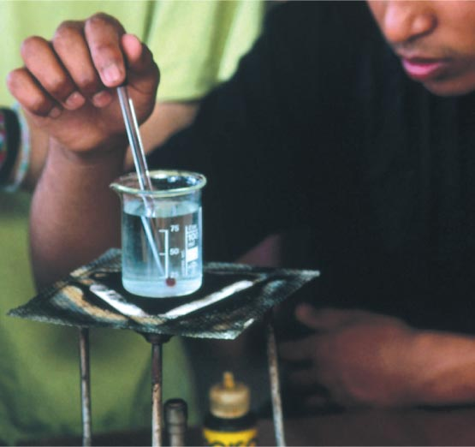
How old are you? How tall are you? The answers to these questions are measurements. Measurements are important in both science and everyday life. It would be difficult to imagine doing science without any measurements.

Slide 2
Using Scientific Notation
Why is scientific notation useful?

Slide 3
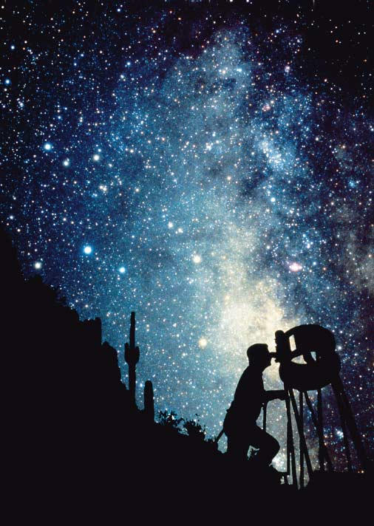
Using Scientific Notation
Why is scientific notation useful?
Scientists often work with very large or very small numbers. Astronomers estimate there are 200,000,000,000 stars in our galaxy.

Slide 4
Using Scientific Notation
Scientific notation is a way of expressing a value as the product of a number between 1 and 10 and a power of 10.
For example, the speed of light is about 300,000,000 meters per second. In scientific notation, that speed is 3.0 × 10⁸ m/s. The exponent, 8, tells you that the decimal point is really 8 places to the right of the 3.

Slide 5
Using Scientific Notation
For numbers less than 1 that are written in scientific notation, the exponent is negative.
For example, an average snail’s pace is 0.00086 meters per second. In scientific notation, that speed is 8.6 × 10⁻⁴ m/s. The negative exponent tells you how many decimals places there are to the left of the 8.6.

Slide 6
Using Scientific Notation
To multiply numbers written in scientific notation, you multiply the numbers that appear before the multiplication signs and add the exponents. The following example demonstrates how to calculate the distance light travels in 500 seconds.
This is about the distance between the sun and Earth.

Slide 7
Using Scientific Notation
When dividing numbers written in scientific notation, you divide the numbers that appear before the exponential terms and subtract the exponents. The following example demonstrates how to calculate the time it takes light from the sun to reach Earth.

Slide 8
Using Scientific Notation
Using Scientific Notation
A rectangular parking lot has a length of 1.1 × 10³ meters and a width of 2.4 × 10³ meters. What is the area of the parking lot?

Slide 9
Using Scientific Notation
Read and Understand
What information are you given?

Slide 10
Using Scientific Notation
Read and Understand
What information are you given?

Slide 11
Using Scientific Notation
Plan and Solve
What unknown are you trying to calculate?
What formula contains the given quantities and the unknown?
Replace each variable with its known value

Slide 12
Using Scientific Notation
Look Back and Check
Is your answer reasonable?
Yes, the number calculated is the product of the numbers given, and the units (m²) indicate area.

Slide 13
Using Scientific Notation
Look Back and Check
1. Perform the following calculations. Express your answers in scientific notation.
a. (7.6 × 10⁻⁴ m) × (1.5 × 10⁷ m)
b. 0.00053 ÷ 29
2. Calculate how far light travels in 8.64 × 10⁴ seconds. (Hint: The speed of light is about 3.0 × 10⁸ m/s.)

Slide 14
SI Units of Measurement
What units do scientists use for their measurements?

Slide 15
SI Units of Measurement
Scientists use a set of measuring units called SI, or the International System of Units.
SI is an abbreviation for Système International d’Unités.
SI is a revised version of the metric system, originally developed in France in 1791.
Scientists around the world use the same system of measurements so that they can readily interpret one another’s measurements.

Slide 16
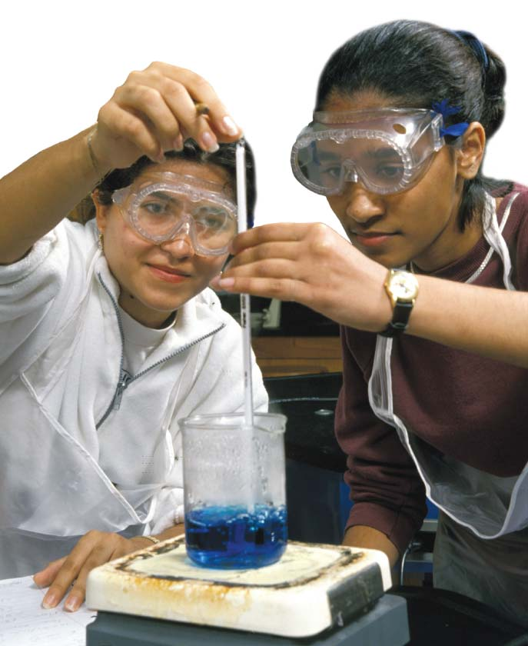
SI Units of Measurement
If you told one of your friends that you had finished an assignment “in five,” it could mean five minutes or five hours. Always express measurements in numbers and units so that their meaning is clear.
These students’ temperature measurement will include a number and the unit, °C.

Slide 17
SI Units of Measurement
Base Units and Derived Units
SI is built upon seven metric units, known as base units.
In SI, the base unit for length, or the straight-line distance between two points, is the meter (m).
The base unit for mass, or the quantity of matter in an object or sample, is the kilogram (kg).

Slide 18
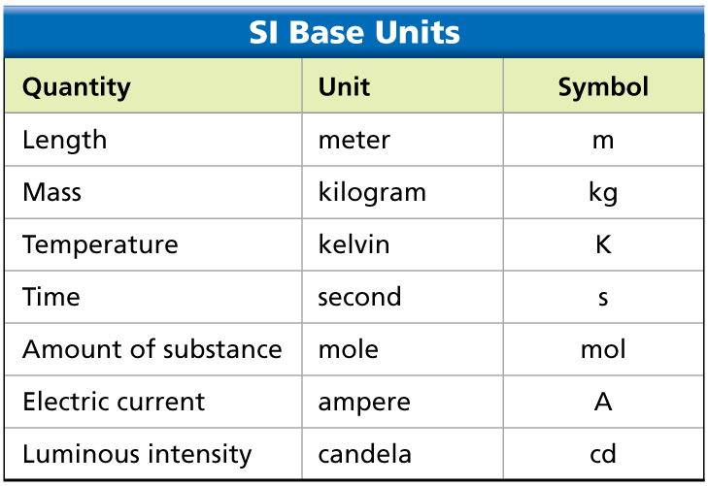
SI Units of Measurement
Seven metric base units make up the foundation of SI.

Slide 19
SI Units of Measurement
Additional SI units, called derived units, are made from combinations of base units.
Volume is the amount of space taken up by an object.
Density is the ratio of an object’s mass to its volume:

Slide 20
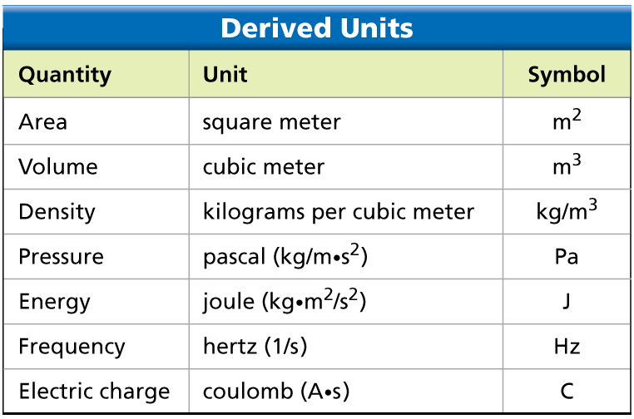
SI Units of Measurement
Specific combinations of SI base units yield derived units.

Slide 21
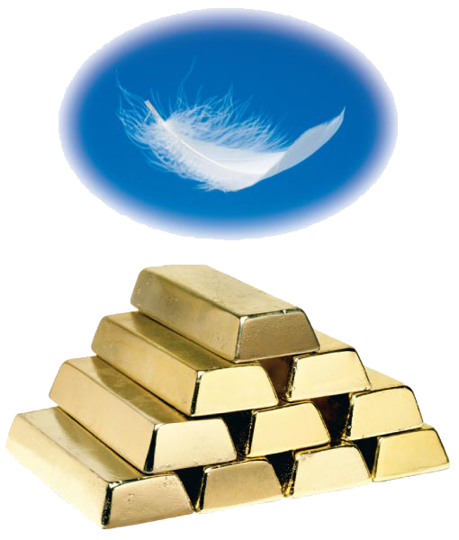
SI Units of Measurement
To derive the SI unit for density, you can divide the base unit for mass by the derived unit for volume. Dividing kilograms by cubic meters yields the SI unit for density, kilograms per cubic meter (kg/m³).
A bar of gold has more mass per unit volume than a feather, so gold has a greater density than a feather.

Slide 22
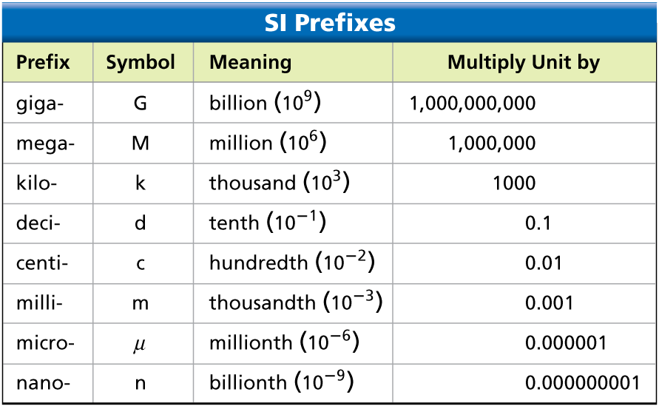
SI Units of Measurement
Metric Prefixes
The metric unit is not always a convenient one to use. A metric prefix indicates how many times a unit should be multiplied or divided by 10.

Slide 23
SI Units of Measurement
For example, the time it takes for a computer hard drive to read or write data is in the range of thousandths of a second, such as 0.009 second. Using the prefix milli- (m), you can write 0.009 second as 9 milliseconds, or 9 ms.

Slide 24
SI Units of Measurement
Metric prefixes can also make a unit larger. For example, a distance of 12,000 meters can also be written as 12 kilometers.
Metric prefixes turn up in nonmetric units as well. If you work with computers, you probably know that a gigabyte of data refers to 1,000,000,000 bytes. A megapixel is 1,000,000 pixels.

Slide 25
SI Units of Measurement
A conversion factor is a ratio of equivalent measurements used to convert a quantity expressed in one unit to another unit.
To convert the height of Mount Everest, 8848 meters, into kilometers, multiply by the conversion factor on the left.

Slide 26
SI Units of Measurement
To convert 8.848 kilometers back into meters, multiply by the conversion factor on the right. Since you are converting from kilometers to meters, the number should get larger.
In this case, the kilometer units cancel, leaving you with meters.

Slide 27
Limits of Measurement
How does the precision of measurements affect the precision of scientific calculations?

Slide 28
Limits of Measurement
Precision
Precision is a gauge of how exact a measurement is.
Significant figures are all the digits that are known in a measurement, plus the last digit that is estimated.

Slide 29
Limits of Measurement
The precision of a calculated answer is limited by the least precise measurement used in the calculation.

Slide 30
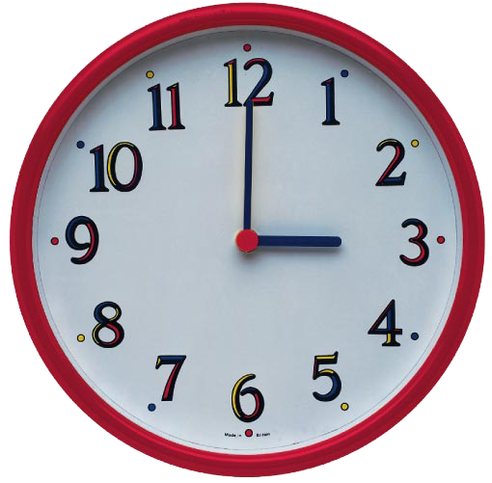
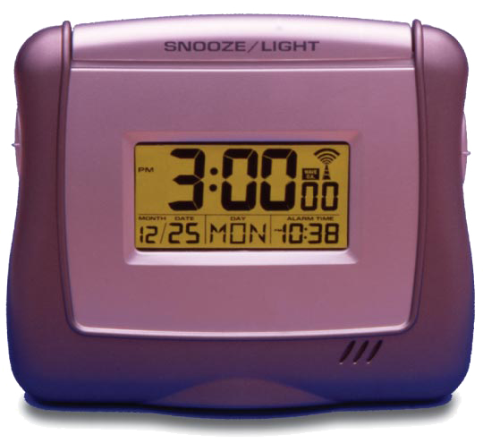
Limits of Measurement
A more precise time can be read from the digital clock than can be read from the analog clock. The digital clock is precise to the nearest second, while the analog clock is precise to the nearest minute.

Slide 31
Limits of Measurement
If the least precise measurement in a calculation has three significant figures, then the calculated answer can have at most three significant figures.
Mass = 34.73 grams
Volume = 4.42 cubic centimeters.
Rounding to three significant figures, the density is 7.86 grams per cubic centimeter.

Slide 32
Limits of Measurement
Accuracy
Another important quality in a measurement is its accuracy. Accuracy is the closeness of a measurement to the actual value of what is being measured.
For example, suppose a digital clock is running 15 minutes slow. Although the clock would remain precise to the nearest second, the time displayed would not be accurate.

Slide 33
Measuring Temperature
A thermometer is an instrument that measures temperature, or how hot an object is.

Slide 34
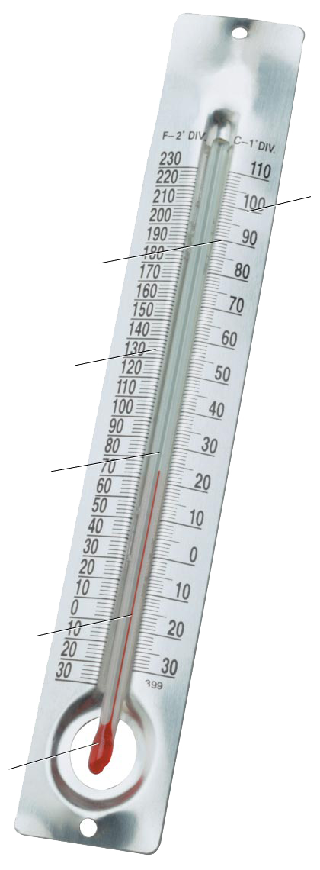
Measuring Temperature
Scale The scale indicates the
temperature according to how
far up or down the capillary
tube the liquid has moved.
Celsius (centigrade)
temperature scale
Fahrenheit scale
Capillary tube
Colored liquid The liquid moves up and down the capillary tube as the temperature changes.
Bulb The bulb
contains the
reservoir of liquid.

Slide 35
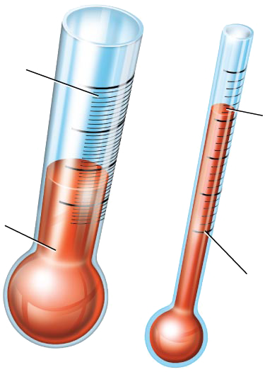
Measuring Temperature
Compressed
scale
Liquid rises
more in a
narrow tube
for the same
temperature
change.
Liquid rises
less in a
wide tube
for the same
temperature
change.
Expanded,
easy-to-read scale

Slide 36
Measuring Temperature
The two temperature scales that you are probably most familiar with are the Fahrenheit scale and the Celsius scale.
A degree Celsius is almost twice as large as a degree Fahrenheit.
You can convert from one scale to the other by using one of the following formulas.

Slide 37
Measuring Temperature
The SI base unit for temperature is the kelvin (K).
A temperature of 0 K, or 0 kelvin, refers to the lowest possible temperature that can be reached.
In degrees Celsius, this temperature is –273.15°C. To convert between kelvins and degrees Celsius, use the formula:

Slide 38
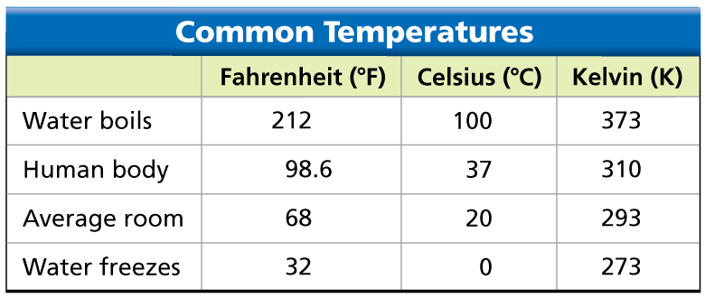
Measuring Temperature
Temperatures can be expressed in degrees Fahrenheit, degrees Celsius, or kelvins.

Slide 39
Assessment Questions
A shopping mall has a length of 200 meters and a width of 75 meters. What is the area of the mall, in scientific notation?
1 × 10³ m²
1.5 × 10³ m²
1.5 × 10⁴ m²
1.75 × 10⁴ m²

Slide 40
Assessment Questions
A shopping mall has a length of 200 meters and a width of 75 meters. What is the area of the mall, in scientific notation?
1 × 10³ m²
1.5 × 10³ m²
1.5 × 10⁴ m²
1.75 × 10⁴ m² ANS: C

Slide 41
Assessment Questions
A student measures the volume and mass of a liquid. The volume is 50.0 mL and the mass is 78.43 g. What is the correct calculated value of the liquid’s density? (A calculator reads 1.5686.)
1.6 g/cm³
1.57 g/cm³
1.569 g/cm³
1.5686 g/cm³

Slide 42
Assessment Questions
A student measures the volume and mass of a liquid. The volume is 50.0 mL and the mass is 78.43 g. What is the correct calculated value of the liquid’s density? (A calculator reads 1.5686.)
1.6 g/cm³
1.57 g/cm³
1.569 g/cm³
1.5686 g/cm³ ANS: B

Slide 43
Assessment Questions
How can you convert a temperature expressed in kelvin (K) to degree Celsius (°C)?
add 32
subtract 32
add 273
subtract 273

Slide 44
Assessment Questions
How can you convert a temperature expressed in kelvin (K) to degree Celsius (°C)?
add 32
subtract 32
add 273
subtract 273 ANS: C

Slide 45
Assessment Questions
The SI base unit for length is the mile. True False

Slide 46
Assessment Questions
The SI base unit for length is the mile. True False ANS: F, meter

