Slide 1
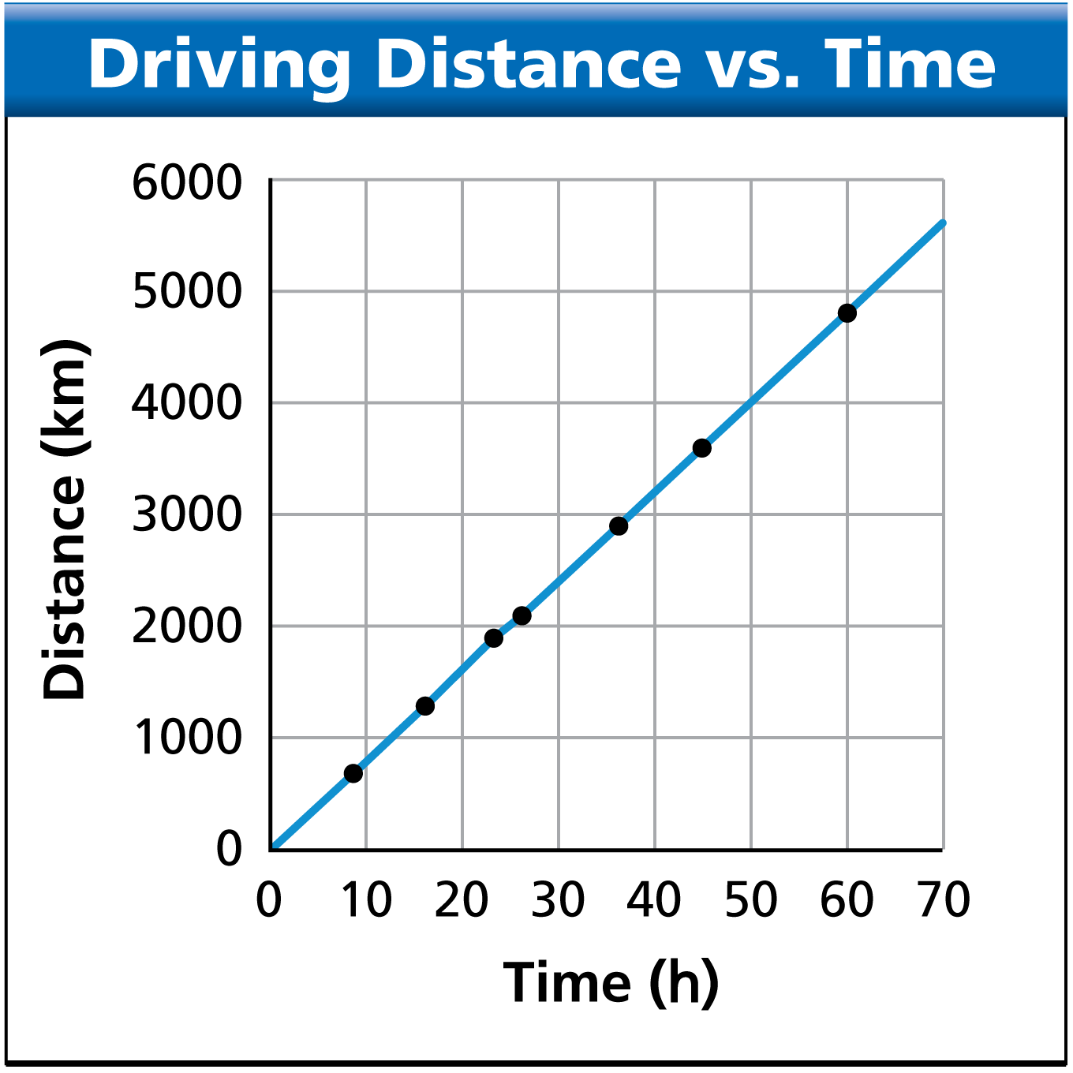
In order for news to be useful, it must be reported in a clear, organized manner. Like the news, scientific data become meaningful only when they are organized and communicated. Communication includes visual presentations, such as this graph.

Slide 2
Organizing Data
How do scientists organize data?

Slide 3
Organizing Data
Scientists can organize their data by using data tables and graphs.

Slide 4
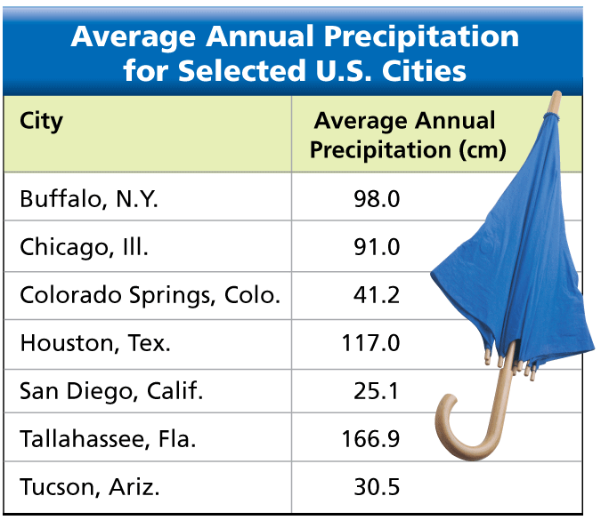
Organizing Data
Data Tables
The simplest way to organize data is to present them in a table. This table relates two variables—a manipulated variable (location) and a responding variable (average annual precipitation).

Slide 5
Organizing Data
Line Graphs
A line graph is useful for showing changes that occur in related variables.
In a line graph, the manipulated variable is generally plotted on the horizontal axis, or x-axis.
The responding variable is plotted on the vertical axis, or y-axis, of the graph.

Slide 6
Organizing Data
Sometimes the data points in a graph yield a straight line.
The steepness, or slope, of this line is the ratio of a vertical change to the corresponding horizontal change.
The formula for the slope of the line is

Slide 7
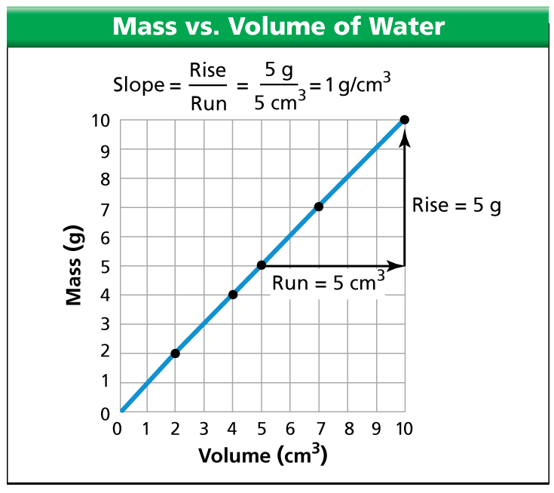
Organizing Data
Plotting the mass of water against the volume of water yields a straight line.

Slide 8
Organizing Data
A direct proportion is a relationship in which the ratio of two variables is constant. The relationship between the mass and the volume of water is an example of a direct proportion.
A 3-cubic-centimeter sample of water has a mass of 3 grams.
A 6-cubic-centimeter sample of water has a mass of 6 grams.
A 9-cubic-centimeter sample of water has a mass of 9 grams.

Slide 9
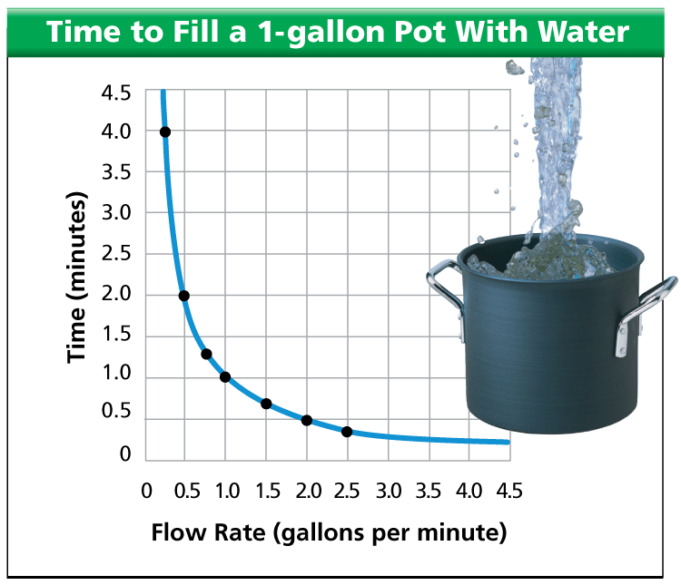
Organizing Data
This graph shows how the flow rate of a water faucet affects the time required to fill a 1-gallon pot.

Slide 10
Organizing Data
An inverse proportion is a relationship in which the product of two variables is a constant.
A flow rate of 0.5 gallon per minute will fill the pot in 2 minutes.
A flow rate of 1 gallon per minute will fill the pot in 1 minute.
A flow rate of 2 gallons per minute will fill the pot in 0.5 minute.

Slide 11
Organizing Data
Faster Than Speeding Data
A modem is a device used to send and receive data. For example, if you upload an image to a Web site, the modem in your computer converts the data of the image into a different format. The converted data are then sent through a telephone line or cable TV line. The smallest unit of data that can be read by a computer is a binary digit, or “bit.” A bit is either a 0 or a 1. Computers process bits in larger units called bytes. A byte is a group of eight bits.

Slide 12
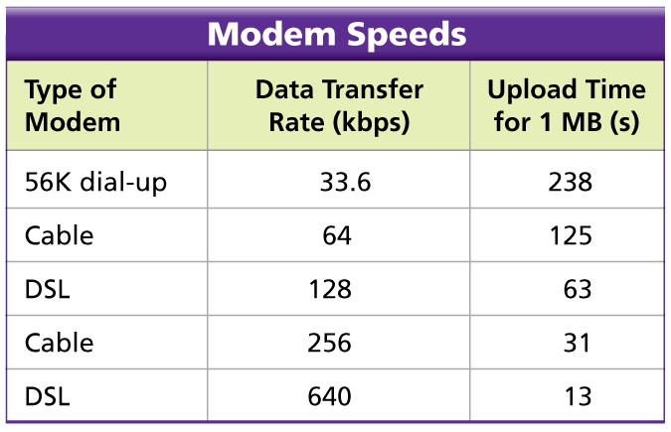
Organizing Data
The table shows the data transfer rates for modems used in home computers. Data transfer rates are often measured in kilobits per second, or kbps. The time required to upload a 1-megabyte (MB) file is given for each rate listed.

Slide 13
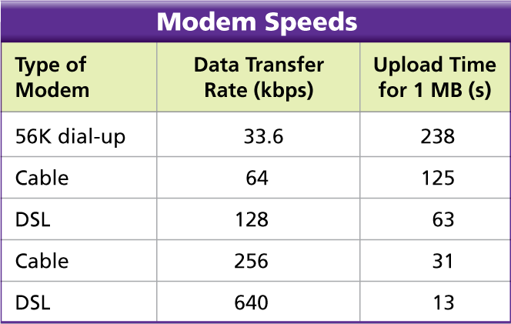
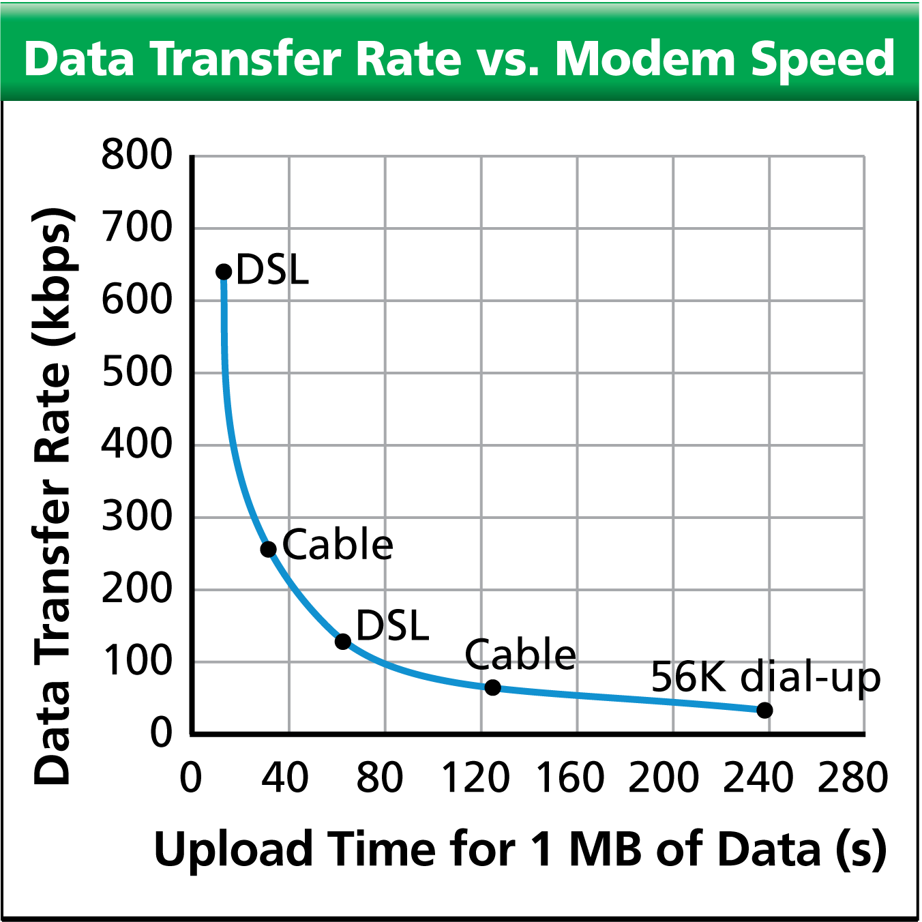
Organizing Data
Using Graphs Use the data in the table to create a line graph. Describe the relationship between data transfer rate and upload time.
Answer:

Slide 14
Organizing Data
2. Inferring How would doubling the data transfer rate affect the upload time?
Answer: Doubling the data transfer rate would halve the upload time.

Slide 15
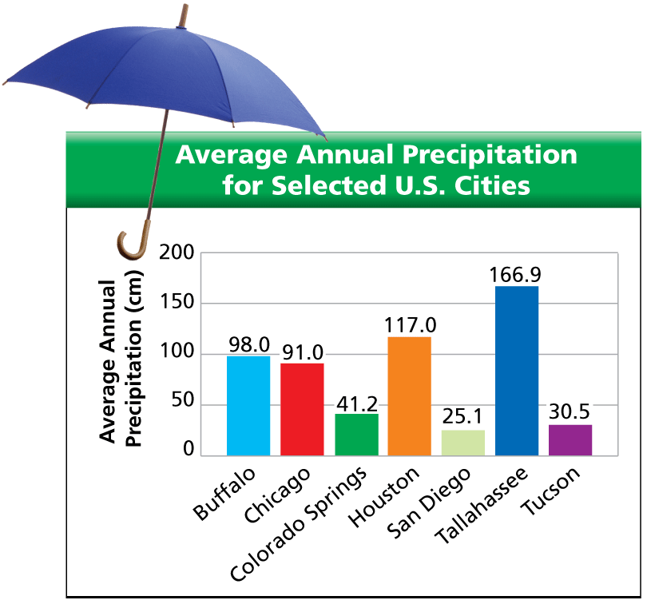
Organizing Data
Bar Graphs
A bar graph is often used to compare a set of measurements, amounts, or changes.

Slide 16
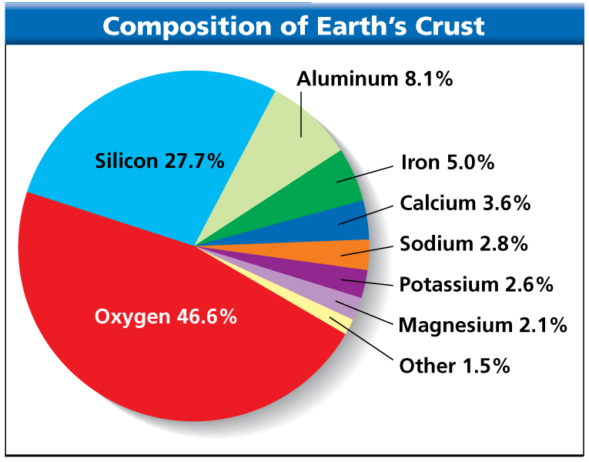
Organizing Data
Circle Graphs
If you think of a pie cut into pieces, you have a mental model of a circle graph. A circle graph shows how a part or share of something relates to the whole.

Slide 17
Communicating Data
How can scientists communicate experimental data?

Slide 18
Communicating Data
Scientists can communicate results by writing in scientific journals or speaking at conferences.

Slide 19
Communicating Data
Scientists also exchange information through conversations, e-mails, and Web sites. Young scientists often present their research at science fairs.

Slide 20
Communicating Data
Peer review is a process in which scientists examine other scientists’ work.
Peer review encourages comments, suggestions, questions, and criticism from other scientists.
Based on their peers’ responses, the scientists who submitted their work for review can then reevaluate how to best interpret their data.

Slide 21
Assessment Questions
Which type of graph is most useful for showing how part of something relates to the whole?
bar
circle
column
line

Slide 22
Assessment Questions
Which type of graph is most useful for showing how part of something relates to the whole?
bar
circle
column
line ANS: B

Slide 23
Assessment Questions
How does a line graph generally show the relationship between the manipulated variable and the responding variable?
The manipulated variable is plotted on the x-axis, and the responding variable is plotted on the y-axis.
The responding variable is plotted on the x-axis, and the manipulated variable is plotted on the y-axis.
The manipulated variable is plotted on the graph, and the responding variable is shown by the slope.
The responding variable is plotted on the graph, and the manipulated variable is shown by the slope.

Slide 24
Assessment Questions
How does a line graph generally show the relationship between the manipulated variable and the responding variable?
The manipulated variable is plotted on the x-axis, and the responding variable is plotted on the y-axis.
The responding variable is plotted on the x-axis, and the manipulated variable is plotted on the y-axis.
The manipulated variable is plotted on the graph, and the responding variable is shown by the slope.
The responding variable is plotted on the graph, and the manipulated variable is shown by the slope. ANS: A

Slide 25
Assessment Questions
How do scientists communicate the results of scientific investigations?
by writing in scientific journals or speaking at conferences
using secret code
only through e-mail
by writing in literary journals

Slide 26
Assessment Questions
How do scientists communicate the results of scientific investigations?
by writing in scientific journals or speaking at conferences
using secret code
only through e-mail
by writing in literary journals ANS: A

Slide 27
Assessment Questions
Why is peer review an important part of the scientific process?
Peer review makes sure that the correct researcher gets credit for discoveries.
Peer review helps identify errors or bias in research.
Peer review is the system used to report information to other scientists.
Peer review helps other scientists form theories about a discovery.

Slide 28
Assessment Questions
Why is peer review an important part of the scientific process?
Peer review makes sure that the correct researcher gets credit for discoveries.
Peer review helps identify errors or bias in research.
Peer review is the system used to report information to other scientists.
Peer review helps other scientists form theories about a discovery. ANS: B

