Slide 1
Enzyme Concept Map
mgolenberke
2015

Slide 2
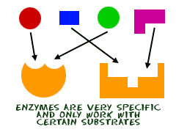
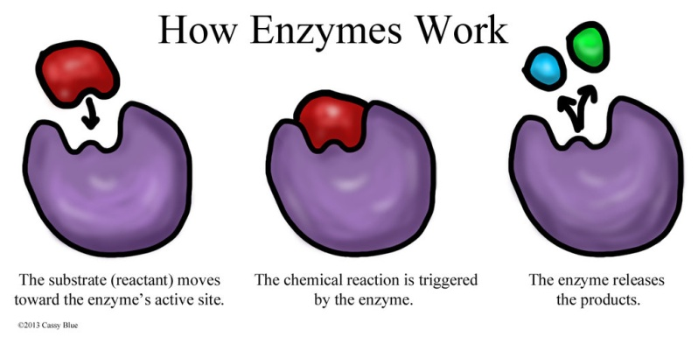
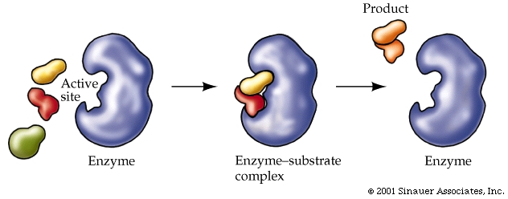
mgolenberke2015
Enzymes
protein
end in “–ase”
reusable (remains unchanged)
called an organic catalyst: enables 100’s of chemical reactions in each cell of our bodies every day
specific
@ active site
binds to substrate
“lock & key model”
Variables that effect reaction rate:
concentration of substrate
remains unchanged
temperature
pH
can break apart molecules
can join molecules

