Slide 1
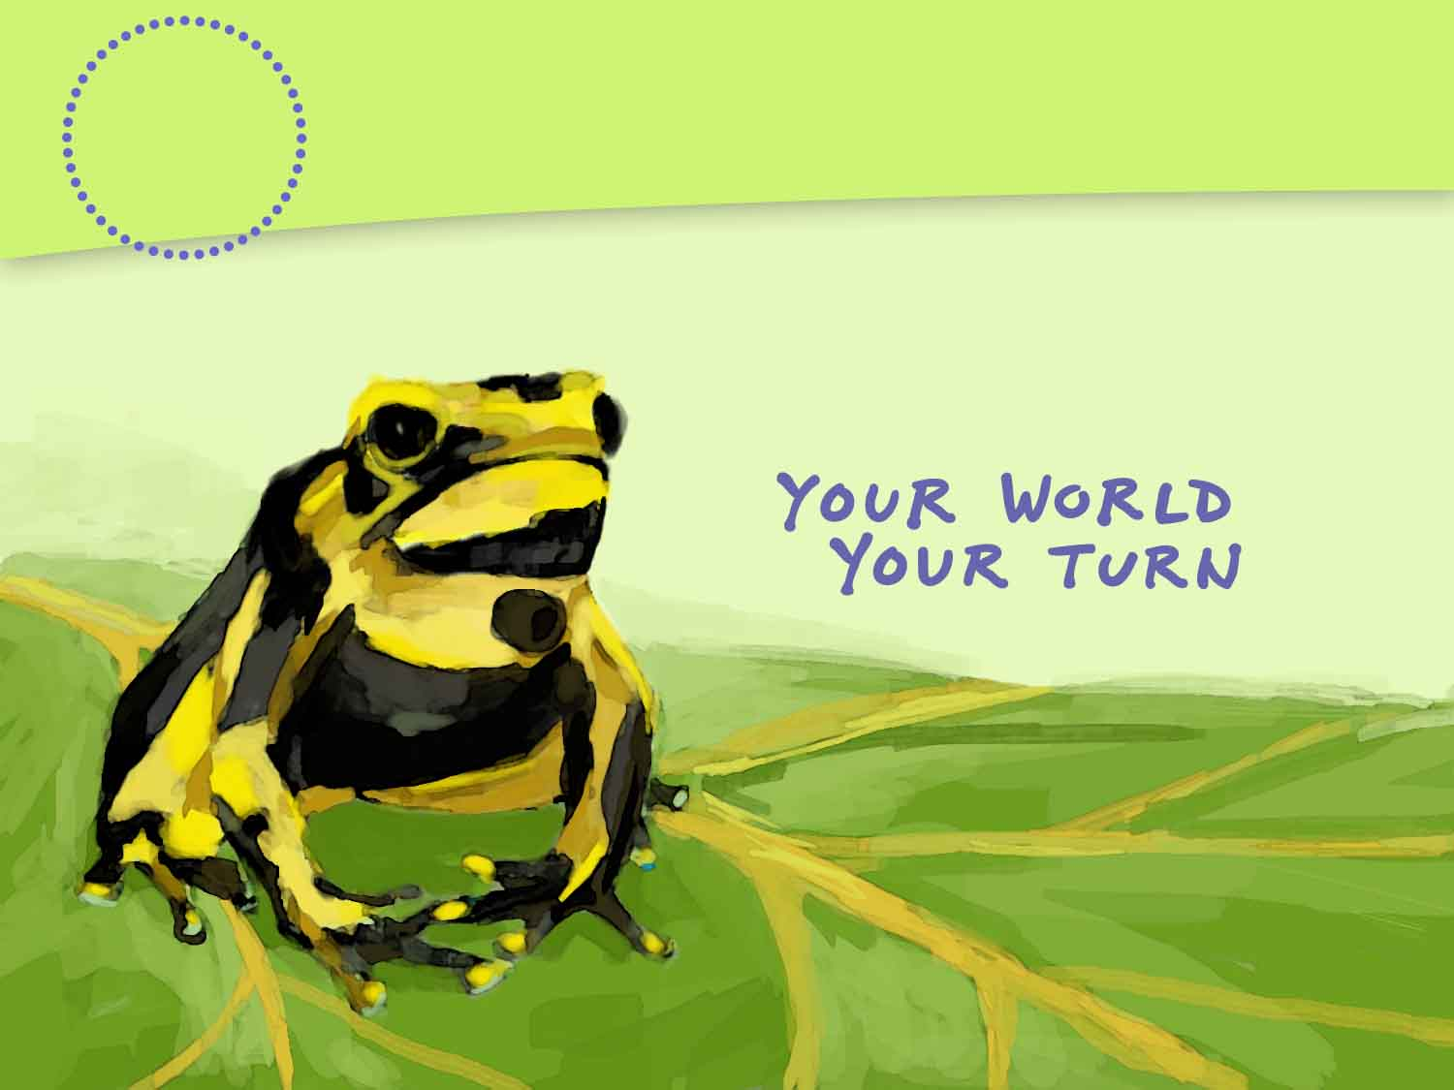
Biomes and Aquatic Ecosystems
6
CHAPTER
Notes:
Placeholder opening page, but maybe we can duplicate the look of the SE chapter opener page by using the same fonts and colors (and maybe that Ch 14 icon?)

Slide 2
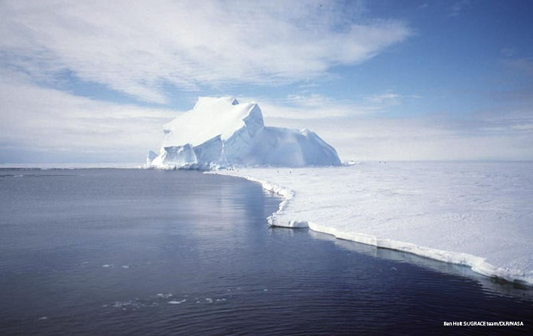
Lesson 6.1 Defining Biomes
Fossil evidence suggests that the frozen continent of Antarctica was once covered in temperate forest.

Slide 3
Objectives
Explain how biomes are characterized
Describe how net primary production varies among biomes.

Slide 4
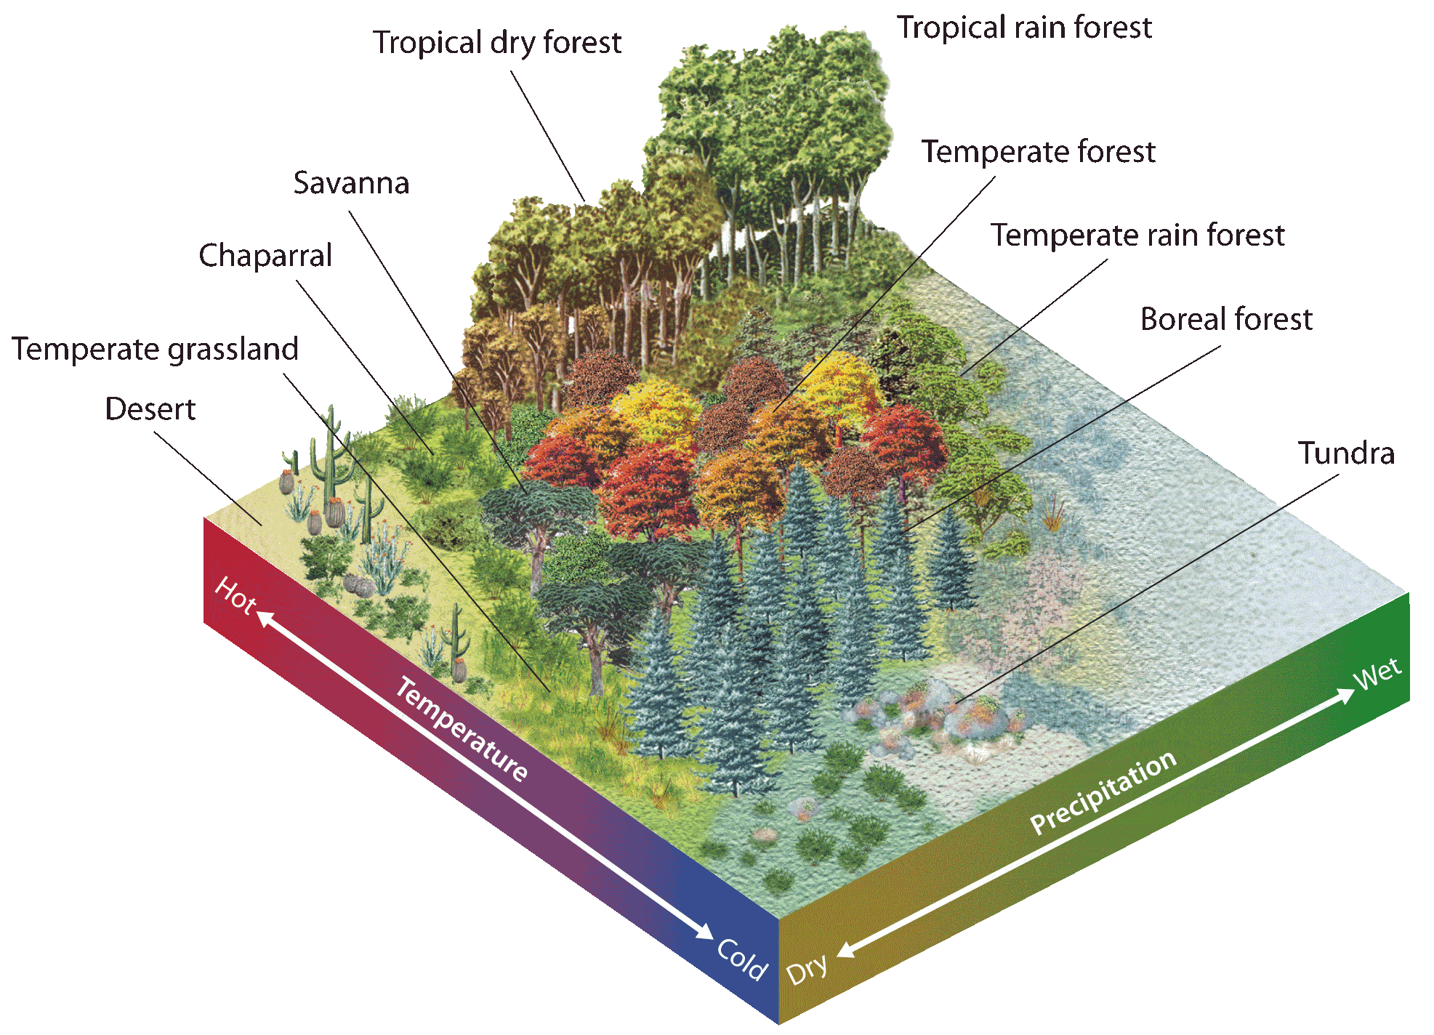
Earth’s Major Biomes
Lesson 6.1 Defining Biomes
Groups of terrestrial ecosystems that share biotic and abiotic conditions
10 primary biomes:
  tropical rain forest
  dry forest savanna
  desert
  temperate rain forest
  temperate forest
  temperate grassland
  chaparral
  boreal forest
  tundra
Did You Know? Taiga is another name for boreal forest.

Slide 5
Question
What are some abiotic and biotic factors in the area we live in?
What biome do you think we live in?
What biomes are near where we live?
Check your answer using Figure 1 pg. 165
What patterns do you notice in the location of biomes in Figure 1 on pg. 165?

Slide 6
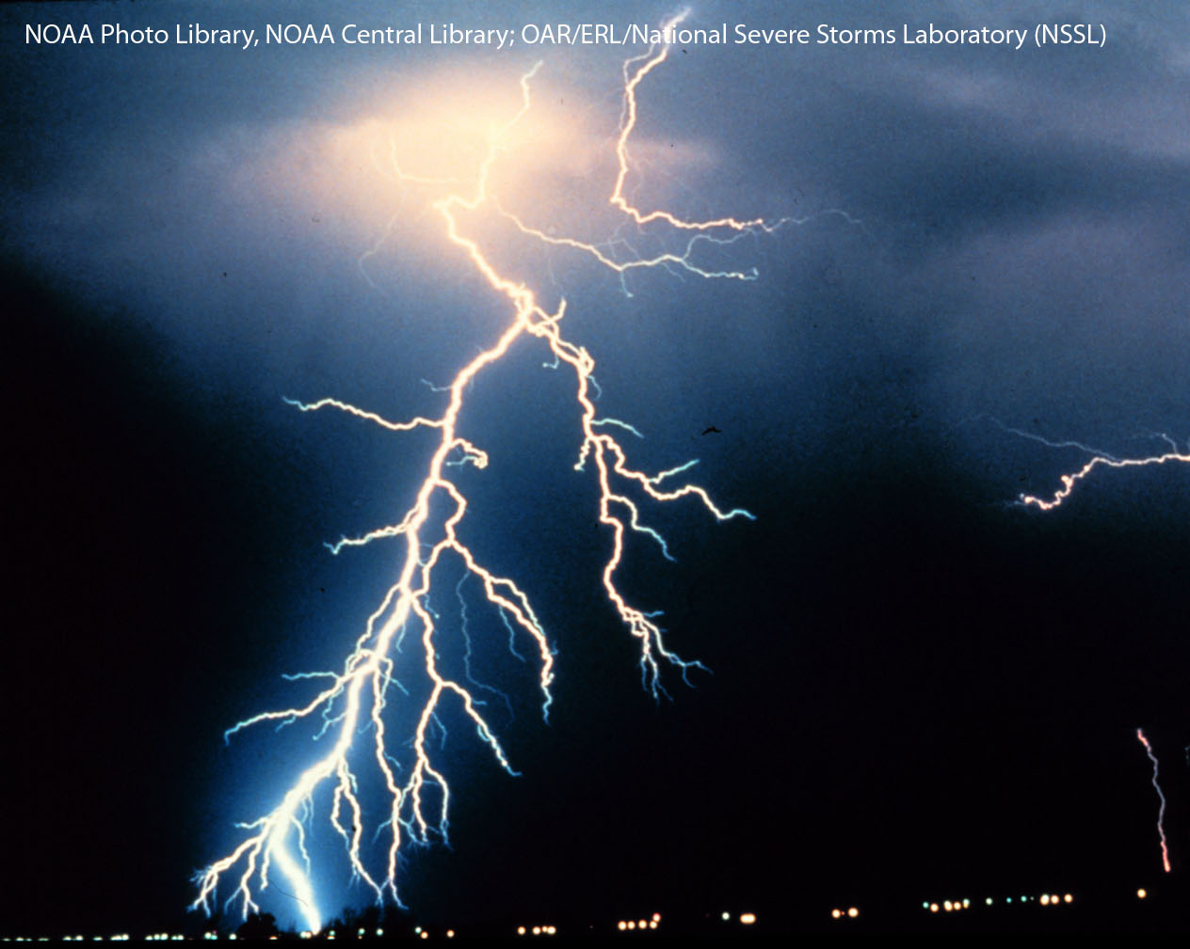
Climate and Climatographs
Lesson 6.1 Defining Biomes
Climate: Average conditions,
including temperature and
precipitation, over long periods
of time in a given area
Weather: Day-to-day conditions
in Earth’s atmosphere
Climatographs: Diagrams that summarize an area’s average monthly temperature and precipitation
Each biome has a set of characteristic organisms adapted to its particular climate conditions.

Slide 7
Question
In Harare, Zimbabwe (see Fig. 2 pg. 165)
  During what months is the rainy season?
  During what months is the dry season?
  What biome is Harare in?

Slide 8
Concept Check
What factors are used to characterize biomes?
What’s the difference between an ecosystem and a biome?

Slide 9
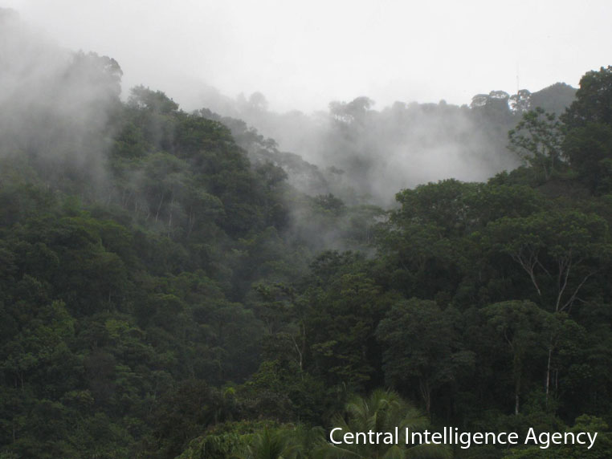
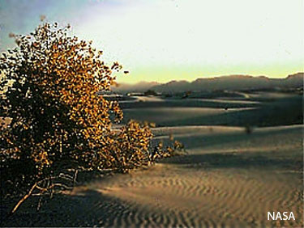
Biomes and Net Primary Production
Lesson 6.1 Defining Biomes
Gross primary production: The rate at which primary producers undergo photosynthesis
Net primary production: The amount of organic matter (biomass) that remains after primary producers use some to carry out cellular respiration
Ecosystems vary in their net primary productivity, the rate
at which primary producers convert energy to biomass.
Warm, wet biomes generally have higher net primary productivity than cold, dry biomes.

Slide 10
Objectives Revisited
Explain how biomes are characterized
Describe how net primary production varies among biomes.

Slide 11
Sum it Up!
On a sheet of looseleaf,
  For each vocabulary word, use your own words to define it.
  Write a one paragraph summary of the information in this lesson.
  Exchange with a neighbor for review.
  Discuss (5 minutes)

Slide 12
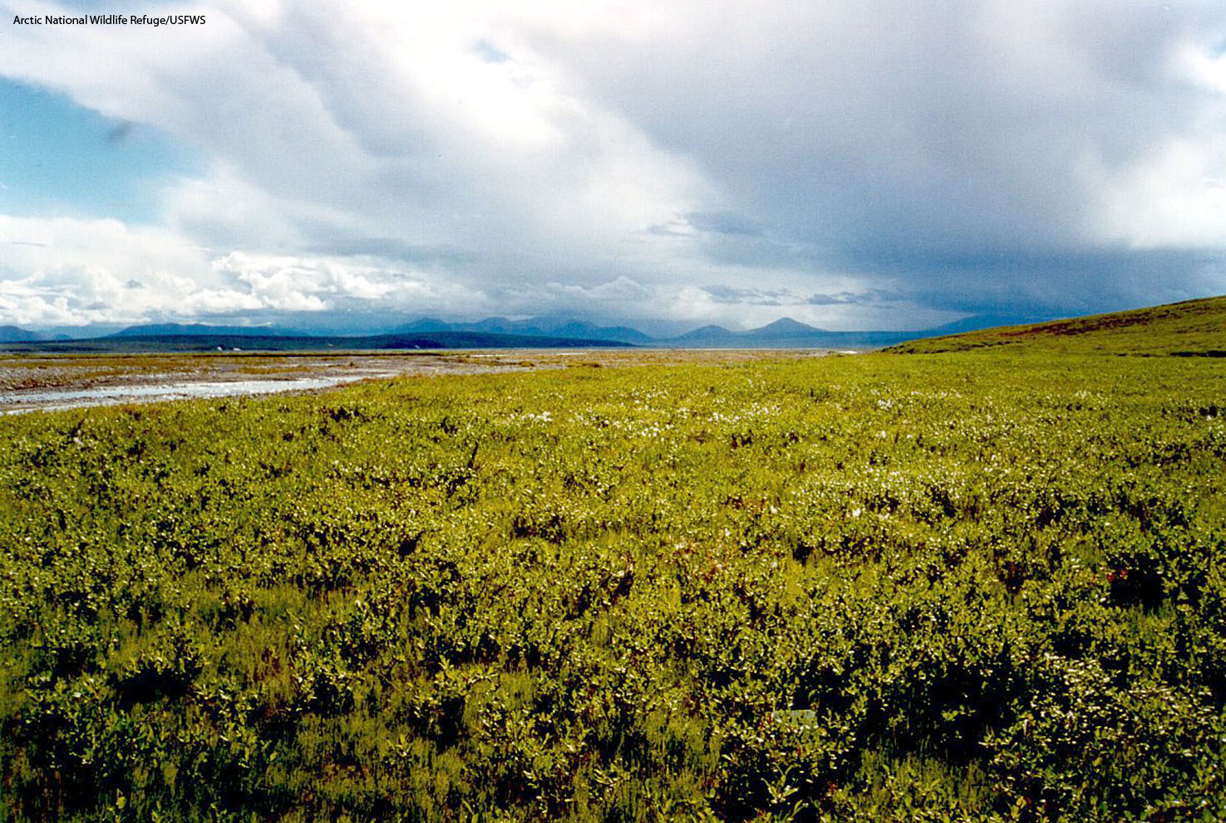
Lesson 6.2 Biomes
Tundra, found at very high latitudes, is nearly as dry as a desert.

Slide 13
Objectives
Explain how organisms are adapted to the conditions of their biomes.

Slide 14
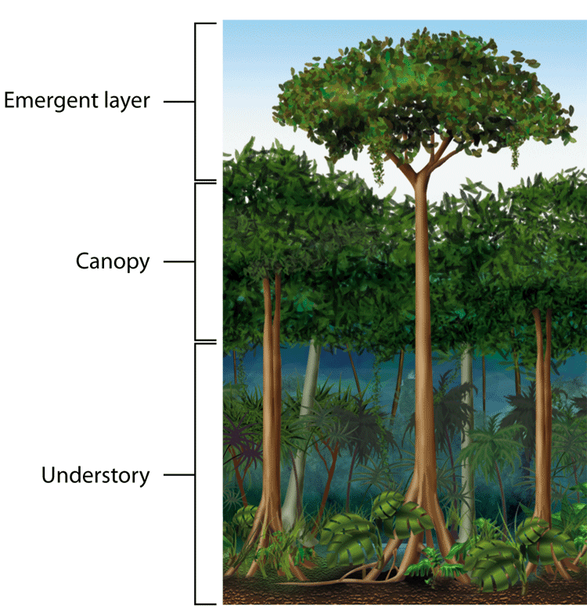
Tropical Rain Forest
Lesson 6.2 Biomes
Year-round warm temperatures and at least 2 m (6.6 ft) precipitation a year
Soil generally nutrient-poor
Forest canopy, emergent layer, and understory support enormous variety of plants.
Plants tend to have large, flat leaves and shallow roots.
Supports more animal species than any other biome; animals tend to be highly specialized.
Did You Know? Some tropical plants (epiphytes) grow high on other plants to access sunlight and do not touch the soil.

Slide 15
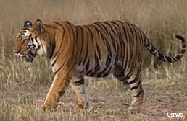
Tropical Dry Forest
Lesson 6.2 Biomes
Warm year-round, but rainfall highly seasonal
Most trees are deciduous—they lose their leaves and cease photosynthesis part of the year.
Plants and animals exhibit adaptations (e.g. waxy leaf coating, deep roots, estivation, migration) that enable them to survive the dry season.
Tiger (Panthera tigris)

Slide 16
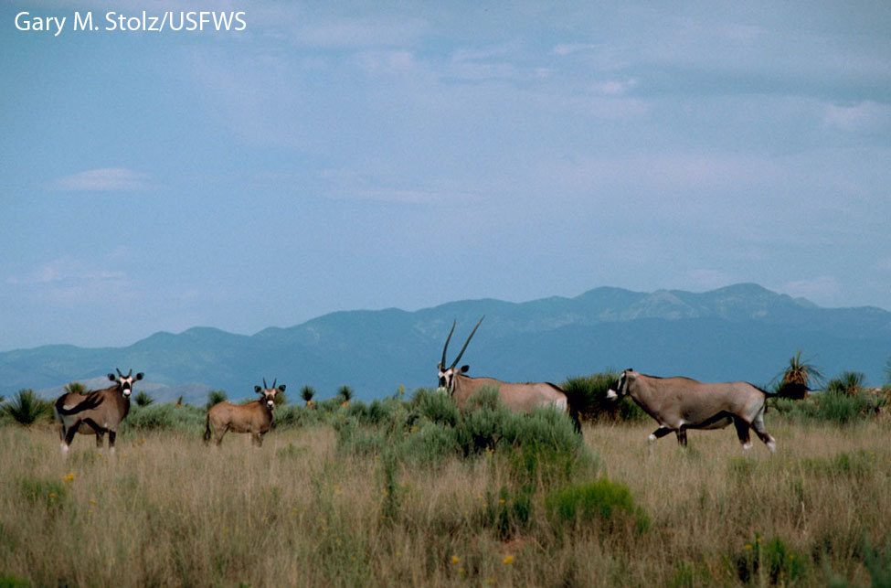
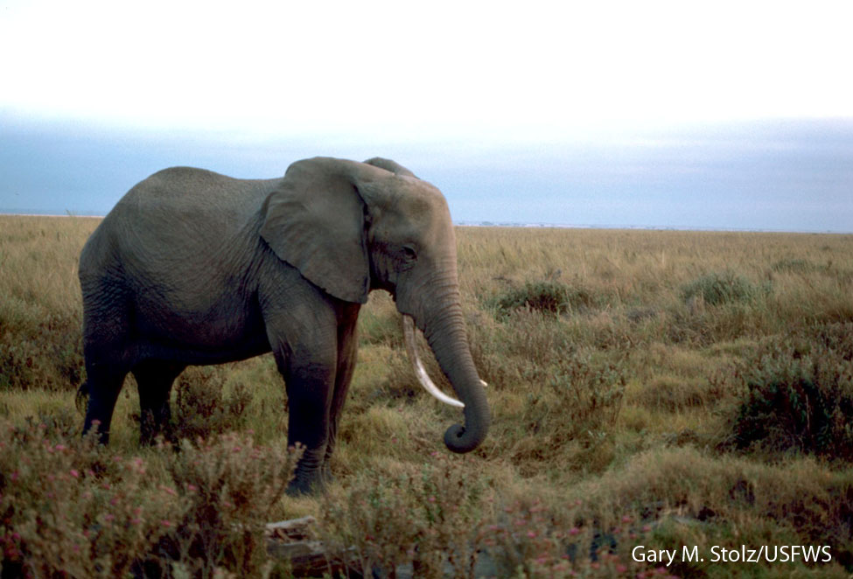
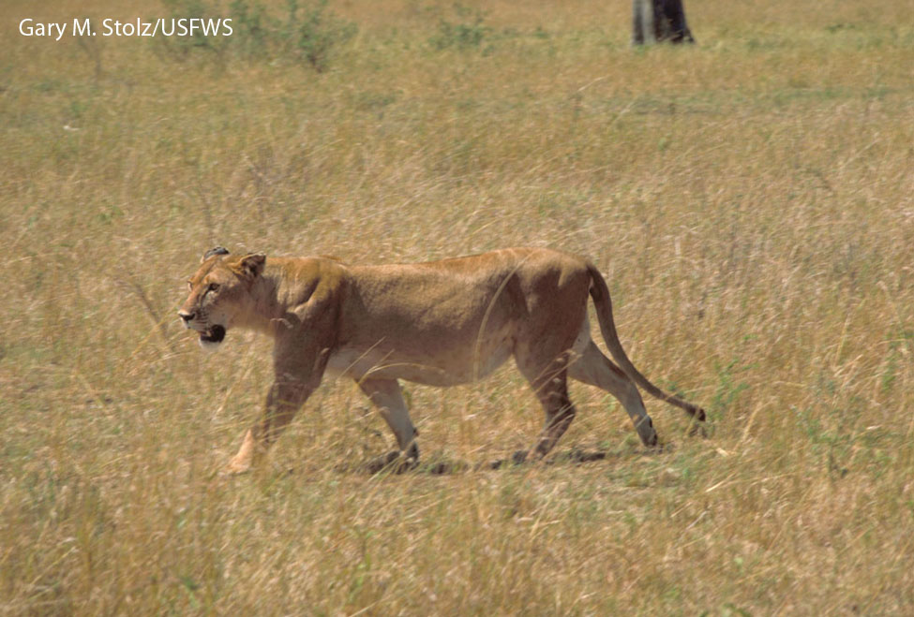
Savanna
Lesson 6.2 Biomes
Receives less precipitation than tropical dry forests, but more than deserts; usually has a distinct rainy season
Grasses interspersed with groups of trees
Tree growth limited by frequent fires and strong winds
Plants are adapted to dry conditions; tend to be deciduous with deep roots, thick bark, and waxy coatings on leaves.
Many animals migrate to find water, or burrow when water is scarce.

Slide 17
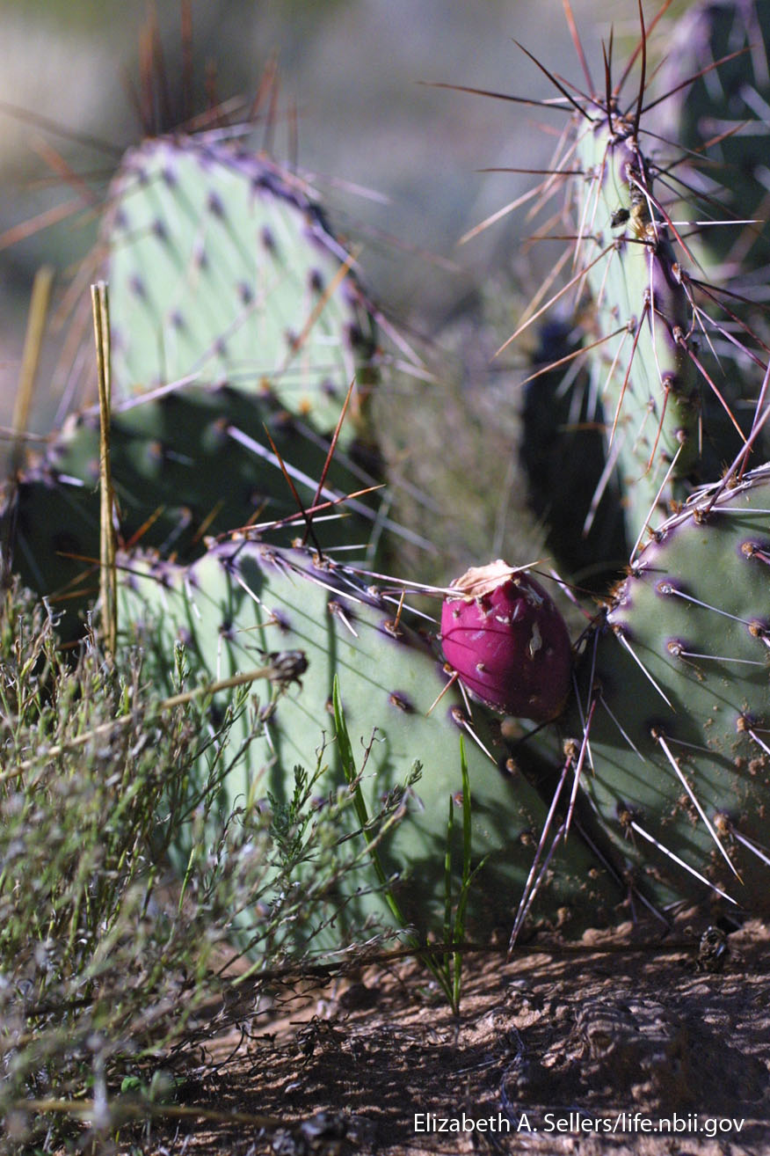
Desert
Lesson 6.2 Biomes
Did You Know? Cactus spines are modified leaves that protect the plant from thirsty animals. Photosynthesis occurs within the green stems and trunks.
Receives less than 25 cm (9.8 in.) of precipitation per year
Temperatures vary widely from day to night.
Plants tend to have thick, leathery leaves, store water in their tissues, and have shallow roots.
Animals get most of their water from the food they eat, and they tend to be nocturnal. Mammals have exaggerated appendages to help regulate body temperature.

Slide 18
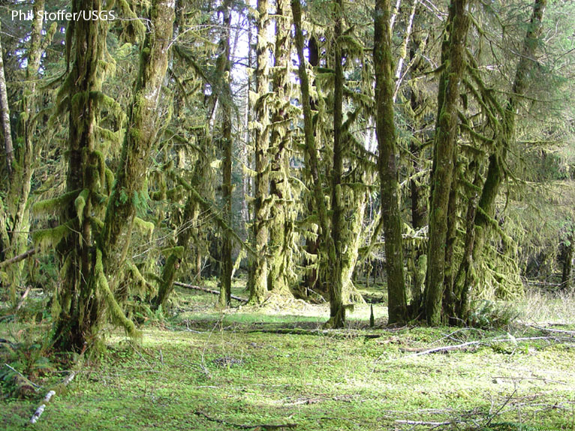
Temperate Rain Forest
Lesson 6.2 Biomes
Year-round moderate temperatures and heavy rainfall
Largest extent found in Pacific Northwest of United States
Characterized by tall evergreen trees, such as cedars and hemlocks, that don’t lose leaves annually; many are conifers (produce seed-bearing cones)
Forest floor is shaded, damp, covered in moss.
Animals that require moisture, such as amphibians, thrive here.
Olympic Peninsula, Hoh River rain forest

Slide 19
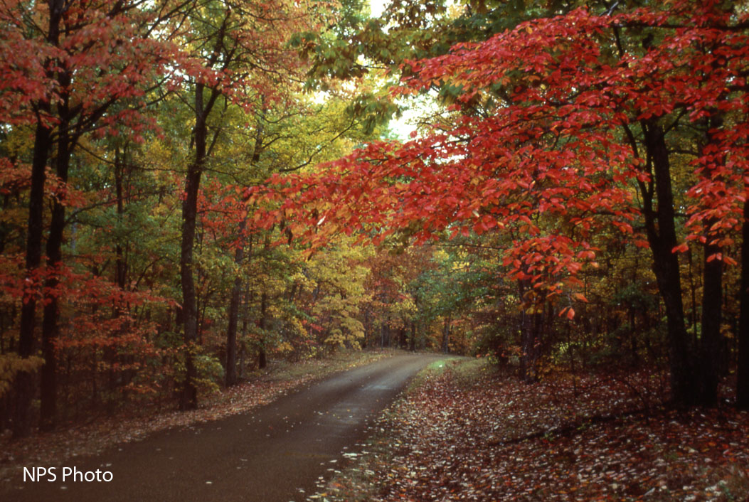
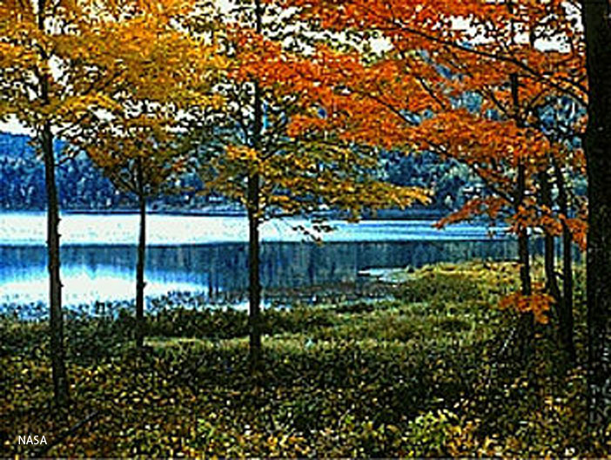
Temperate Forest
Lesson 6.2 Biomes
Precipitation evenly spread throughout the year
Varied temperatures (hot summers, cold winters)
Plants tend to be broad-leafed and deciduous.
Soil is enriched with nutrients from annual leaf drop.
Animals may migrate, hibernate, or store food to survive cold conditions.

Slide 20
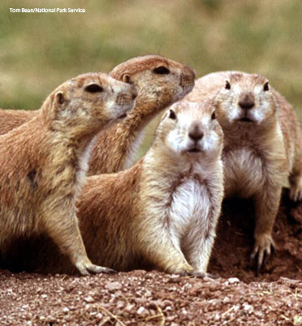
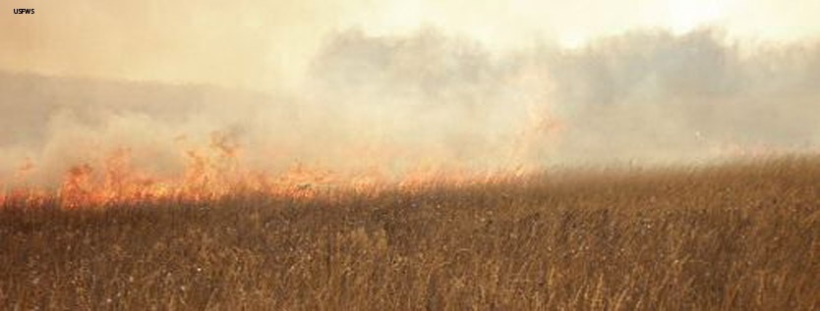
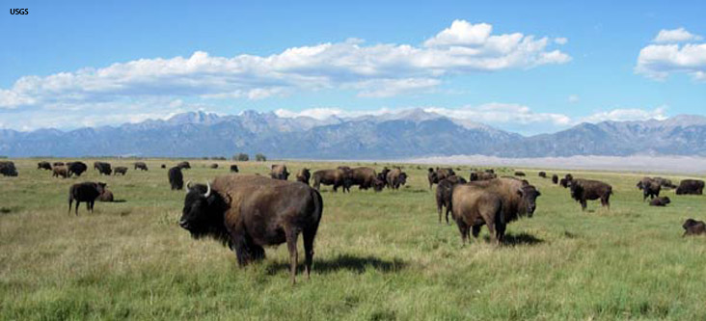
Temperate Grassland (Prairie)
Lesson 2.2 Biomes
Moderate seasonal precipitation and fairly extreme seasonal temperatures; droughts and fires common
Not enough precipitation to support large trees; grasses, which grow from their base, thrive despite droughts, fires, animals grazing
Animals are adapted to deal with lack of cover.
Soil tends to be rich in nutrients; most of world’s grasslands have been converted to farmland.

Slide 21
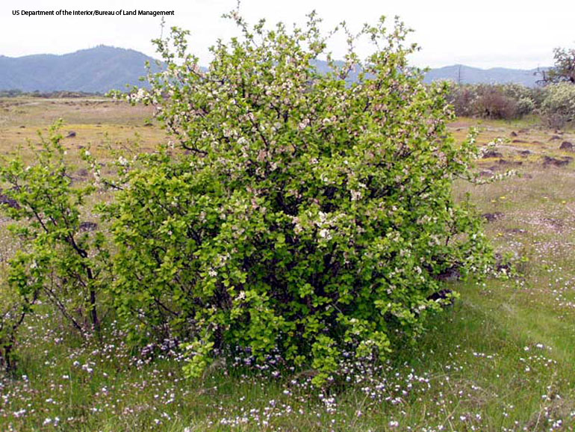
Chaparral
Lesson 6.2 Biomes
Did You Know? Some chaparral plants contain oily compounds that facilitate the spread of fire.
Highly seasonal conditions with mild,
wet winters and warm, dry summers
Prolonged hot, dry periods; droughts and fires common
Plants are drought-resistant; many have thick, waxy leaves or leaves with hairs that trap moisture;
succulents are common.
Plants may have thick bark and
deep roots to resist fire; some plants
require fire to germinate.
Many animals burrow or are nocturnal
to avoid heat.

Slide 22
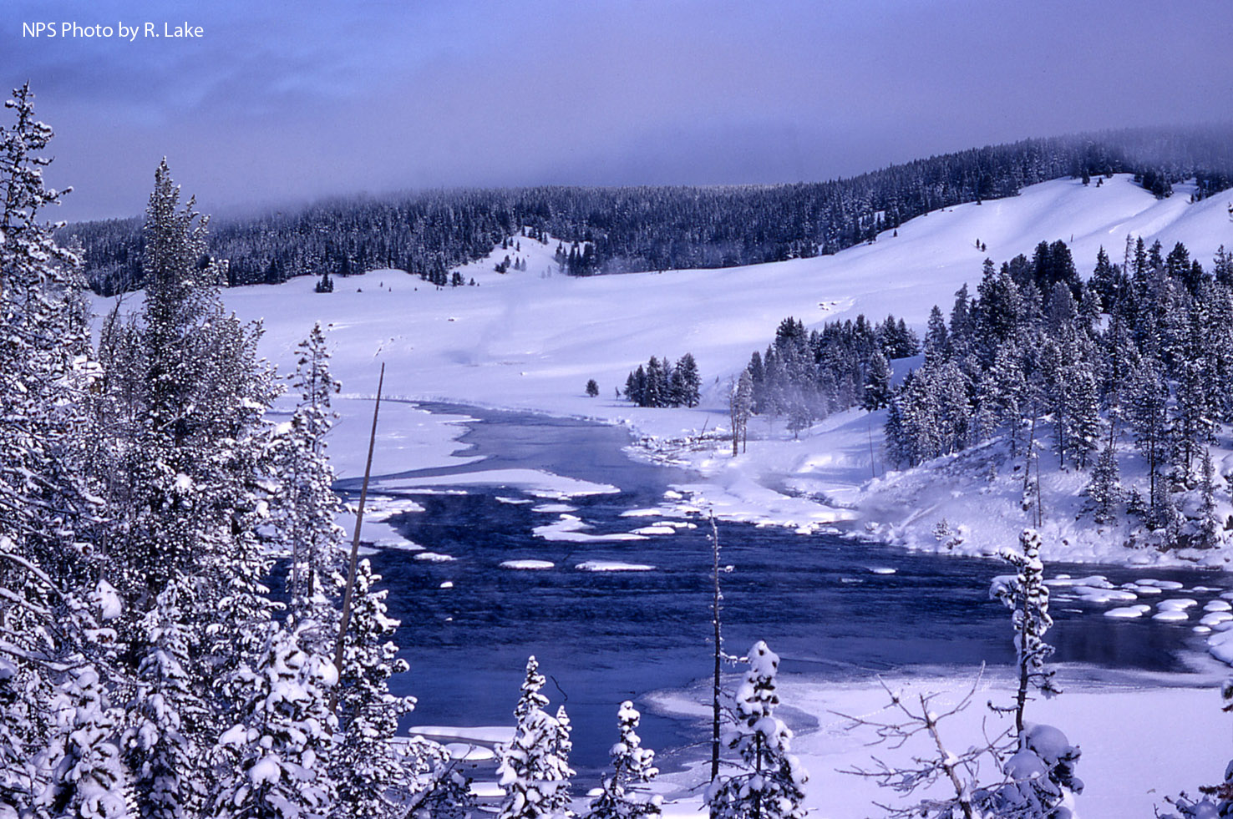
Boreal Forest (Taiga)
Lesson 6.2 Biomes
Long, cold winters; short,
cool summers
Nutrient-poor, slightly
acidic soils
Low species diversity
Coniferous trees with
waxy needles and conical
shape, adapted to harsh, snowy conditions are common.
Animals feed, breed, and care for young mostly during short warm season; year-round residents tend to have thick insulation and small extremities that maintain heat.

Slide 23
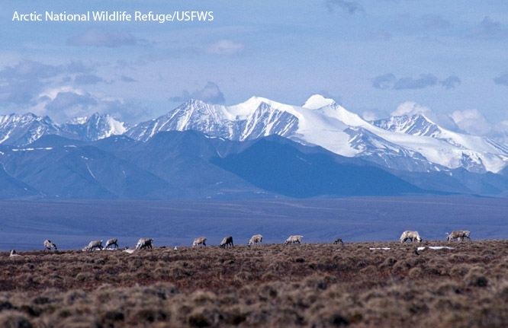
Tundra
Lesson 6.2 Biomes
Extremely cold, dark winters; relatively sunny and cool summers
Found at very high latitudes in the Northern Hemisphere
Harsh winds, nutrient-poor soil, and freezing temperatures limit plant growth; no tall trees; mosses and lichens common
Characterized by permafrost (underground soil that is frozen year-round)
Birds and caribou migrate to the tundra during the mild summer to feed on insects and lichens; only a few species live here year-round.

Slide 24
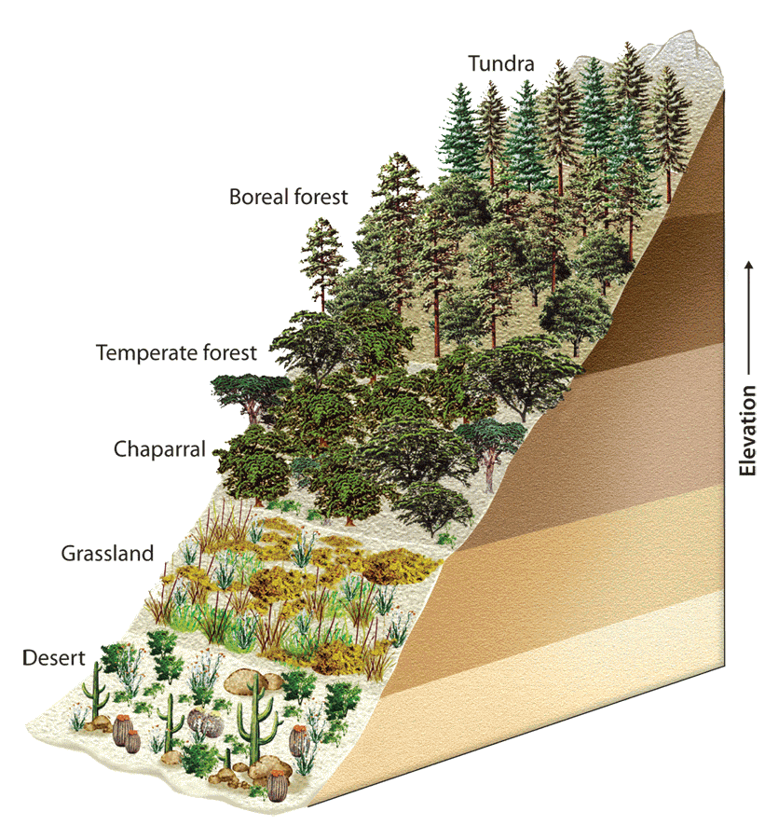
Polar Ice and Mountains
Lesson 6.2 Biomes
Not classified as biomes
No land under polar ice in Northern Hemisphere; ice sits atop Antarctica in Southern Hemisphere
Very few plants; most life
is in surrounding ocean
Mountain communities
change with elevation,
similar to how biome communities change
with latitude.

Slide 25
Local Climatograph
Month | Mean Temp (F) | Avg. Precip.
Jan | 26 | 3.85
Feb | 29 | 2.9
March | 37 | 3.81
April | 48 | 3,99
May | 58 | 4.77
June | 68 | 4.78
July | 72 | 4.47
Aug | 71 | 4.64
Sept | 63 | 4.54
Oct | 51 | 3.95
Nov | 43 | 4.22
Dec | 32 | 3.78
Based on the table to the left, make a climatograph for Palmerton, PA
What biome is Palmerton, PA in?
Does this match what you predicted earlier?

Slide 26
Reinforcement
Create a riddle about one of the biomes described in this lesson.
  Ex: I am a biome that receives a lot of rain, has nutrient poor soil and has a huge variety of plants. What biome am I?
  Share

Slide 27
Objectives Revisited
Explain how organisms are adapted to the conditions of their biomes.

Slide 28
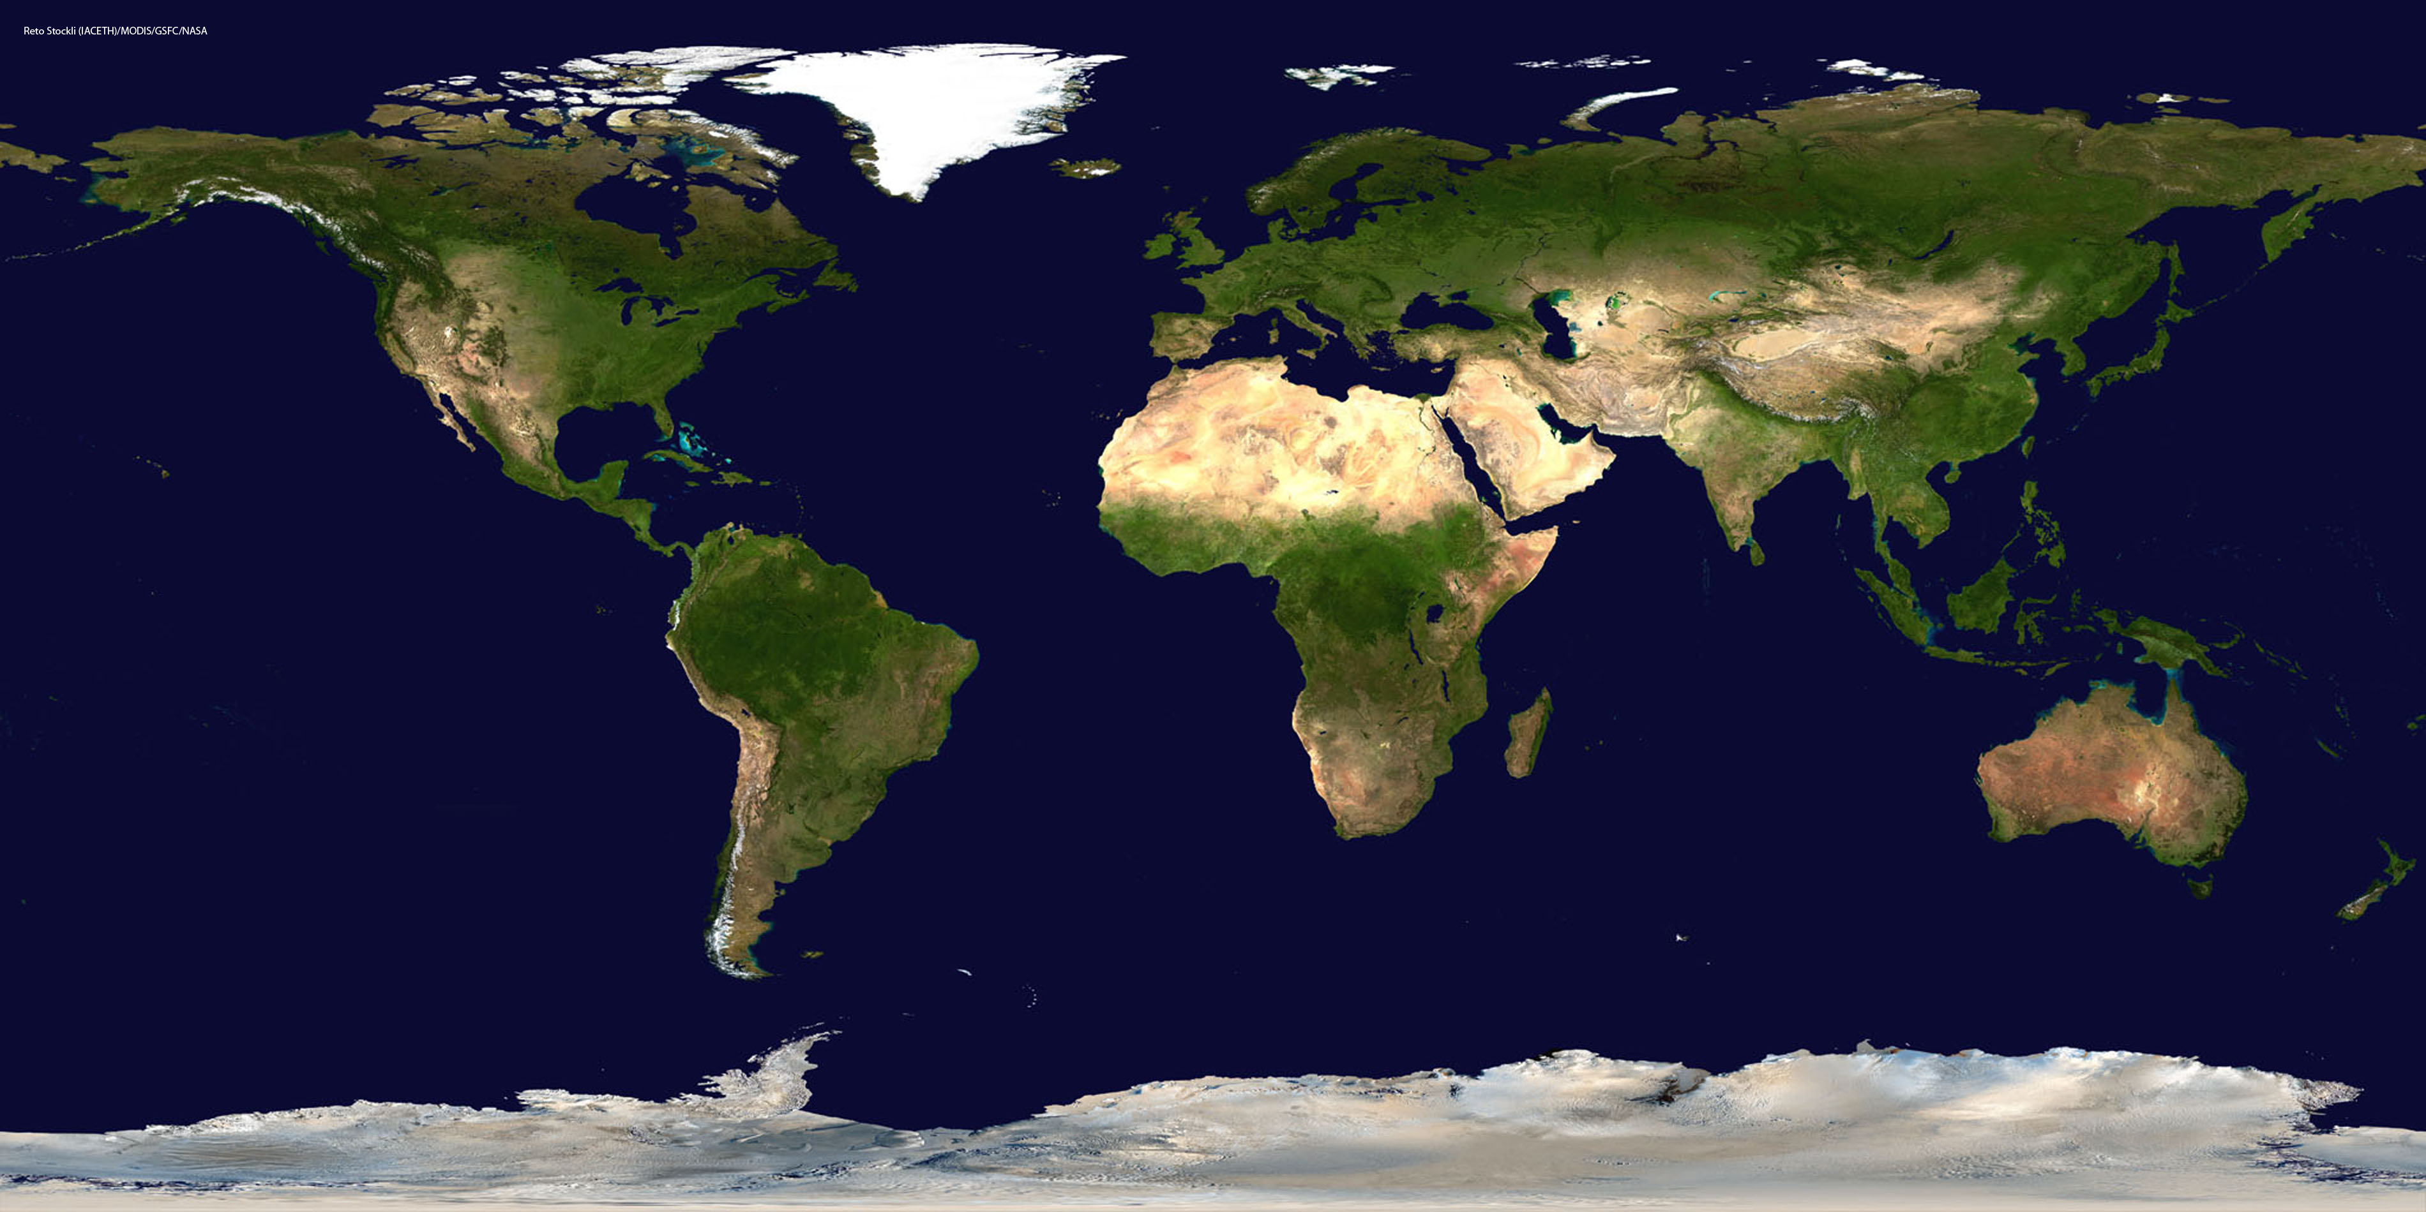
Lesson 6.3 Aquatic Ecosystems
75% of Earth’s surface is covered by water.

Slide 29
Objectives
Describe the criteria ecologists use to classify aquatic ecosystems.
List the major categories of freshwater ecosystems.
Explain the ecological importance of estuaries.
List the 3 major zones of the ocean.

Slide 30
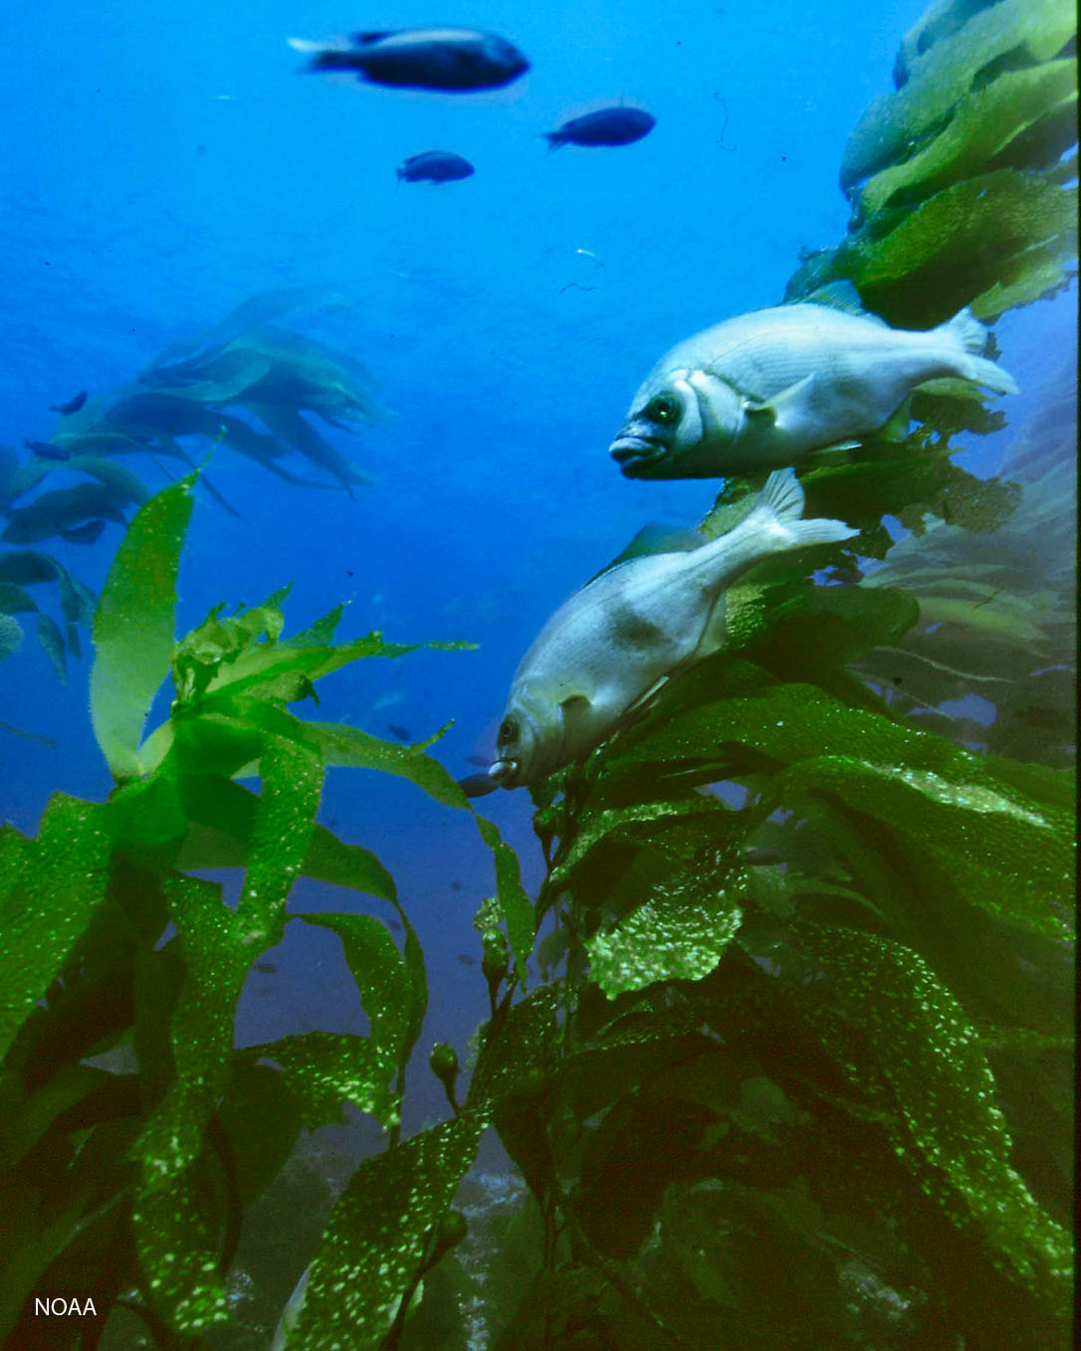
Describing Aquatic Ecosystems
Lesson 6.3 Aquatic Ecosystems
Salinity: the amount of dissolved salt present in water. Ecosystems are classified as salt water, fresh water, or brackish depending on salinity.
Photosynthesis tends to be limited by light availability, which is a function of depth and water clarity.
Aquatic ecosystems are either flowing or standing.
Aquatic ecosystem zones: photic, aphotic, benthic

Slide 31
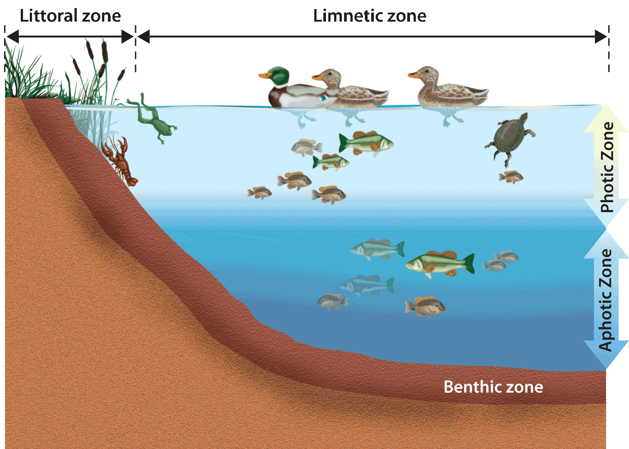
Freshwater Ecosystems: Ponds, Lakes, Inland Seas
Lesson 6.3 Aquatic Ecosystems
Salinity is less than 0.5 ppt (parts per thousand)
Ponds and lakes are
similar, except in size,
but inland seas contain
organisms adapted for
open water.
Ponds and lakes are
divided horizontally
into zones: littoral
and limnetic

Slide 32
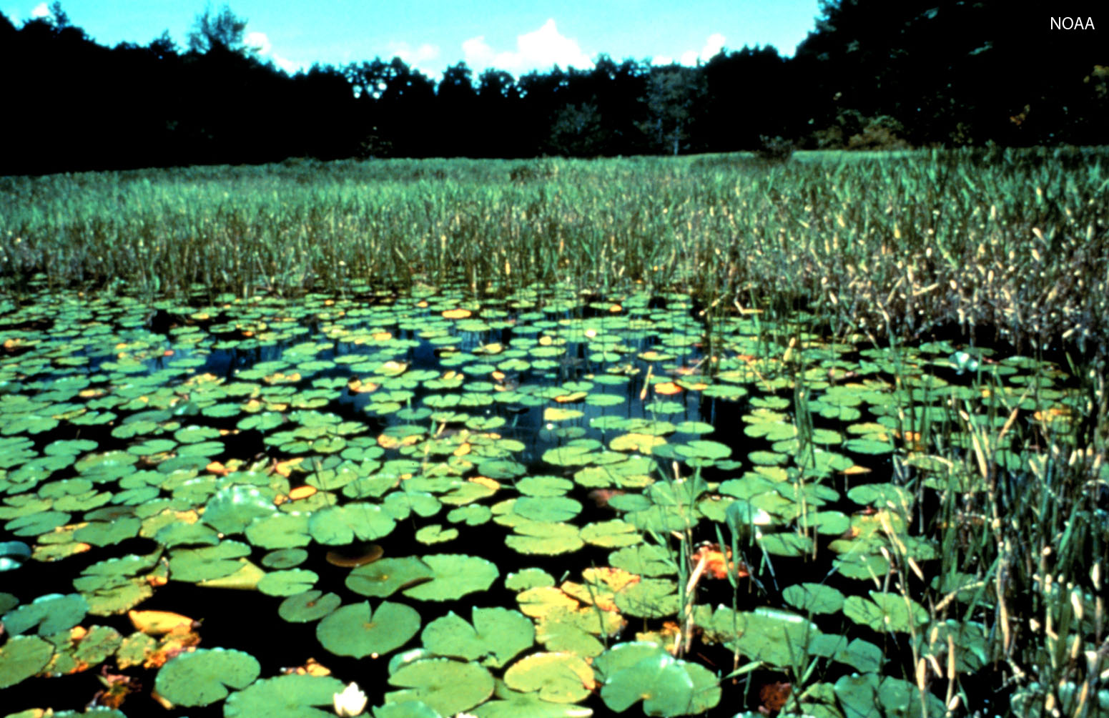
Freshwater Ecosystems: Wetlands
Lesson 6.3 Aquatic Ecosystems
Areas of land flooded with water at least part of the year
Include freshwater marshes, swamps, bogs, and fens
Wetlands prevent flooding, recharge aquifers, filter pollutants, and provide habitats.

Slide 33
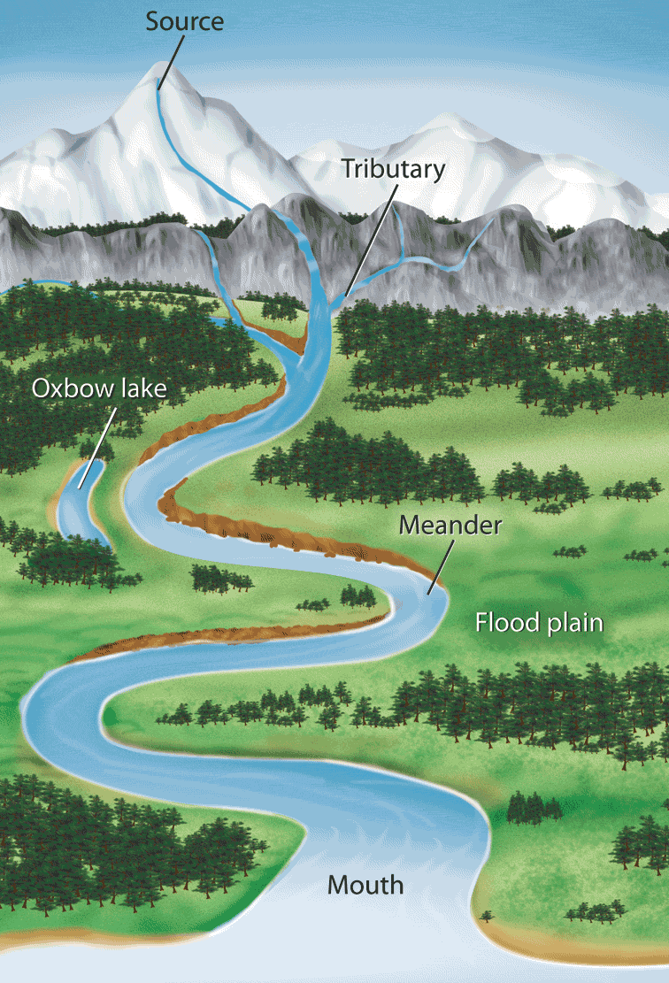
Freshwater Ecosystems: Rivers and Streams
Lesson 6.3 Aquatic Ecosystems
Bodies of surface water that flow downhill, eventually reaching an ocean or inland sea
Watershed: The area of land drained by a river and its tributaries
Characteristics, such as dissolved oxygen, temperature, water speed, organisms, and others, change from source to mouth.

Slide 34
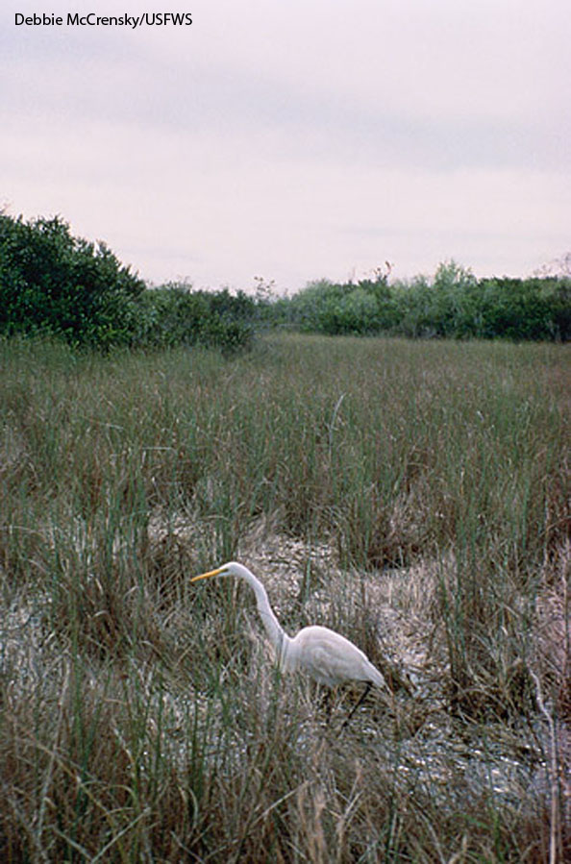
Estuaries
Lesson 6.3 Aquatic Ecosystems
Occur where a river flows into the ocean or an inland sea
Coastal estuaries are brackish ecosystems; organisms must tolerate wide salinity and temperature ranges.
Coastal estuaries are home to salt marshes and mangrove forests.
Like wetlands, estuaries help prevent flooding and soil erosion as well as provide habitats.
Everglades, Florida, wetlands
Did You Know? Salt marshes and mangrove forests are two of the most productive ecosystems on Earth.

Slide 35
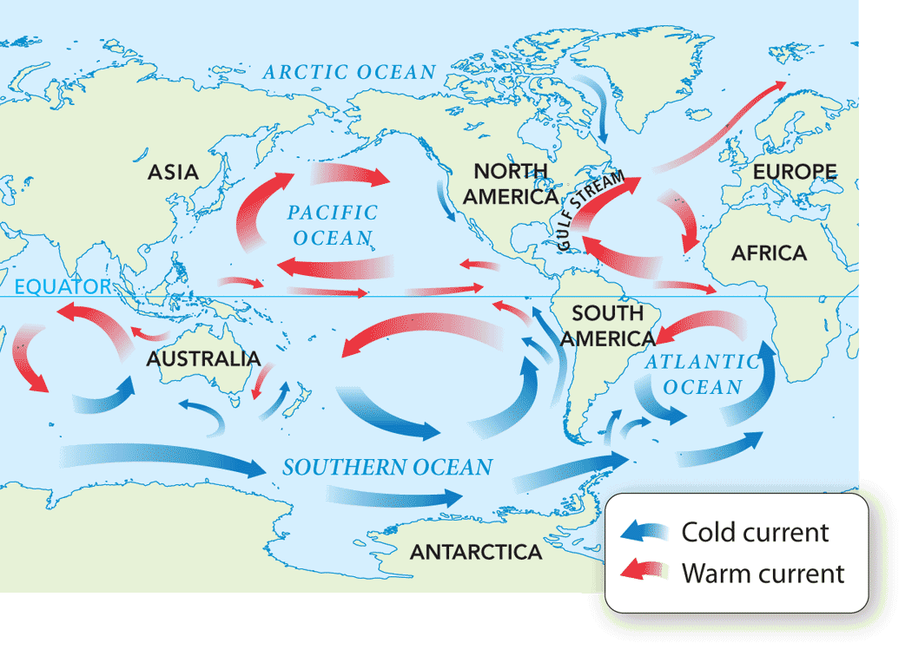
Oceans
Lesson 6.3 Aquatic Ecosystems
Currents are driven by water temperature and density differences, wind, and gravity.
Surface winds and heating generate vertical currents that transport nutrients and oxygen.
Horizontal ocean zones: intertidal, neritic, open ocean
Vertical ocean zones: photic, aphotic, benthic
Did You Know? If the water in the oceans evaporated, a 60 m (200 ft) deep layer of salt would be left behind.

Slide 36
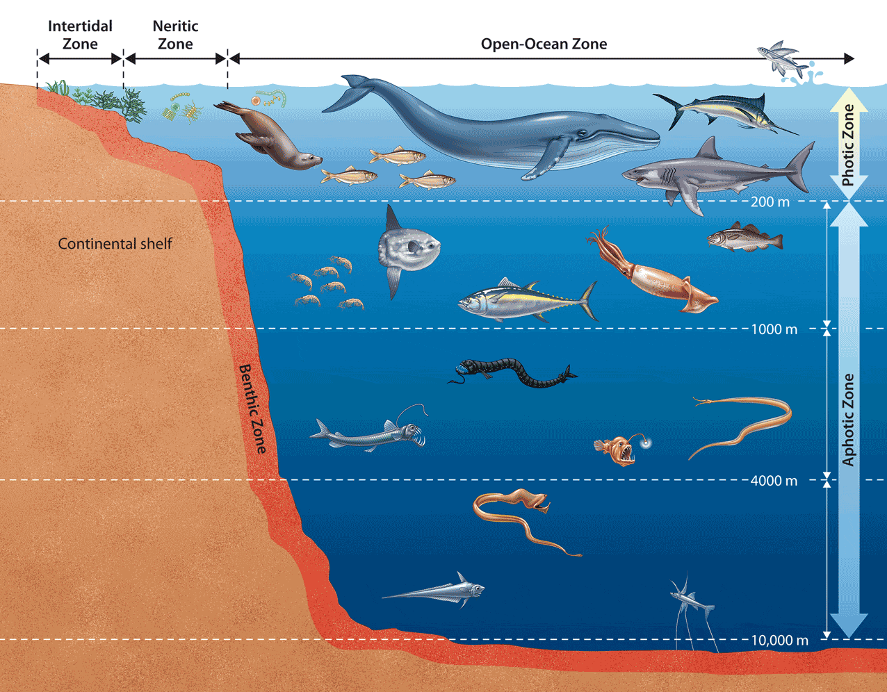
Ocean Ecosystems
Lesson 6.3 Aquatic Ecosystems
Intertidal: Highly diverse; extreme range of temperature, moisture, and salinity
Neritic: Productive kelp forests and coral reefs provide habitats and help protect shorelines from erosion.
Open ocean: Low productivity due to low light penetration; phytoplankton base of food chain; deep sea organisms and hydrothermal vent communities
Did You Know? Over 90% of ocean water on Earth is in the open ocean zone.

Slide 37
Writing Prompts
Aquatic ecosystems are classified based on…
The major categories of freshwater ecosystems are…
Estuaries are ecologically important because…
Based on distance from the shore, the ocean is classified into 3 zones called…

Slide 38
Objectives Revisited
Describe the criteria ecologists use to classify aquatic ecosystems.
List the major categories of freshwater ecosystems.
Explain the ecological importance of estuaries.
List the 3 major zones of the ocean.

