Slide 1
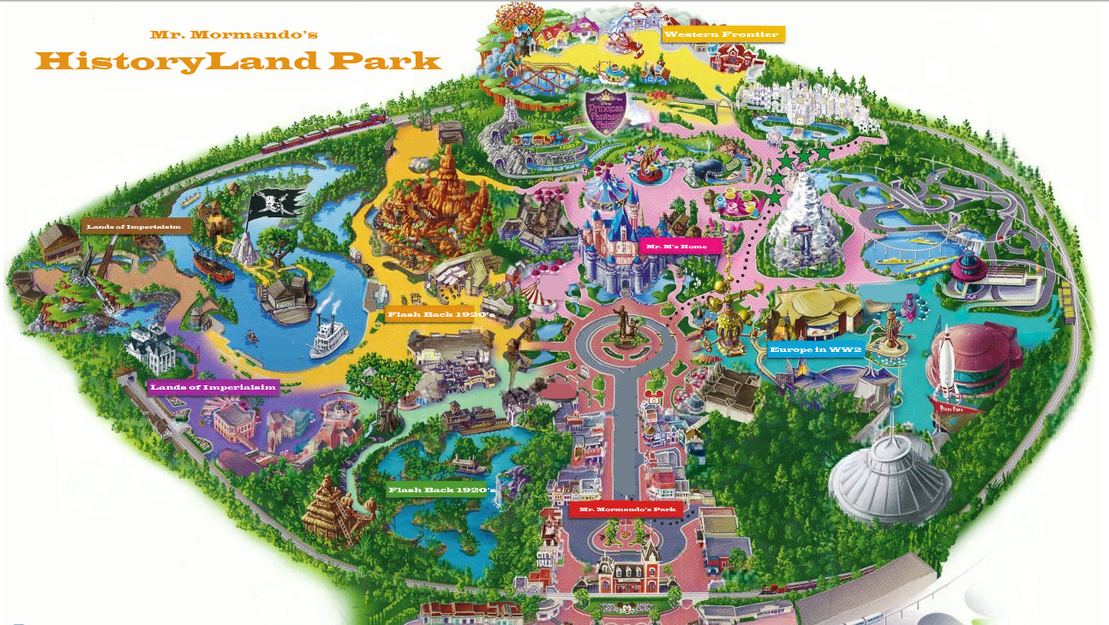
Mr. Mormando’s
US History 2 Final (Example)

Slide 2
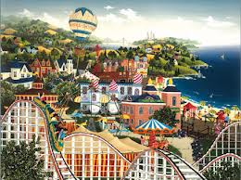
Park Sections
Western Frontier Land
Lands of Imperialism
Flash Back to the 1920’s
Europe in World War 2

Slide 3
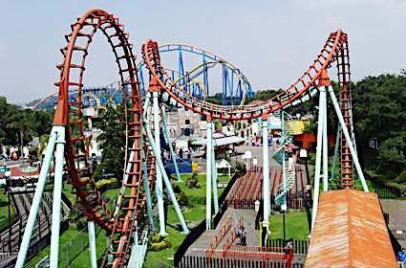
Western Frontier Land
The Exoduster
The Exoduster is a rollercoaster with 3 upside down turns and 2 30 foot drops.
It was named after the thousands of African-Americans who moved form the Post-Reconstruction South to Kansas in the late 1860’s.

Slide 4
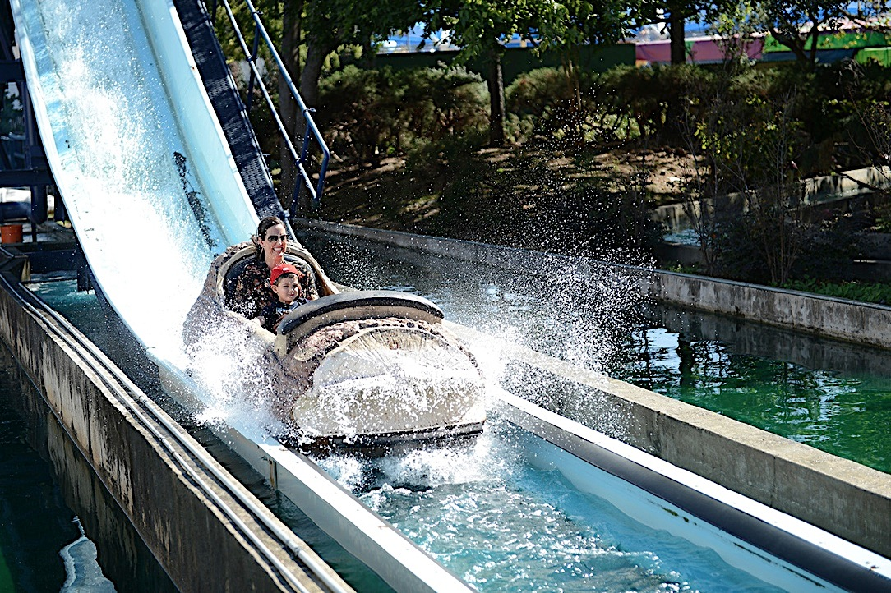
Western Frontier Land
The Long Drive Log Flume
The Long Drive Log Flume is a fun ride for families on a hot day because everyone gets splashed when the flume drops into the waiting pool of water.
This ride was named after the the long overland transport of animals by the cowboys during the late 1800s.

Slide 5
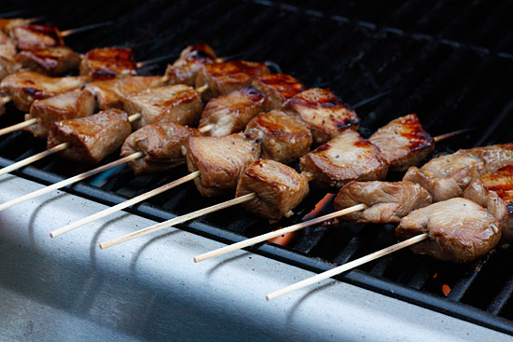
Western Frontier Land
Buffalo Skewers
Delicious skewers of Buffalo meat marinated overnight to make these bites most appetizing.
The Buffalo was significant to the Native Americas because they supplied them with meat, hides for clothing, bones for weapons, and horns for spoons and bowls.

Slide 6
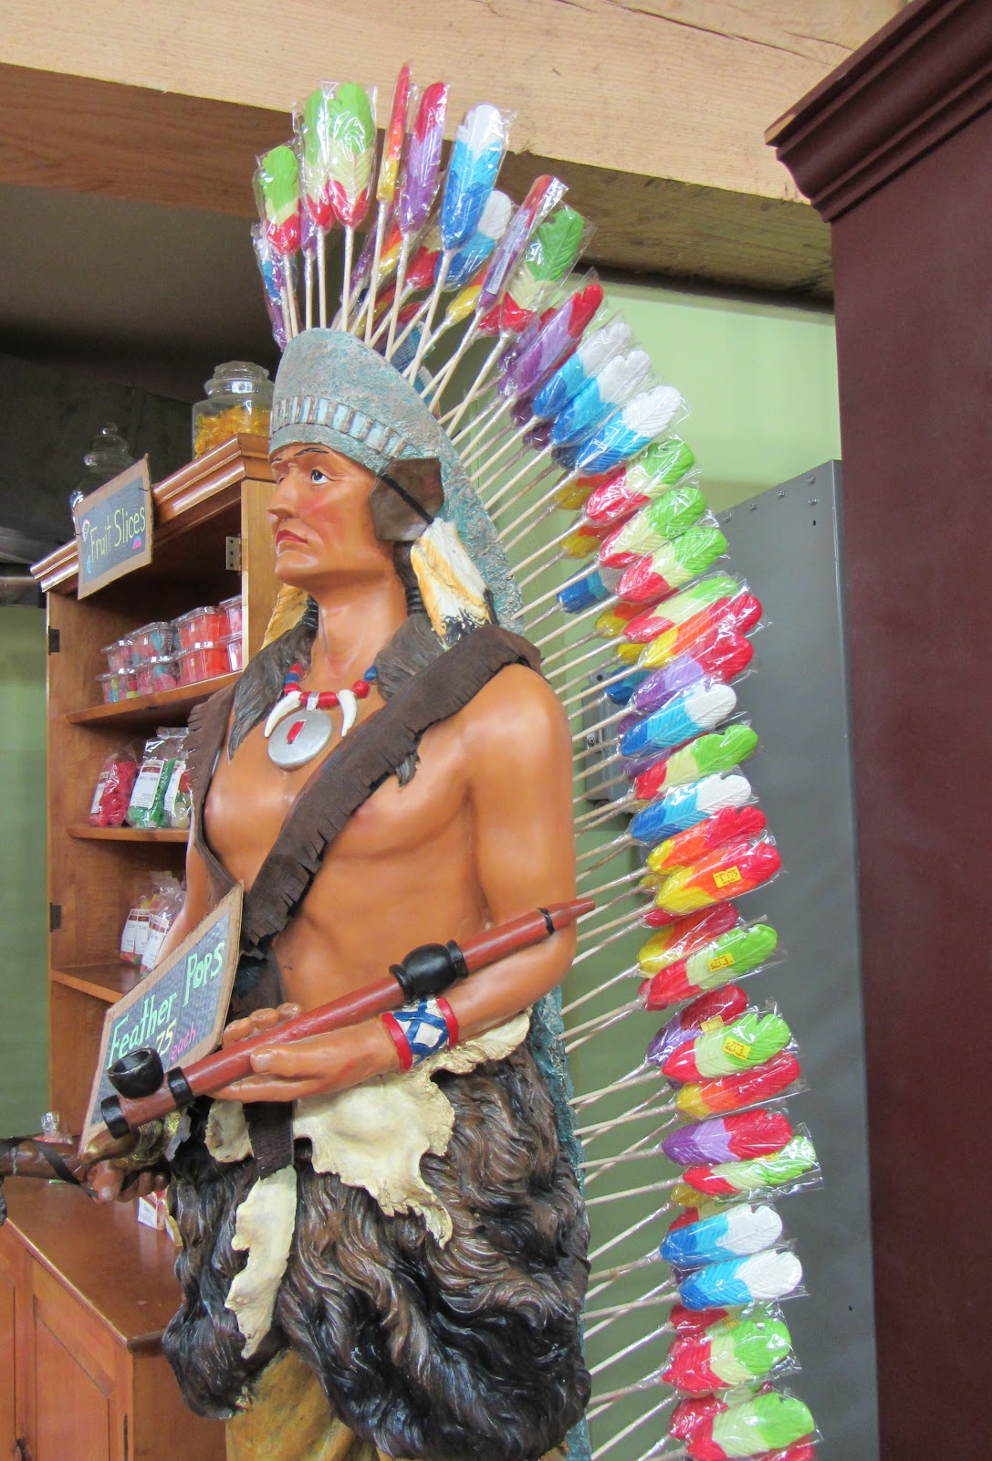
Western Frontier Land
Wounded Knee Lollipops
Lollipops made in the shapes of famous Native American warriors.
On December 28, 1890, General Custer rounded up 350 Native Americans at Wounded Knee Creek, South Dakota and demanded they give up their weapons. A shot was fired and in the end most of all 350 were killed.

Slide 7
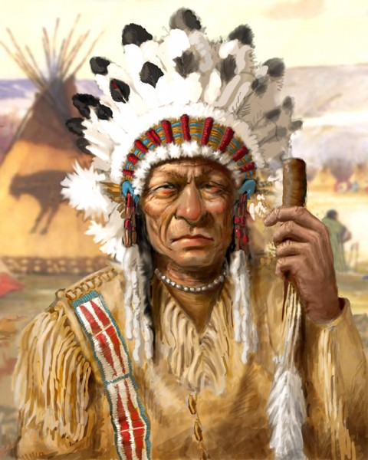
Western Frontier Land
Roaming Character (Sitting Bull)
Native American holy man who led his people as a tribal chief during years of resistance to United States government policies.
He was killed by Indian agency police on the Standing Rock Indian Reservation during an attempt to arrest him at a time when authorities feared that he would join the Ghost Dance movement

Slide 8
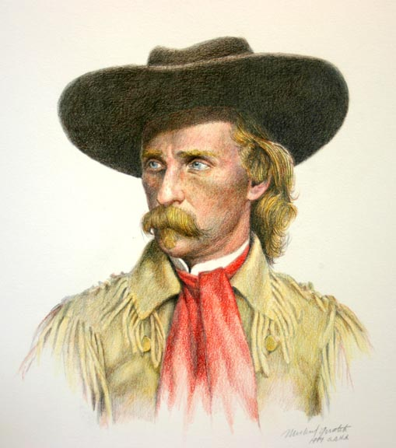
Western Frontier Land
Roaming Character (General Custer)
After the Civil War, Custer was dispatched to the west to fight in the Indian Wars. His disastrous final battle overshadowed his prior achievements.
Custer and all the men with him were killed at the Battle of the Little Bighorn in 1876, fighting against a coalition of Native American tribes in a battle that has come to be popularly known in American history as "Custer's Last Stand

Slide 9
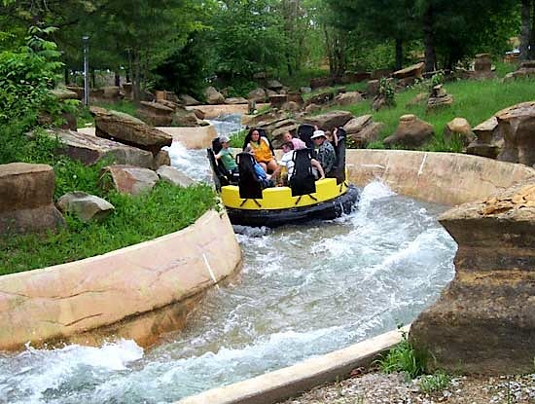
Lands of Imperialism
The Great White Fleet Raging Rapids
This raging rapids ride features 2.5 miles of dips and turns to make this ride one of the park’s most popular.
Name after the 16 battleships President Teddy Roosevelt sent around the world to show America’s power and naval capabilities.

Slide 10
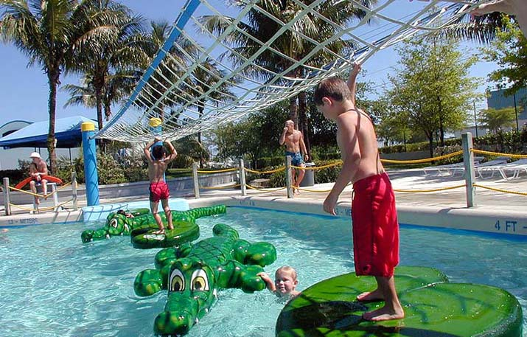
Lands of Imperialism
The Annexation of Hawaii
This section of the park is designed for the kids ages 5-12 and features several obstacle course designs to challenge the youngsters.
This kiddie park is named for the the overthrow of Queen Liliuokalani and the taking of the Hawaiian Islands in 1893.

Slide 11
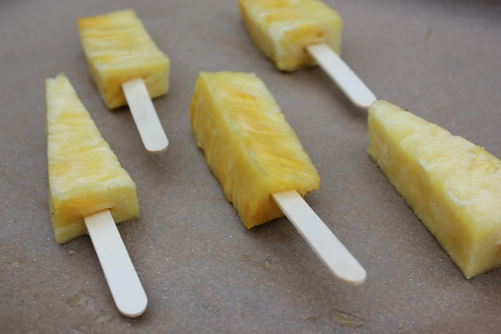
Lands of Imperialism
Dole Pineapples on a stick
These delicious treats are 100% pure pineapple frozen and placed on a stick for a great summer delight.
Named in honor of Sanford Dole who served as an enemy of the Hawaiian royalty and friend of the elite immigrant people. Dole advocated the westernization of the Hawaiian government and culture.

Slide 12
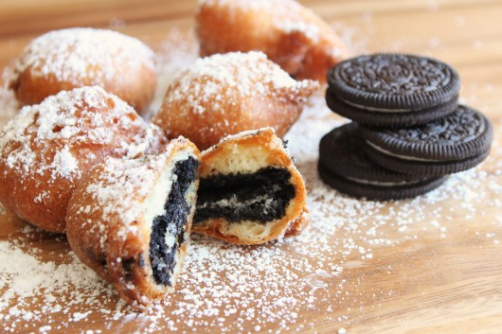
Lands of Imperialism
Rough Rider Oreos
These treats are Oreo cookies that have been coated in batter and deep fried.
These treats get their name from the famous voluntary cavalry unit led by Theodore Roosevelt that helped win the Spanish-American War by charging San Juan Hill and fighting off the Spanish Army.

Slide 13
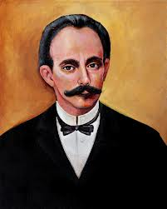
Lands of Imperialism
Roaming Character (Jose Marti)
José Martí was a Cuban patriot, freedom fighter and poet. Although he never lived to see Cuba free, he is considered the national hero.
José Martí roams around this section of the park and tells people his goal of a free Cuba and democracy without slavery.

Slide 14
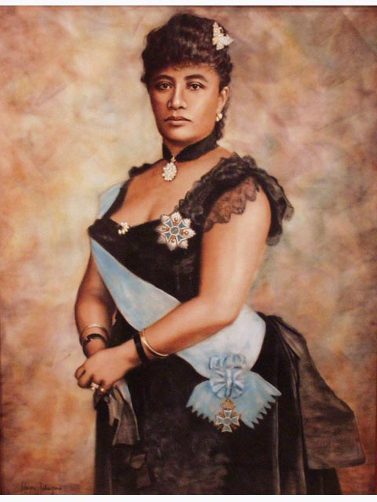
Lands of Imperialism
Roaming Character (Queen Liliuokalani)
Queen Liliuokalani was the last reigning monarch of the Hawaiian islands. She felt her mission was to preserve the islands for their native residents. In 1898, Hawaii was annexed to the United States and Queen Liliuokalani was forced to give up her throne.
The Queen is one of the park’s most popular roaming characters and often is seen taking pictures with children.

Slide 15
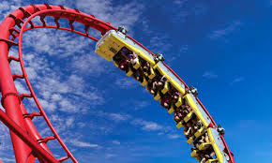
Flash Back to the 20’s
The Red Scare Roller Coaster
The so-called "Red Scare" refers to the fear of communism in the USA during the 1920’s. It is said that there were over 150,000 anarchists or communists in USA in 1920 alone.
This red roller coaster put the fear of the red scare into anyone to is brave enough to ride this terrifying ride.

Slide 16
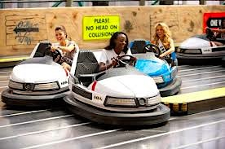
Flash Back to the 20’s
Model T Bumper Cars
Henry Ford’s Model T, also known as the “Tin Lizzie,” and changed the way Americans live, work and travel. Henry Ford’s revolutionary advancements in assembly-line automobile manufacturing made the Model T the first car to be affordable for a majority of Americans.
Since driving was not a prefect science in the 1920’s these bumper cars simulate what is must have been like driving to work in the mornings.

Slide 17
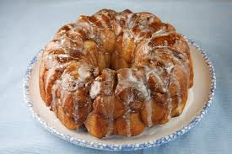
Flash Back to the 20’s
Scopes Trial Monkey Bread
Monkey Bread is a sweet, sticky, gooey pastry served in the United States for breakfast. It consists of pieces of soft bread with cinnamon sprinkled on it.
This treats is named after The Scopes Trial, formally known as The State of Tennessee v. John Thomas Scopes and commonly referred to as the Scopes Monkey Trial, was a famous American legal case in 1925 in which a high school teacher, John Scopes, was accused of violating Tennessee's Butler Act, which made it unlawful to teach human evolution in any state-funded school.

Slide 18
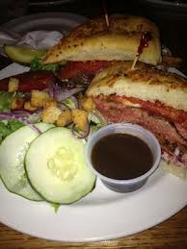
Flash Back to the 20’s
Speakeasy Sandwiches
A speakeasy, also called a is an establishment that illegally sells alcoholic beverages. Such establishments came into prominence in the United States during the Prohibition era.
These delicious sandwiches named in honor of these businesses and made of prohibition style roast beef, your choice or cheese, and a special Elliot Ness secret sauce.

Slide 19
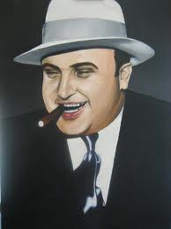
Flash Back to the 20’s
Roaming Character (Al Capone)
Al Capone is America's best known gangster and the single greatest symbol of the collapse of law and order in the United States during the 1920s Prohibition era. Capone had a leading role in the illegal activities that lent Chicago its reputation as a lawless city.
Besides roaming the park to take pictures with admiring guests, Al Capone also sells cigars after hours in the gift shop.

Slide 20
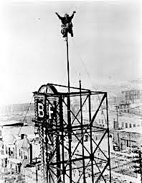
Flash Back to the 20’s
Roaming Character (Shipwreck Kelly)
Alvin "Shipwreck" Kelly was a master of flagpole-sitting, a nutty public fad of the 1920s. Kelly would climb to the top of a specially-prepared flagpole and remain there on a small platform for days or even weeks, usually as a paid publicity stunt.
Although considered a roaming character for the park, Mr. Kelly doesn’t necessarily roam. He kind of sits the entire time.

Slide 21
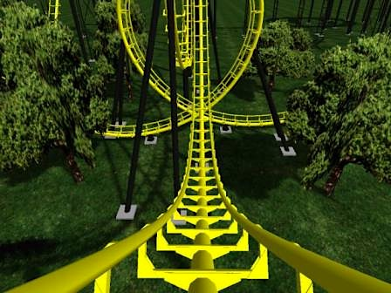
World War 2 Europe
Stalin Express
This death defying roller coaster goes 200mph while changing direction 3x and goes upside down twice.
Named after the famous dictator of the Union of Soviet Socialist Republics (USSR) from 1929 to 1953. Under Stalin, the Soviet Union was transformed from a peasant society into an industrial and military superpower. However, he ruled by terror, and millions of his own citizens died during his brutal reign. So far, no one has been hurt on the Stalin Express.

Slide 22
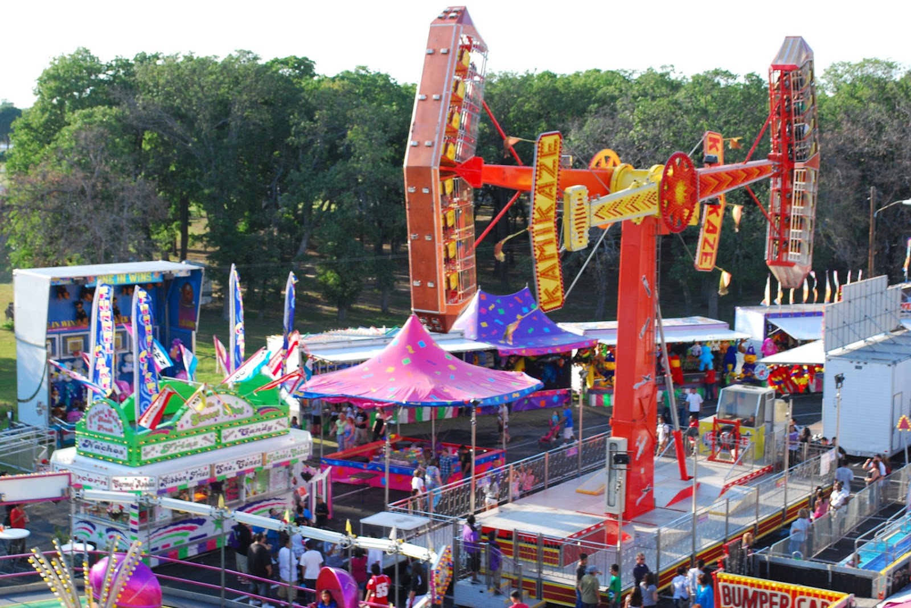
World War 2 Europe
The Kamikaze
This ride is named after those crazy Japanese pilots who performed suicidal missions by crashing their aircraft, loaded with explosives, into an enemy targets.
This ride spins almost out of control like a diving kamikaze pilot in WW2 heading for a navy ship in the Pacific Ocean.

Slide 23
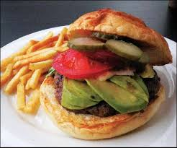
World War 2 Europe
Hamburgers from Hamburg
Named after the German city of Hamburg, our park features this delicious all beef paddy of ground sirloin, topped with cheese of your choice and lettuce and tomatoes. Served with a side of fries and drink.

Slide 24
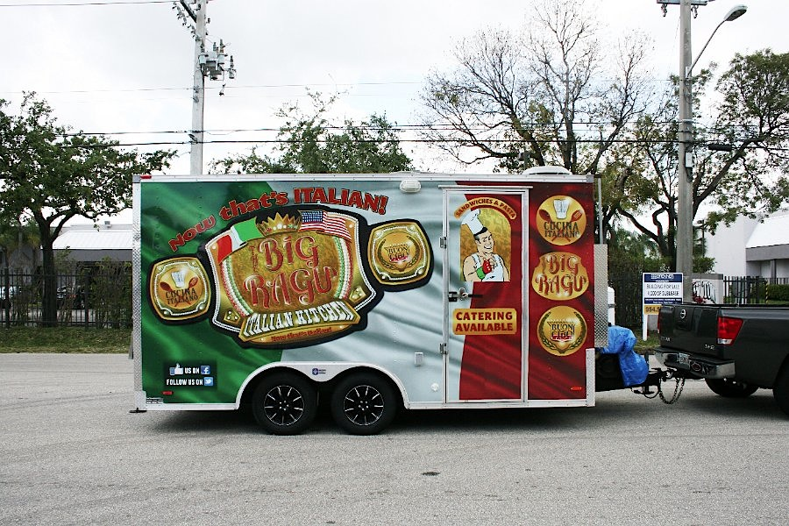
World War 2 Europe
Mussolini Food Truck
The Mussolini food truck serves up Italian food just like from the old country. Featuring pasta dishes, seafood from the Mediterranean Sea, and a must try – Fascist Fries. Named after the famous WW2 leader of Italy Benito Mussolini.

Slide 25
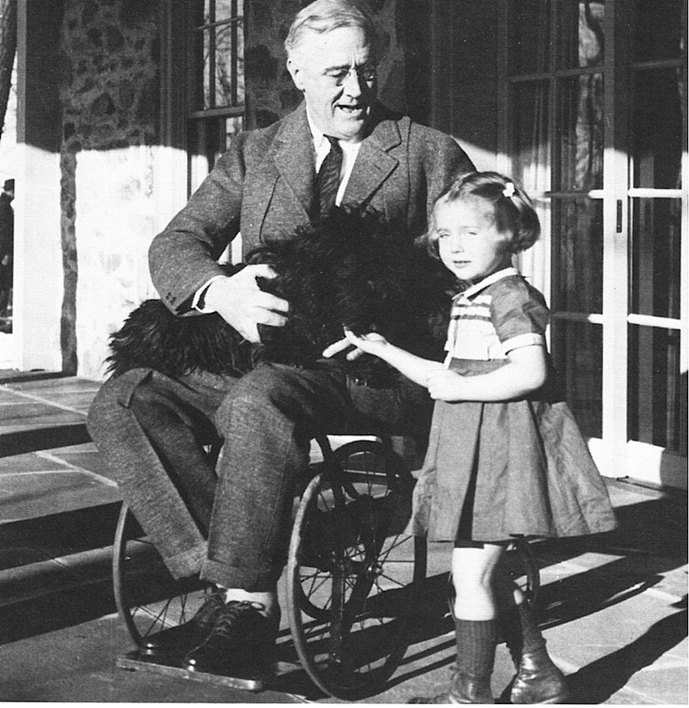
World War 2 Europe
Roaming Character (FDR)
Although the FDR roaming character is in a wheelchair, don’t let that fool you, he moves about the park like anyone else.
FDR was 32nd President of the United States he was elected for four consecutive terms, and remains the only president ever to serve more than eight years. He was a central figure in world events during the mid-20th century, leading the United States during a time of worldwide economic depression and World War 2.

Slide 26
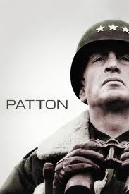
World War 2 Europe
Roaming Character (George Patton)
In this part of our park you will see General Patton himself roaming around and greeting our visitors.
Be careful not to anger the General though, he is known for his quick temper and loud voice. These 2 attributes allowed General Patton to become one of the most famous military leaders of WW2.

