Slide 1
While - Loop
Mr. Crone

Slide 2
While - Loop
A while-loop is designed to repeat a specific section of code over and over
A while-loop takes the following form:
while(condition)
statement;

Slide 3
While - Loop
Like if-statements, a while-loop can include several statements through the use of brackets
A while-loop also takes the form:
while(condition){
statement;
statement;
statement;
}

Slide 4
While - Loop
A while-loop is designed to execute all statements included within the loop as long as THE CONDITION REMAINS TRUE
The condition must be met before any statement within the while-loop is executed
while(condition){
statement;
statement;
statement;
}

Slide 5
While-Loop
int x = 1;
while( x < 5 ){
cout << “Hello” << endl;
x++;
}

Slide 6
While-Loop
int x = 1;
while( x < 5 ){
cout << “Hello” << endl;
x++;
}
// Prints:
//Hello
//Hello
//Hello
//Hello

Slide 7
While-Loop
All repetition statements can be broken down into three parts:
Initialized Variables
Looping Condition
Executed Code and Update Statements
int x = 1; // Initialized Variable
while( x < 5 ){ // Condition
cout << “Hello” << endl; // Executed Code
x++; // Update Statement
}

Slide 8
What does the following code print?
int x = 3;
while(x>0){
cout << x ;
x--;
}

Slide 9
What does the following code print?
int x = 3;
while(x>0){
cout << x ;
x--;
}
//Prints:
// 321

Slide 10
What does the following code print?
int x = 15;
while(x<11)
x= x + 5;
cout << x << endl;

Slide 11
What does the following code print?
int x = 15;
while(x<11) // Never enters Loop!
x= x + 5;
cout << x << endl; // Prints 15

Slide 12
What does the following code print?
int x = 5;
while(x<11)
cout << x;

Slide 13
What does the following code print?
int x = 5;
while(x<11) // Infinite Loop!
cout << x;
// Condition will always be true!

Slide 14
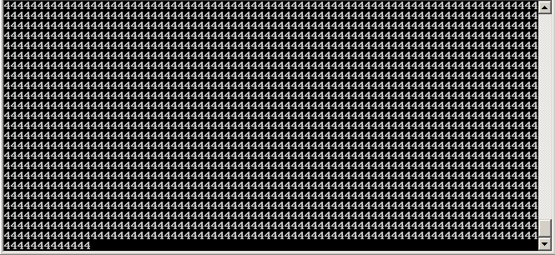
Infinite Loops
An infinite loop occurs when the condition is always evaluated to be true
Repetition statements must have some form of update statement to ensure that infinite loops do not occur

