Slide 1
Chapter 1 Background
Fundamentals of Java: AP Computer Science Essentials, 4th Edition
Lambert / Osborne

Slide 2
Objectives
Give a brief history of computers.
Describe how hardware and software make up computer architecture.
Explain the binary representation of data and program in computers.
2
2

Slide 3
Objectives (continued)
Discuss the evolution of programming languages.
3
3

Slide 4
Vocabulary
application software
assembly language
auxiliary input/output (I/O)
auxiliary storage device
bit
byte
central processing unit (CPU)
hardware
internal memory
machine language
4
4

Slide 5
Vocabulary (continued)
primary memory
RAM
secondary memory
software
system software
user interface
5
5

Slide 6
History of Computers
ENIAC (1940s) was one of the world’s first digital electronic computers.
IBM sold its first business computer in the 1950s.
It was thought the world needed no more than 10.
Power was 1/2000 of the typical laptop of today.
Today there are hundreds of millions of laptop and desktop computers in the world.
6
6

Slide 7
History of Computers (continued)
The first computers could perform only a single task at a time.
Paper cards and tape used for input and output.
In 1960s, time-sharing computers were sold for businesses.
Cost up to millions of dollars.
30 people could work at once.
Teletypes used phone wires.
7
7

Slide 8
History of Computers (continued)
In 1970s, e-mail and file transfers were born.
In 1980s, personal computers and local area networks were available.
In 1990s, an explosion of computer use and availability of Internet access.
Computing has become ubiquitous.
Cell phones, cameras, PDAs, music players
8
8

Slide 9
Computer Hardware and Software
Computers are machines that process information.
Hardware are the physical devices on your desktop.
Software are the programs that give the hardware functionality.
Bits and Bytes:
Bits are the smallest unit of information processed by a computer (0s and 1s).
Bytes are eight bits.
9
9

Slide 10
Computer Hardware and Software (continued)
Computer Hardware:
Computers have six major subsystems:
User interface
Keyboard, monitor
Auxiliary input/output (I/O)
Printer, digital camera, joystick
Auxiliary storage devices
Secondary memory
Hard disks, DVDs, flash memory
Network connection
Modem, TV cable, satellite dish
10
10

Slide 11
Computer Hardware and Software (continued)
Computer Hardware (cont):
Internal memory (RAM)
RAM (random access memory) is primary memory
Central processing unit (CPU)
Performs basic tasks using complex hardware.
Moore’s Law: speed is doubled every two years
Transistor is the building block of the CPU and RAM.
11

Slide 12
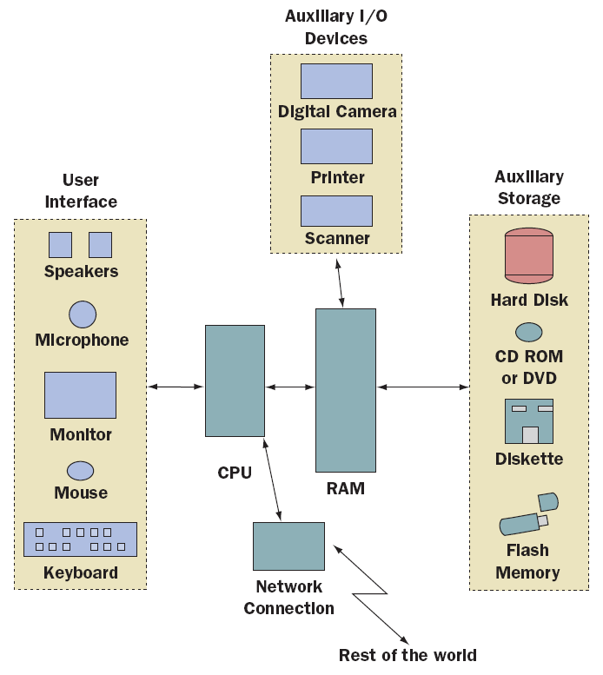
Computer Hardware and Software (continued)
A computer’s six major subsystems
12
12

Slide 13
Computer Hardware and Software (continued)
Computer Software:
System software
Supports the operations of the computer.
Includes the operating system, communication software, compilers, and the user interface subsystem.
Application software
Allows users to accomplish tasks.
Types include Word processors, spreadsheets, databases
13
13

Slide 14
Binary Representation of Information and Computer Memory
Computer memory stores patterns of electronic signals.
The patterns are strings of binary digits or bits.
Computers use binary (base 2) notation.
Two bases: On/Off
Computer scientists also use bases octal (8) and hexadecimal (16).
14
14

Slide 15
Programming Languages
Generation 1 (Late 1940s to Early 1950s)-Machine Languages:
Programs were coded in machine language, whose only symbols are binary digits.
Coding was tedious, slow, and error-prone.
It was difficult to modify programs.
Each type had its own machine language so programs were not portable.
15
15

Slide 16
Programming Languages (continued)
Generation 2 (Early 1950s to Present)-Assembly Languages:
Assembly languages use mnemonic symbols to represent instructions & data.
Programs are translated by assembler and loaded and run using a loader.
Assembly language is more programmer friendly, but still tedious.
Like machine language, it is not portable as each computer has its own unique language.
16
16

Slide 17
Programming Languages (continued)
Generation 3 (Mid-1950s to Present)-High-Level Languages:
Examples of high-level languages are FORTRAN, COBOL, BASIC, C, Pascal, C++, Python, Smalltalk, and Java.
High-level languages are easy to write, read, understand.
Translation to machine language is done using a compiler.
17
17

Slide 18
Basic Concepts of Object-Oriented Programming
High-level programming languages fall into two major groups.
The older languages, COBOL, FORTRAN, BASIC, C, and Pascal, all use a procedural approach.
New languages, Smalltalk, C++, Python, and Java use an object-oriented approach.
Object-oriented is considered superior.
18
18

Slide 19
Summary (continued)
Modern computers consist of two primary components: hardware and software. Computer hardware is the physical component of the system. Computer software consists of programs that enable us to use the hardware.
All information used by a computer is represented in binary form. This information includes numbers, text, images, sound, and program instructions.
19
19

Slide 20
Summary (continued)
Programming languages have been developed over the course of three generations: generation 1 is machine language, generation 2 is assembly language, and generation 3 is high-level language.
20
20

