Slide 1
Interfaces

Slide 2
9.2 Java Interfaces The Client Perspective
The term interface is used in two different ways.
An interface is the part of a software system that interacts with human users.
An interface is a list of a class's public methods.

Slide 3
9.2 Java Interfaces The Client Perspective
The code in an interface consists of method signatures followed by semicolons
An interface provides programmers with the ability to know what an implementing class can do
It is important to realize that an interface is not a class, and that the methods of an interface have no implementation

Slide 4
Sample Interface – Animal Interface
public interface Animal{
public String getName();
public void setName(String s);
public int getAge();
public void setAge(int ag);
public boolean hasFur();
public void setHasFur(boolean b);
}

Slide 5
Interfaces
A class can implement an interface with the Java reserved word implements
implements must be placed in the class header
Example)
public class Dog implements Animal{
// All methods of the Animal interface must
// be defined within the Dog class
}

Slide 6
Interfaces
If a class implements an interface, it MUST define all of the methods that are listed in an interface
Eclipse provides a shortcut that allows programmers to add unimplemented methods to a class
Simply click on the error message next to the class header and select: Add unimplemented methods

Slide 7
Interfaces and Instantiation
Interfaces CANNOT be instantiated
However, it is possible to declare variables of Interface types
Examples)
Animal a1 = new Animal(); // Not Valid
Animal a1; // Valid
Animal a1 = new Dog(); // Valid, but a1 can only use methods
// from the Animal interface

Slide 8
9.3 Java Interfaces - The Implementation Perspective
Summary
An interface contains only methods, never variables.
The methods in an interface are usually public.
If more than one class implements an interface, its methods are polymorphic.
A class can implement methods in addition to those listed in the interface.
A class can implement more than one interface.

Slide 9
9.6 Some Observations About Interfaces and Inheritance
Interfaces can extend other interfaces
If a variable is declared to be of an interface type, then it can be associated with an object from any class that implements the interface.
If a class implements an interface, then all of its subclasses do so implicitly.

Slide 10
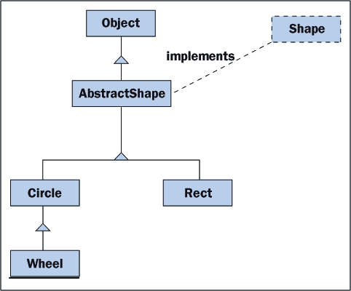
9.5 Inheritance and Abstract Classes
A relationship between a class and an interface is represented with a dotted-line

Slide 11
instanceof
The instanceof operator can be used to determine how a reference variable was instantiated.
Animal a1 = new Dog();
Animal a2 = new Cat();
System.out.println(a1 instanceof Dog); // returns true
System.out.println(a2 instanceof Dog); // returns false

Slide 12
Class Casting
It is possible to cast reference variables to a different type
Animal a1 = new Dog();
a1.<anyAnimalMethod>;
((Dog)a1).<anyDogMethod>; // Dog MUST implement //Animal

