Slide 1
Subclasses - Java

Slide 2
The Purpose of Subclasses
Class Farm
String getOwner()
void setOwner(String s)
int getSize()
void setSize(int s)
Class DairyFarm
String getOwner()
void setOwner(String s)
int getSize()
void setSize(int s)
int getNumCows()
void setNumCows(int s)

Slide 3
Subclasses
In the previous example, it would be inefficient to spend time creating both of these classes in their entirety
The DairyFarm class should be created using the process of inheritance
Inheritance is the process by which a subclass can reuse attributes and behavior defined in a superclass
The most efficient way to create these classes would be to create the Farm class, and make the DairyFarm a subclass of the Farm class

Slide 4
Subclasses
Create a subclass by using the reserved word extends in the class header
Example)
public class DairyFarm extends Farm{
…
// DairyFarm is now a subclass of the Farm

Slide 5
Subclasses Hierarchy
In the Java hierarchy, subclasses are positioned below their parent classes
Object
In this case, Farm is referred to as the superclass, or parent class of DairyFarm
Farm
DairyFarm

Slide 6
Subclasses
Subclasses inherit all of the instance variables and methods of their parent classes
If a variable of a superclass is declared to be private, the subclass will still inherit the variable, although it will not have the power to modify/access the variable directly
Superclass methods can be accessed with the keyword super
The keyword super can be used to access public methods in ANY of the class’s superclasses

Slide 7
Subclasses
Assuming that DairyFarm is the subclass of Farm, the code below provides an example of the use of super
public class DairyFarm extends Farm{
public int getNumAcres(){
int acres = super.getSize();
return acres;
}
}

Slide 8
Using Super in Constructors
super can also be used when creating constructors
If super is used in the constructor, it MUST be the first line in the constructor
First look at the constructor of the Farm class below:
public Farm(String own, int siz){
owner = own;
size = siz;
}

Slide 9
Using Super in Constructors
public Farm(String own, int siz){
owner = own;
size = siz;
}
// ---------------------------------------------------------------------------
public class DairyFarm extends Farm(){
private int numCows;
public DairyFarm(String own, int siz, int numC){
super(own, siz); // calls super constructor
numCows = numC;
}
}

Slide 10
Using Super in Constructors
If super() is not explicitly called in a subclass’s constructor, a call to super() is automatically made
The automatic super() call will always call the default constructor of the parent class
public class DairyFarm extends Farm(){
private int numCows;
public DairyFarm(int numC){
// automatically calls default super constructor
numCows = numC;
}
}

Slide 11
Vocabulary
Overriding Methods – providing new code for a method that is already located in a superclass
Overloading Methods – using the same method name but accepting different parameters
Polymorphism – the property of one operator or symbol having many different meanings
Extension
Occurs when a new method is added that does not exist in a superclass
Occurs when a subclass method invokes the same method as the superclass and also extends the behavior of the method with its own operations
*Definitions from Fundamentals of Java 4th Edition

Slide 12
Class Relationships & UML Diagrams
As you have already seen, previously created classes are often used when creating a new class
When a new class is created, its relationship to other classes can be represented with a UML Diagram
A UML (Unified Modeling Language) Diagram can be used to show several different relationships between interfaces, superclasses, abstract classes, and classes being used within another class

Slide 13
Relationships Between Classes
Dependency
Occurs when an object of one class sends a message to an object of another class
Example) Imagine that a Circle class was created with a draw() method that used the StandardPen class to draw the circle. The Circle is dependent upon the StandardPen Class
UML Diagram)

Slide 14
Relationships Between Classes
2) Aggregation (has-a)
An object of one class contains objects of another class as structural components
Example) The Line class contains two Point objects
UML Diagram)

Slide 15
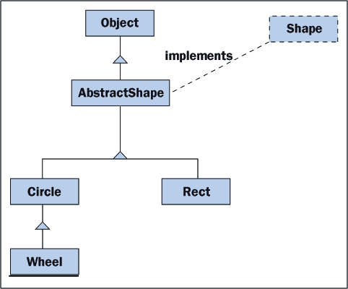
Relationships Between Classes
3) Inheritance & Implementation (is-a)
Occurs when a class extends a superclass or implements an interface
UML Diagram)

