Slide 1
Linear and Binary Searching
Mr. Crone

Slide 2
Linear search
Examines each element in sequence to determine if a target element is present
Starts with the first element
The search checks every element and returns -1 if the target is not found
If the target element is found, the search stops at the target element and returns the correct index
Elements do NOT have to be in order

Slide 3
Linear Search example
int[] arry = {1,3,5,7,8,9,6,2,1,6,5,4,8,6,2,3,5};
int index = Searcher.linearSearch(arry, 7);
//assigns index the value of 3

Slide 4
Linear Search example
int[] arry = {1,3,5,7,8,9,6,2,1,6,5,4,8,6,2,3,5};
int index = Searcher.linearSearch(arry, 27);
//assigns index the value of -1

Slide 5
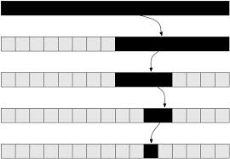
Binary Search
MUCH faster than the Linear Search
Emulates the process of searching for a name in a phone book
Splits amount of elements to be checked in half each iteration

Slide 6
Binary search REQUIREMENT
ELEMENTS MUST BE IN ORDER
ELEMENTS MUST BE IN ORDER
ELEMENTS MUST BE IN ORDER
ELEMENTS MUST BE IN ORDER
ELEMENTS MUST BE IN ORDER

Slide 7
Binary search REQUIREMENT
ELEMENTS MUST BE IN ORDER!

