Slide 1
Javadoc Comments
Mr. Crone

Slide 2
Comments
Single-Line Comment: //
Multi-Line / Block Comment: /* … */
Javadoc Comment: /** … */

Slide 3
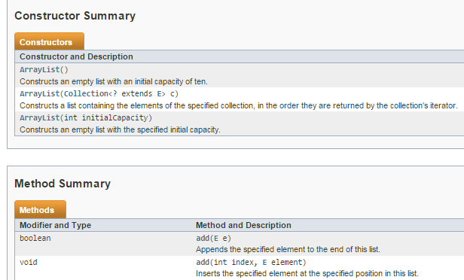
Javadoc Comments
- After Javadoc comments are created, a Javadoc HTML File can be generated
- Javadoc comments allow us to create HTML files that detail our own classes in the same format as the classes found on docs.oracle.com

Slide 4
Creating a Javadoc Comment
-Javadoc comments can be easily created by typing: /** “Enter”
- After pressing “Enter” the code below and any accompanying tags will automatically be generated
/**
*
*/

Slide 5
Creating Javadoc Comments
- Javadoc comments can be placed above any method, field, or class header
- Javadoc comments generate different HTML tags depending upon what they will be used to describe and where the comment is placed
Example) Placing a comment above a class header will automatically generate the “@author” tag
/**
* @author
*/
public class CommentTester {

Slide 6
Creating Javadoc Comments
- Finish the Javadoc comment below by adding a description above the @author tag and identifying the author
- Descriptions of Methods/Classes can be placed above the tags
- Write information beside or below a tag to describe a specific tag
/**
* This class demonstrates the use of Javadoc Comments
* @author Mr. Crone
*/
public class CommentTester {

Slide 7
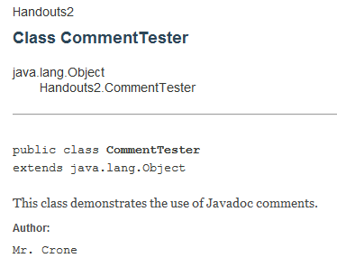
Creating Javadoc Comments
- The code below creates the Javadoc on the right
/**
* This class demonstrates the use of Javadoc Comments
* @author Mr. Crone
*/
public class CommentTester {
…

Slide 8
Javadoc Tags
- The AP Exam requires that you have knowledge of the @param and @return tags
- The @param tag can be used to describe parameters of a method/constructor
- The @return tag describes exactly what a method will return
- @param and @return are automatically generated when the Javadoc comment is created above a method

Slide 9
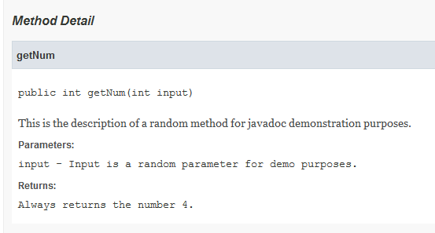
Javadoc Method Example
/**
* This is the description of a random method for
* javadoc demonstration purposes.
* @param input
* Input is a random parameter for demo purposes.
* @return
* Always returns the number 4.
*/
public int getNum(int input){
return 4;
}

Slide 10
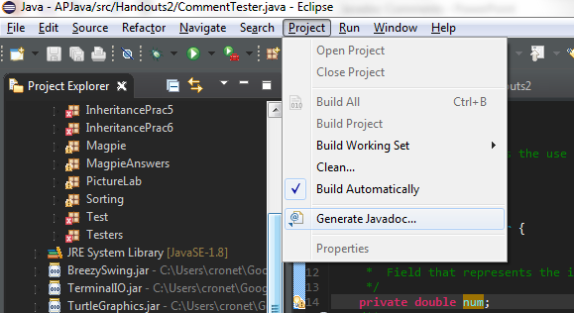
Generating a Javadoc

Slide 11
Generating the Javadoc
- After clicking “Generate Javadoc”, you will be given the option to select an individual class or entire packages/projects
- If you are generating the Javadoc file for a single class, ensure that other classes are not also selected
- After generating the Javadoc, the files will appear as a regular folder within the project and can be viewed within eclipse

