Slide 1
Chapter 6 Logical Operators Nested If-Statements
Mr. Crone
Fundamentals of Java 2nd Edition
- Lambert, Osborne

Slide 2
Logical Operators
Java includes three logical operators equivalent in meaning to the English words AND, OR, and NOT
These operators are used in boolean expressions to control while, if, and for-statements
1) AND - “&&”
2) OR - “||”
3) NOT - “!”

Slide 3
Logical Operators
“AND” has a higher precedence than “OR”
In other words, && will be evaluated before ||
x || y && z
Is equivalent to:
x || (y && z)

Slide 4
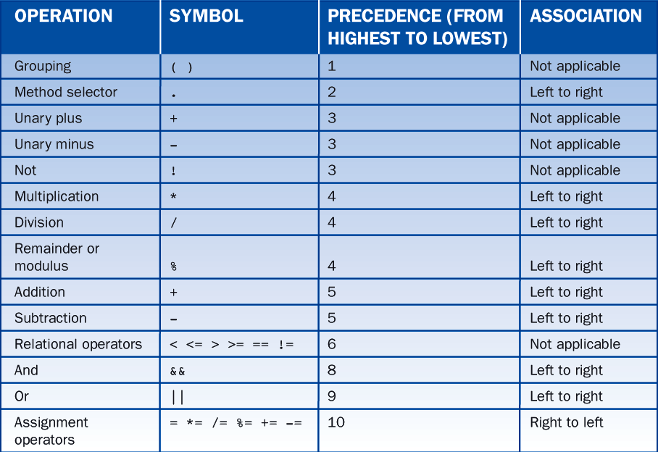
Operator Precedence

Slide 5
Truth Tables
Truth Tables are used to determine the output of a complicated boolean expression
The Left side of the truth table lists the possible combinations for the boolean variables
If n is the number of boolean variables (or operands), there are 2^n combinations of true and false

Slide 6
Truth Tables
How many possible combinations of true and false are there for 4 boolean variables?

Slide 7
Truth Tables
How many possible combinations of true and false are there for 4 boolean variables?
Answer: 2^4 = 16

Slide 8
Nested If-Statements
An if-statement placed inside another if-statement is referred to as a Nested If-Statement
Example)
if(x > y) {
if(x > 0){
System.out.println(“Hello”);
}
else
System.out.println(“Goodbye”);
}

Slide 9
Nested If-Statements
Which comment will the code reach? 1, 2, 3 or error?
int x =4, y = 5, z = 6;
if(x < y )
if(y < z)
// 1
else
// 2
else
// 3

Slide 10
Nested If-Statements
Which comment will the code reach? 1, 2, 3 or error?
int x =4, y = 5, z = 3;
if(x < y )
if(y < z)
// 1
else
// 2 ANSWER
else
// 3

Slide 11
Nested Loops
A while-loop or for-loop placed inside another while-loop or for-loop is known as a nested loop
Ex)
for(int I = 0; I < 3; I ++){
for(k = 0; k < 3; k ++) // Nested Loop
System.out.println(I + “ “ + k);
}

