Slide 1
Lesson 8: Introduction To Arrays

Slide 2
Lesson 8: Introduction To Arrays
Objectives:
Write programs that handle collections of similar items.
Declare array variables and instantiate array objects.
Manipulate arrays with loops.
Create parallel arrays and two-dimensional arrays.

Slide 3
Lesson 8: Introduction To Arrays
Vocabulary:
array
element
index
initializer list
logical size
multi-dimensional array
one-dimensional array
parallel arrays
physical size
ragged array
range bound error
subscript
two-dimensional array

Slide 4
8.1 Conceptual Overview
An array consists of an ordered collection of similar items.
An array has a single name, and the items in an array are referred to in terms of their position within the array.
An array makes it is as easy to manipulate a million test scores as it is three.

Slide 5
8.1 Conceptual Overview
Without arrays, a program with 20 test scores would look like this:
int test1, test2, test3, test4, test5,
test6, test7, test8, test9, test10,
test11, test12, test13, test14, test15,
test16, test17, test18, test19, test20;

Slide 6
8.1 Conceptual Overview
And the computation of the average score looks like this:
// Compute and return a student’s average
int average;
average = (test1 + test2 + test3 + test4 + test5 +
test6 + test7 + test8 + test9 + test10 +
test11 + test12 + test13 + test14 + test15 +
test16 + test17 + test18 + test19 + test20) / 20;

Slide 7
8.1 Conceptual Overview
The items in an array are called elements.
For any particular array, all the elements must be of the same type.
The type can be any primitive or reference type (object).
For instance, we can have an array of test scores, an array of names, or even an array of KeyboardReader objects.

Slide 8
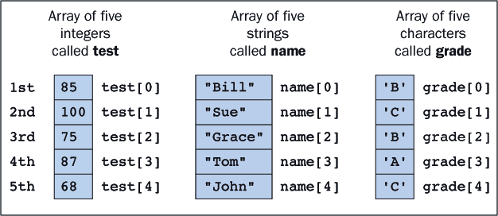
8.1 Conceptual Overview
The first element in the array test is referred to as test[0], the second as test[1], and so on.
An item's position within an array is called its index or subscript.

Slide 9
8.2 Simple Array Manipulations
Instantiate an Array using the format below
Type[] varName = new Type[sizeOfArray];
Example below creates an array of 500 integers
By default, all of the values are initialized to 0:
int[] abc = new int[500];

Slide 10
8.2 Simple Array Manipulations
The basic syntax for referring to an array element has the form:
Where <index> must be between 0 and the array's length less 1.
The subscript operator ([]) has the same precedence as the method selector (.).
<array name>[<index>]

Slide 11
8.2 Simple Array Manipulations
Example)
int[] abc = new int[500]; //Instantiates array of 500 integers
abc[0] = 78; //1st element 78
abc[1] = 66; //2nd element 66
abc[2] = (abc[0] + abc[1]) / 2; //3rd element average of first two
abc[i] = 82; //4th element 82 because i is 3
abc[i + 1] = 94; //5th element 94 because i + 1 is 4
abc[499] = 76; //500th element 76

Slide 12
8.2 Simple Array Manipulations
The JVM checks the values of subscripts before using them and throws an ArrayIndexOutOfBoundsException if they are out of bounds (less than 0 or greater than the array length less 1).
To compute the average of the first five elements, we could write:
avFirstFive = (abc[0] + abc[1] + abc[2] + abc[3] + abc[4])/5;

Slide 13
8.2 Simple Array Manipulations
It often happens that we need to interchange elements in an array.
// Initializations
. . .
abc[3] = 82;
abc[4] = 95;
i = 3;
. . .
// Interchange adjacent elements
temp = abc[i]; // temp now equals 82
abc[i] = abc[i + 1]; // abc[i] now equals 95
abc[i + 1] = temp; // abc[i + 1] now equals 82

Slide 14
8.2 Simple Array Manipulations
We frequently need to know an array's length.
The array itself makes this information available by means of a public instance variable called length:
System.out.println ("The size of abc is: " + abc.length);

Slide 15
8.3 Looping Through Arrays
Sum the Elements
The following code sums the numbers in the array abc.
Each time through the loop adds a different element to the sum. On the first iteration we add abc[0] and on the last abc[499].
int sum;
sum = 0;
for (int i = 0; i < 500; i++)
sum += abc[i];

Slide 16
8.3 Looping Through Arrays
Count the Occurrences
We can determine how many times a number x occurs in the array by comparing x to each element and incrementing count every time there is a match:
int x;
int count;
x = ...; //Assign some value to x
count = 0;
for (int i = 0; i < 500; i++){
if (abc[i] == x)
count++; //Found another element equal to x
}

Slide 17
8.3 Looping Through Arrays
Working With Arrays of Any Size
It is possible and also desirable to write code that works with arrays of any size.
Simply replace the literal 500 with a reference to the array's instance variable length in each of the loops.
For example, this code would sum the integers in an array of any size:
int sum;
sum = 0;
for (int i = 0; i < abc.length; i++)
sum += abc[i];

Slide 18
8.4 Declaring Arrays
Arrays are objects and must be instantiated before being used.
Several array variables can be declared in a single statement like this:
Or like this:
int[] abc, xyz;
abc = new int[500];
xyz = new int[10];
int[] abc = new int[500], xyz = new int[10];

Slide 19
8.4 Declaring Arrays
Array variables are null before they are assigned array objects.
Failure to assign an array object can result in a null pointer exception.
int[] abc;
abc[1] = 10; // runtime error: null pointer exception

Slide 20
8.4 Declaring Arrays
Because arrays are objects, two variables can refer to the same array as indicated in Figure 8-2 and the next segment of code:
int[] abc, xyz;
abc = new int[5]; // Instantiate an array of 5
integers
xyz = abc; // xyz and abc refer to the same array
xyz[3] = 100; // Changing xyz changes abc as well.
System.out.println(abc[3]); // 100 is displayed

Slide 21
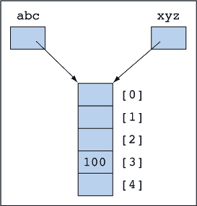
8.4 Declaring Arrays
When two reference variables point to the same object, this is known as aliasing.

Slide 22
8.4 Declaring Arrays
Arrays can be declared, instantiated, and initialized in one step.
The list of numbers between the braces is called an initializer list.
int[] abc = {1,2,3,4,5} // abc now references an array of five integers.

Slide 23
8.4 Declaring Arrays
double[] ddd = new double[10];
char[] ccc = new char[10];
boolean[] bbb = new boolean[10];
String[] ggg = new String[10];
String str;
ddd[5] = 3.14;
ccc[5] = 'Z';
bbb[5] = true;
ggg[5] = "The cat sat on the mat.";

Slide 24
8.4 Declaring Arrays
Another option for declaring arrays
int aaa[]; // aaa is an array variable.

Slide 25
8.5 Working with Arrays That Are Not Full
One might create an array of 20 ints but receive only 5 ints from interactive input.
This array has a physical size of 20 cells but a logical size of 5 cells currently used by the application.
From the application's perspective, the remaining 15 cells contain garbage.

Slide 26
8.5 Working with Arrays That Are Not Full
It is possible to track the array's logical size with a separate integer variable.
The following code segment shows the initial state of an array and its logical size:
Note that abc.length (the physical size) is 50, whereas size (the logical size) is 0
int[] abc = new int[50];
int size = 0;

Slide 27
8.5 Working with Arrays That Are Not Full
Processing Elements in an Array That Is Not Full
When the array is not full, one must replace the array's length with its logical size in the loop.
Here is the code for computing the sum of the integers currently available in the array abc:

Slide 28
8.5 Working with Arrays That Are Not Full
int[] abc[50];
int size = 0;
... code that puts values into some initial portion of the array and sets
the value of size ...
int sum = 0;
for (int i = 0; i < size; i++) // size contains //the number items in the array
sum += abc[i];

Slide 29
8.6 Parallel Arrays
Suppose we want to keep a list of people's names and ages.
This can be achieved by using two arrays in which corresponding elements are related.
Thus, Bill's age is 20 and Mary's is 24.
String[] name = {"Bill", "Sue", "Shawn", "Mary", "Ann"};
int[] age = {20 , 21 , 19 , 24 , 20};

Slide 30
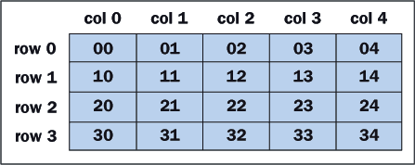
8.7 Two-Dimensional Arrays
A table of numbers, for instance, can be implemented as a two-dimensional array. Figure 8-3 shows a two-dimensional array with four rows and five columns.
Suppose we call the array table; then to indicate an element in table, we specify its row and column position, remembering that indexes start at 0:
x = table[2][3]; // Set x to 23, the value in (row 2, column 3)

Slide 31
8.7 Two-Dimensional Arrays
- The code below is designed to find the sum of all of the elements in a two dimensional array
int i, j;
int sum = 0;
for (i = 0; i < 4; i++){ // There are four rows: i = 0,1,2,3
for (j = 0; j < 5; j++){ // There are five columns: j = 0,1,2,3,4
sum += table[i][j];
}
}

Slide 32
8.7 Two-Dimensional Arrays
This segment of code can be rewritten without using the numbers 4 and 5.
The value table.length equals the number of rows,
Table[i].length is the number of columns in row i.
int i, j;
int sum = 0;
for (i = 0; i < table.length; i++){
for (j = 0; j < table[i].length; j++){
sum += table[i][j];
}
}

Slide 33
8.7 Two-Dimensional Arrays
Declare and Instantiate
Declaring and instantiating two-dimensional arrays are accomplished by extending the processes used for one-dimensional arrays:
int[][] table; // The variable table can reference a
// two-dimensional array of integers
table = new int[4][5]; // Instantiate table as an array of size 4,
// each of whose elements will reference an array
// of 5 integers.

Slide 34
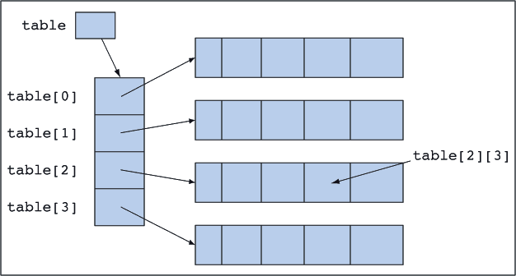
8.7 Two-Dimensional Arrays
The variable table references an array of four elements.
Each of these elements in turn references an array of five integers.

Slide 35
8.7 Two-Dimensional Arrays
Initializer lists can be used with two-dimensional arrays. This requires a list of lists.
The number of inner lists determines the number of rows, and the size of each inner list determines the size of the corresponding row.
The rows do not have to be the same size, but they are in this example:
int[][] table = {{ 0, 1, 2, 3, 4}, // row 0
{10,11,12,13,14}, // row 1
{20,21,22,23,24}, // row 2
{30,31,32,33,34}}; // row 3

Slide 36
8.7 Two-Dimensional Arrays
Variable Length Rows
Ragged arrays are rows of a two-dimensional arrays that are not all the same length.
int[][] table;
table = new int[4][]; // table has 4 rows
table[0] = new int[6]; // row 0 has 6 elements
table[1] = new int[10]; // row 1 has 10 elements
table[2] = new int[100]; // row 2 has 100 elements
table[3] = new int[1]; // row 3 has 1 element

Slide 37
8.8 Arrays and Methods
When any object is used as a parameter to a method, what actually gets passed is a reference to the object and not the object itself.
The actual and formal parameters refer to the same object, and changes the method makes to the object's state are still in effect after the method terminates.
In the figure, the method changes the student's name to Bill, and after the method finishes executing the name is still Bill.

Slide 38
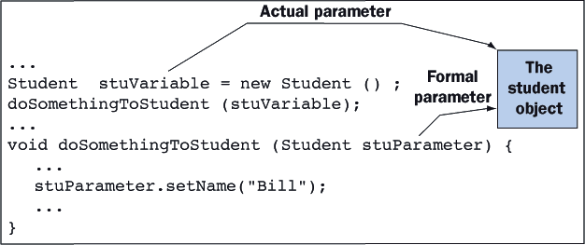
8.8 Arrays and Methods

Slide 39
8.8 Arrays and Methods
Arrays are objects, so the same rules apply.
When an array is passed as a parameter to a method, the method manipulates the array itself and not a copy.
Changes made to the array in the method are still in effect after the method has completed its execution.
A method can also instantiate a new object or a new array and return it using the return statement.

