Slide 1
Computer Science II
Chapter 1

Slide 2
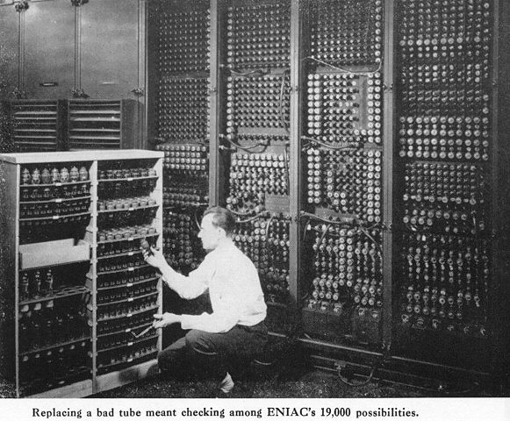
History of computers (1.1)
Eniac- one of the worlds first computers
Used more electricity than an entire city block of houses
Filled an entire room
Built in late 1940’s

Slide 3

History of computers
By the 1970’s, computers began to be connected through networks
Email was developed
File transfer became possible

Slide 4
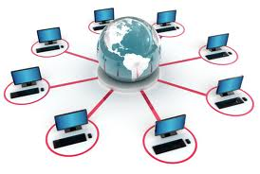
History of computers
In the 1990’s, hundreds of millions of computers were now in residential homes
Many computers were now connected to the internet

Slide 5
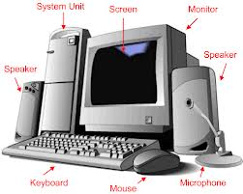
Computer hardware and Software (1.2)
Computers consist of two main parts
    Hardware
    Software
Hardware
    The machines, wiring, and other physical components of a computer

Slide 6
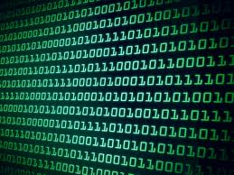
Computer hardware and Software (1.2)
Software
    Transforms complex patterns of electronic states (0’s and 1’s) and allows the user to view them as text, images, or other outputs.
Bit (binary digit)
    The smallest unit of information processed by a computer
    Consists of a single
    0 or 1
Byte
    Eight adjacent bits

Slide 7
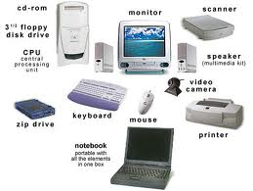
Computer hardware and Software (1.2)
Computer Hardware has six major subsystems
    CPU
    RAM (Internal Memory)
    Auxiliary I/O Devices
    Network Connection
    User Interface
    Auxiliary Storage Devices

Slide 8
Computer hardware and Software (1.2)
User Interface
    Input/Output Devices
    Keyboard, monitor, microphone, speakers
Auxiliary I/O Devices
      Printer, Scanner, Joysticks
Auxiliary Storage Devices
      Flash Drives
      External Hard drives
      CD-ROMs
Network Connection
    Connects PC to internet resources
Central Processing Unit (CPU)
    Does the work of the computer
    Performs numerous simple calculations to accomplish tasks

Slide 9
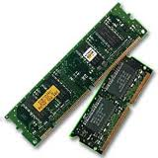
Computer hardware and Software (1.2)
Internal Memory
    Random Access Memory (RAM or Primary memory)
        Erased every time the computer is turned off
        Much more expensive than hard disk storage

Slide 10
Computer hardware and Software (1.2)
Secondary Memory
    Hard Disk Memory
        Much larger than RAM
        Must be manually deleted
    Auxiliary Storage devices
      CD-ROMs
      Flash Drives
      DVDs
      External Hard Drives

Slide 11
Computer hardware and Software (1.2)
System Software
supports basic operations of a computer and allows human users to transfer information to and from the computer.
Example
  Computer Operating Systems
Application Software
allows human users to accomplish specialized tasks
Examples
  Word processors
  Spreadsheets
  Database systems

Slide 12
1.3 Binary Representation of information and computer memory

Slide 13
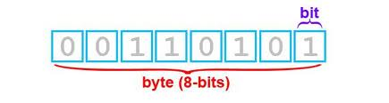
Base 2 number system
Most of us are accustomed to the base 10 number system
Binary is a base 2 number system
Every number can be represented as a series of 1’s and 0’s

Slide 14
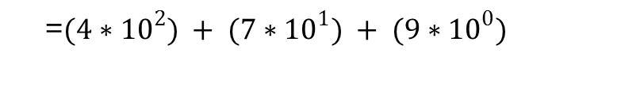
Binary Number System
Analyzing Base 10 Number System
Example) 479
4 7 9
= (4*100) + (7*10) + (9*1)
=$(4∗{10}^{2}) + (7∗{10}^{1}) + (9∗{10}^{0})$

Slide 15
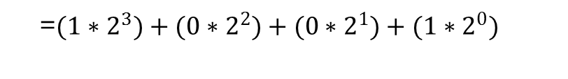
Binary number system
Example) 1001
1 0 0 1
=$(1∗2^{3})+(0∗2^{2})+(0∗2^{1})+(1∗2^{0})$
=(1 * 8) + (0 * 4) + (0 * 2) + (1 * 1)
=(8) + (0) + (0) + (1)
= 9

Slide 16
Hexadecimal number system
Base 16 Number System
Numbers in the hexadecimal system can now be represented with letters
For example
  45B
  C6

Slide 17
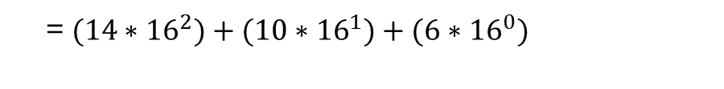
Binary number system
Example) EA6
E A 6
=$(14∗{16}^{2})+(10∗{16}^{1})+(6∗{16}^{0})$
=(14 * 256) + (10 * 16) + (6 * 1)
=(3584) + (160) + (6)
= 3750

Slide 18
Binary number system
Translate 101 (base 2) to a base 10 number.
Translate 1001100 (base 2) to a base 10 number.
Translate 53A (base 16) to a base 10 number.
Translate 11E (base 16) to a base 10 number
= 5
= 76
= 1338
= 286

Slide 19

Characters and Strings
To process letters and symbols, the computer also has a language of 1’s and 0’s
Made up of 16 bits, or two bytes (Unicode)
Schemes: ASCII, Unicode
Java uses Unicode (which contains ASCII)

Slide 20
Characters and Strings
Ex) “The grass is green”
Converts to:
01010100 01101000 01100101 00100000 01100111 01110010 01100001 01110011 01110011 00100000 01101001 01110011 00100000 01100111 01110010 01100101 01100101 01101110
http://www.evilgenius.net/asciibin.html

Slide 21
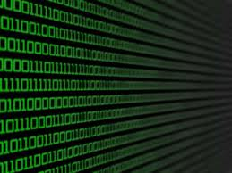
Computer Memory
Memory consists of a huge sequence of bytes
A specific byte location is called its Address
The addresses are numbered from 0 to (total #bytes - 1)

Slide 22
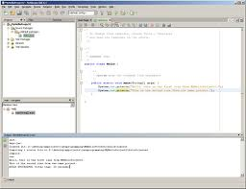
Programming languages (1.4)
Machine Languages
  1940’s to 1950’s
  Generation I
Assembly Languages
  Generation 2
  1950’s to present
High-Level Languages
  1950’s to present
  C++, Java

Slide 23
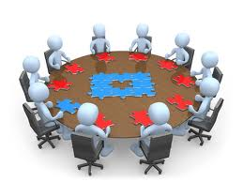
Software Development Process (1.5)
Several Phases
Customer Request
Analysis
Design
Implementation
Integration
Maintenance

Slide 24
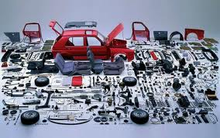
Object-Oriented Programming (1.6)
(OOP)
C++ and Java are both object oriented
Objects work together to accomplish the mission of the program

