Slide 1
Arrays vs. ArrayLists
Mr. Crone

Slide 2
Arrays
Have both physical and logical size
Logical size – amount of indexes currently in use
Physical size – size of array upon instantiation
Are instantiated by defining a definite physical size
int[] arry = new int[5];
Use square brackets to directly refer to a specific index
arry[4] = 23;
Can be instantiated using any primitive or object type

Slide 3
Array Lists
Can only contain OBJECTS
Requires the use of wrapper classes
Physical size unknown upon instantiation
Logical size of 0 upon instantiation
ArrayList<String> list1 = new ArrayList<String>();
Type Parameter of the ArrayList determines the type of objects that the list can contain
Use methods to access and manipulate elements
list1.add(“Tiger”);
Use the size() method to access logical size

Slide 4
Primitive vs. Object Review
Primitive
Object
int
double
char
boolean
String
Student
Soldier
TRex

Slide 5
Comparison
Array
ArrayList
Can be of any primitive or object type
Has a specific physical size upon instantiation
Uses square brackets to access elements
.length
Can only contain Objects
Logical size of 0 at instantiation
Uses methods to access elements and manipulate the ArrayList
.size()

Slide 6
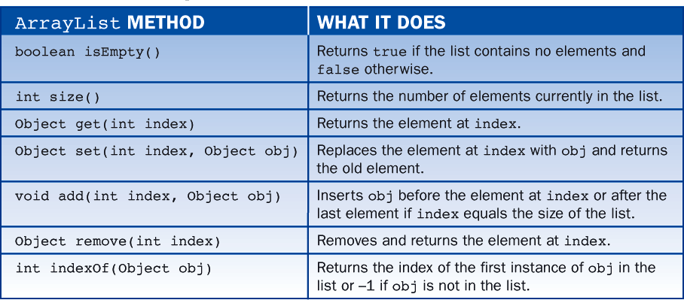
The Class java.util.ArrayList

Slide 7
Wrapper Classes
Allows us to store primitive data types in lists
Created to hold a value of a primitive type
int => Integer
Integer myInt = new Integer(5);
double => Double
Double myDub = new Double(3.4);
char => Character
Character myChar = new Character(‘c’);
boolean => Boolean
Booloean myBool = new Boolean(true);

Slide 8
Wrapper Classes
Arraylists use wrapper classes to store primitive data types
The wrapper class must be correctly declared as the element list type
//examples
ArrayList<Integer> list1 = new ArrayList<Integer>();
ArrayList<Character> list2 = new ArrayList<Character>();

Slide 9
Wrapper Classes
ArrayList<Integer> list1 = new ArrayList<Integer>();
Correct Syntax, but not necessary:
Integer myInt = new Integer(5);
list1.add(myInt);
Correct Syntax:
list1.add(5);
// Both accomplish the same task of adding 5 to the ArrayList

Slide 10
List Interface
The ArrayList Class implements the List Interface
The following code is common on the AP Computer Science Exam:
List<Integer> list1 = new ArrayList<Integer>();
//Still executes all ArrayList methods correctly
// Same thing as saying:
ArrayList<Integer> list1 = new ArrayList<Integer>();

Slide 11
Enhanced For-Loop For-Each Loop
Used to loop through Lists and ArrayLists
Uses the following Syntax:
for(<Type> <variable> : <Pre-Defined List> ){
//Looping statements
}

Slide 12
For-Each Loop Example
List<String> list1 = new ArrayList<String>();
list1.add(“The”);
list1.add(“House”);
list1.add(“Red”);
for(String str : list1){ // Type must coincide with List
System.out.print(str + “ “);
}
//Prints:
//The House Red

