Slide 1
C++ Programming: Presentation 1
Mr. Crone

Slide 2
First Progams
#include <iostream>
using namespace std;
int main( )
{
cout << “Statement 1” << endl;
cout << “Statement 2” << endl;
return 0;
}

Slide 3
Header Files
# include <iostream>
is a preprocessor header file
is a pre-written program segment inserted at this point. (note: no semi-colon)

Slide 4
Functions
Functions are similar to math functions, values are sent to the function and an answer is returned or an operation is performed.
int main(){ // example of a function
return 0; // must return 0
}

Slide 5
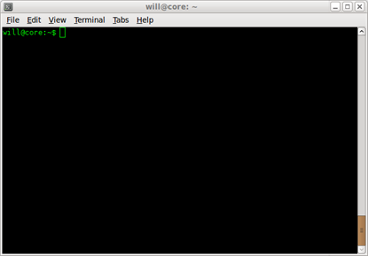
COUT
cout is an object of the ostream class
This object allows us to print to the terminal window

Slide 6
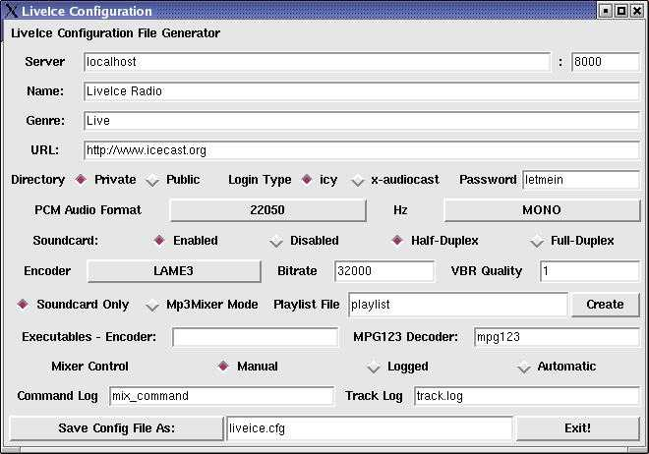
Graphical User Interfaces (GUI’s)

Slide 7
Use of system(“pause”)
When using Dev C++, we must tell the terminal window to pause in order for us to see the result of our program
Omitting system(“pause”) will cause the program to flash the terminal window and then end the program

Slide 8
Files Generated
1) Source code - your typed program ( .cpp)
3) Executable file - the executable version of your program.( .exe)

Slide 9
Using cout
In a cout statement, everything in quotations will be literally printed to the terminal window (spaces included)
cout << “H W”; //Prints: H W
cout << “HW”; // Prints: HW

Slide 10
Commenting Within Programs
Single Line Commenting
// name
// program & date
Block Commenting
/* name
program
date */

Slide 11
Commenting in Programs
Comments are not meant to document every line of code
Comments should be used to label sections of code or explain code that may be difficult to read

Slide 12
Escape Sequence
In C++, the backslash is the escape key
Escape sequences are special combinations of “\” and letters to perform a specific instruction
\n - starts a new line
\t - inserts a tab
Escape sequences MUST be placed within quotations

Slide 13
Escape Sequence Examples
cout << “Hello 1\n”; // Equivalent to using endl
cout << “Hello 1”;
Prints:
Hello 1
Hello 1

Slide 14
Escape Sequence Examples
cout << “Race\ncar”;
// Prints:
Race
car

