Slide 1
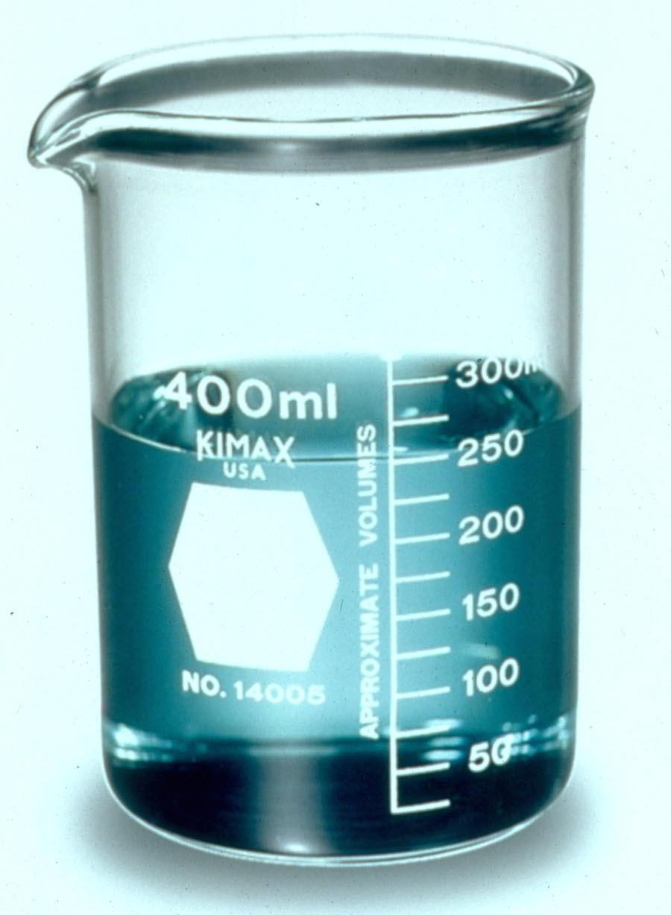
Measurement and the Metric System

Slide 2
Metric System
-Universal method of measuring used in science and medicine
-Based on units of 10
-Used to measure length, volume, mass and temperature
-Other countries use the metric system for all of their measurements.

Slide 3
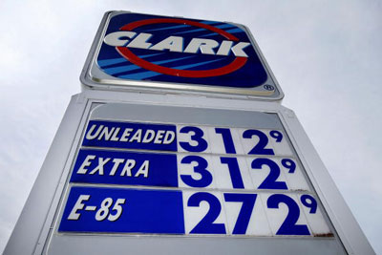
For example, speed signs in other countries are in km/hour.
Gasoline in other countries is sold by the liter (L), not gallon

Slide 4
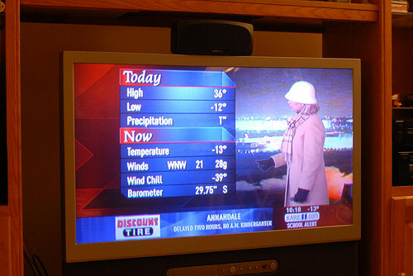
Temperature is reported in degrees Celsius (°C)

Slide 5
Basic Units
Length-meter (m)
Volume-Liter (L)
Mass-gram(g)
Temperature-degrees Celsius (°C)
For length, volume and mass, prefixes are used:
kilo- hecto- deca- deci- centi- milli-

Slide 6
Prefix Meaning
kilo- one thousand
hecto- one hundred
deca- ten
(meter, Liter, gram)
deci- one tenth
centi- one hundredth
milli- one thousandth
Example; One kilometer is equal to one thousand meters, because “kilo” means one thousand.

Slide 7
Length
-Basic Unit -meter (m)
-Tool used to measure-meter stick, tape measure or ruler
-The most common measurements in length used are the kilometer (km), meter (m), centimeter (cm) and millimeter (mm)
-One meter is equal to about 39 inches, slightly larger than a yard.
-One kilometer is smaller than a mile, actually a mile is equal to 1.6 kilometers.

Slide 8
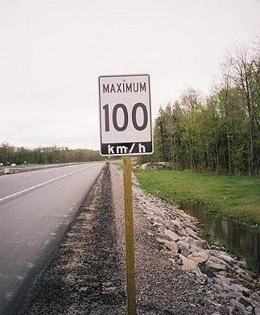
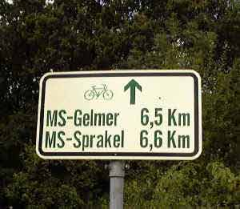
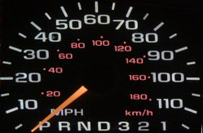
Examples of distances in metric units: http://player.discoveryeducation.com/index.cfm?guidAssetId=84FF70DF-F2E7-4EDD-9939-3948D9C9AB9C (3:20)

Slide 9
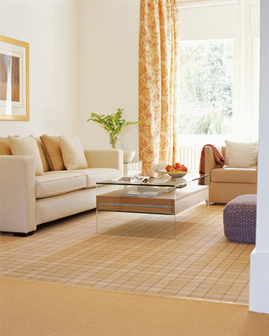
Area
To calculate Area, multiply the length by the width Area= Length x Width
Example of problems;
How much carpet will be needed for
A room that is 12 meters by 8 meters?
A = L x W
A = 12m x 8m
A = 96 m²

Slide 10
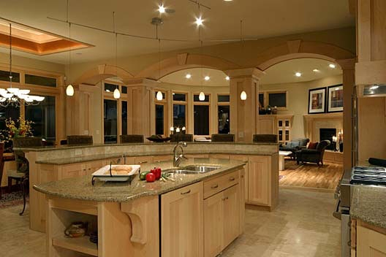
What would be the area for a kitchen countertop that is 90 cm by 400 cm?
A = Length x Width
A = 90 cm x 400 cm
A = 36,000 cm²

Slide 11
Mass
Mass- the amount of matter an object has
Basic Unit-gram (g)
Tool or Instrument used to measure-balance
Prefixes are added to make different units
Examples; kilogram (kg), milligram (mg)

Slide 12
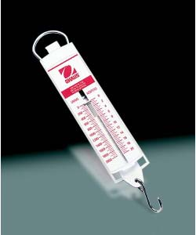
Weight
Weight-measurement of the force of gravity on an object
Basic Unit-Newton (N)
DO NOT ADD PREFIXES TO THE NEWTON (N)
Tool or Instrument used to measure-spring scale

Slide 13
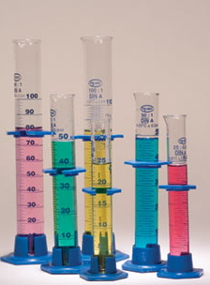
Volume
Volume-the amount of space an object takes up
Basic Unit-Liter (L)
Tool or Instrument used to measure-graduated cylinder
Prefixes are added to make different units
Examples; milliliter (mL)
*In the metric system, there is a direct relationship between length and volume. One cubic centimeter (cm³ or cc) is equal to one mL…. Therefore, if you had a small box that was 1cm by 1cm by 1cm, it has a volume of 1mL
1mL= 1cc = 1cm³

Slide 14
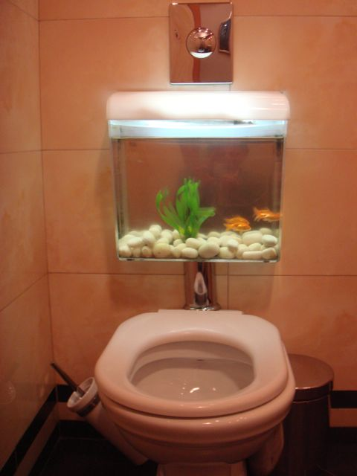
Calculating Volume
Formula for calculating volume of a regularly shaped object
Volume = Length x Width x Height
V = L x W x H
Example of volume problems;
What is the volume of a fish tank that is 20 cm by 30 cm by 50 cm?
V = L x W x H
V = 20cm x 30cm x 50cm
V = 30,000 cm³ or 30,000 cc or
30,000 mL

Slide 15
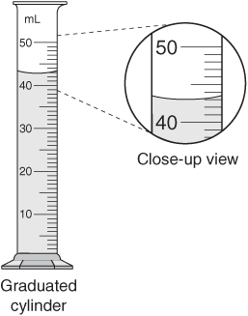
Displacement
-Fill a graduated cylinder with water
-Record the volume
-Slowly lower the irregularly shaped
object into the graduated cylinder
-Record the new volume
-Subtract the two volumes to get the
volume of the irregularly shaped
object

Slide 16
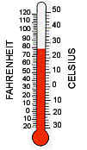
Temperature
-In the metric system, temperature is measured in Degrees Celsius (°C)
-Water Freezes at 0 °C and boils at 100°C
-The tool or instrument used to measure temperature is the thermometer

Slide 17
Conversions Within the Metric System
Conversions within the metric system are very easy because the metric system is based on units of ten
When converting, we multiply or divide by units of ten, so therefore, we simply move the decimal point.
Steps: 1. Decide whether you are moving the decimal place to the right or the left.
Small Large
milli- centi- deci- (basic) deca- hecto- kilo-
-Small to Large, move it left
-Large to Small, move it right
2. Count how many places you are to move the
decimal point.

Slide 18
Metric Conversions
For example;
2.5 km = ____________ m
In this problem, you are converting from larger to smaller units, so the decimal is moved to the right. Count the places……3….move the decimal 3 places to the right.
2.5 km = 2,500 m
4,200 mL = ____________ L
In this problem, you are converting from smaller to larger units, so the decimal is moved to the left. Count the places……3….move the decimal 3 places to the left.
4,200 mL = 4.2 L

Slide 19
Conversions
Video explaining converting from metric to standard units: (3:04)
http://player.discoveryeducation.com/index.cfm?guidAssetId=B7499731-2285-423F-8484-E138261E470A

