Slide 1
Animals and Their Environments

Slide 2
Tundra

Slide 3
Polar Bear

Slide 4
Dessert

Slide 5
Lizard

Slide 6
Forest

Slide 7
Bear

Slide 8
Deep Ocean

Slide 9
Octopus

Slide 10
Prairie

Slide 11
Prairie Dogs

Slide 12
Wetlands

Slide 13
Frog

Slide 14
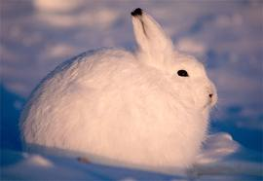
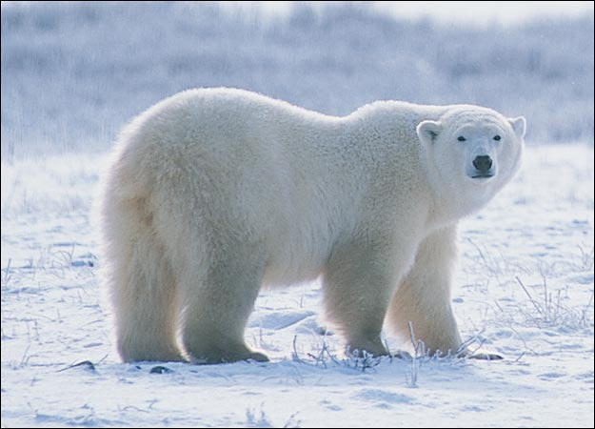
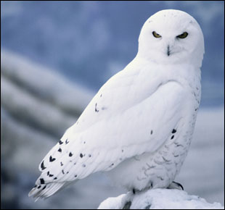
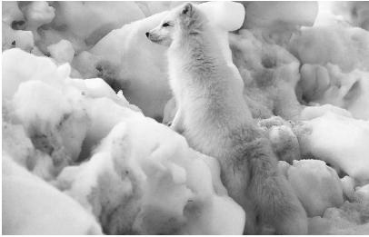
What characteristic do each of these animals have in common? How might this help them survive in their environment?

