Slide 1
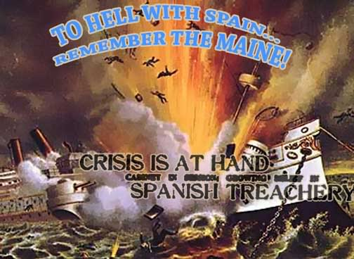
The Spanish-American War and the Explosion of the USS Maine

Slide 2
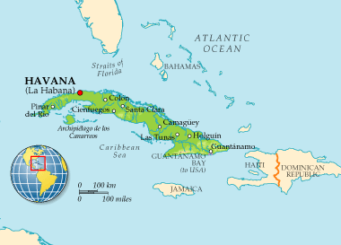
The Colony of Cuba
Spanish possession ➔ Important because of sugarcane plantations

Slide 3
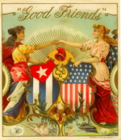
US-Cuban Relationship
By early 1890s, countries linked economically
New US tariff on sugar hurt Cuba drastically, causing a new rebellion against Spain

Slide 4
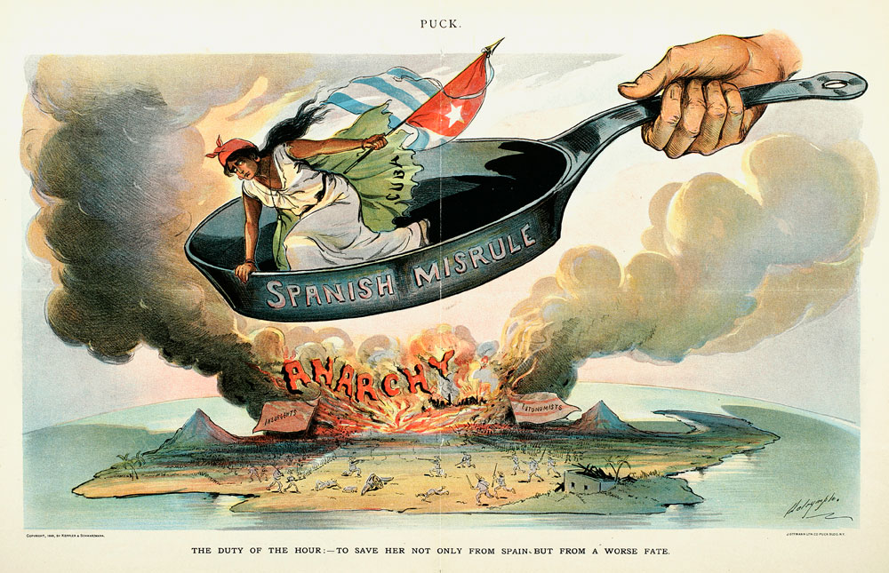
US-Cuban Relationship
When uprising began, the official stance of America = NEUTRAL!
Many Americans openly supported Cuba
Similar to American Revolution??

Slide 5
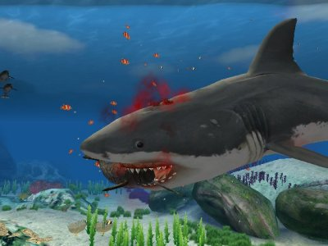
What increased American support for the rebel cause?
Hearst and The New York World
Stories of “blood on the roadsides, blood in the fields, blood on the doorsteps”
Pulitzer and The New York Journal
Stories of Spanish guards feeding prisoners to sharks and dogs

Slide 6
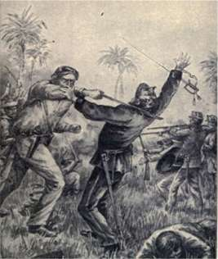
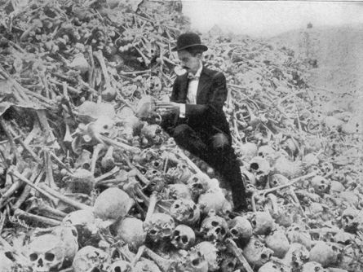
Life in Cuba during Rebellion
Spanish troops sent to put down insurrection
Cuban rebels destroyed American plantations and infrastructure
Cubans moved to reconcentration camps

Slide 7
How does American get involved?
Spain offers Cuba autonomy only if it remains in Spanish empire
Cuba says NO!
Fearing Americans would be harmed in riots, USS Maine sent to Havana for evacuation if needed
The de Lome letter ➔ McKinley = weak

Slide 8
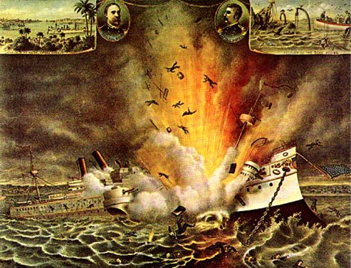
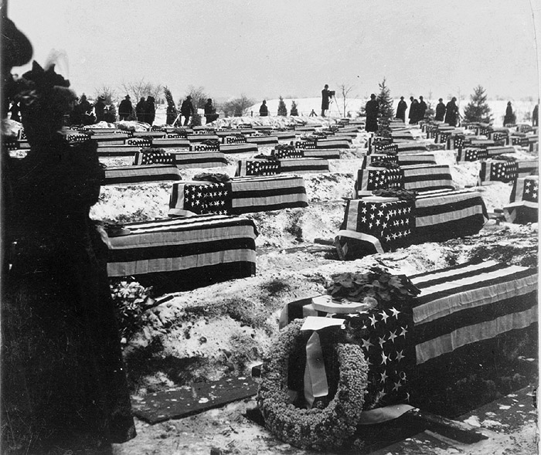
The EXPLOSION!!
9:40 pm on Feb. 15, 1898
262 sailors and officers killed
US Gov’t inquiry – External explosion then caused internal explosion
External explosion cause not stated

Slide 9
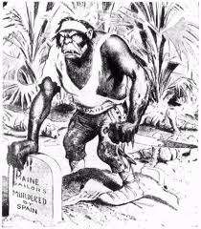
Was it the Spanish?
Spain not really ready for fight with “young-buck” America
Spain also agreed to USS Maine visit to Cuba
Spanish investigation believed internal explosion due to mechanical failure
US raced to blame Spain
Did US keep evidence proving
internal explosion hidden??

Slide 10
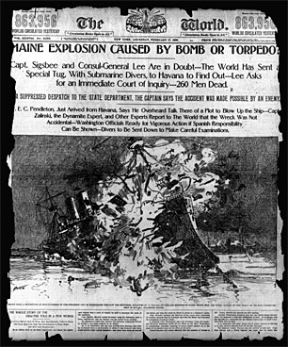
Was it the Cubans?
Possible attempt to draw in American intervention
No evidence ever produced
Would Cuba want to replace
rule by one empire with rule of
another?

Slide 11
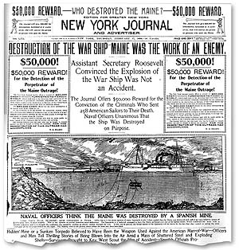
Fueled by the Media
Coverage of the events in Cuba sold newspapers
The more sensational the story, the more papers sold, the MORE PROFITS MADE!!
Did public anger from newspapers cause the push for war from Congress?

