Slide 1
Journal Prompt
Answer the following questions in your journal:
How does media influence the value and importance of news?
What is yellow journalism and what is its purpose?

Slide 2
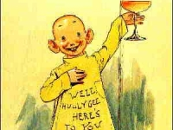
Yellow Journalism

Slide 3
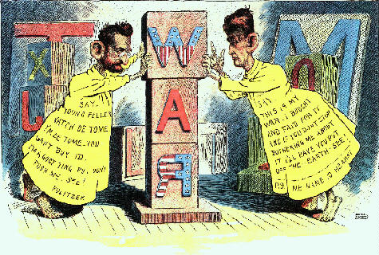
What is “yellow journalism”?
Term first coined during the Spanish-American War in 1898
Battle ensued between two men:
Joseph Pulitzer and the New York World
William Randolph Hearst’s New York Journal

Slide 4
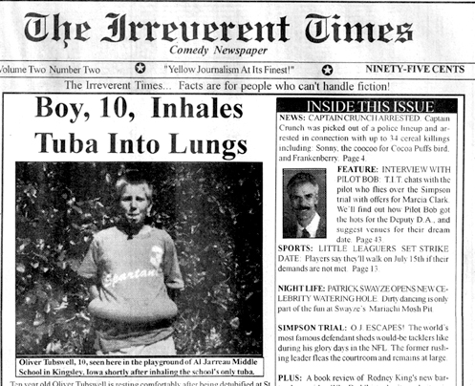
What is “yellow journalism”?
Biased opinion masquerading as objective fact
Involved sensationalism, distorted stories, and misleading images for the sole purpose of boosting newspaper sales and exciting public opinion

Slide 5
A look at yellow journalism:

Slide 6
What are some present-day examples?

Slide 7
Activity Part I
Using one of the provided newspapers, you will identify a piece of yellow journalism.
You and your partner will select one example from the newspaper and fill out the corresponding worksheet, detailing why your selection should be considered sensationalist and yellow.

Slide 8
Activity Part II
Now that you have identified a current piece, let’s see if you can turn an objective piece of news into yellow journalism
Choose an article from a paper and change the style, word choice and images to create a piece of yellow journalism

