Slide 1
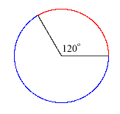
Angles & Arcs of Circles
Lesson 1 ~ Unit G-6: Circles

Slide 2
Note to Students:
Whenever you see the ☑ symbol next to a term or concept, we are going to put that into our concept builder packet.
For Example: Circle: ☑ The set of all points in a plane equidistant from a given point called the center.☑

Slide 3
Some Important Vocabulary:
Radius: ☑ a segment with endpoints at the center of the circle and on the circle.
Chord: ☑ a segment with endpoints on the circle.
Diameter: ☑ a chord that passes through the center of the circle. The diameter is made up of collinear radii.
Use the picture on the next slide to draw each of the segments discussed above!

Slide 4
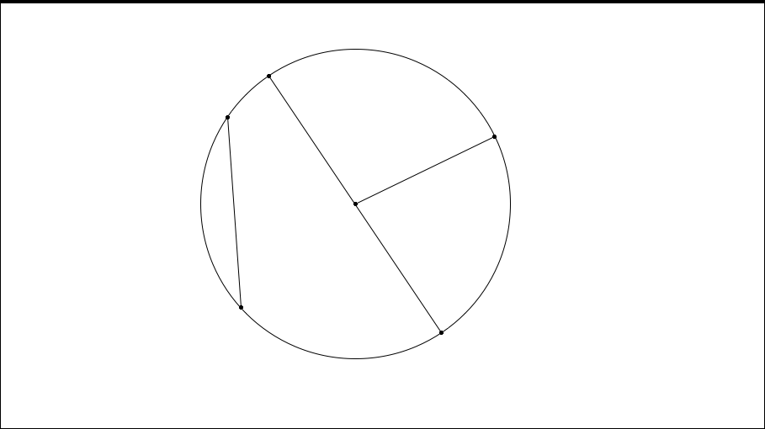
Can you name each of the segments below?

Slide 5
Circumference of a Circle
☑ The distance around a circle.
Formula:

Slide 7
If given the circumference, find the following:
Example 4:
If the circumference is 112.6 cm, what is the radius?
Example 5:
If the circumference is 80 in., what is the diameter?

Slide 8
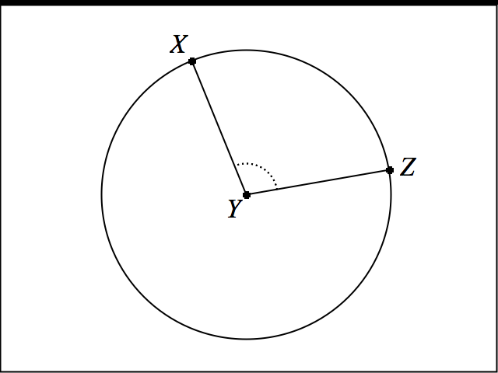
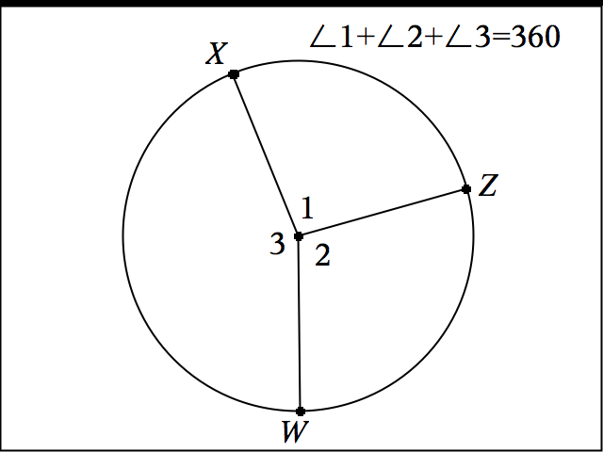
Central Angles:
Central Angle: ☑
Central Angle Sums ☑
An angle with the vertex at the center of the circle.
The sum of all the central angles of a circle is 360.

Slide 9
Arc & Arc Measures
Minor Arc ☑
Major Arc ☑
The shortest arc connecting two endpoints on a circle.
The measure of a minor arc is less than 180 degrees and is equal to the measure of its associated central angle.
The longest arc connecting two endpoints on a circle.
The measure of a major arc is greater than 180 degrees and is equal to 360 minus the measure of the minor arc with the same endpoints.
Continued next slide

Slide 10
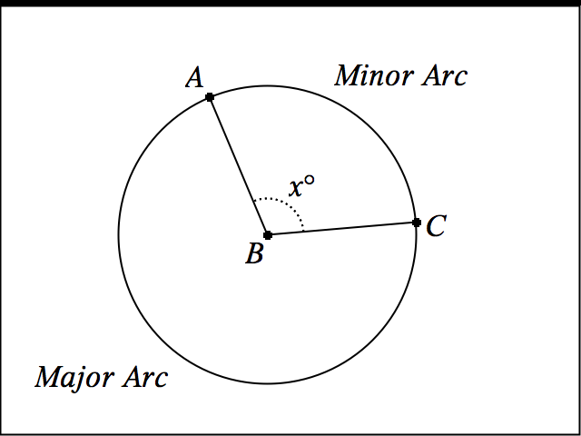

Slide 11
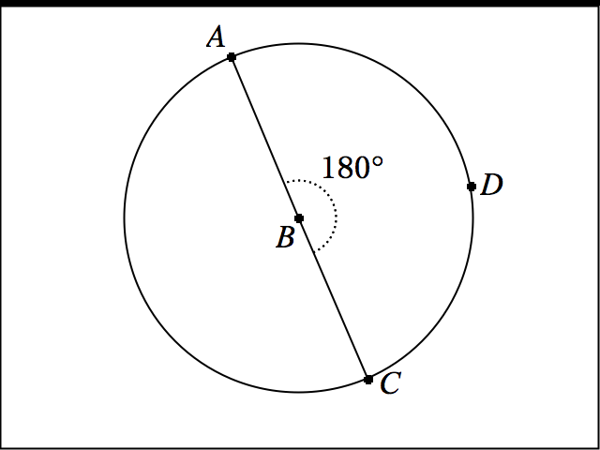
Semicircle: ☑
An arc with endpoints that lie on a diameter.
The measure of a semicircle is 180 degrees.

Slide 12
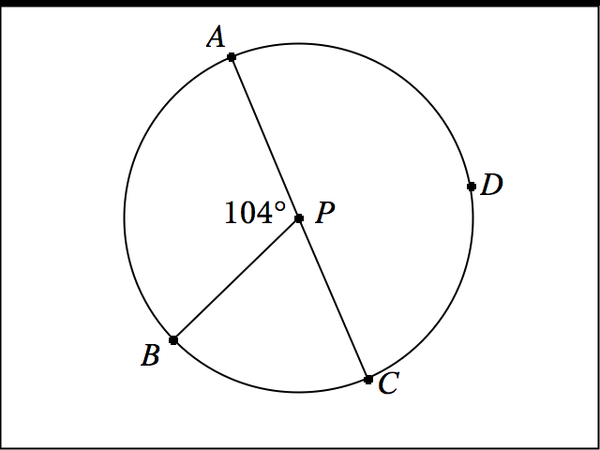
Examples: Measuring Arcs
If AC is the diameter, identify each of the following arcs as major, minor, or semicircle; then find each measure.

Slide 15
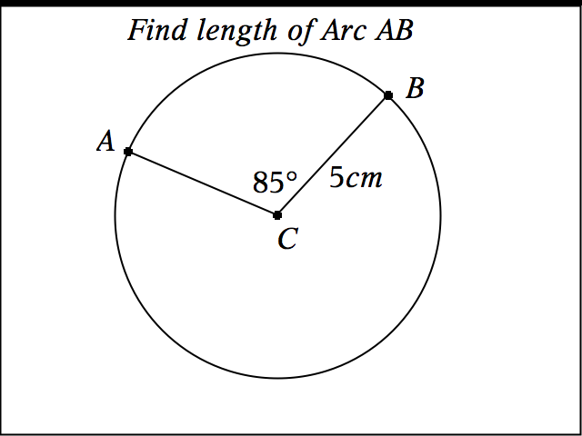
Examples: Finding Arc Length

Slide 16
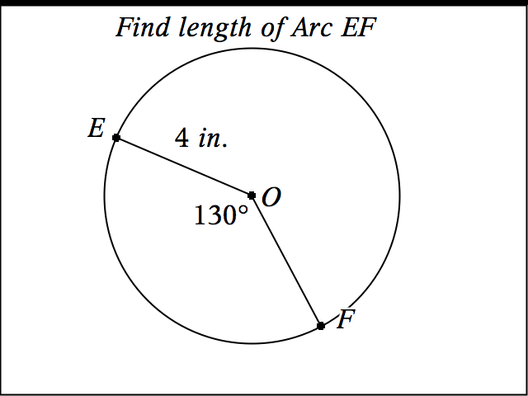
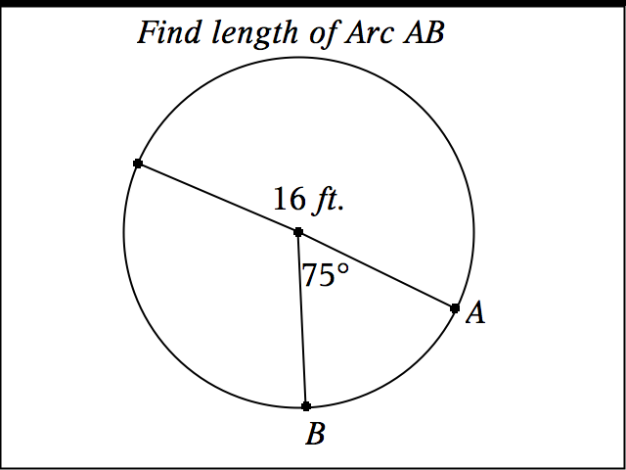

Slide 20
For the following Examples
Use the given handout to follow along.
Use your Concept Builder to look up theorems if needed.
Always think about what rule you will need to use to solve each problem.

Slide 22
2.

Slide 23
3.

Slide 24
4.

Slide 25
5.

Slide 26
6.

Slide 27
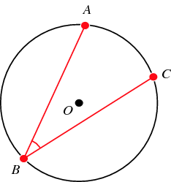
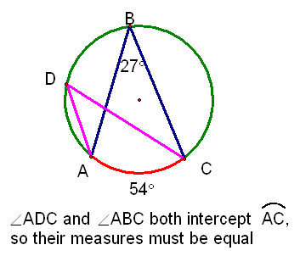
Inscribed Angles
Definition ☑: Angle that has a vertex on a circle and sides that are chords of the circle.
Inscribed Angle Theorem A ☑: If an angle is inscribed in a circle, then the measure of the angle equals one half the measure of the intercepted arc. {Angle B = ½ Arc AC}
Inscribed Angle Theorem B ☑: If two inscribed angles of a circle intercept the same arc or congruent arcs, then the angles are congruent.

Slide 28
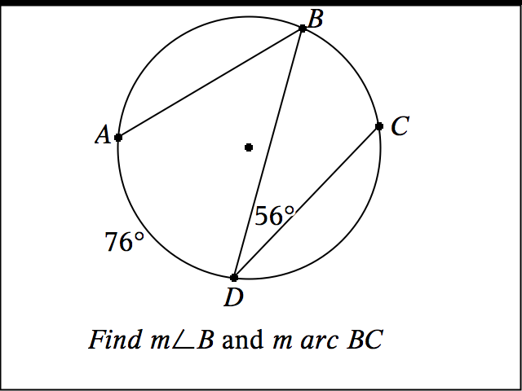
Example 1 ~ Inscribed Angles

Slide 29
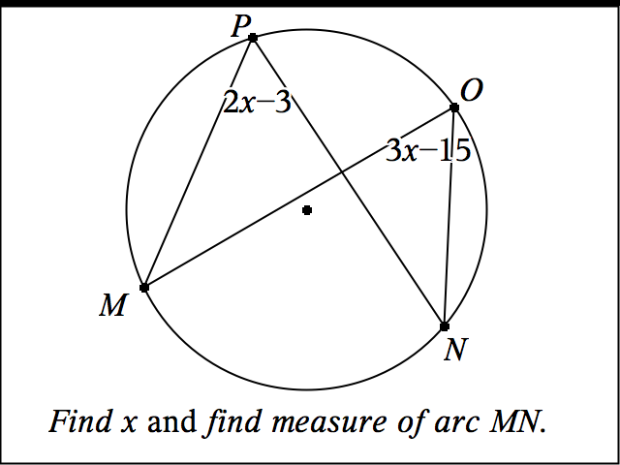
Example 2 ~ Inscribed Angles

Slide 30
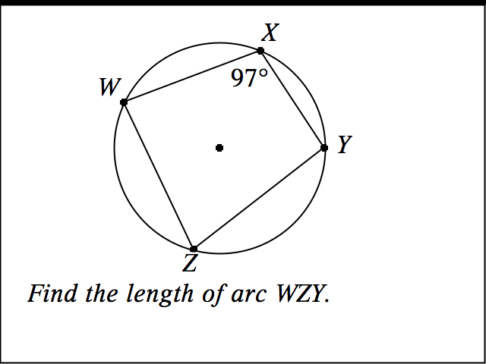
Example 3 ~ Inscribed Angles

