Slide 1
SECANTS, TANGENTS, & ANGLE MEASURE
Lesson 2 ~ Circles

Slide 2
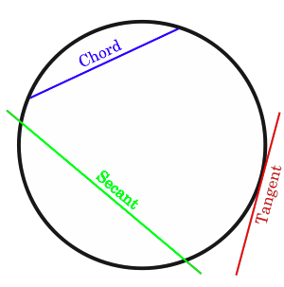
VOCABULARY
☑ Secant: A line that intersects a circle in exactly 2 points.
☑ Tangent: A line that intersects a circle in exactly 1 point.

Slide 3
CHORD VS. SECANT?
What is the relationship between a chord and a secant?

Slide 6
EXTERIOR INTERSECTION THEOREM ☑
If two secants, a secant and a tangent, or two tangents intersect in the exterior of a circle, then the measure of the angle formed is one half the difference of the measure of the intercepted arcs.
Can you draw the 3 situations mentioned above?

Slide 8
PARTNER ACTIVITY BEFORE CONTINUING WITH EXAMPLES WE WILL BE DOING AN ACTIVITY.

