Slide 1
Segments in Circles
Lesson 3 ~ Circles

Slide 6
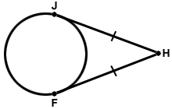
Tangent Theorem 2 ☑
If two segments from the same exterior point are tangent to a circle, then they are congruent.

Slide 8
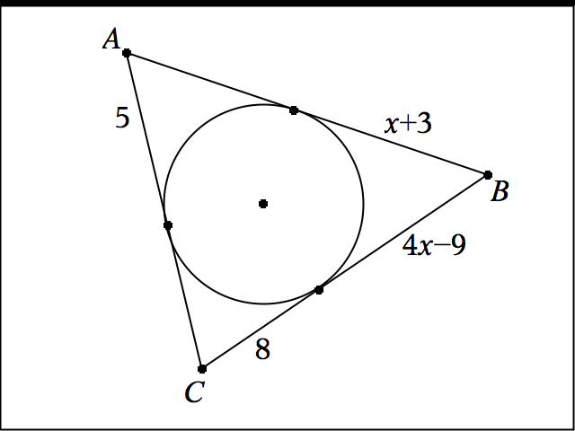
Example 5: Find the perimeter of Triangle ABC

Slide 9
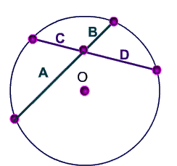
Intersecting Chord Theorem ☑
If two chords intersect in a circle, then the products of the lengths of the chord segments are equal.

Slide 12
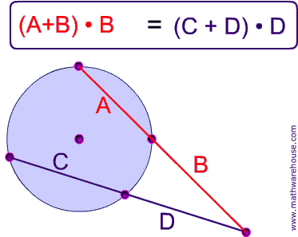
Secant Segment Theorem ☑
If two secants intersect in the exterior of a circle, then the product of the measure of one secant segment and its external secant segment is equal to the product of the measures of the other secant and its external secant segment.

