Slide 1
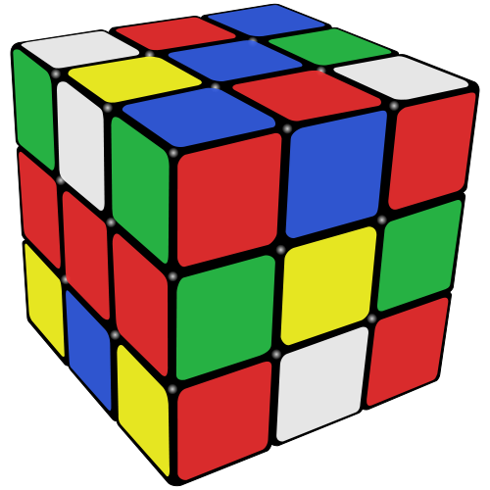
Volume
Notes:
Source: http://upload.wikimedia.org/wikipedia/commons/thumb/a/ae/Rubik%27s_cube_scrambled.svg/500px-Rubik%27s_cube_scrambled.svg.png

Slide 2
Volume is the amount of space occupied by an object.
Which has more volume:
A brick or a house?
A bathtub or a coffee cup?
A baby or an adult?

Slide 3
Metric Units
Which of these are metric units for volume?
Cubic centimeters
Centimeters
Milliliters
Cubic meters

Slide 4
Metric Units
Metric units for volume:
Cubic centimeters
Centimeters
Milliliters
Cubic meters

Slide 5
English Units
English units for volume:
Can you put them in order from the least volume to the most?
Gallon
Quart
Bushel
Half-gallon
Cup
Pint

Slide 6
English Units
English units for volume:
Can you put them in order from the least volume to the most volume?
Cup
Pint
Quart
Half-gallon
Gallon
Bushel

Slide 7
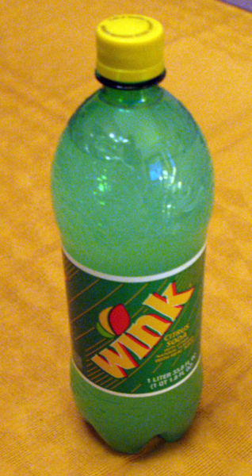
Metric Units
The basic unit of volume in the metric system is the liter and it is represented by L or l.
A liter of soda:
Notes:
Source: http://upload.wikimedia.org/wikipedia/commons/thumb/f/fa/Wink_Soda.jpg/318px-Wink_Soda.jpg

Slide 8
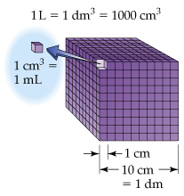
1 liter is equal to 1 cubic decimeter. A decimeter is the size of a cube that is 10 cm on each side.

Slide 9
Metric Units
1 liter (L) = 1000 milliliters (mL)
1 milliliter (mL) = 1 cm³ (or cc)
Which has more volume?
a. 1 liter or 1500 milliliters
b. 300 mL or 1.3 L
c. 10 cm³ or 1 mL

Slide 10
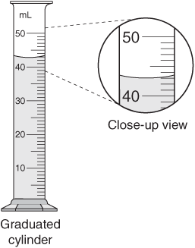
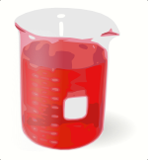
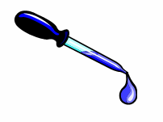
Measuring Volume
A graduated cylinder is an instrument for measuring the volume of a liquid.
We can also measure the volume of a liquid with a beaker or an eyedropper.
Notes:
Image sources: http://ritter.tea.state.tx.us/student.assessment/resources/online/2006/grade8/science/images/20graphicaa.gif, http://upload.wikimedia.org/wikipedia/commons/c/c0/Beakerred.png, http://upload.wikimedia.org/wikipedia/commons/thumb/1/1d/Syringe2.jpg/800px-Syringe2.jpg

Slide 11
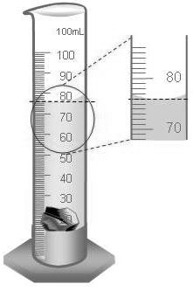
Measuring Liquid Volume
The meniscus is the curve at the top of the liquid in a graduated cylinder.
Read the volume at the
bottom of the meniscus.
Always read at eye level.
What is the volume shown here?
Notes:
Image sources: https://wiki.friscoisd.org/users/pearsonj/weblog/07a60/images/68550.gif,
http://upload.wikimedia.org/wikipedia/commons/thumb/4/41/Menschliches_Auge.jpg/711px-Menschliches_Auge.jpg

Slide 12
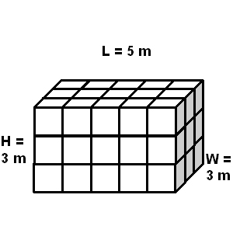
Measuring Solid Volume: Regular Objects
We can measure the volume of a cube using the formula:
length × width × height
____ × ____ × ____ = ____

Slide 13
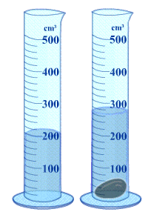
Measuring Solid Volume: Irregular Objects
We can measure the volume of an “irregular object” such as a rock using water displacement:
Amount of water with object = ______ Amount of water without object = ______ Difference = Volume = ______ cm³ = ______ mL
What do you think “displacement” means?
What do you think “regular” and “irregular” mean?
Notes:
Image source: http://resources.edb.gov.hk/~s1sci/R_S1Science/sp/en/syllabus/unit14/new/testingmain1.htm

