Slide 1
Drawing Mitosis

Slide 2
Mitosis New cells with identical genetic information to the parent cell are formed.

Slide 3
Cell Division
A repeating set of events that make up the life of a cell is called the cell cycle.
The time between cell divisions is called interphase.
During cell division, the chromosomes and cytoplasm are equally divided between two daughter (offspring) cells.
Cell division includes two parts, mitosis (m-phase) and cytokinesis.

Slide 4
Directions
USE THE FOLLOWING COLORS TO CREATE YOUR DRAWINGS IN YOUR DRAWING PACKETS
Red = 1 (big, from father), Orange = 1 (big, from mother),
Light blue = 2 (small, from father), Dark blue = 2 (small, from mother)
Showing 4 sample chromosomes.
A real human cell would have 46 chromosomes.

Slide 5
Interphase
G1 phase: New cells grow to mature size. Time between cell division and DNA replication (copying).
S phase: The cell’s DNA is copied.
G2 phase: Time between creation of DNA (S phase) and cell division.

Slide 6
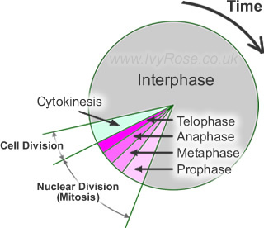
Interphase Model

Slide 7
MITOSIS – Occurs in all cells for growth and repair
Prophase
Notes
Chromosomes double

Slide 8
Metaphase
Notes
Chromosomes line up

Slide 9
Anaphase
Notes
Chromosomes pulled apart

Slide 10
Telophase
Notes
New nuclei

Slide 11
Cytokinesis
Notes
4
Showing ___ sample chromosomes in each cell.
Real human cell would have ___ chromosomes in each cell.
One cell becomes ____ cells.
46
2

Slide 12
What happened to the final number of chromosomes in each cell compared to the beginning?
It stays the same.

Slide 13
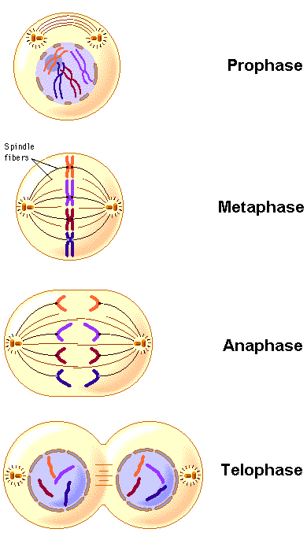
Mitosis Diagram
Source: http://www.freethought-forum.com/images/anatomy4/mitosis.gif

