Slide 1
Drawing Meiosis

Slide 2
Meiosis Reduces the number of chromosomes by half in new cells. Produces genetically different offspring cells.

Slide 3
Directions
USE THE FOLLOWING COLORS TO CREATE YOUR DRAWINGS IN YOUR DRAWING PACKETS
Red = 1 (big, from father), Orange = 1 (big, from mother),
Light blue = 2 (small, from father), Dark blue = 2 (small, from mother)
Showing 4 sample chromosomes.
A real human cell would have 46 chromosomes.

Slide 4
Interphase
Similar to mitosis

Slide 5
Meiosis I
MEIOSIS - Occurs in ovaries/testes to make egg/sperm cells
Prophase I
Notes
Similar to mitosis except the
same sized chromosomes pair up with one another.

Slide 6
Meiosis I
Metaphase I
Notes
Same size chromosomes line up as pairs.

Slide 7
Meiosis I
Anaphase I
Notes
Chromosome pairs split apart.

Slide 8
Meiosis I
Telophase I
Notes
Chromosomes unwind.
New nuclei.

Slide 9
Meiosis I
Cytokinesis
Notes
Cell membrane splits into 2.
Occurs after meiosis I.

Slide 10
Meiosis I
This is only the end of the first cycle, continue on to meiosis II.

Slide 11
Meiosis II
Prophase II
Notes
Chromosomes pair up with one another in each cell.

Slide 12
Meiosis II
Metaphase II
Notes
Individual chromosomes line up.

Slide 13
Meiosis II
Anaphase II
Notes
Chromosomes split.

Slide 14
Meiosis II
Telophase II
Notes
Chromosomes unwind.
New nuclei

Slide 15
Meiosis II
Cytokinesis
Notes
2
Showing ___ sample chromosomes in each cell.
Real human cell would have ___ chromosomes in each cell.
One cell becomes ____ cells.
23
4

Slide 16
Meiosis II
What happened to the final number of chromosomes in each cell compared to the beginning?
There are half as many.

Slide 17
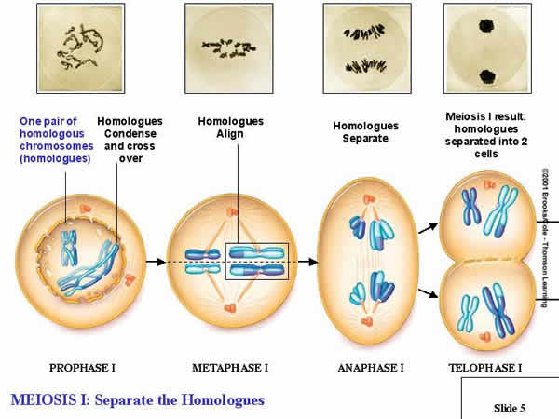
Meiosis I Diagram
Source: http://www.biology.iupui.edu/biocourses/n100/images/meiosis1cropped.jpg

Slide 18
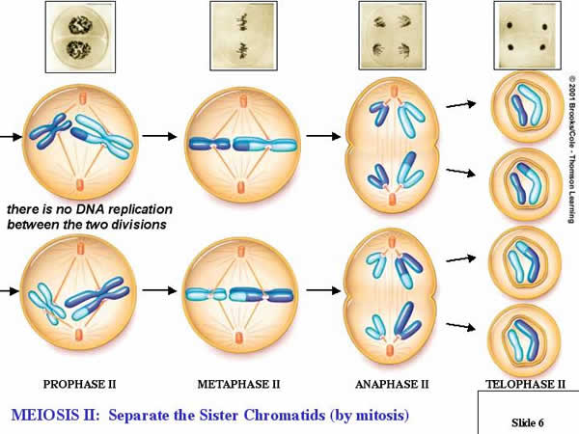
Meiosis 2 Diagram
Source: http://www.biology.iupui.edu/biocourses/n100/images/meiosis2cropped.jpg

